Slide 1

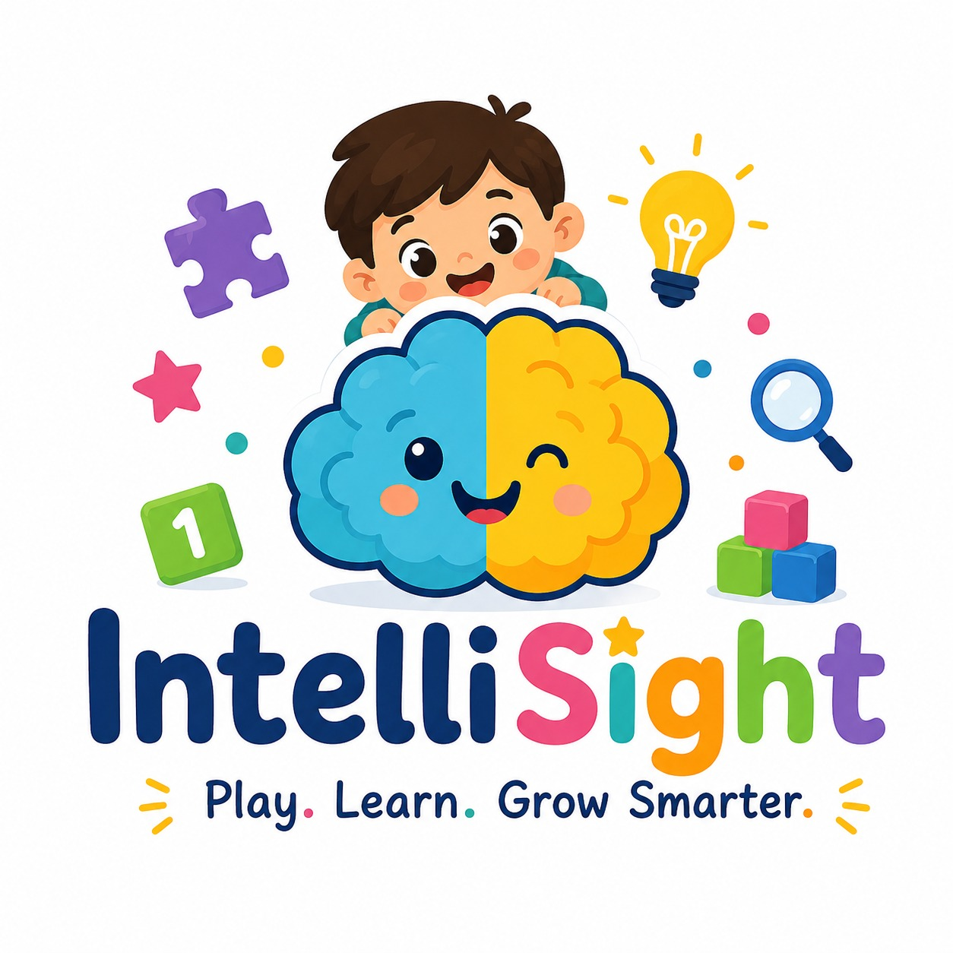
| Tech Management, SRI-B
CLAWS
CLASH OF THE
COLLAGE NAME:- RVCE
TAGLINE:-UNDERSTANDING EVERY CHILD BEYOND IQ SCORE
TEAM MEMBER:-
D ROHAN SAMUEL
SYED MOHAMMED ZUBER
SHARON SAMUEL HALLI
K ANUSHKA REDDY

Slide 2
Idea
Problem Statement
Why We Selected This Theme: We selected the GenAI + Productivity theme because current child cognitive assessments are outdated, stressful, and heavily dependent on static IQ tests.
Problem We Are Solving:
Traditional assessments:
Measure only final answers
Ignore behavioral patterns
Create pressure and anxiety in children
Fail to adapt to different learning styles
A child may think creatively or logically but still perform poorly in rigid tests.
Who Faces This Problem:
Personas
Parents seeking accurate developmental insights
Teachers monitoring learning ability
Children who struggle with traditional testing systems
Why It Is Important:
Early misjudgment can:
Affect confidence
Lead to incorrect labeling
Delay personalized learning support
There is currently no engaging, AI-driven cognitive
assessment platform focused on real interaction behavior.

Slide 3
Ide
Current Solution & Gaps
Existing Solutions
IQ tests
School assessments
Static educational apps
Basic puzzle games
What’s Missing
Current systems:
Do not analyze behavioral data
Are not adaptive
Provide generic reports
Ignore reaction time, memory patterns, and attention behavior
Opportunity
Using AI and gameplay interaction data, we can create:
Continuous cognitive evaluation
Personalized cognitive insights
Stress-free assessment experiences
This creates a scalable future for AI-assisted child development platforms.

Slide 4
Idea
Your Solutions
What We Built:
IntelliSight is a mobile-based cognitive assessment platform that evaluates children through interactive games instead of traditional tests.
Core Idea:
We measure:
Memory
Attention
Logic
Processing speed
Comprehension
by observing:
Accuracy
Time taken
Decision patterns
Gameplay behavior
Key Features
Gamified cognitive assessment
AI-generated cognitive reports
Child-specific progress tracking
Real-time scoring engine
Personalized cognitive profiles
Parent-friendly dashboard
AI Integration
OpenClaw AI analyzes gameplay sessions and generates cognitive insights and recommendations.

Slide 5
Idea
Demo/Product Walkthrough
Key Features
Gamified Learning
Real-Time Analysis
AI-Based Reports
Progress Tracking

Slide 6
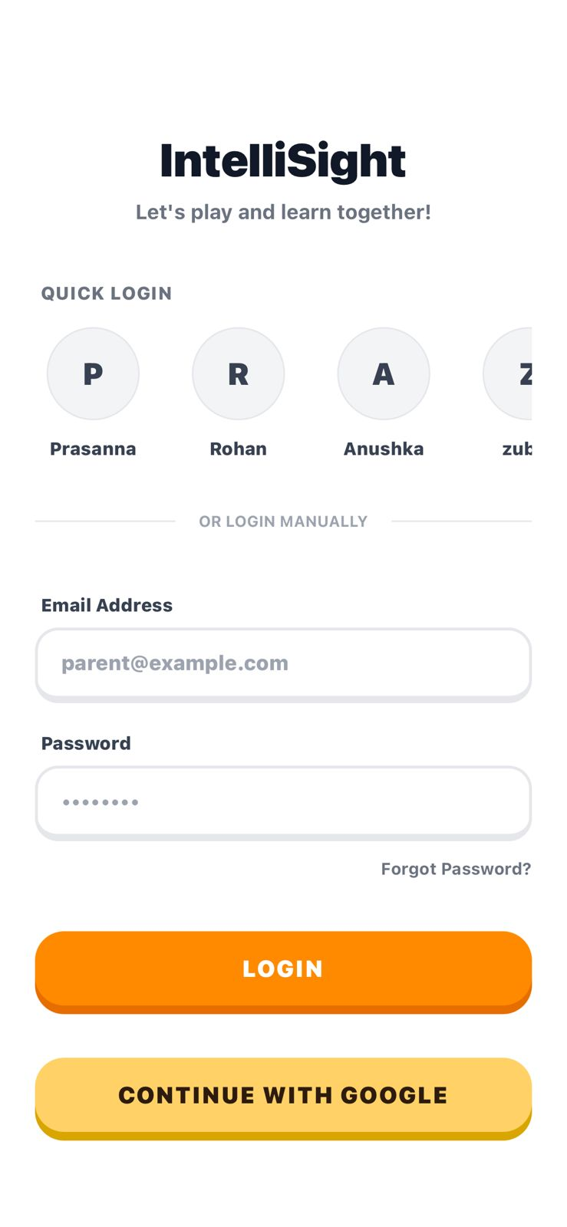
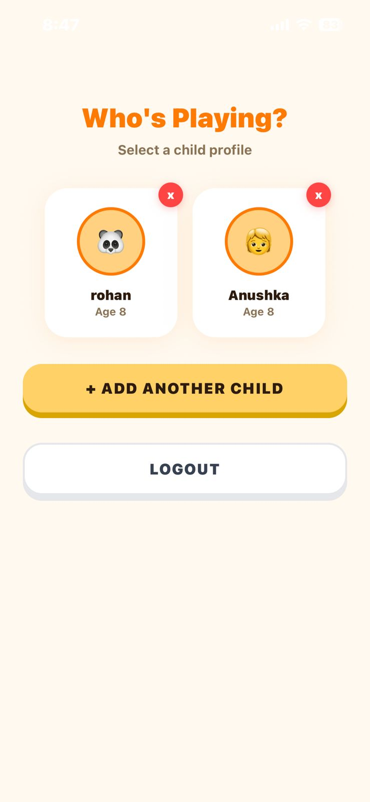
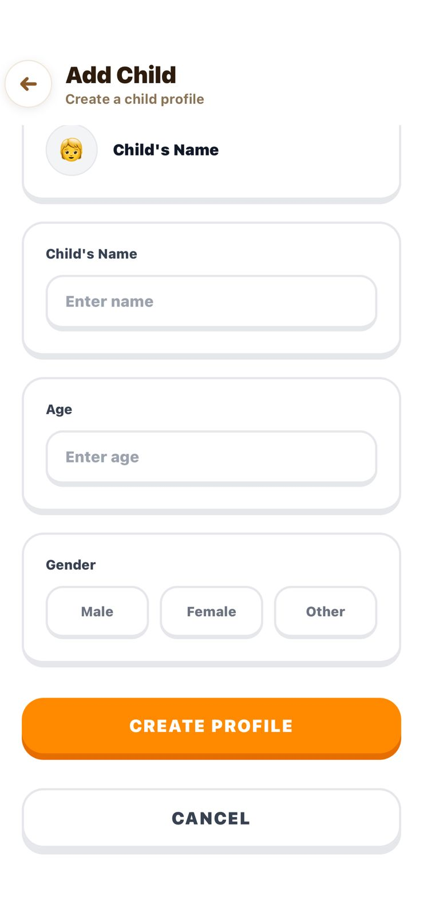
Create Child Profile

Slide 7
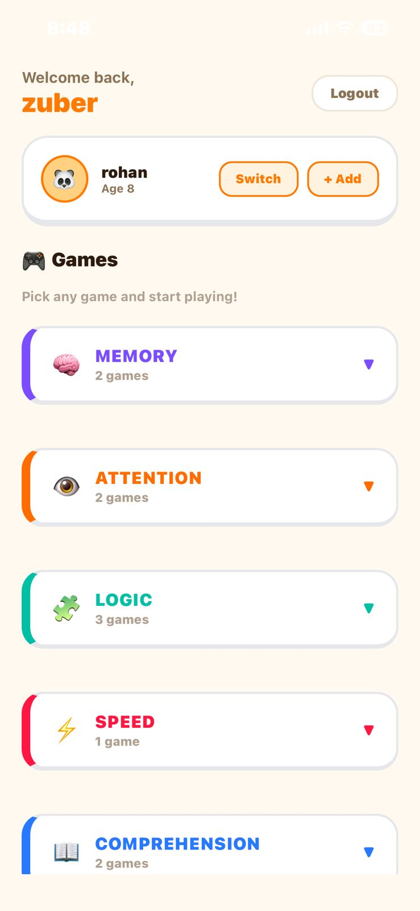
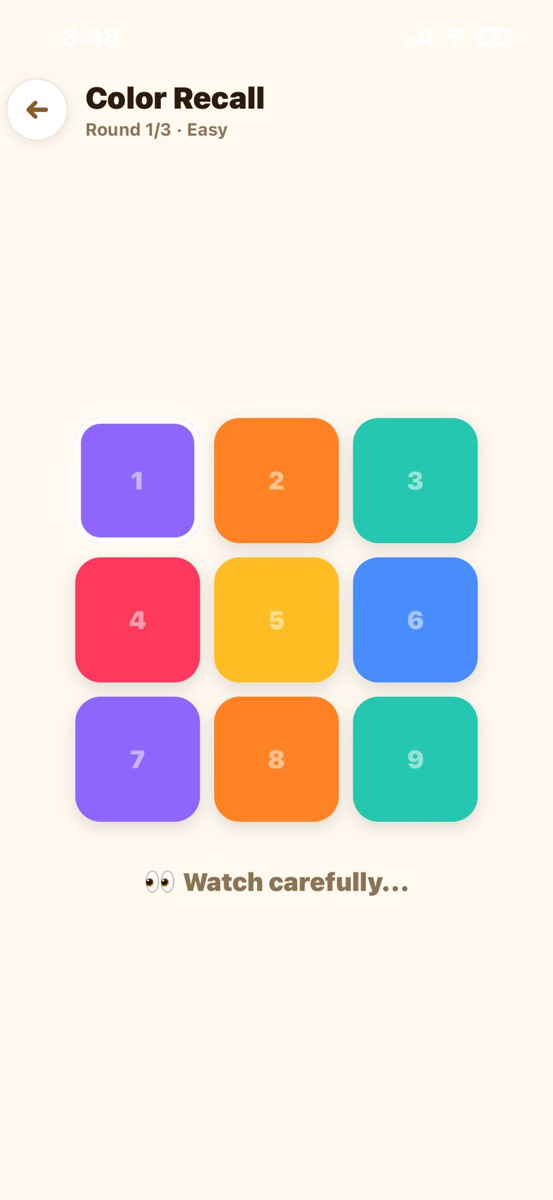
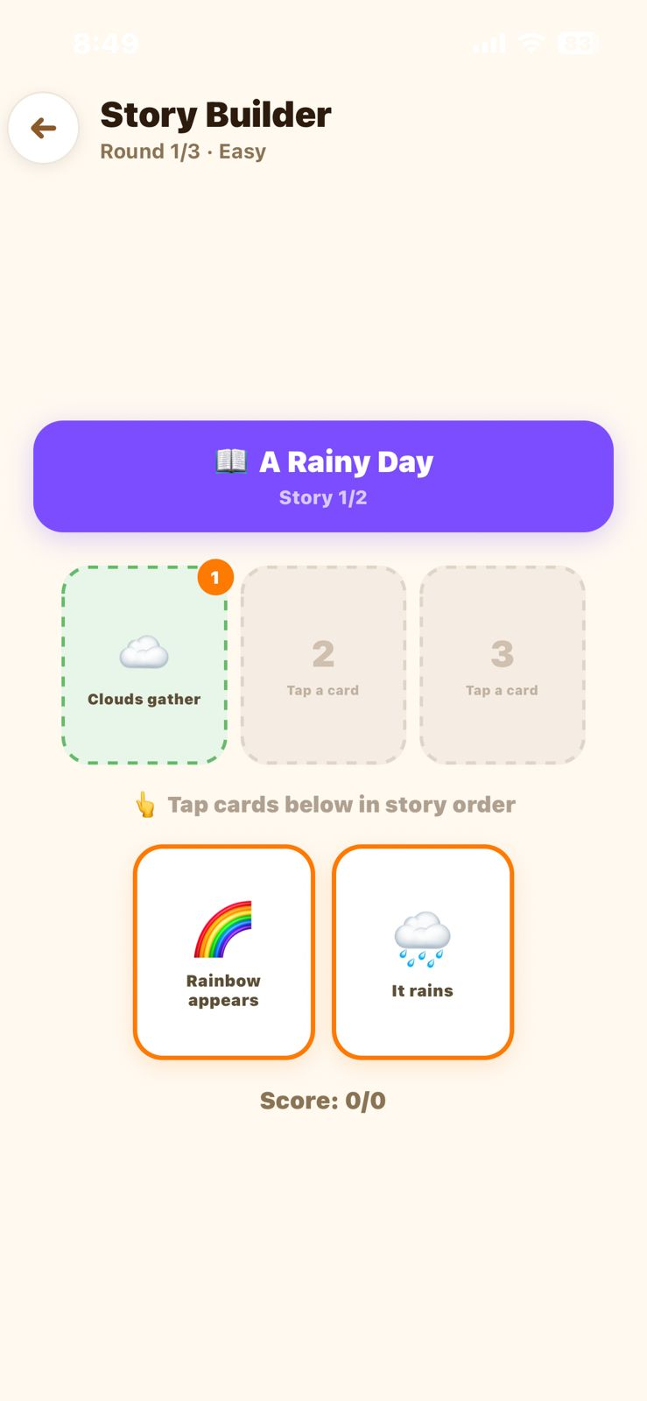
Select Cognitive Game
Child Plays Interactive Activity

Slide 8
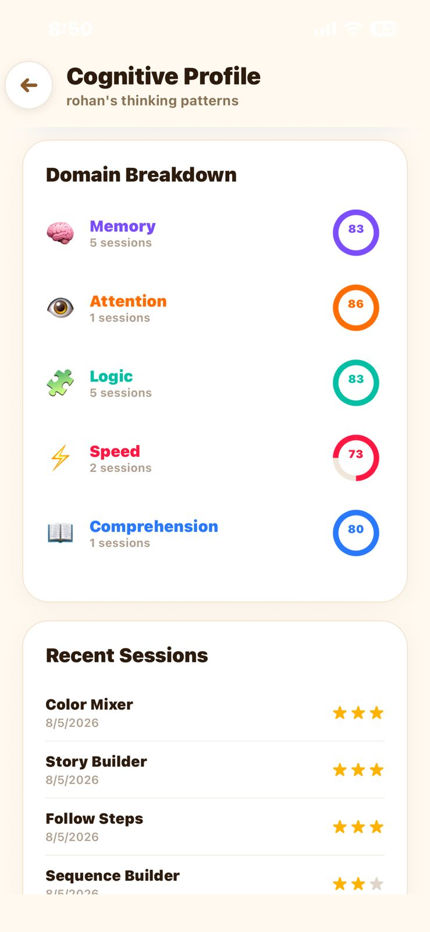
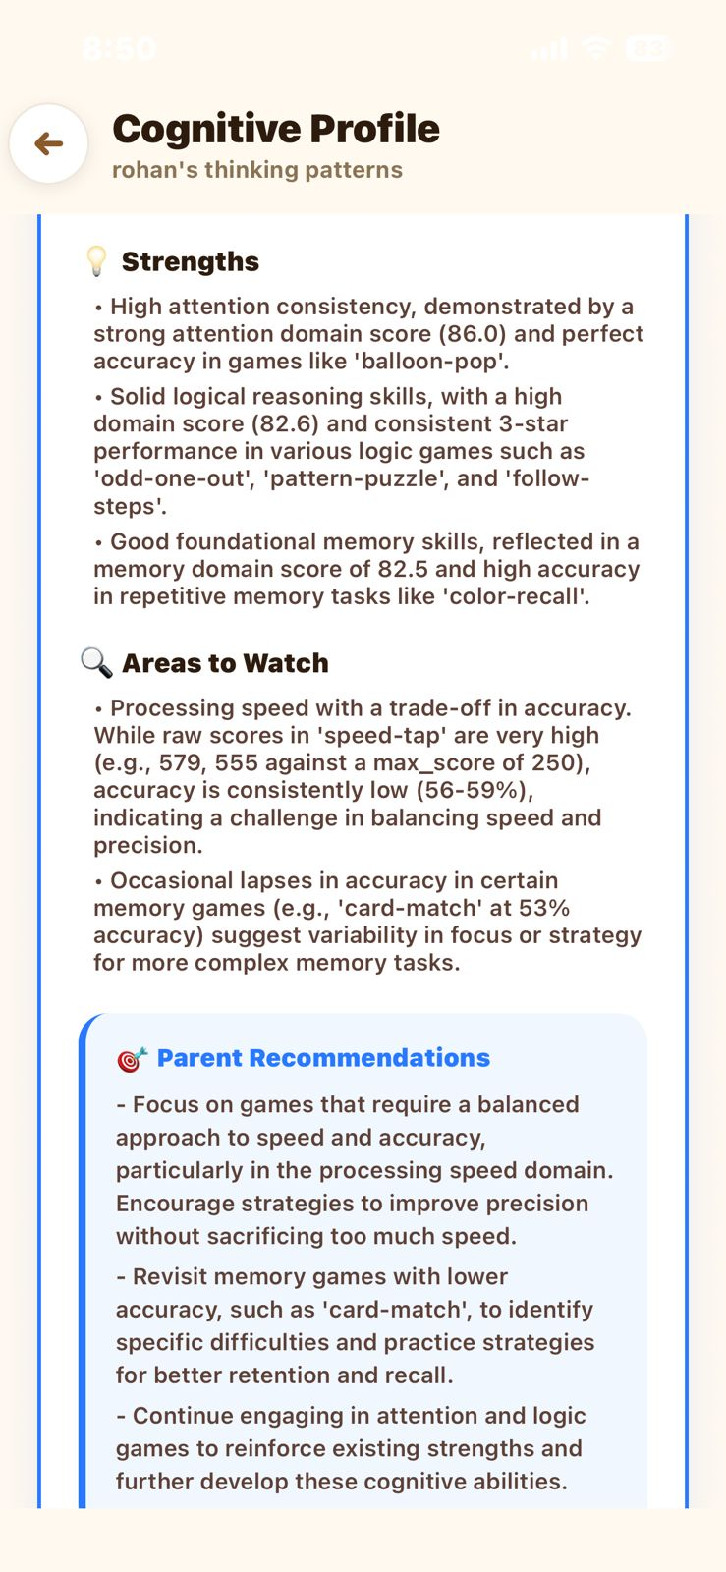
AI Generates Cognitive Report

Slide 9
Idea
Tech & Architecture
Tech Stack
Frontend
React Native (Expo)
Expo Router
Axios
AsyncStorage
Backend
FastAPI
Python
SQLAlchemy
Database
PostgreSQL
AI Layer
OpenClaw AI Agent

Slide 10
Idea
Tech & Architecture
System Architecture
Frontend
React Native (Expo)
Expo Router
Axios
AsyncStorage
Backend
FastAPI
Python
SQLAlchemy
Database
PostgreSQL
AI Layer
OpenClaw AI Agent

Slide 11
Idea
Impact & Use cases
Real-Life Use Cases
Parents can track child development at home
Schools can identify learning strengths early
Helps reduce stress from traditional IQ testing
Supports continuous cognitive improvement
Impact
Personalized learning experience
Early identification of cognitive skills
Engaging and stress-free assessment
Scalable for schools and learning centers

Slide 12
Idea
Differentiation
What Makes IntelliSight Different?
Gamified assessments instead of stressful IQ tests
AI-generated cognitive insights based on real gameplay
Continuous skill tracking, not one-time evaluation
Parent-friendly and child-friendly experience
Our Strong MOAT
Unique combination of gaming + AI-based cognitive analysis
Personalized reports generated from behavioral data
Adaptive and scalable for schools and home learning

Slide 13
Idea
Demo Link
GitHub Repo
https://github.com/rohansamuel123/intelliSight.git
Demo Link
https://drive.google.com/drive/folders/1LlIMcvet9LefkE7VD86S1tq6YyWxueaS?usp=sharing

Slide 14
Idea
<Brownie Slide>
Future Scope:-
Upcoming Enhancements
AI-based adaptive game difficulty :-
Games will automatically adjust difficulty based on the child’s performance and learning pace
Personalized learning recommendations :-
AI will recommend activities and exercises tailored to each child’s cognitive strengths and weaknesses
Cloud deployment and real-time sync :-
Secure cloud storage and real-time synchronization across devices for continuous tracking

Slide 15
Real-World Applications & Impact
Where IntelliSight Can Be Implemented
Schools & Educational Institutions
Early cognitive assessment during admissions
Identifying learning strengths and support needs
Monitoring student cognitive development over time
Homes & Parent Monitoring
Helps parents understand a child’s learning behavior
Encourages stress-free cognitive development through games
Tracks progress continuously instead of one-time testing
Special Education Support
Provides additional behavioral insights for children with different learning styles
Encourages inclusive and adaptive learning approaches

Slide 16
Why IntelliSight Matters
Moves beyond traditional IQ-based evaluation systems
Focuses on behavioral understanding instead of static scores
Reduces stress and pressure during cognitive assessment
Encourages continuous learning and skill improvement
Helps parents and educators better understand learning patterns
Supports personalized and adaptive learning approaches
Makes cognitive assessment engaging, interactive, and child-friendly
Creates a scalable platform for schools, homes, and learning centers
“Every child learns differently — IntelliSight helps understand those differences through interaction, behavior, and continuous growth.”

