Slide 1

Identifying Significant Associations in Gene Expression Data for Both Normal and Carcinogenic State
Presented By:
Rohan Sarkar, Rishav Ganguly, Rajagopal Mondal, Amartya Roy
Under the Supervision of:
Mr. Subir Hazra, HOD (IT), MSIT

Slide 2
OVERVIEW
What is cancer and it’s mutation
Molicular Biology and Microarray gene technology
Our plan of execution

Slide 3
Association Rule
What is Associatoin Rule
Application of Association Rule (Marker Basket analysis)
How we apply this Association Rule.

Slide 4
Terminology
Association Rules
An association rule is an implication expression of the form X→Y where X and Y are disjoint item sets
X → Y
ANTECEDENT
CONSEQUENT

Slide 5
Terminology
Support
It is the percentage of the transaction, in which all the items in the item set is bought together.
Support = $\frac{number of times item has bought together}{Total items}$ * 100

Slide 6

Terminology
Confidence
The confidence of an association rule is a percentage value that shows how frequently the rule head occurs among all the groups containing the rule body
Confidence = $\frac{how many times X,Y bought together}{how many times X is bought together}$ * 100
(X -> Y)

Slide 7
Terminology
Normalization and z score.

Slide 8
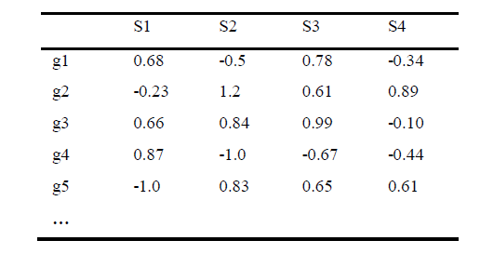
Matrix Structure
Data Representation and matrix structure
Data Representation and matrix structure

Slide 9
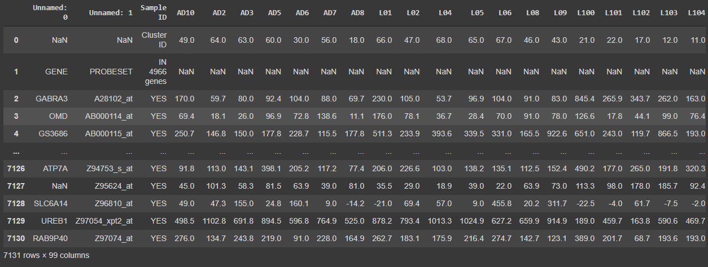
METHODOLOGY
Lung Dataset

Slide 10
START
LUNG DATA
NORMAL
DATA
CARCINOGENIC
DATA
ELIMINATING REDUNDANT AND NULL VALUES
ELIMINATING REDUNDANT AND NULL VALUES
PRE-PROCESSING
TRANSPOSING DATA
TRANSPOSING DATA
Z-SCORE NORMALISATION
Z-SCORE NORMALISATION
NORMALISATION

Slide 11
IF
-1.0>=DATA<= 0.0
IF
1.0>=DATA<= 0.0
REPLACE THE VALUE WITH THE NAME OF THE GENE
REPLACE THE VALUE WITH Nan
REPLACE THE VALUE WITH THE NAME OF THE GENE
REPLACE THE VALUE WITH Nan
WORKING NORMAL DATA
WORKING CARCINOGENIC DATA
ASSOCIATION RULE MINING USING APRIORI ALGORITHM
ASSOCIATION RULE MINING USING APRIORI ALGORITHM
GENE ASSOCIATION DUE TO MUTATION IN CARCINOGENIC STATE
GENE ASSOCIATION WHICCH REMAIN UNCHANGED
GENE ASSOCIATION DUE TO MUTATION IN NORMAL STATE

Slide 12
RESULTS
ORIGINAL
UNMUTATED ASSOCIATIONS (5)
5978
575
GENES ASSOCIATED IN CARCINOGENIC
GENES ASSOCIATED IN NORMAL

Slide 13
RESULTS
DEGREE OF ASSOCIATION
CARCINOGENIC STATE
NORMAL STATE
5978
575
1375
127
STRONGLY
ASSOCIATED
STRONGLY
ASSOCIATED

Slide 14
CONCLUSION
Systematic and unbiased approach to cancer classification is of great importance to cancer treatment and drug discovery.
In our project, it has been reviewed that Apriori algorithm for mining frequent pattern from microarray gene expression data
Recent studies have shown that gene expression changes are related to different types of cancer

Slide 15


Slide 16
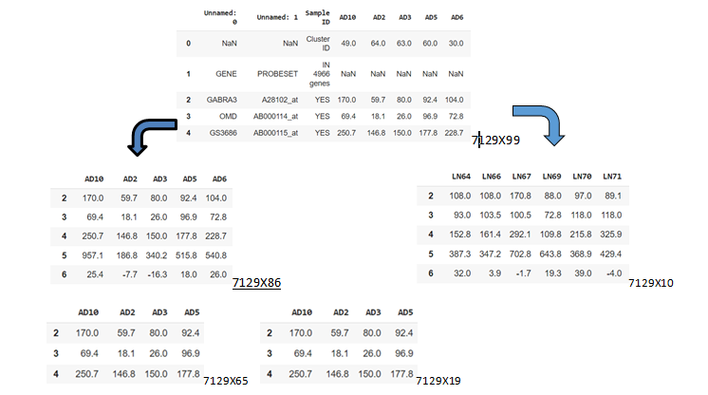
METHODOLOGY

