Slide 1
Smart Recipe Hub
Capstone Project Presentation

Slide 2
Project Overview and Target Audience
🍲What is Smart Recipe Hub? | 🎯 Who is it for?
📤Share your go-to recipes | 👩‍🍳 Home Cooks — mix things up with new meals
🔍Discover meals from ingredients you already have | 💪 Fitness Buffs — track what fits your diet
💡AI suggests what to cook next — tailored to your needs | 🎓 Students — budget-friendly and easy to follow
✨ No more decision fatigue. Just delicious meals. | 😵 Busy folks — stop stressing about dinner

Slide 3
Tech Stack Used
Frontend:
React + Vite, React Router, Bootstrap, Clerk, Axios
Backend:
Node.js, Express.js, MongoDB, Mongoose
APIs:
Google Gemini AI, Google Cloud Storage, Pexels API
Authentication:
Clerk
Deployment:
Vercel

Slide 4
Key APIs
Sr. | Method | Route | File
1. | POST | /clerk-webhook | clerkWebHooks.js
2. | POST | /gemini-recommend | gemini.js
3. | POST | /add-recipe | recipe.js
4. | GET | /all-recipes | recipe.js
5. | POST | /like-recipe/:id | recipe.js
6. | POST | /like-recipe/:id | recipe.js
7. | POST | /recipes/:recipeId/comments | recipe.js
8. | GET | /recipes/user/:userId | recipe.js
9. | DELETE | /recipes/:recipeId | recipe.js
10. | POST | /save-user | User.js

Slide 5
Sprint 1 – Initial Setup
Frontend UI integration, Clerk Auth, Gemini API, DB strategy
System design, GitHub setup, folder structure, Routing Strategy
Finalized ER diagram and DB relationships
Scrum Master, Jira task management, deployment research
Figma wireframes, UI structure for all pages

Slide 6

Sprint 2 – Functional Development
Trending Recipes UI with responsiveness
Add & Browse Recipe UI, filters, validations
Auth and user profile pages with Clerk integration
Secured APIs using Clerk RBAC middleware
AI Recipe Recommendation logic and mock API
User profile API with update validations
Recipe CRUD API with validation & file upload
MongoDB Models for Users, Recipes, Comments
Comments & Likes APIs with cascading handling

Slide 7

Sprint 3 – Feature Implementation
AI Recipe Suggestions via Gemini API
Feed system for user-shared recipes with pagination
Search & Filtering with fuzzy match and indexing
Full comment system (nested + secure)
Likes APIs with toggle & fetch
Query optimization using indexes and aggregation
Post Recipe UI with validation
Responsive feed UI with infinite scroll and filters
Display AI suggestions, like and comment feature

Slide 8

Sprint 4 – Final Touches
Deployed frontend on Vercel; set up env vars and custom domain with SSL/DNS.
Configured Clerk prod keys, authorized origins, webhooks; tested login/signup.
Deployed backend APIs via Vercel serverless; verified DB connection and routes.
Tested all recipe, auth, comment APIs using Postman; logged results and errors.
Audited prod logs; monitored backend CPU/memory via Vercel dashboard.
Verified image uploads (Multer + Cloud Storage); handled upload errors.
Fixed responsive layout issues after UI tests on desktop and mobile.
Managed MongoDB Atlas configs, handled data migration; verified persistence.
Created user guide and API docs; documented sprint outcomes.

Slide 9
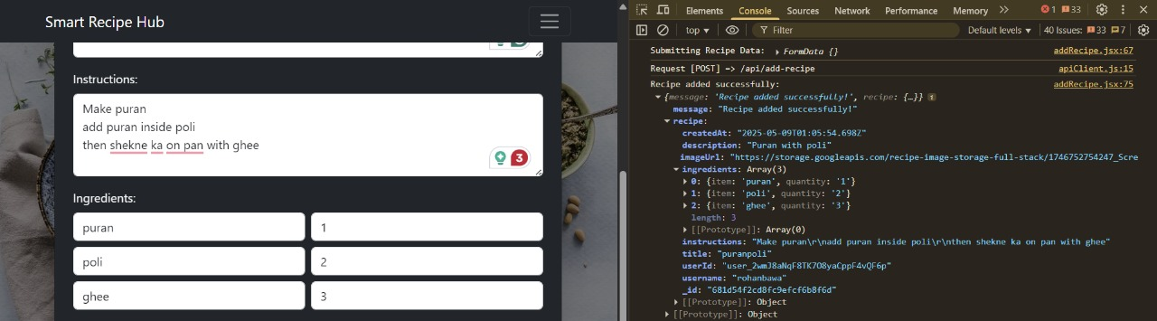
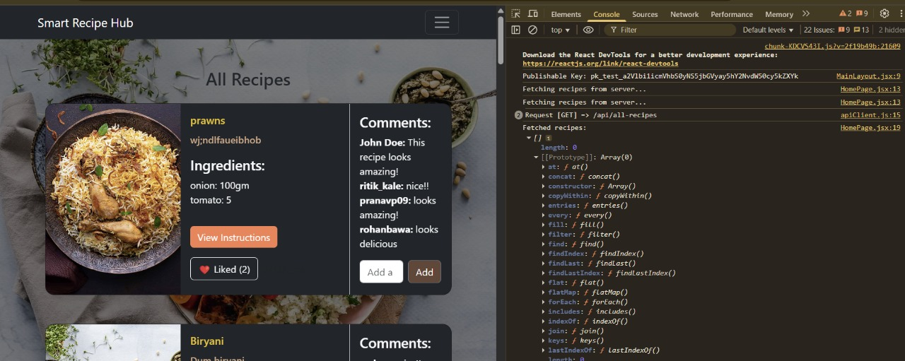
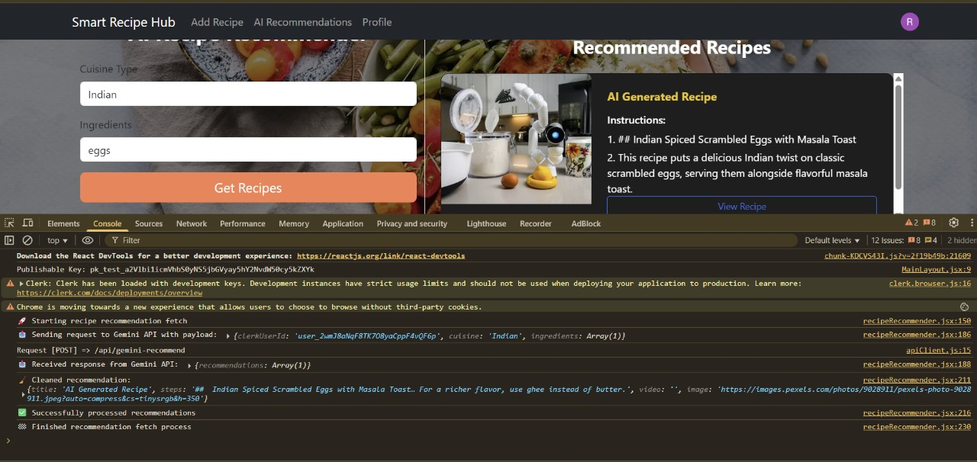
Test Cases

Slide 10
Future Updates
Introduce user following and personalized feeds.
Badges, streaks for daily recipe posts or cooking goals achieved.
Leaderboards for most-liked/shared recipes.
Build a React Native version or use PWA features for mobile accessibility.
Image upload from cloud storage
Allow multiple images per recipe with drag-and-drop ordering.

Slide 11
THANK YOU
Thank You

