Slide 1
Music Search: Million Playlist Dataset Challenge
Team PYTHON
Chirag bhatt (2018mt10750)
Parth Singhal (2018ch10231)
Rohan sharma (2018tt10909)

Slide 2
CHALLENGE DESCRIPTION
The Spotify Million Playlist Dataset challenge consists of Automatic Playlist Continuation task i.e., recommending relevant tracks to the incomplete playlists
Challenge set consists incomplete playlists of 10 different categories containing some or no seed tracks. Along with this, for some playlists we have been given their titles and for some only tracks are present. Each of the 10 categories contain 1000 incomplete playlists
500 tracks must be recommended for each incomplete playlist using the given million playlist dataset containing 1 million playlists and 2262292 unique tracks

Slide 3
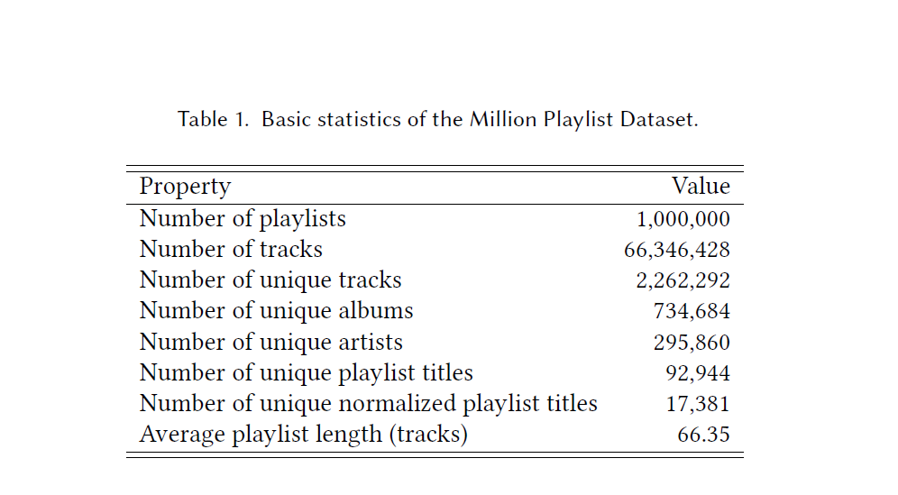
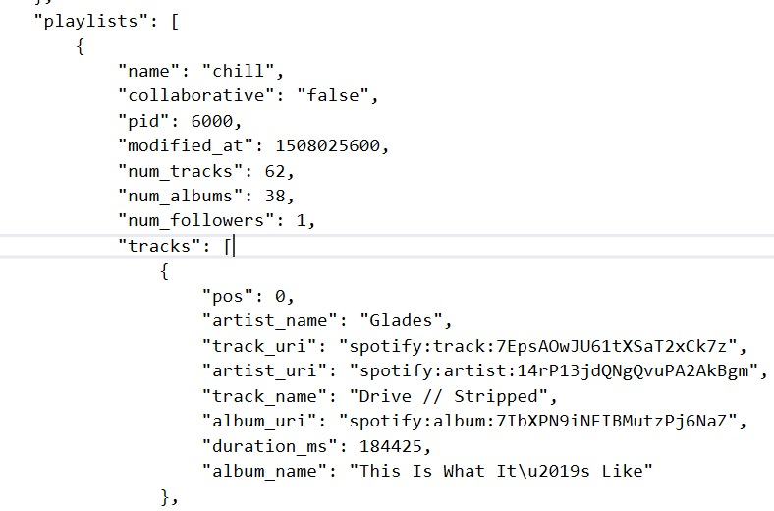
TRAINING DATASET
This dataset contains 1 million playlists
The main features of this dataset are the track names, album names and artist names corresponding to each playlist in the dataset
The given dataset was created between the time period of 2010-2017 by the Spotify users in America [1][2]
SOURCE – [2]
The given image shows the attributes of a playlist and one of the tracks present inside it

Slide 4
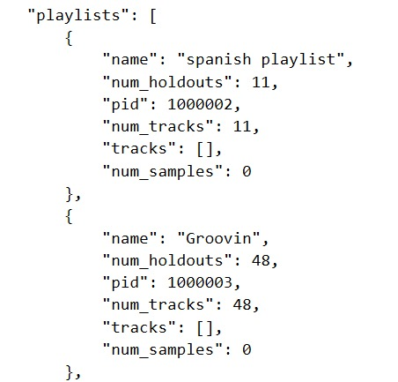
CHALLENGE DATASET
The challenge set contains incomplete playlists and these playlists have been divided into 10 categories –
Playlist with title only and zero tracks(Cold Start Problem)
Playlist with title and rank 1 track
Playlist with title and top 5 ranked tracks
Playlist with title and top 10 ranked tracks
Playlist with title and top 25 ranked tracks
Playlist with title and 25 random tracks
Playlist with title and top 100 ranked tracks
Playlist with title and 100 random tracks
Playlist with no title and top 5 ranked tracks
Playlist with no title ad top 10 ranked tracks
The given image shows the attributes of an incomplete playlist in the challenge dataset

Slide 5
TECHNICAL OUTLINE
Data Pre-Processing
Playlists Similarity Computation (inspired by [3])
Doc2Vec Model (for Cold Start Problem)

Slide 6
Citations for Libraries used
similaripy – Boglio Simone. (2019, April 14). bogliosimone/similaripy: v0.1.00 stable release (Version v0.1.00). Zenodo. http://doi.org/10.5281/zenodo.2639343
genism – Radim \v Reh\r u\v rek, & Petr Sojka (2010). Software Framework for Topic Modelling with Large Corpora. In Proceedings of the LREC 2010 Workshop on New Challenges for NLP Frameworks (pp. 45–50). ELRA.

Slide 7
Data pre-processing
Dictionary to store information about tracks, albums and artists with key being their respective URI
List to store playlists, each row containing information about playlist with playlist id equal to row index
Playlist-track, Playlist-artist, Playlist-album sparse matrix using Scipy.sparse library. Rows being different playlists and columns being unique tracks/artists/albums. Specifically created sparse matrix to accelerate the computation

Slide 8

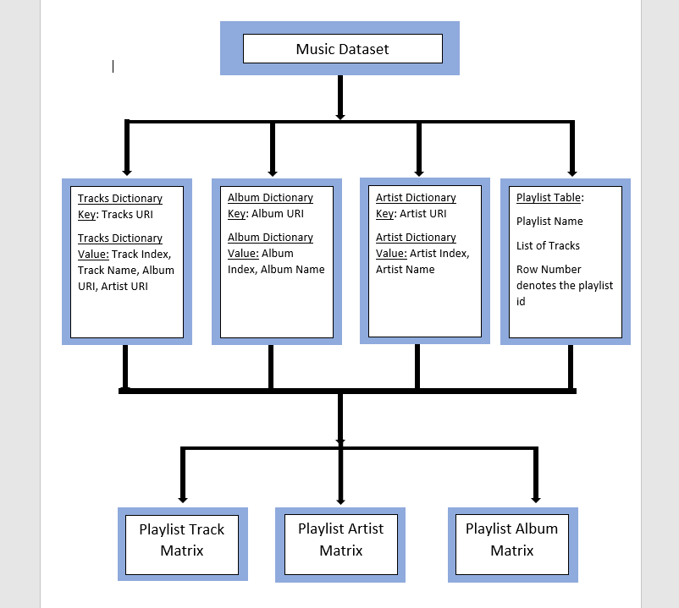
Block diagram to show the Pre-processing of data and its subsequent in memory storage

Slide 9
Playlists Similarity Computation
Playlist-Track Matrix normalized with BM25/BM25+/ TFIDF using Similaripy library
Represented test playlist as vector of size : #unique tracks, containing zero for the tracks not present and ones for the tracks present in the playlist
Computed cosine similarity with playlist vectors present in the dataset using the sklearn utilities
Computed score for all the tracks present in the dataset as the sum of the similarity score of all the playlists in which it occurs
Sorted tracks according to their scores and returned top 500 tracks with highest scores not already present in the seed tracks

Slide 10
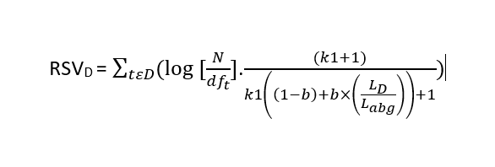
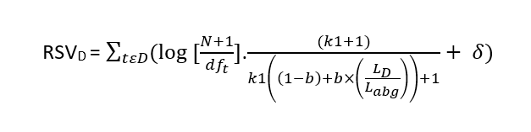
Normalizations
BM25 –
BM25 plus –

Slide 11
Cold START PROBLEM
Only playlist feature available for the cold start problem is their titles
Track genre/album genre/artist genre highly influenced by the playlist title (Eg. Throwback, Hip-Hop, etc.)
Our algorithm relies on recommending tracks from the playlists having titles similar to the title of the incomplete playlist
Playlist titles can be a combination of words or a single word. Thus, Doc2Vec seemed as a plausible model to find similarity (rather than Word2Vec due to this reason) between playlist titles
Bag of Words (BOW) Model and Latent Dirichlet Allocation (LDA) not used due lose of word ordering and high complexity respectively [4]

Slide 12
DOC2VEC
Allows simple vector representation of documents and takes into account the effects of word ordering thereby, gives a better topic representation
Algorithm similar to the word2vec algorithm, the only difference being that the document IDs are also used while training
We implemented doc2vec using the gensim library of python
The training dataset contained unique playlist titles (92944) retrieved from the Million Playlist Dataset and the test set contained the unique playlist titles (862) belonging to the playlists of the cold start problem
Larger the dataset, better is to represent it on a high vector dimension (we used a dimension value of 100 (50 being the default value))
Vector representations learned using the final weight vectors were used to compute cosine similarity (using the NMSIB utility of gensim) between the test dataset elements and the elements of the training dataset

Slide 13
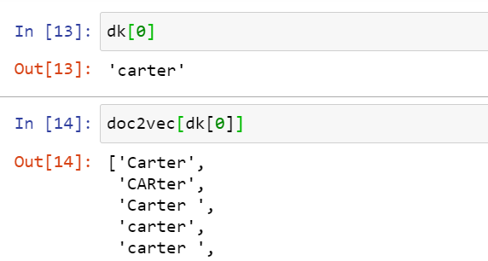
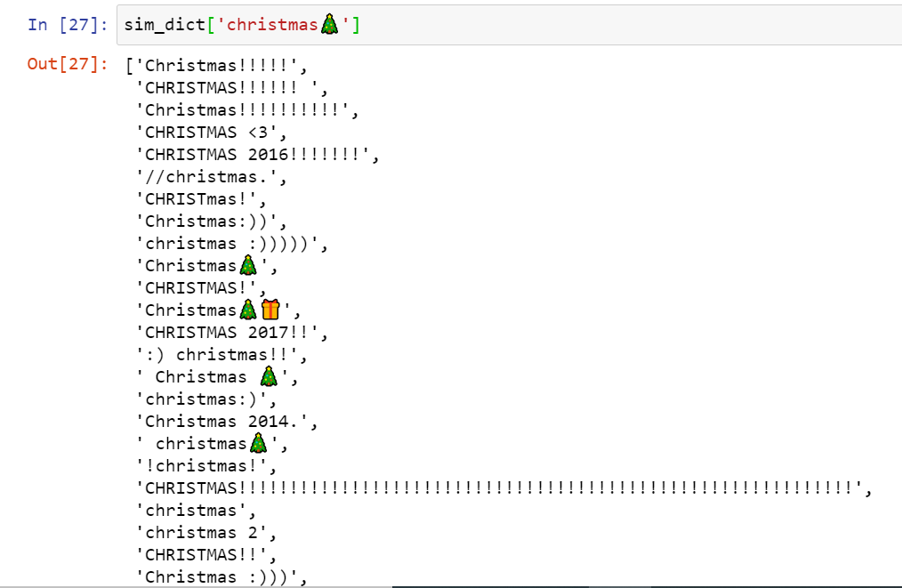
DOC2VEC
The given image shows the results (top 5 most similar playlists from the training dataset) obtained for one of the playlist titles in the cold start problem, using the doc2vec model –
For each playlist of the Cold Start Problem, the top 5 similar playlists were used for the recommendation of the tracks
The tracks being common in most of the playlists were given higher weightage

Slide 14


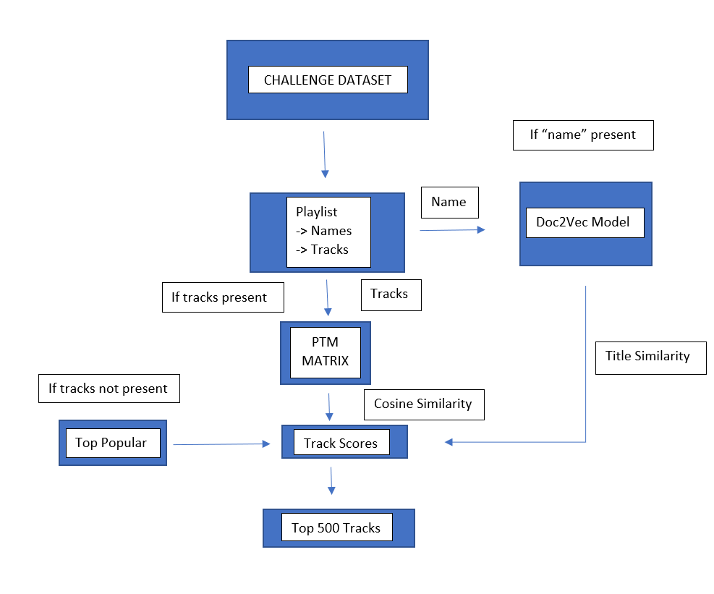
Block diagram to show the process of recommending tracks

Slide 15
EVALUATION METRICS
R-precision: Ratio of the number of common tracks in the recommended and the ground truth set and the number of tracks in the ground truth set. Higher the better
Normalized DCG (NDCG): Measures the ranking quality of the recommended tracks, higher when relevant tracks are placed higher in the list
Recommended songs clicks: If 10 song recommended at once, number of refreshes needed before a relevant track is encountered. Lower the better

Slide 16
Submission
Our submission tested 2 different models (based on the track recommendation for the Cold Start Problem), each having 3 different types of normalizations -
In the first model we recommended the tracks which occurred the most number times, in the training dataset, for test playlists with no seed tracks (Top Popular). While for the test playlists with some songs in them, we recommended the tracks using the Playlist Similarity Computation Algorithm.
In the second model, we returned tracks on the basis of title similarity of the test playlists with the titles of the playlists present in the training dataset (similarity found using the implementation of Doc2vec model and NMSIB (cosine similarity) utilities if the gensim library). While for the test playlists with some songs in them, we recommended the tracks using the Playlist Similarity Computation Algorithm

Slide 17
RESULTS
Normalization | R-prec | NDCG | Clicks
BM25 | 0.1799 | 0.3267 | 3.1616
BM25p | 0.1795 | 0.3261 | 3.1611
TFIDF | 0.1788 | 0.3251 | 3.1647
Results obtained without the implementation of Doc2Vec model in the Cold Start Problem
Normalization | R-prec | NDCG | Clicks
BM25 | 0.1835 | 0.3312 | 2.9132
BM25p | 0.1832 | 0.3306 | 2.9127
TFIDF | 0.1788 | 0.3251 | 3.1647
Results obtained with the implementation of Doc2Vec model in the Cold Start Problem

Slide 18
COMPARISON WITH SOTA
Results of Team Python (without the implementation of Doc2Vec model in the Cold Start Problem) compared with the results of other top teams [2] –

Slide 19
COMPARISON WITH SOTA
Results of Team Python (with the implementation of Doc2Vec model in the Cold Start Problem) compared with the results of other top teams [2] –

Slide 20
Runtime
The given results are based upon the computation time required by our models on a Lenovo 530s ideapad laptop with 8 GB ram and 512 GB SSD –
Model | Runtime (hrs.)
Playlist Based Similarity (all the 3 normalizations) | 6
Playlist Based Similarity + doc2vec model (all the 3 normalizations) | 7
The given results are the runtime required by the models proposed by top 3 teams –
Team | Runtime (hrs.)
Team vl6 (Rank 1) | Full end-to-end runtime takes approximately 1.5 days [5]
Team hello world! (Rank 2) | Takes about 3~4 days to train using the whole MPD under our environment [6]
Team Avito (Rank 3) | The entire pipeline execution takes about 100 hours [7]

Slide 21
CONCLUSION
The final results are in comparison with the results obtained by the top performing teams
This means that the recommendation task is highly influenced by the playlist track vector similarity and playlist title similarity
The doc2vec model helped in improving the R-prec, NDCG and Clicks values as expected
The results of BM25 normalization were better as compared to the BM25 plus normalization due to the fact that the document vectors or playlist are not long but small in size hence, BM25’s bias towards the small documents is not relevant here as expected

Slide 22
CHALLENGES
High running time for the models where we wanted to boost the scores by using the doc2vec similarity for all the playlist titles in the test case
No parameter tuning due to hardware limitations; used the values as provided by various past literatures

Slide 23
FURTHER IMPROVEMENTS
The scores can be improved by using an ensemble model where scoring is based on the artist, album and playlist title related parameters
Some playlists contain tracks of a particular album or artist higher in number thus, the tracks corresponding to such categories should be given more weightage
Playlist title similarity using the doc2vec model was used only for the Cold Start Problem, this can be extended to all the playlists of the challenge dataset and the tracks belonging to the playlist having similar title as the playlist of the test set should be given a higher weightage during the recommendation
The above methods can extensively improve the NDCG and Clicks values
Parameter tuning should be done for the different types of normalizations and the doc2vec model
Some playlist titles are just emojis so, a CNN can be used to find the topic which the emojis represent

Slide 24
REFERENCES
https://www.aicrowd.com/challenges/spotify-million-playlist-dataset-challenge
Antenucci, Sebastiano & Boglio, Simone & Chioso, Emanuele & Dervishaj, Ervin & Kang, Shuwen & Scarlatti, Tommaso & Ferrari Dacrema, Maurizio. (2018). Artist-driven layering and user's behaviour impact on recommendations in a playlist continuation scenario. 1-6. 10.1145/3267471.3267475.
Zamani, Hamed et al. “An Analysis of Approaches Taken in the ACM RecSys Challenge 2018 for Automatic Music Playlist Continuation.” ACM Transactions on Intelligent Systems and Technology (TIST) 10 (2019): 1 - 21.
https://medium.com/wisio/a-gentle-introduction-to-doc2vec-db3e8c0cce5e#:~:text=As%20said%2C%20the%20goal%20of,method%20has%20to%20be%20found.
https://github.com/layer6ai-labs/vl6_recsys2018
https://github.com/hojinYang/spotify_recSys_challenge_2018
Vasiliy Rubtsov, Mikhail Kamenshchikov, Ilya Valyaev, Vasiliy Leksin, and Dmitry I. Ignatov. 2018. A hybrid two-stage recommender system for automatic playlist continuation. In <i>Proceedings of the ACM Recommender Systems Challenge 2018</i> (<i>RecSys Challenge '18</i>). Association for Computing Machinery, New York, NY, USA, Article 16, 1–4. DOI:https://doi.org/10.1145/3267471.3267488

