Slide 1
<Snakes Game>
A Project Report on
Presented By
Rajan Sharma
18CSU165 (CSE)
Rishabh
18CSU170 (CSE)
Rithwick Negi
18CSU173 (CSE)
Rohan Sharma
18CSU178 (CSE)
Under the supervision of
Ms. Akanksha Kaushik
(The North Cap University)

Slide 2
Introduction
Snake is a game where its body grows in length. There is no standard version of the game. The concept originated in the 1976 arcade game Blockade, and its simplicity has led to many implementations (some of which have the word snake or worm in the title). After a variant was preloaded on Nokia mobile phones in 1998, there was a resurgence of interest in the Snake concept as it found a larger audience.

Slide 3
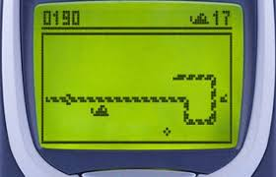
Continuation
The first published by Nokia, for monochrome phones. It was programmed in 1997 by Taneli Armanto of Nokia and introduced on the Nokia 6110 .

Slide 4
Why this project?
Because we all are avid gamers and we wanted to work on a project which we could relate to and work on enthusiastically. Choosing Snakes as the one was done after a thorough discussion and we were excited to recreate the iconic game on our own.

Slide 5
Methodology Used
Programming Requirements:
• System with a Linux based environment
• Python 3
System with a Linux based environment is required because of the curses module. The curses module provides an interface to the curses library, the de-facto standard for portable advanced terminal handling. While curses is most widely used in the Unix environment, versions are available for Windows, DOS, and possibly other systems as well.

Slide 6
Data for the program
Most of the data representation in the program is straightforward. The score is a number. The position of the food is given by an (x,y) coordinate pair but the food’s function needs to know the size of the canvas if it’s going to randomly appear in a place where we can eat it. Our Scoreboard class needs to be told when the score has increased, and the score increases whenever the snake runs over food. The Snake is more complex as it needs to know the bounds of the canvas, the location of the food, and the location of all pieces of itself.

Slide 7
Program Analysis
To create a Snake game that allows users to control the movement of a snake on a screen, to get points for eating food and avoiding running into the walls or the growing tail of the snake itself.

Slide 8
Continuation
In this problem, we want to write a game where a graphical representation of a snake moves across the screen. When it encounters a piece of food, the snake grows longer, and we gain a point. If it hits the wall or runs into itself, we die. To write this program we are going to need:
● A way of representing the snake
● A way of representing the food
● A way to display the score
● A way for our instructions to reach the snake
● And a way to know when we’ve run into ourselves and died

Slide 9
Functional Requirements
The snake must appear to move around the screen
The snake must turn in response to user input
The snake will increase in length if it eats food
The snake will die if it runs over itself
The snake never stops moving

Slide 10
How can we show the snake eating?
The simplest answer is that if the head of the snake and the food are in the same place, we consider that the snake eats the food. This means that we must know where the food is. When it’s eaten, it disappears, the snake grows, and the food shows up somewhere else.

Slide 11
Basic Algorithm
Let's look at how a program to run the whole game might look:
1. Draw the playing area with bounding rectangle, set the counter to zero and display it
2. Draw the snake in a starting position
3. Draw the food in a starting location
4. On user input, change snake direction
5. Move the snake one move
6. If the snake is over food, eat it, increase the score, grow, move the food
7. Else if the snake is over itself, die
8. Go back to 4
9. Until the snake dies

Slide 12
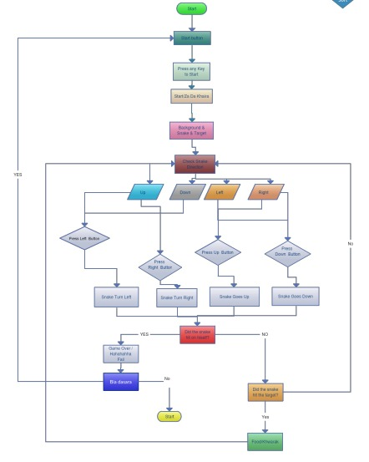
Flowchart

Slide 13
Future Prospects
This is a very basic game in its very initial stage. The team is planning to make the game complex and introduce stages in the game. Complexity can be done by introducing obstructions in the path of the snake and time limits to achieve a certain score.

Slide 14
Real life usage
Since the game is very basic and can be run on machines with minimal specs we are planning to implement this game and future games to enhance motor skills of the physically gifted students.

