Slide 1
Summer Internship Presentation on Neural Network and Deep Learning
By - Rohan Sharma
Roll no. – 18CSU178

Slide 2
About the Specialization
The Neural Networks and Deep Learning specialization consisted of 4 weeks –
Introduction to deep learning
Neural Networks Basics
Shallow Neural Networks
Deep Neural Networks

Slide 3
Introduction
Deep learning (also known as deep structured learning) is part of a broader family of machine learning methods based on artificial neural network. Learning can be supervised, semi-supervised or unsupervised. Deep learning allows machines to solve relatively complex problems even when using data that is diverse, less structured or interdependent. Deep learning is a form of machine learning that is inspired and modelled on how the human brain works.
In this course we were introduced to the basics of deep learning and have learnt how it compares to other techniques.

Slide 4
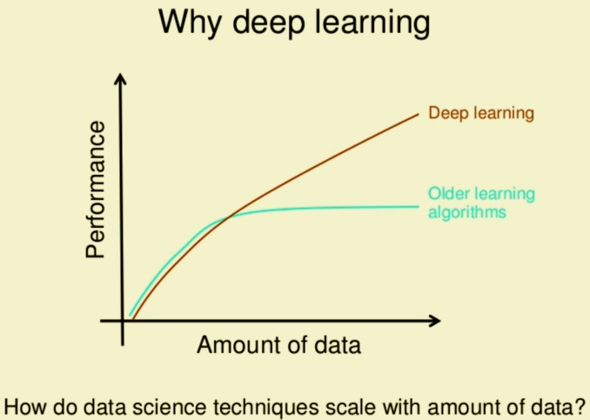
Week 1 Learning Outcomes
Major topics covered in this week:
Neural Network
Working of a Neural Network
Supervised learning
Introduction to Deep learning
Why Deep Learning?

Slide 5
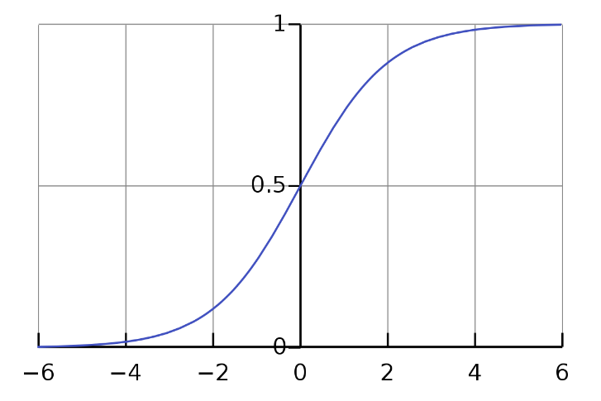
Week 2 Learning Outcomes
Major topics covered in this week:
Binary Classification
Logistic Regression
Loss Function
Cost Function
Gradient Descent
Computation graph and Derivatives with a Computation Graph

Slide 6
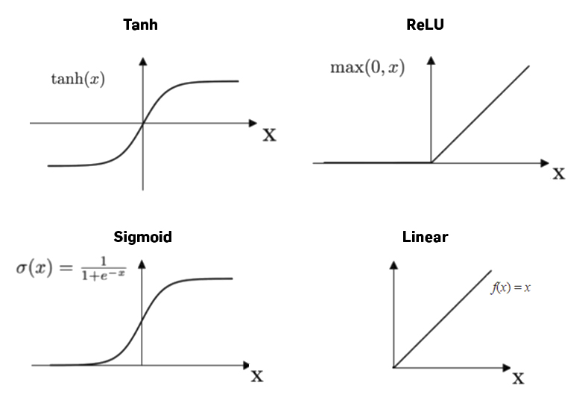
Week 3 Learning Outcomes
Major topics covered in this week:
Neural Network Representation
Shallow Neural Network
Computing a Neural Network’s Output
Activation functions, Need for Activation functions
Random Initialization

Slide 7
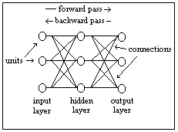
Week 4 Learning Outcomes
Major topics covered in this week:
Deep L-layer neural network
Building blocks of deep neural networks
Forward and Backward Propagation
Parameters vs Hyperparameters

Slide 8
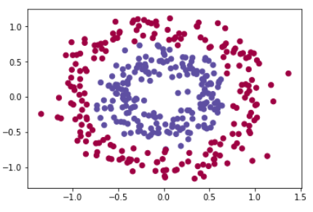
Outcomes on Dataset
Planar data classification with a hidden layer
Circles dataset was made using sklearn.datasets
From this we can see that the dataset looks like a
donut shape.

Slide 9
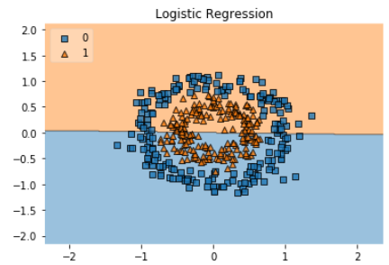
Results
Logistic regression is performed and decision boundary for logistic regression is plotted.
Accuracy of logistic regression : 49%

Slide 10
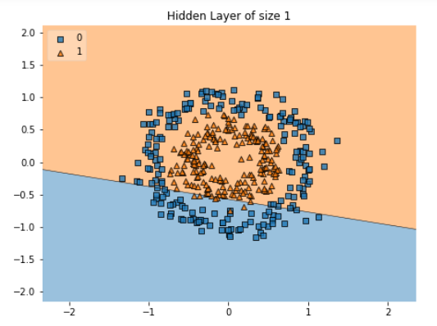
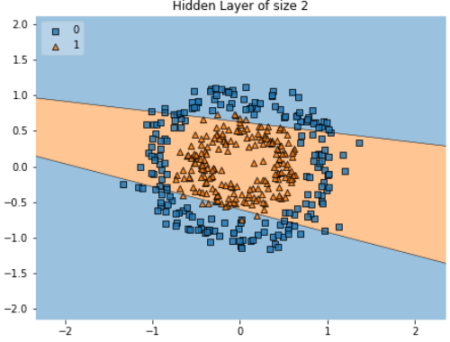
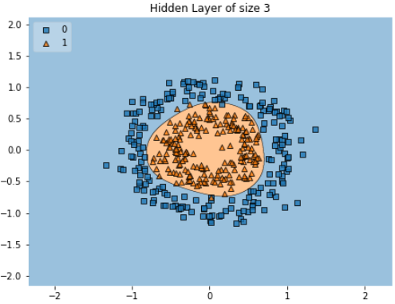
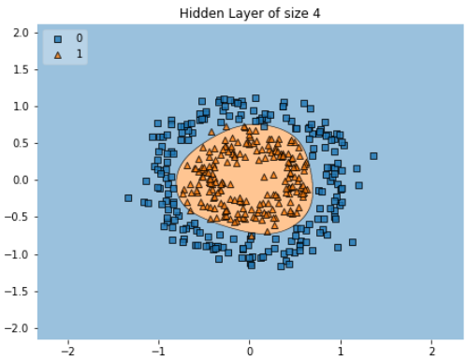
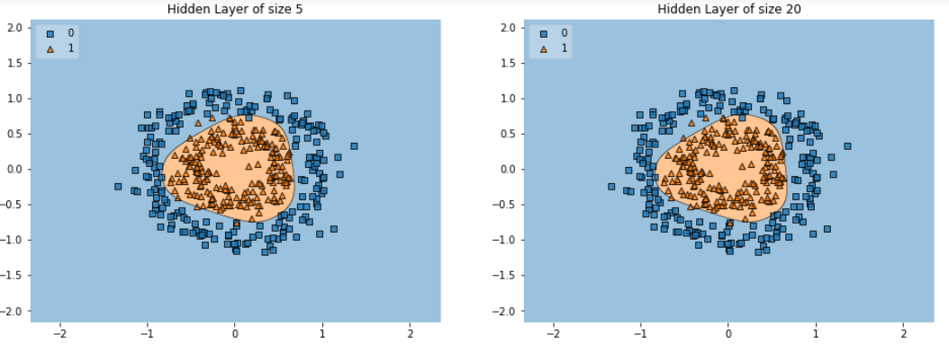
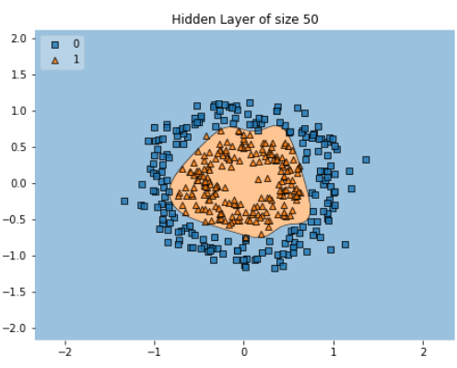
Accuracy for hidden units
64.0% 78.25% 99% 99%
98.5% 98.25% 99.5%

Slide 11
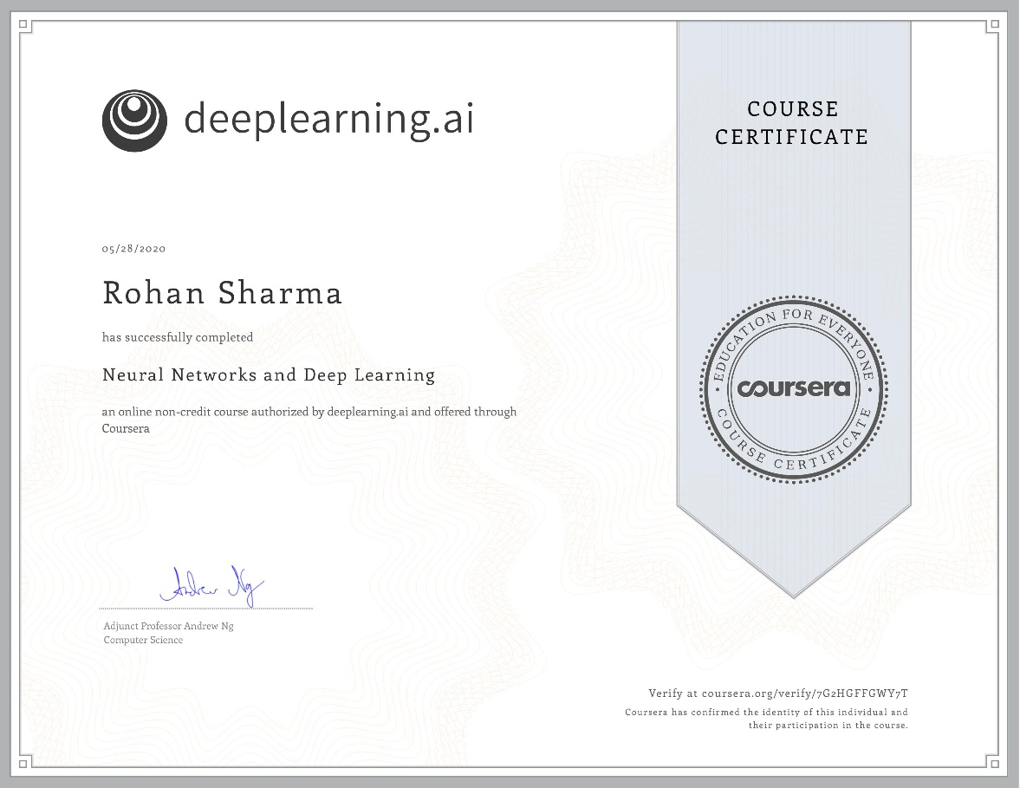
CERTIFICATE OF THE COURSE

Slide 12
Conclusion
This specialization improved my skill-set in the field of Artificial Intelligence and made me capable of making more projects like this. By learning a wide range of techniques and applying some of them made an efficient use of my time and has now opened an entirely new world for me to explore. Not only was I able to execute deep learning using python but I was also able to understand how the calculations are done in neurons and how the output of a given problem is generated. This course gave me a basic idea of neural networks.

Slide 13
Reference
https://www.coursera.org/learn/neural-networks-deep-learning/home/welcome
https://www.geeksforgeeks.org/introduction-deep-learning/
https://pathmind.com/wiki/neural-network

Slide 14
THANK YOU

