Slide 1






RGIT-Hackathon

Slide 2

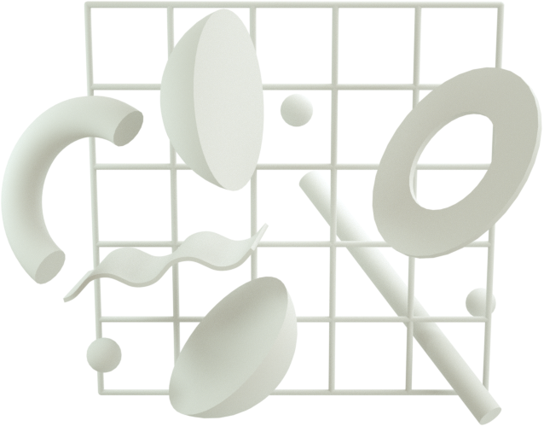
Team Members
Tushar Sharma
Rohan Sharma
Venkatsaigautam Bathina
Meet Mali

Slide 3
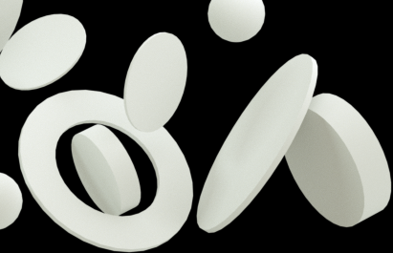


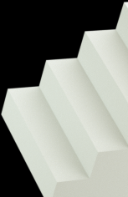
Heart Disease Prediction
Framework and Programming Languages Used
Algorithms Used
Libraries Used
-> numpy
-> matplotlib
-> sklearn
-> seaborn
-> pandas
-> Flask
-> html
->Bootstrap
->Python
-> KNN
-> Random Forest Classifier
-> Decision Tree
-> SVC

Slide 4

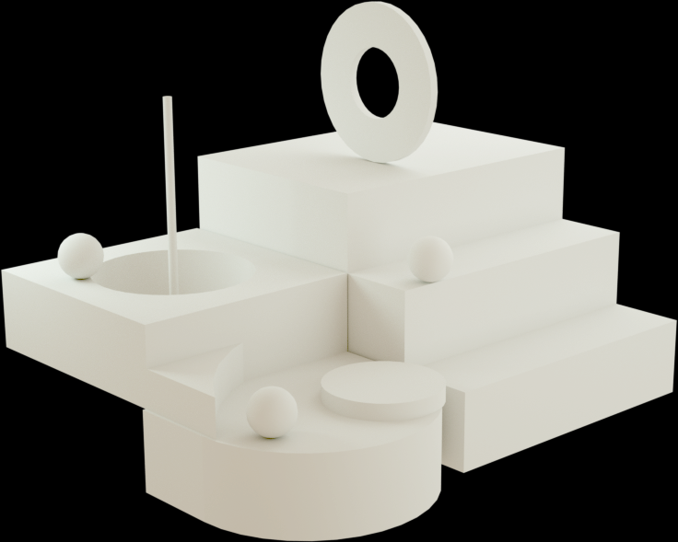

How does it work ?
The user enters values for the attributes which are required and the model predicts that whether the person is suffering from heart disease or not.

Slide 5



Thank you...!

