Slide 1
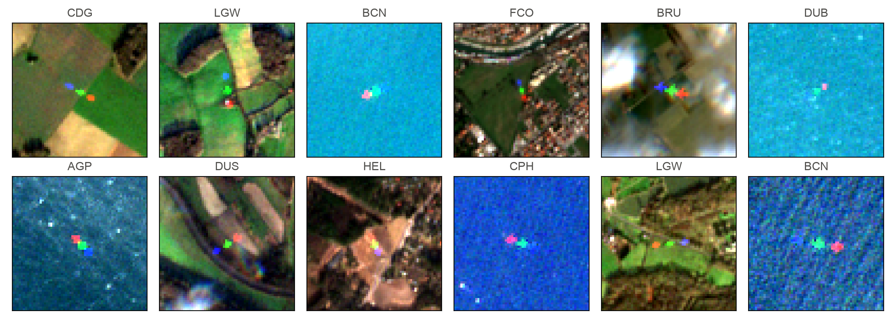
Detecting aircraft in flight
From a parked-plane classifier to satellite and sky detectors, measured on real aircraft in flight
Rohan Shenoy · October 2026
Aircraft in flight on Sentinel-2, 10 m pixels: each shows as blue, green and red copies
Notes:
Review of the planesnet-detector work: rebuilding a PlanesNet classifier (parked aircraft, satellite) into two detectors for aircraft in flight, one looking down from orbit and one for cameras looking at aircraft, then building real test sets for both and training the sky model longer on more data. All numbers come from files in the repository (docs/report.md, data/aot_part2/results, data/s2_flying).

Slide 2
Where we ended up
Both detectors now have real test sets large enough to trust
0.80
18 of 19
6.6× | 49×
6.5×
Sky detector average precision on 1,708 aircraft from flights it never saw (untrained COCO model: 0.12)
aircraft found by the new S2Net in an independent Sentinel-2 set, at 5% clutter false alarms (PlaneNet: 5)
Larger real test sets: sky 260 → 1,708 aircraft; satellite 19 → 927 aircraft
More training data (1,548 → 10,051 crops), 50 epochs on the Mac's GPU
Average precision: area under the precision-recall curve, matching by centre distance. False alarms: share of 2,134 random background chips scored above 0.5.
Notes:
Headline numbers. Sky: AOT part 2 has 1,813 crops with 1,708 aircraft from 1,312 flights that no model trained on. Average precision (AP) uses centre-distance matching (a hit is within max(8 px, half the box) of an aircraft), because AOT aircraft are often under 10 px. Satellite: data/s2_flying is a label-guided Sentinel-2 set of 927 aircraft at 10 European airports, plus 2,134 background chips; S2Net is trained on it and tested on data/s2_airborne (19 aircraft, 2025). background chips. The two test-set factors compare with the previous test sets: 260 aircraft (AOT part 1 validation) and 19 aircraft (data/s2_airborne).

Slide 3
Contents
Seven parts, from the starting point to what to do next
1
The problem
What the original repo did, and the two viewpoints
5
Sky results
Validation, a 6.6× larger test set, curves, examples
2
Data
AOT video, PlanesNet, Sentinel-2; splits and leakage
6
Satellite results
Building a 927-aircraft Sentinel-2 test set
3
Models
PlaneNet and the YOLO variants
7
Repository and next steps
Fixes, reproducibility, limitations
4
Training
12 epochs on CPU, then 50 epochs on the Apple GPU
Notes:
Sections follow the order of the work. The appendix-style slides at the end (repo fixes, reproducibility) document what changed in the repository and how to rerun everything.

Slide 4
The problem
1
The repo classified parked aircraft; we needed aircraft in flight
Notes:
The original repository (Bob Hammell, 2017-2020) trains a TFLearn CNN on PlanesNet and slides it across Planet scenes. PlanesNet is almost entirely parked and taxiing aircraft at Californian airports.

Slide 5
Starting point
Data, model and detector all assumed aircraft parked on concrete
Part | Original | Problem for aircraft in flight
Data | PlanesNet: 32,000 RGB chips, 20×20 px, Planet imagery at about 3 m per pixel | Almost every aircraft is parked or taxiing; no cloud, sea or haze backgrounds
Model | TFLearn CNN: 2 conv blocks and a 512-unit dense layer, normalised with airport statistics | Learns "white cross on grey concrete"; the normalisation is tied to tarmac brightness
Detector | 20 px window slid in 2 px steps: about 280,000 model calls per scene | Very slow, no score threshold, no use of motion
Stack | TensorFlow 1, TFLearn, Python 3.5 | No longer installs on current Python
Notes:
Original pipeline: model.py (TFLearn CNN, 877,058 parameters, 93% in one dense layer), train.py (PlanesNet JSON), detector.py (20 px window at 2 px steps, one model call per window, every hit boxed at 20x20). TensorFlow 1 and TFLearn no longer install on current Python, so the files are kept only for reference.

Slide 6
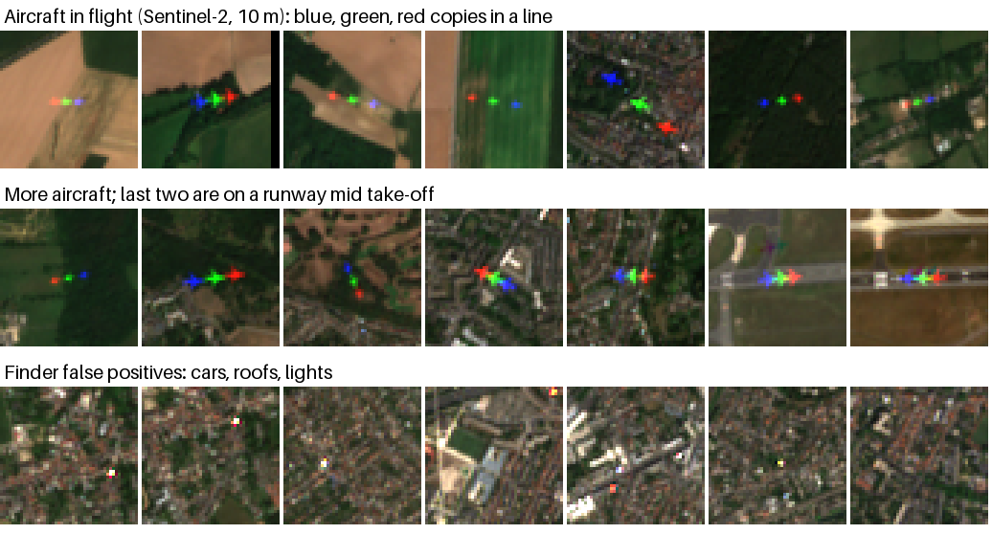
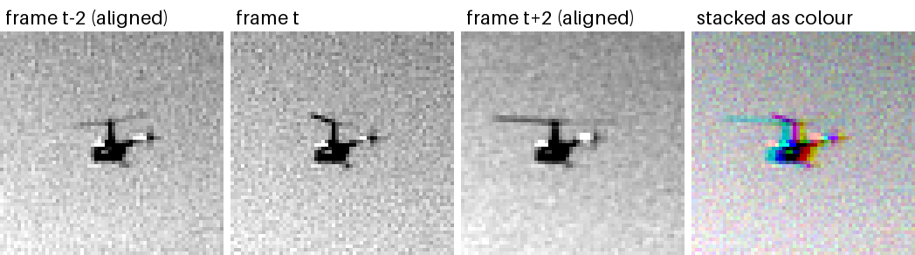
Two viewpoints, two pipelines
"Aircraft in flight" means looking down from orbit or up from a camera
Satellite: looking down
Sky: cameras looking at aircraft
AOT: 2448×2048 greyscale video from aircraft-mounted cameras, about 10 frames per second
Most aircraft are under 20 px, against sky or ground clutter
Code: sky/ (YOLO11 fine-tuning)
Planet and Sentinel-2 RGB, 3 to 10 m per pixel
Aircraft are a few pixels; motion splits them into blue, green and red copies
Code: satellite/ (PlaneNet)
Notes:
satellite/ is PyTorch: PlaneNet, a fully convolutional classifier trained on PlanesNet plus synthetic in-flight samples, with static-object suppression across dates and band-offset motion cues. sky/ fine-tunes Ultralytics YOLO on Amazon's Airborne Object Tracking (AOT) dataset, with tiled inference, multi-frame tracking and a 3-frame temporal input.

Slide 7
Data
2
Real airborne video for the sky, PlanesNet plus synthetic samples and real Sentinel-2 for the satellite
Notes:
Every dataset used, how it was split, and the leakage checks.

Slide 8
Datasets
Each pipeline is trained on one source and tested on real aircraft in flight
Dataset | Used for | Amount used | Access
AOT (Amazon Prime Air), parts 1-3 | Sky training, validation and test | 10,051 training crops, 540 validation, 1,813 test (part 2) | Public S3, no account
PlanesNet | Satellite training: aircraft seen from above | 32,000 chips (8,000 aircraft) | Kaggle; data branch
Sentinel-2 L2A (10 m) | Satellite test sets | 19 aircraft (s2_airborne), 927 aircraft (s2_flying) | AWS COGs via Earth Search
Flying Airplanes labels | Guide for the 927-aircraft test set | 1,782 labels at 15 European airports | GitHub, MIT licence
COCO yolo11n / yolo11s | Starting weights and baseline | Pretrained "airplane" class | Ultralytics releases
Notes:
AOT: s3://airborne-obj-detection-challenge-training, CDLA-Permissive 1.0, about 4,943 flights in three parts. PlanesNet: Kaggle rhammell/planesnet, supplied on the data branch because Kaggle was blocked in the cloud. Sentinel-2: L2A COGs in the public sentinel-cogs bucket, found through Earth Search. Flying Airplanes labels: Pamplona Segundo et al. 2021, github.com/maups/covid19-custom-script-contest, MIT licence.

Slide 9
AOT crops for the sky detector
Native-resolution crops keep 6 px aircraft visible to YOLO
1
2
3
4
5
Map classes
Airplane, helicopter, drone are scored; birds and unknown objects are ignored
Pick frames
At most 6 per flight, 20+ frames apart, with neighbours t−2 and t+2
Crop 640 px
At native resolution around an aircraft; about 15% empty crops
Stack 3 frames
t−2, t, t+2 aligned by phase correlation, stored as colour channels
Split by flight
md5 of the flight id: 20% of flights held out, never split by frame
1.8 M label rows in part 1 alone
< 10 px size of 43% of the test aircraft
~28% of part 1 frames missing from the bucket
Notes:
Full 2448x2048 frames would shrink a 6 px aircraft below one pixel at YOLO's 640 px input. sky/prepare_aot.py maps AOT instance names to 5 classes (airplane, helicopter, bird, drone, unknown); birds and unknowns stay labelled but are ignored in scoring. About 28% of part 1 frames listed in groundtruth.csv are missing from the bucket (HTTP 404); the script over-plans by 35% and now retries transient network errors.

Slide 10
AOT parts share flights
Part 2 is a clean test set; part 3 is used for training without part 2's flights
Part 1
1,311 flights
Training (80%) and validation (20%)
Part 3
1,531 flights
Training only, minus part 2's flights
Part 2
1,312 flights
Test set: 1,708 aircraft
352 shared
Same side in both (flight hash)
364 shared
Removed from training
Part 1 and part 2: 0 shared. Every model trained on part 1 can be tested on part 2. Built with prepare_aot --part part2 --train 0 --val-fraction 1: 1,813 crops.
Checked after building: no training flight is in validation or in part 2.
Notes:
Flight ids compared across the three groundtruth.csv files. Part 1 and part 2 share none, so part 2 is a clean test set for every model trained on part 1. Part 3 shares 352 flights with part 1 and 364 with part 2, so training on part 3 as-is would leak into the test set. prepare_aot --exclude-flights part2.csv removes them; keeping --val-fraction 0.2 puts any flight shared by parts 1 and 3 on the same side (train or validation) in both, because the split is a hash of the flight id. Checked after building: 0 training flights in part 2, 0 training flights in validation.

Slide 11
Training data grew 6.5 times
From 1,548 crops of part 1 to 10,051 crops from parts 1 and 3
540 crops
validation: 230 held-out part 1 flights
1,813 crops
test (part 2): 1,708 aircraft, 1,312 flights
0 failures
building part 3 after adding download retries
Notes:
The 12-epoch models (report runs on a 4-core cloud CPU) used 1,548 training crops from part 1. The 50-epoch run used 5,874 crops from part 1's training flights and 4,177 from part 3 with part 2 excluded. On a slow connection about a quarter of downloads first failed with connection resets and timeouts; after adding retries with backoff, part 3 built with 0 failures.

Slide 12
Three frames as one image
Static scenery stacks to grey; anything moving leaves coloured fringes
Align:
neighbours are shifted onto frame t by phase correlation
Stack:
frames t−2, t and t+2 become the three colour channels
Effect: at equal recall, about 40% fewer false detections than one frame
Notes:
AOT is greyscale, so the three colour channels are free. sky/temporal.py aligns frames t-2 and t+2 to frame t by phase correlation (to cancel the camera's own motion), matches brightness, and stacks them as (B, G, R) = (t-k, t, t+k). Hue and saturation augmentation is switched off for these models because it would scramble the time channels. No layer changes are needed.

Slide 13
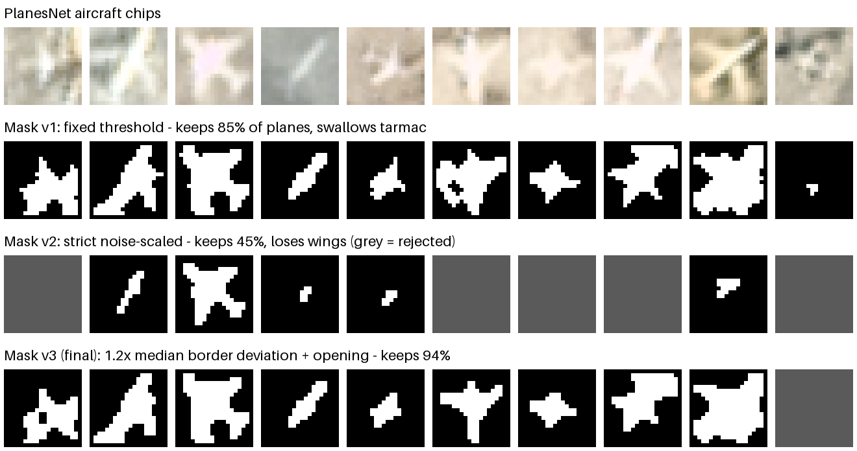
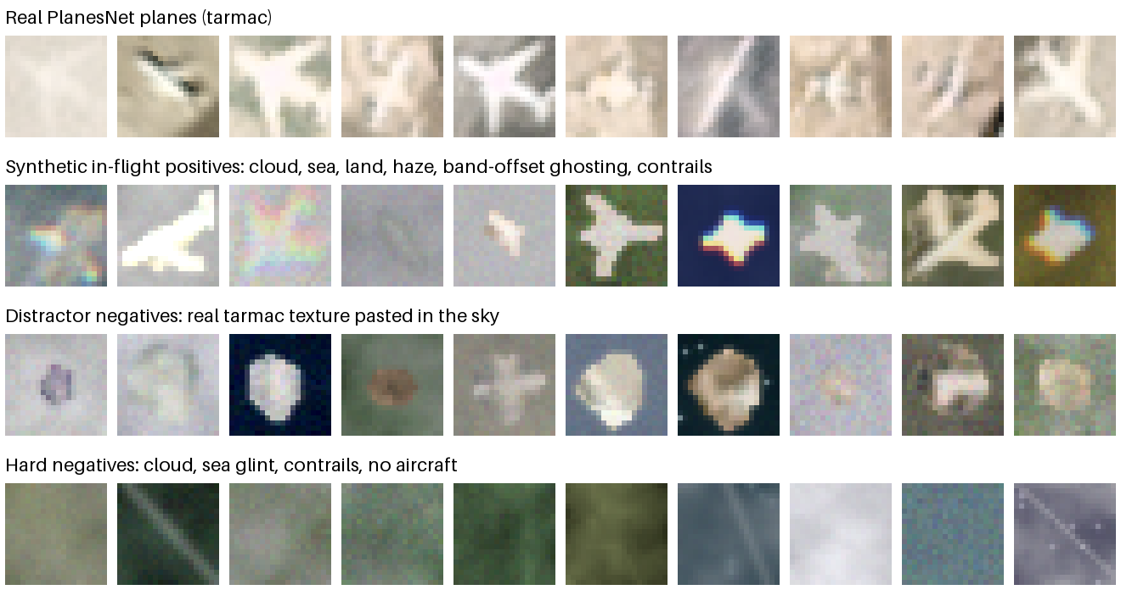
Satellite training data
PlanesNet aircraft moved into the air, plus hard negatives
Mask settings: version 3 keeps the silhouette and 94% of aircraft
Rows: real PlanesNet, synthetic in-flight positives, tarmac distractors, hard negatives
Notes:
satellite/augment.py cuts each PlanesNet aircraft out of its chip (plane_mask) with a threshold scaled to each chip's background variation; 7,489 of 8,000 aircraft are kept with clean outlines. They are pasted onto procedural cloud, sea with glint, farmland, haze and contrails, with simulated band-offset ghosting. 30% of synthetic negatives are blobs of real ground texture, so "tarmac in the sky" is not a shortcut.

Slide 14
Models
3
A small fully convolutional satellite classifier, and YOLO11 variants for the sky
Notes:
Architecture changes for both pipelines.

Slide 15
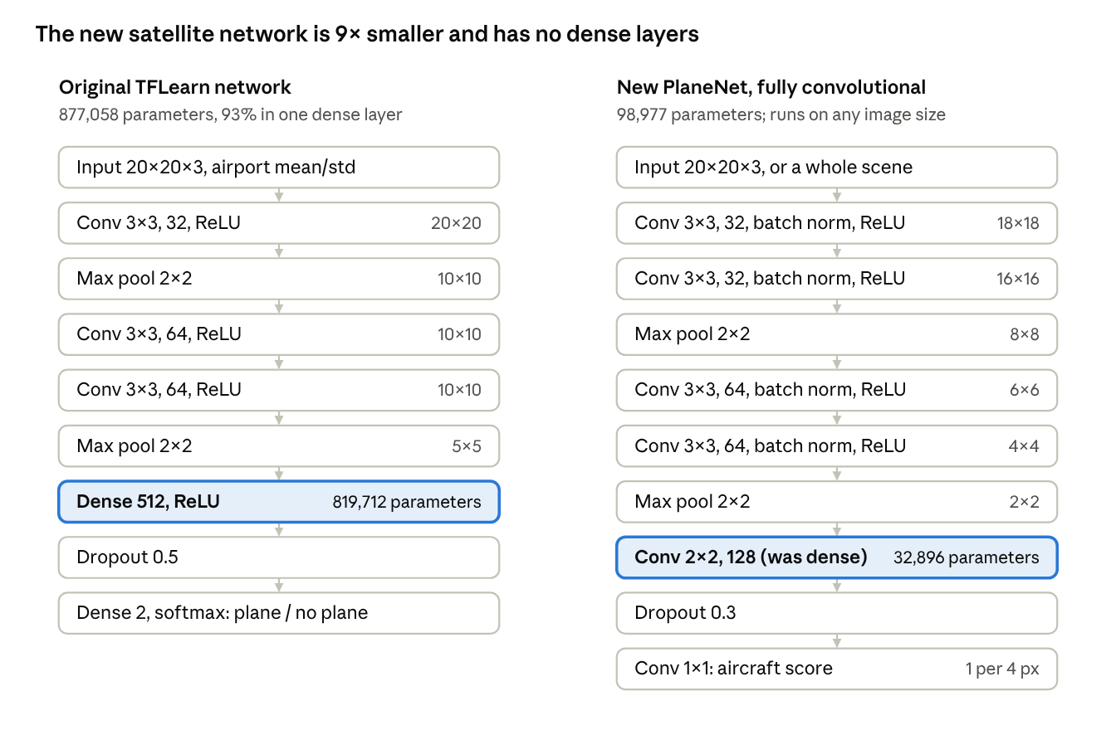
PlaneNet
Nine times fewer parameters, and one pass over a whole scene
877k → 99k
parameters; the dense layer becomes a 2×2 convolution
1 pass
per scene instead of about 280,000 window calls
~4 s
for a 1225×1139 scene on CPU
Notes:
Two 3x3 conv blocks (32 then 64 channels, batch norm, ReLU, 2x2 pooling), then the old dense layer rewritten as a 2x2 convolution to 128 channels, dropout and a 1x1 convolution to one score. No convolution is padded and the pools are aligned, so on a full scene the network outputs one score every 4 px, identical to classifying each 20x20 window separately; tests/test_satellite.py checks this.

Slide 16
Sky detector variants
Same recipe for all; they differ in input, detection layers and size
Model | Parameters | Input | Detection layers | Training
yolo11n, COCO weights (baseline) | 2.62 M | 1 frame | 8, 16, 32 px | None
yolo11n fine-tuned | 2.62 M | 1 frame | 8, 16, 32 px | 12 epochs, 1,548 crops, CPU
yolo11n fine-tuned | 2.62 M | 3 frames | 8, 16, 32 px | 12 epochs, 1,548 crops, CPU
yolo11n-p2 | 2.74 M | 3 frames | 4, 8, 16, 32 px | 12 epochs, 1,548 crops, CPU
yolo11s | 9.46 M | 3 frames | 8, 16, 32 px | 12 epochs, 1,548 crops, CPU
yolo11s | 9.46 M | 3 frames | 8, 16, 32 px | 50 epochs, 10,051 crops, Apple GPU
Notes:
yolo11-p2 adds a fourth detection output at 4 px per cell for 4-10 px targets; 297 of 593 weight tensors transfer from yolo11n, the rest start untrained. Its config was lost to a .gitignore rule and rebuilt from the trained checkpoint, verified tensor for tensor. yolo11s has the same structure with twice the channels.

Slide 17
Training
4
12 epochs on a 4-core CPU, then 50 epochs on the Apple M5 Pro GPU
Notes:
Recipe: 640 px, batch 16, COCO weights, centre-distance scoring. Loss: box (CIoU) + classification (BCE) + DFL.

Slide 18
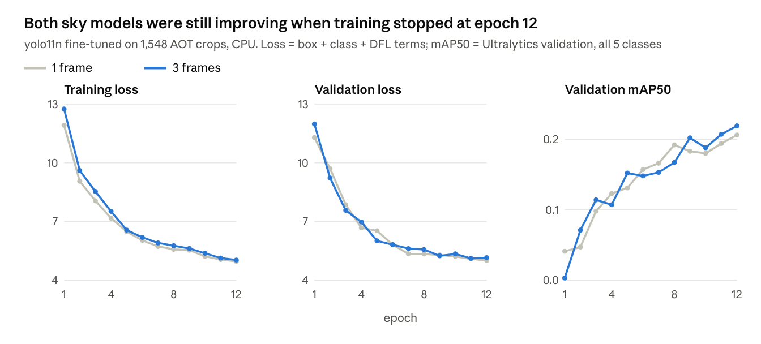
12-epoch runs on CPU
Every model was still improving when training stopped
Notes:
From the cloud runs in docs/report.md: 12 epochs at 640 px, batch 16, about 6 minutes per epoch for yolo11n on 4 cores. Validation loss more than halved and mAP50 roughly quintupled, still rising at the last epoch; the 1-frame and 3-frame models swapped the lead several times. These mAP50 values count all five classes with box-overlap matching, so they run lower than the aircraft-only average precision used elsewhere.

Slide 19
50-epoch run on the Apple GPU
Validation mAP50 rose from 0.21 at epoch 12 to 0.31 at epoch 45
Notes:
yolo11s, 3-frame input, 10,051 training crops, 540 validation crops, --device mps on an Apple M5 Pro (24 GB). About 6.7 minutes per epoch (the 12-epoch yolo11n run took about 6 minutes per epoch on 1,548 crops on a 4-core CPU). Mosaic off for the last 10 epochs. The best epoch by Ultralytics fitness (0.1 mAP50 + 0.9 mAP50-95) is 45; that checkpoint is models/sky_yolo11s_3frame_e50.pt. The validation set differs from the 12-epoch runs' (540 vs 287 crops), so these mAP50 values are not comparable with the previous slide.

Slide 20
Sky results
5
Validation, a 6.6× larger test set, precision-recall curves and examples
Notes:
Scoring: a prediction is a hit when its centre lies within max(8 px, half the box) of an airplane, helicopter or drone. Birds and unidentified objects are ignored. Precision and recall are read at the threshold with the best F1.

Slide 21
Results hold on a 6.6× larger test set
Every model scores within 0.01 of its validation result
Notes:
Validation: 287 crops, 260 aircraft from held-out part 1 flights (docs/report.md). Test: AOT part 2, 1,813 crops, 1,708 aircraft from 1,312 flights, none shared with part 1. Average precision: COCO 0.11 vs 0.12, yolo11n 1-frame 0.55 vs 0.56, 3-frame 0.58 vs 0.58, yolo11s 0.63 vs 0.64, yolo11n-p2 0.41 vs 0.42. The 50-epoch model used a different validation set, so it is not in this chart.

Slide 22
Average precision on AOT part 2
Training longer on more data lifted it from 0.64 to 0.80
85% / 77%
precision / recall at best F1 (12 epochs: 75% / 57%)
85%
maximum recall at the lowest threshold (12 epochs: 80%)
354
test aircraft found by 50 epochs and missed by 12
Notes:
All six models on the same 1,708 test aircraft. Values: COCO yolo11n 0.12, yolo11n-p2 0.42, yolo11n 1 frame 0.56, yolo11n 3 frames 0.58, yolo11s 12 epochs 0.64, yolo11s 50 epochs 0.80 (0.8047). The P2 model was undertrained at 12 epochs: about half its weights started untrained.

Slide 23
Precision against recall
At 70% recall the 50-epoch model keeps 92% precision; the others are below 50%
Notes:
Interpolated precision (upper envelope) against recall on AOT part 2, sampled every 1% of recall; each curve ends at the model's maximum recall. Precision at 50% recall: yolo11s 50 epochs 99%, 12 epochs 83%, yolo11n 3 frames 75%, 1 frame 67%. At 70% recall: 92%, 47%, 36%, 35%. The COCO model never reaches 20% recall (maximum 15%).

Slide 24
Where the gain came from
Largest gains where the model was weakest: ground backgrounds and tiny aircraft
Notes:
Recall at each model's best-F1 threshold, by group, on AOT part 2. Groups: 1,095 aircraft against sky, 590 against ground (23 unlabelled), 727 under 10 px, 981 at 10 px or more. Data and epochs changed together in the 50-epoch run, so this run cannot say how much of the gain comes from each.

Slide 25
Data or epochs?
Part 1 alone reaches the same 0.805 as parts 1 + 3: the part 3 data added nothing measurable
Recall at best F1 | Part 1 | Parts 1 + 3
Against sky | 86% | 87%
Against ground | 55% | 58%
Under 10 px | 55% | 55%
Precision / recall | 87% / 75% | 85% / 77%
Equal epochs, so the two 50-epoch runs differ only in the part 3 data. The gain from 0.64 comes from 50 epochs and 3.8× more part 1 crops together.
Notes:
Three yolo11s 3-frame runs scored on AOT part 2. 12 epochs on 1,548 part 1 crops (cloud CPU); 50 epochs on 5,874 part 1 crops; 50 epochs on 10,051 crops from parts 1 and 3. The last two differ only in the part 3 data, at equal epochs. The first two differ in both epochs and amount of part 1 data, so a run of 50 epochs on 1,548 crops is still needed to isolate epochs. Validation thresholds and recipe as before; one run each.

Slide 26
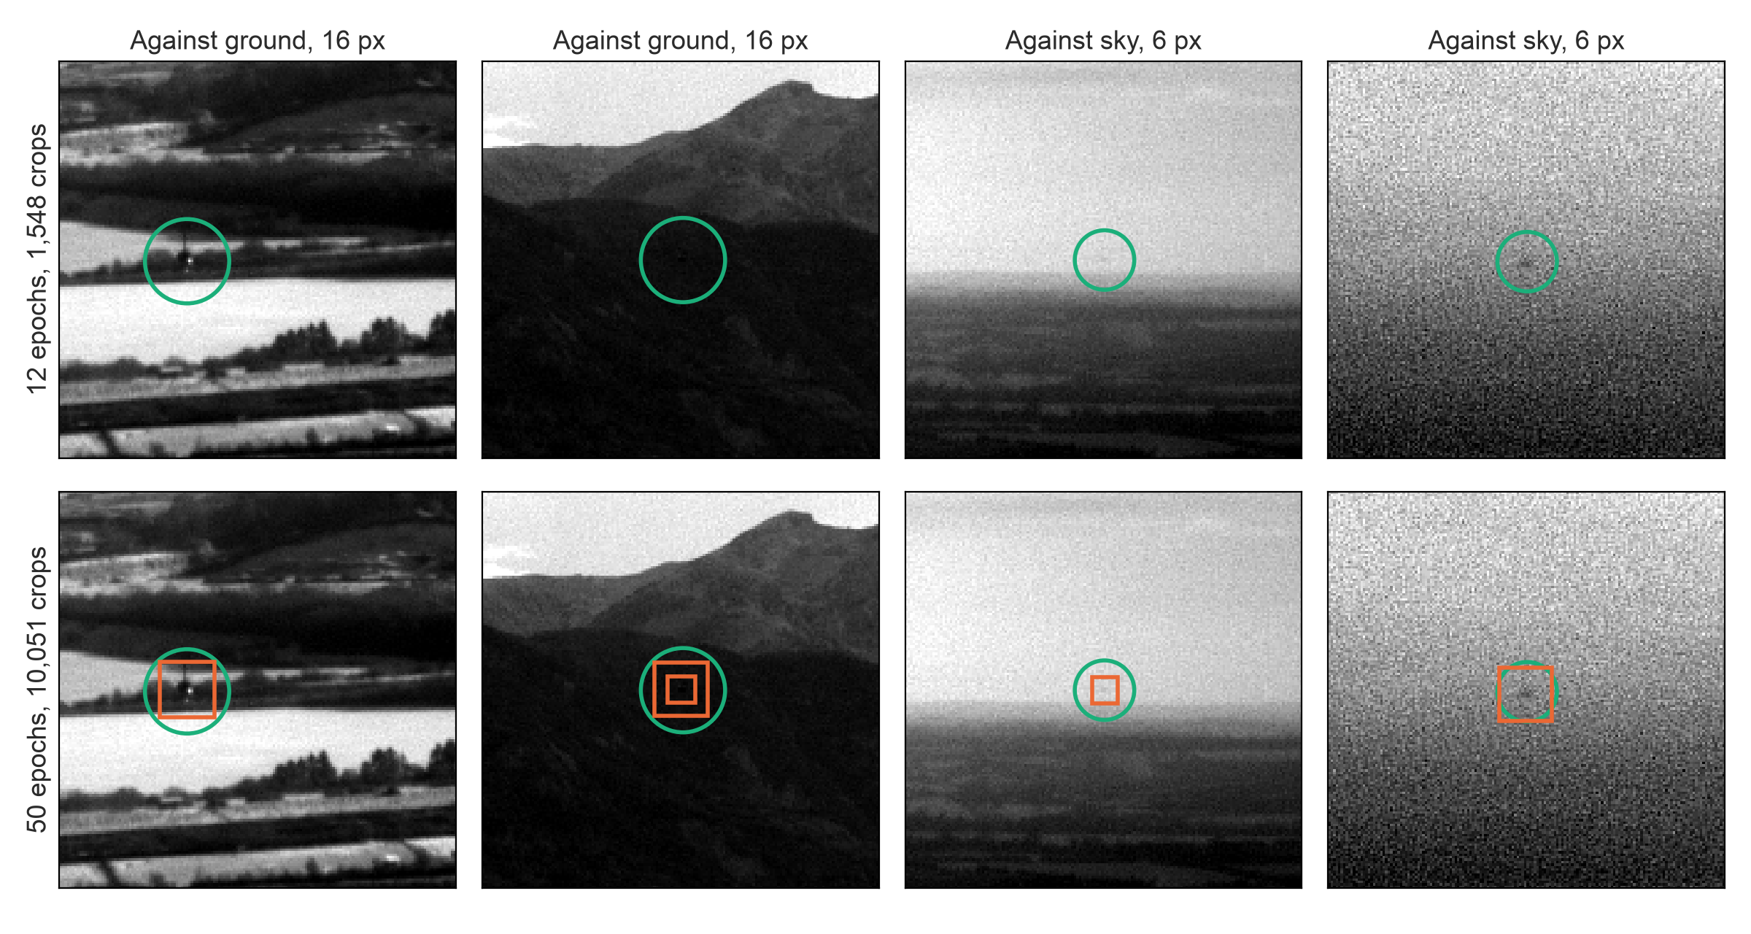
What the longer run finds
Aircraft the 12-epoch model missed: against ground, and 6 px against sky
Notes:
Four of the 354 part-2 aircraft that the 50-epoch model finds at its best-F1 threshold (0.23) and the 12-epoch model misses at its own (0.21). Green circle: labelled aircraft. Orange boxes: detections above each model's threshold, drawn on the greyscale frame (the models see the 3-frame stack). In the second column the 50-epoch model also draws a duplicate box, which the scoring counts as a false alarm. Windows are 160 px of a 640 px crop.

Slide 27
Full frames and tracking
On full frames the 50-epoch model still leads, but by far less than on crops
Model | Full-frame AP | Raw: found / precision | False alarms per frame | Offline: found / precision
yolo11n, 1 frame | 0.43 | 47% / 47% | 0.54 | 46% / 59%
yolo11n, 3 frames | 0.45 | 49% / 45% | 0.59 | 48% / 56%
yolo11s, 3 frames, 12 epochs | 0.34 | 51% / 35% | 0.97 | 49% / 43%
yolo11s, 3 frames, 50 epochs | 0.50 | 57% / 48% | 0.61 | 54% / 65%
Crops overstate full frames: crop AP 0.80 vs 0.58; full-frame AP 0.50 vs 0.45. Train with more background-only crops next.
Notes:
8 clips of 50 full 2448x2048 frames from held-out part 1 flights, 400 aircraft instances, tiled at native resolution (sky/evaluate_clips.py). Thresholds: each model's best-F1 threshold on the 540 held-out part 1 validation crops. Full-frame average precision counts every detection at confidence 0.05 or more, so it does not depend on a threshold. Raw: every detection above threshold. Offline: every detection of a track confirmed at any frame (5 hits). Crops are cut around aircraft (about 15% empty), so crop scores reward finding aircraft more than ignoring a whole frame of clutter: the 12-epoch yolo11s raises 0.97 false alarms per frame. 400 instances from 8 clips are about 8 tracked aircraft, so differences of a few points are not significant.

Slide 28
Satellite results
6
Synthetic scores overstate real performance, so we built a real test set of 927 aircraft
Notes:
PlaneNet scores 0.999 AUC on synthetic in-flight validation. The question is how it does on real aircraft in flight from orbit.

Slide 29
The synthetic gap
Near-perfect on synthetic samples; far lower on real aircraft in flight
0.999
47%
71%
AUC on synthetic in-flight validation (98.8% accuracy)
of 19 real Sentinel-2 aircraft found at 0.5 (data/s2_airborne)
of 927 real Sentinel-2 aircraft found at 0.5 (data/s2_flying, new)
Sentinel-2 is 10 m per pixel; PlanesNet is about 3 m, so a 6 px window is upsampled to the model's 20 px
Both real sets keep only aircraft with a clear three-colour signature, so recall on all aircraft is lower still
Notes:
Training: 20 epochs, AdamW, one-cycle schedule. Held-out PlanesNet: 98.6% accuracy (AUC 0.998). Synthetic in-flight validation: 98.8% accuracy (AUC 0.999). data/s2_airborne: 19 aircraft found by a band-offset finder at six airports and labelled by eye, plus 62 clutter and 250 background chips. data/s2_flying: 927 aircraft at 10 airports, built on the next slides.

Slide 30
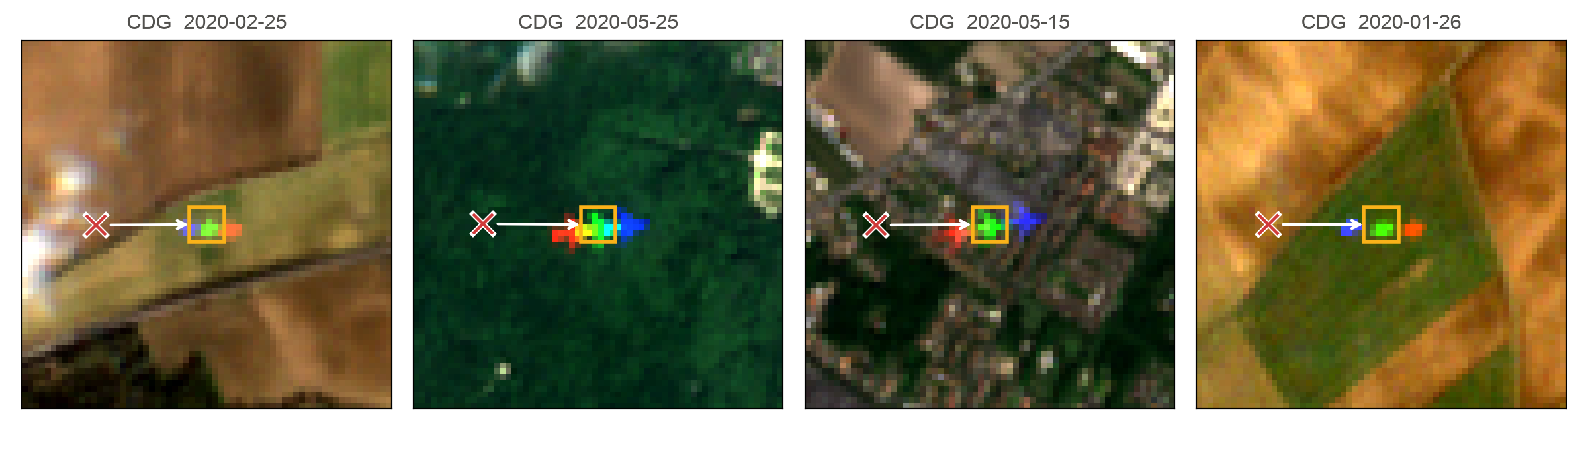
Published labels missed their aircraft
Converted to ground positions, they were off by a fixed offset per airport
1 Search
Find blue, green and red copies in a line near each label (150 px)
2 Vote
Each image votes for the shift that puts two or more labels on a signature
3 Agree
An airport's offset is the shift at least 60% of its images agree on
4 Keep
Strong signatures at that offset only; duplicates across images removed
Notes:
Flying Airplanes labels (Pamplona Segundo et al. 2021): 1,782 airplanes at 15 European airports, January to June 2020, as row/column pixels in mosaics built by their download.py (7x7 blocks of 0.15 x 0.10 degrees). Converting with that geometry and cutting chips from the AWS Sentinel-2 archive put the labels next to, not on, their aircraft: about 200 m east at CDG. Red cross: converted label. Yellow box: the aircraft's green copy. The cause could not be found without the authors' own images.

Slide 31
One offset per airport
10 of 15 airports agree on an offset of 110 m to 1.5 km; 927 aircraft kept
72 of 80
random chips of the final set show a clear aircraft (by eye)
Notes:
Offsets from the build log (pixels x 10 m). Images agreeing: share of an airport's voting images within 15 px of its offset. Dropped: AMS, ARN, ATH, FRA, IST (12-33% agreement within 150 px). With a 400 px search, AMS and FRA give consistent offsets (-4, -158) and (-188, 113) px, but only 61-64% of images agree and about 80% of a checked sample were clear aircraft, so they are left out. Funnel: 1,782 labels; 1,189 at the 10 kept airports; 927 matched to a strong signature (score >= 15) after removing duplicates.

Slide 32
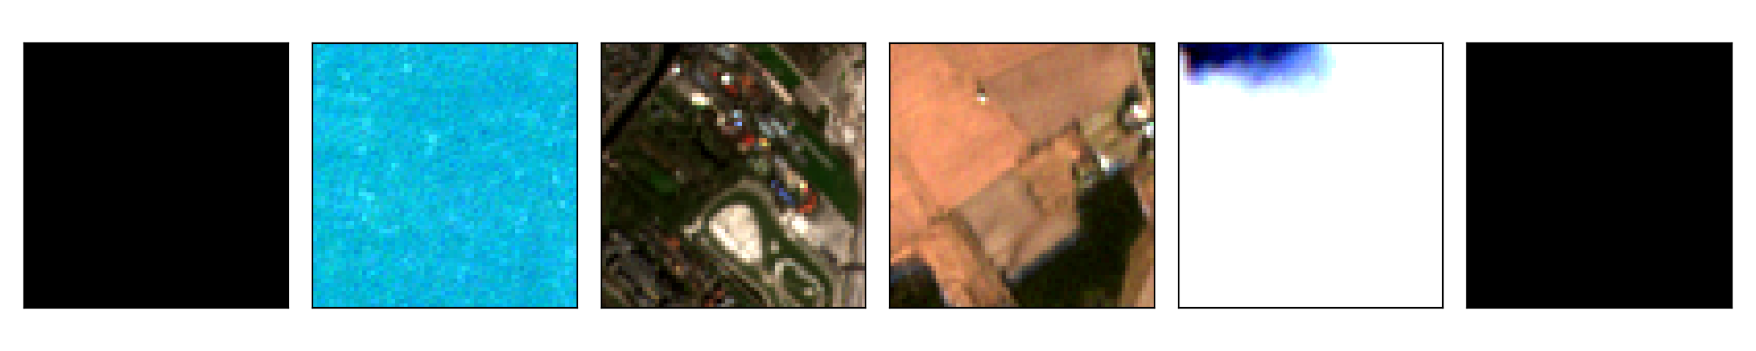
The 927-aircraft test set
Aircraft over fields, towns and sea at 10 airports, plus 2,134 background chips
Background chips: random points at least 1 km from any label
Notes:
Each chip is 64x64 px at 10 m, centred on the aircraft's green copy, 8-bit reflectance / 0.3, the format of data/s2_airborne. Chips are not committed; python -m satellite.build_s2_flying data/s2_flying --chips-from-labels re-cuts them from labels.csv (checked byte-identical on 279 chips). Contains modified Copernicus Sentinel data (2020).

Slide 33
Satellite results on 927 aircraft
71% found at 0.7% false alarms; realigning the bands no longer helps
Notes:
As-is: the 60 m (6 px) square around the green copy, upsampled to 20 px. Realigned: red and blue shifted onto the green copy first, using the recorded copy positions. s2_airborne: AUC 0.99 vs background, 0.88 vs clutter. s2_flying: AUC 0.96 vs background (as-is), 0.94 realigned; false alarms 0.7% on 2,134 background chips. Recall by airport ranges from 53% (DUB, 66 aircraft) to 77% (BRU, DUS). The 63% realigned on 19 aircraft was within noise.

Slide 34
S2Net: a model for Sentinel-2
Cross-validated by airport it finds 99% at 0.2% false alarms (PlaneNet: 71%, 0.7%)
Window:
48×48 px (480 m) holds all three copies; PlaneNet sees 60 m
Network:
three blocks of 3×3 convolutions with batch norm, 290k parameters
Positives:
927 real aircraft of data/s2_flying
Negatives:
background chips as cut, and re-centred on their strongest colour spot
Augmentation: rotations, flips, 2 px shifts, brightness and contrast
99%
of 927 aircraft found at 0.5, each scored by a model that never saw its airport
0.2%
false alarms on 2,134 background chips (0.4% when centred on a colourful spot)
0.999
AUC against background (PlaneNet: 0.96)
Notes:
satellite/s2_model.py and satellite/train_s2.py. 5 folds by airport: every chip is scored by a model that never saw its airport; folds CDG, LGW+HEL, BCN+DUS, FCO+AGP+AMS+ARN+ATH+FRA+IST, BRU+DUB+CPH. Partly circular: data/s2_flying keeps only aircraft whose signature a band-offset finder saw clearly, which is what S2Net learns. Every airport scores 97% or more. Training: 30 epochs, AdamW, one-cycle schedule, positives weighted to balance classes, CPU.

Slide 35
Independent test: S2Net finds 18 of 19
On 2025 scenes from other airports it beats PlaneNet at every false-alarm level
 | S2Net | PlaneNet
Found at 0.5 | 95% | 47%
AUC vs clutter | 0.99 | 0.88
AUC vs background | 0.999 | 0.988
False alarms at 0.5, clutter | 11% | 8%
False alarms at 0.5, background | 1.2% | 0.8%
Notes:
data/s2_airborne: 2025, six airports (LHR, LGW, CDG, FRA, ORD, JFK), candidates from a different band-offset finder, labelled by eye: 14 aircraft, 5 probable, 62 clutter (cars, roofs, lights), 250 background. S2Net trained on all of data/s2_flying. Matched rates: for each model the threshold is the highest that keeps clutter false alarms at or below 5%, 8.1% (PlaneNet's rate at 0.5) and 15%. At 0.5 S2Net raises slightly more false alarms (clutter 11%, background 1.2%) than PlaneNet (8%, 0.8%). With 19 aircraft every figure has wide error bars, and both test sets lean towards clear signatures.

Slide 36
Repository and next steps
7
What was fixed, how to rerun everything, what is still open
Notes:
PR rohanshenoy/planesnet-detector#1 holds the original work; branch claude/validation-sets adds the test sets, the 50-epoch run and the fixes below.

Slide 37
Problems found and fixed
Three .gitignore rules had silently dropped files from the repo
Problem | Effect | Fix
.gitignore models/ matched any folder named models | sky/models/yolo11-p2.yaml never committed | Rule anchored to /models/; config rebuilt from the checkpoint
.gitignore *_detections.png matched a figure | Report figure missing | Restored; report_figs/ re-included
.gitignore *.pt glued to the previous line | Weights outside models/ not ignored | Rule on its own line
AOT parts share flights | Training on part 3 would leak into the test set | --exclude-flights; part 2 as test set
Network resets during downloads | About a quarter of crops skipped | Retries with backoff (part 3: 0 failures)
Part 2 labels spell a bird "BIrd" | 61 bird boxes dropped instead of ignored | Mapped to bird
Ultralytics 8.4 nests relative run folders | Runs saved under runs/detect/runs/sky/ | Absolute project path
evaluate_clips still called the old fetch() | Every clip download would crash | Part passed through; regression test
Notes:
Each fix is a commit on claude/fervent-pascal-x2ge7z (PR #1) or claude/validation-sets, with tests where code changed. The P2 config was rebuilt from the config stored inside the trained checkpoint: 2,740,032 parameters, identical 593 tensor names and shapes, 297/593 tensors transfer from yolo11n.pt.

Slide 38
Reproducing the work
34 tests run in seconds on synthetic data; every number has a command
python -m pytest -q
python -m sky.prepare_aot part2.csv data/aot_part2 --part part2 --train 0 --val 1500 --val-fraction 1
python -m sky.prepare_aot part3.csv data/aot_train_p3 --part part3 --train 9000 --val 0 --exclude-flights part2.csv
python -m sky.finetune data/aot_train/temporal.yaml --temporal --weights yolo11s.pt --epochs 50 --device mps
python -m sky.evaluate models/sky_yolo11s_3frame_e50.pt data/aot_part2/temporal --meta data/aot_part2/meta.json
python -m satellite.build_s2_flying data/s2_flying --chips-from-labels
python -m satellite.evaluate_s2 models/satellite_planenet.pt data/s2_flying
python -m satellite.train_s2 data/s2_flying --out models/s2net.pt --test data/s2_airborne
python -m sky.evaluate_clips part1.csv data/aot_clips --clips 8 --model s=models/sky_yolo11s_3frame_e50.pt:0.226:2
Full write-up: docs/report.md · agent guide: CLAUDE.md · dataset notes: data/s2_flying/README.md
Notes:
Tests: python -m pytest -q (34 passed, about 15 s, no downloads). Local environment: .venv with requirements.txt plus rasterio. Trained weights are git-ignored in models/ (see models/README.md); downloaded data lives under data/ and is git-ignored except data/s2_airborne and data/s2_flying/labels.csv.

Slide 39
Limitations
The numbers are real, but each has a known bias or gap
!
Crops overstate full frames
Sky AP 0.80 on crops but 0.50 on full frames; 8 clips give wide error bars.
!
Epochs not isolated
The part-1-only run separates part 3 data, not epochs (needs 50 epochs on 1,548 crops).
!
Satellite sets lean on band-offset finders
Both keep clear signatures; S2Net cross-validation is partly circular.
!
Small independent satellite test
19 aircraft in data/s2_airborne; labels of s2_flying about 90% clean.
!
One training run per model
Differences of a few points in a subgroup are within run-to-run noise.
Notes:
Each item here is also in docs/report.md under Limitations.

Slide 40
Next steps
In order of expected value
1
Train the sky model for full frames
Add background-only and hard-negative crops mined from full frames; rescore clips
2
Isolate epochs
Train 50 epochs on 1,548 part 1 crops and compare with the 12-epoch run
3
Test S2Net without a finder
Sentinel-2 aircraft located from ADS-B tracks, so faint ones are included
4
Harder S2Net negatives
Use finder false positives (cars, roofs, lights) as training negatives
5
Merge
Merge PR #1 and the validation-sets PR; keep the 93 MB PlanesNet zip out of master
Notes:
Done since the first version of this deck: the 50-epoch model on full frames, a part-1-only 50-epoch run, S2Net, and the wider search for dropped airports. The PlanesNet data branch holds a 93 MB zip that should not be merged.

