Slide 1
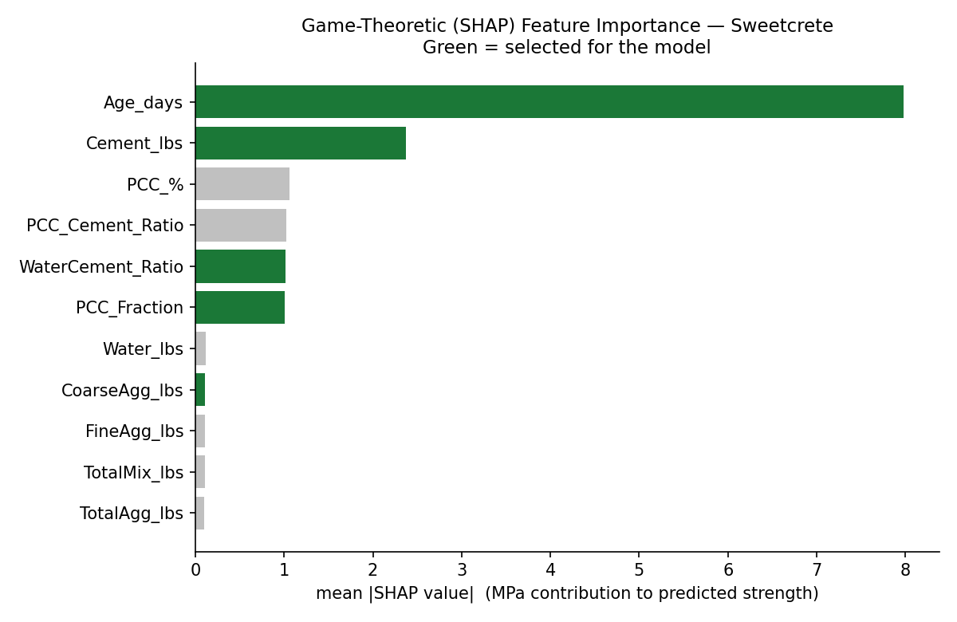
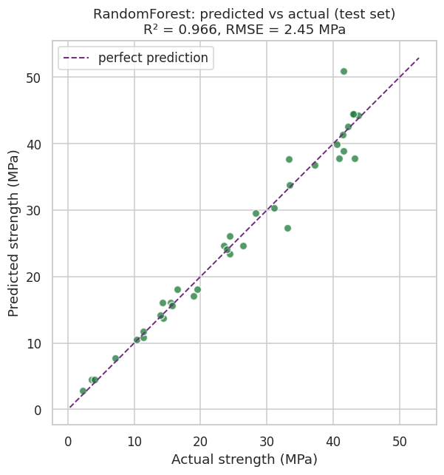
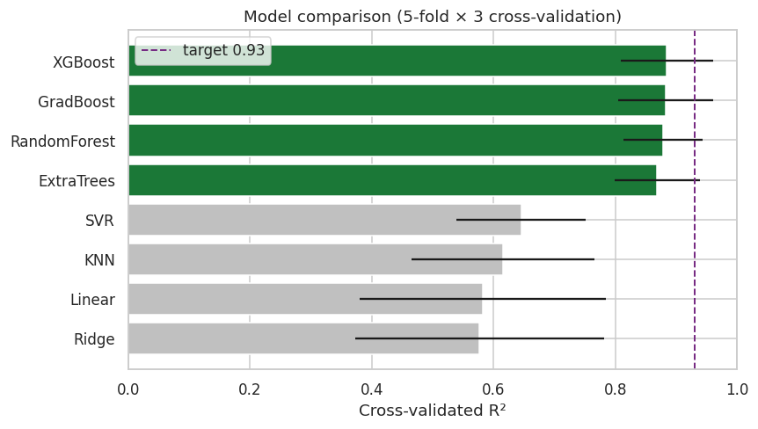
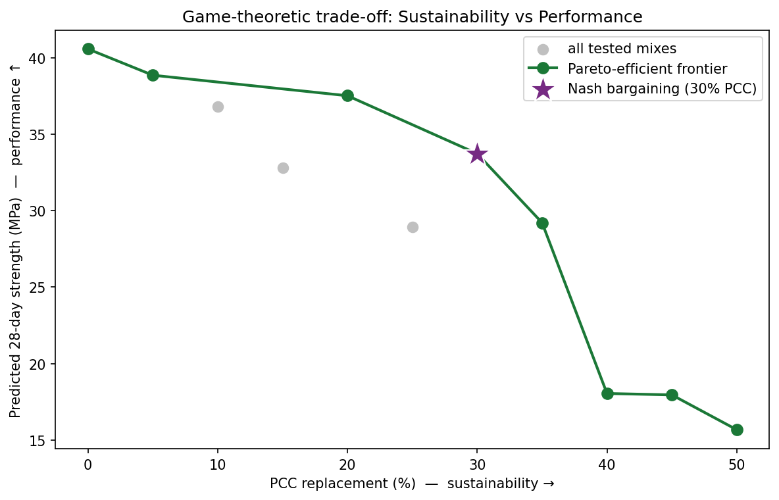
Machine-Learning Prediction & Game-Theoretic Optimization of Sweetcrete
A low-carbon concrete that replaces Portland cement with precipitated calcium carbonate (PCC), a sugar-beet refining byproduct
[Harsha Rouniyar, Rohan Shrestha] · Department of Civil and Environmental Engineering, Idaho State University
Introduction
Feature Selection — Shapley Values
Results
Cement production is costly and carbon-intensive. Sweetcrete substitutes part of the cement with PCC — an abundant byproduct of regional sugar-beet refining — lowering cost and embodied carbon while diverting industrial waste from landfill.
Shapley values (cooperative game theory) ranked candidate features. Five deployment-valid features were kept; cured-specimen measurements were excluded to prevent data leakage.
R² = 0.97
held-out test set
RMSE 2.45 MPa · MAE 1.54 MPa · cross-validated R² ≈ 0.89
Objective
Predict compressive strength from a mix recipe (target R² ≥ 0.93), explain the predictions, and recommend the most sustainable mix that still meets a required strength.
Fig 1. SHAP feature importance (selected = green).
Fig 3. Predicted vs actual strength (test set).
Modeling
Game-Theoretic Optimization
Eight models compared under repeated 5-fold cross-validation; tree/boosting models won. A tuned Random Forest was selected as the final model.
Sustainability vs performance as a two-player game. The Nash bargaining solution identifies ≈30% PCC — the knee before the strength cliff.
Data & Cleaning
178 laboratory specimens (after cleaning)
Design grid: PCC 0–50% × curing age 1–90 days
Recomputed one corrupted strength value; removed one inconsistent record
Cleaned strength range: 2.2–52.6 MPa
Fig 2. Cross-validated R² across candidate models.
Fig 4. Sustainability–performance frontier (★ = Nash).
Conclusions & Future Work
A compact, interpretable Random-Forest model predicts Sweetcrete strength above the 0.93 target, and a game-theoretic analysis pinpoints ≈30% PCC as the balanced optimum between sustainability and strength. The full pipeline is deployed as an interactive decision-support tool.
Future work: decouple water/cement ratio from PCC level, incorporate treated wastewater, add cost and durability objectives, quantify prediction uncertainty, and validate against full-scale field pours.

