Slide 1

BLOGGING TO IMPROVE STUDENT'S LEARNING

Slide 2

INTRODUCTION
Most institutions press their faculty to add technology to their classroom by adopting the Learning Management System—Blackboard, Moodle, etc. Faculty often end up spending hours learning the system and loading the same content that they use in the classroom and finish wondering if the benefit was worth the effort. Kris Kelly notes that blogging encourages higher levels of reasoning because the “focus is not necessarily on the content of the blog, but more on the process of constructing and evaluating knowledge helping us reach the sometimes elusive upper levels – analyzing, evaluating, and creating – of Bloom’s Taxonomy”

Slide 3
ADVANTAGES
It is open for all.
As it is public so we are more attentive to quality of our work.
Blogging creates a person-centered dicussion, as opposed to the topic-centered discussion.
We can get reviews and suggestion from other fellow mates which improves the project's quality.

Slide 4


Creating a blogging website
USER NAME
PASSWORD
LOGIN
Register Forgot Username ?
Forgot Password ?

Slide 5
A user can sign-up which will includes a one time verification of the user ( by a valid institute ID card )
UPLOAD
Choose file to upload your valid institution ID-Card
Next

Slide 6

On this site, user can upload his blog on the topic on their respective institute dashboard.

Slide 7


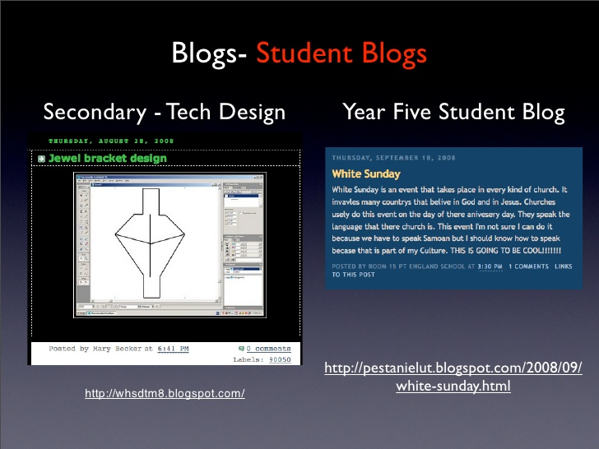
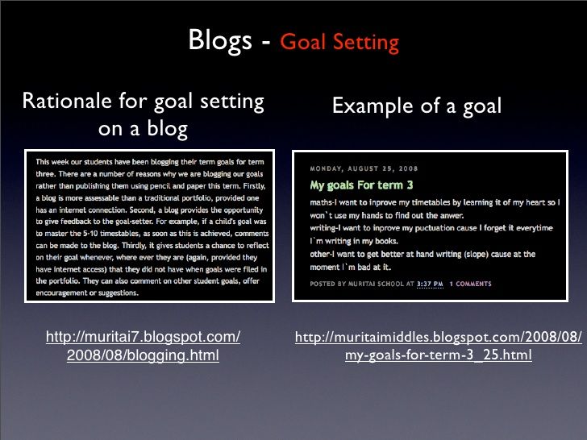
LOGOUT
UPLOAD

Slide 8
Other users from the institute can review and suggest any type of modification in their project which can help the blogger in improving his projects in a better way.
Like
Comment
Share

Slide 9
Conclusion
Now, the project is not only limited to any specified students. It can include the ideas of several other students. So, it includes teamwork, immediate feedback, trust and respect as learning is always in demand.
The best part is that, as a user build resources on his blog to teach others, he may realize that there is a chance to monetize his blog by creating educational products or services online.The only way to become a better writer is to write – pages and pages, day after day and a blog always helps user in that because the more he blog, the more he write – and the better writer he become.

