Slide 1
Introduction
Hospitals and communities are interested in controlling health care costs.
Approximately 17 million people visit the emergency room (ER) every year resulting in increased health care costs.
Technological advances have led us into the Data Age.

Slide 2
The Role of Data Mining
Data mining is a new field aiming at using computers to analyze vast amounts of data to find patters impossible to determine manually.
Can help evaluate medical data, but close attention must be paid to results since data disregards subjective legality and ethics.

Slide 3
Purpose
The question was proposed and tested:
  What factors contribute to the increase or decrease of emergency department visits?
Categories we are testing correlations for:
  Economic Factors
  Social Factors
  Health Factors
  Demographics

Slide 4
Significance
If the factors were known, emergency department visits, hospital expenditures, and number of patients in critical condition could be vastly reduced.
Identifying these factors could also identify groups of people for whom we can deploy outreach programs for.

Slide 5
Hypotheses
Patient income and health care costs will correlate with ER visits as a patient will be more inclined to use preventative services if he/she are financially stable.
Racial composition will have some correlation with ER visits due to inherent cultural biases affecting use of preventative services.
Healthy alternatives in the environment will be correlated with fewer ER visits because they promote a health focused lifestyle.
Better family/social conditions will reduce ER visits because of more available support for people.

Slide 6
The Data
County Data included the following:
Demographics, such as racial composition, age groups, and sex.
Economic attributes, such as household income, health care costs, and unemployment rate.
Social attributes, such as high school graduation rate, violent crime rate, and percent of single-parent households.
Health attributes, such as obesity rate, diabetes rate, and recreational facility rate.
Emergency Department visits from 2008

Slide 7
Methodology
Initial review of data and attribute selection
Excel
Decision tree to determine most significant attributes
Principal component analysis to test independence
Weka
Initial analysis through scatterplots
Excel & Python
Merged data from different sources
filled missing values with mean.
Selection of significant attributes

Slide 8
Python Script
# Merge the files
countyData = pd.merge(countyData, countyData2, how = "inner", on='FIPS',copy=False)
# Drop useless columns like County and State
countyDataML = countyData.drop(['FIPS','County','State', '2008 EmergencyRate','2009 EmergencyRate'],axis = 1)
colNames = countyDataML.columns
# Fill in missing values
imp = Imputer(missing_values='NaN', strategy='mean', axis=0)
countyDataML = imp.fit_transform(countyDataML)
countyDataML = pp.scale(countyDataSVD)
countyDataMLFrame = pd.DataFrame(countyDataML, columns = colNames)
countyDataMLFrame[['FIPS','State','County','2008 EmergencyRate']] = countyData[['FIPS','State','County','2008 EmergencyRate']]
countyDataMLFrame.to_csv("C:\Users\Pradeep\Documents\Clients\Rohan - SciFair\TestAllCountyData.csv")

Slide 9
Scatter Plots for Correlations
Scatter Plots were created through Microsoft Excel for an initial analysis of the data.
Dependent Variable: ER Visits
Independent Variables (listed at the top of the each chart): Economic Factors, Social factors, Health Factors, Demographics.

Slide 10
Social Factors
-Red means positive correlation which indicates it correlates with more ER visits.
-Green means negative correlation which indicates it correlates with less ER visits.
-Grey indicates very little correlation.

Slide 11
Economic Factors
-Red means positive correlation which indicates it correlates with more ER visits.
-Green means negative correlation which indicates it correlates with less ER visits.
-Grey indicates very little correlation.

Slide 12
Demographics
-Red means positive correlation which indicates it correlates with more ER visits.
-Green means negative correlation which indicates it correlates with less ER visits.
-Grey indicates very little correlation.

Slide 13
Health Factors
-Red means positive correlation which indicates it correlates with more ER visits.
-Green means negative correlation which indicates it correlates with less ER visits.
-Grey indicates very little correlation.

Slide 14
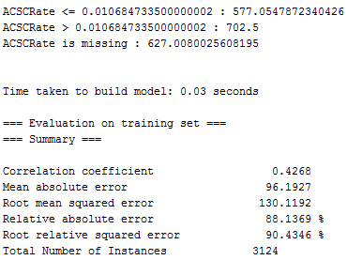
Decision Tree
Using decision trees via Weka I created a list of attributes ranked by effect on ER visits.
Below is a sample run of the 1 level decision tree.

Slide 15
Results
1. ACSC Rate
2. Health Care Costs
3. Teen Birth Rate
4. Some College
5. Percent Diabetic
6. Single Parent Households
7. Unemployed
8. Household Income
9. Percent Race African American
10. Smoker Rate
11. Particle Pollution M25
12. Obesity Rate
13. Forgo Expensive Care
14. Percent Physically Inactive
15. STD Rate
16. Excessive Drinking Rate
17. Limited Access Healthy Foods
18. No Social Emotional Support
19. Percent Fast Foods
20. High School Graduation Rate
21. Dentist Rate
22. Percent Rural
23. Percent Female
24. Violent Crime Rate
25. Prime Care Physician Rate
26. Percent Race Native
27. Recreational Facility Rate
28. HIV Rate
29. Percent Race White
30. Uninsured
31. Percent Race Hispanic
32. Percent Race Asian

Slide 16
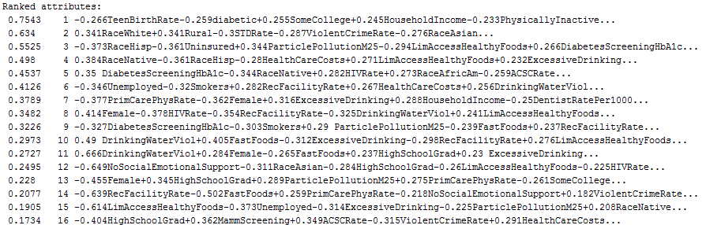
PCA
PCA groups attributes occurring in same proportion which usually have underlying causal variable.
Approach for reducing attributes for data mining.
Needs to be fully interpreted.

Slide 17
Discussion
By inverting the ranks on the list and taking the mean of each category of attributes I was able to decide which categories effect ER visits the most.
The means are as follows:
  1. Economic Factors – 22.16
  2. Social Factors – 17.6
  3. Health Factors – 16.07
  4. Demographics – 7.42
Economic and social factors had the largest correlation with ER visits.
It is important to note that by discarding other demographics, percent race African American had a score of 23.

Slide 18
Sources of Error
Data is diluted due to the fact that counties already contain averaged out data over it’s diverse population.
Missing values in the data created problems during analysis. To compensate the missing data was filled with mean values
Outliers: some of the values are not consistent with the rest of the population.

Slide 19
Conclusion
Outreach programs should be deployed for people with worse family/social conditions.
Subsidized care should also be given to those who are economically unstable. This would encourage them to visit more often so they will be in better health and thereby reduce ER visits.
The costs for these would be covered by the money saved from the decrease in ER visits.
After finding what causes the correlation between percent race African American and ER visits, an outreach program should be used to eliminate the cause.

Slide 20
Further Work
I plan to fully interpret the results of the principal component analysis.
I also plan to conduct independent component analysis which is similar to principal component analysis.
I plan to find the cause for the correlation between percent race African American and ER visits.

