Slide 1


Consumer Goods Ad_Hoc Insights

Slide 2
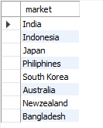
Request 1
Provide the list of markets in which customer “Atliq Exclusive” operates its business in the APAC region.
Query:
SELECT distinct market FROM gdb023.dim_customer where customer = 'Atliq Exclusive' and region = 'APAC';
Output

Slide 3
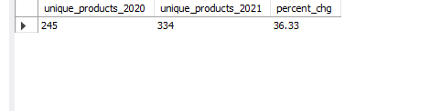
Request 2
What is the percentage of unique product increase in 2021 vs. 2020? The final output contains these fields,
unique_products_2020 unique_products_2021 percentage_chg
Output

Slide 4
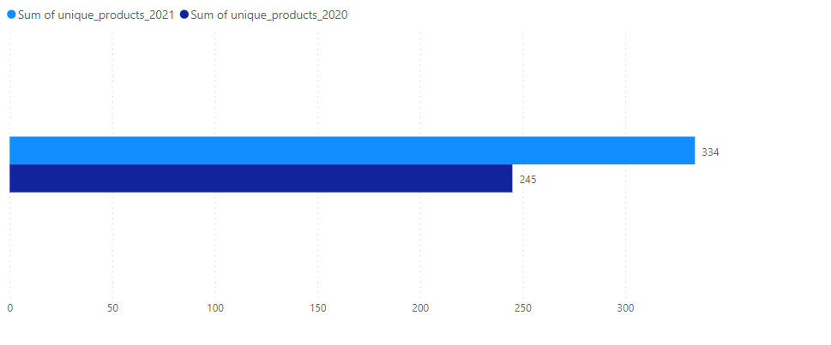
Data to Visual

Slide 5
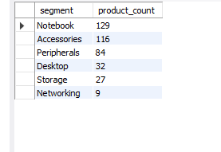
Request 3
Provide a report with all the unique product counts for each segment and sort them in descending order of product counts.
The final output contains 2 fields: Segment, product_count
Output

Slide 6
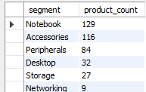
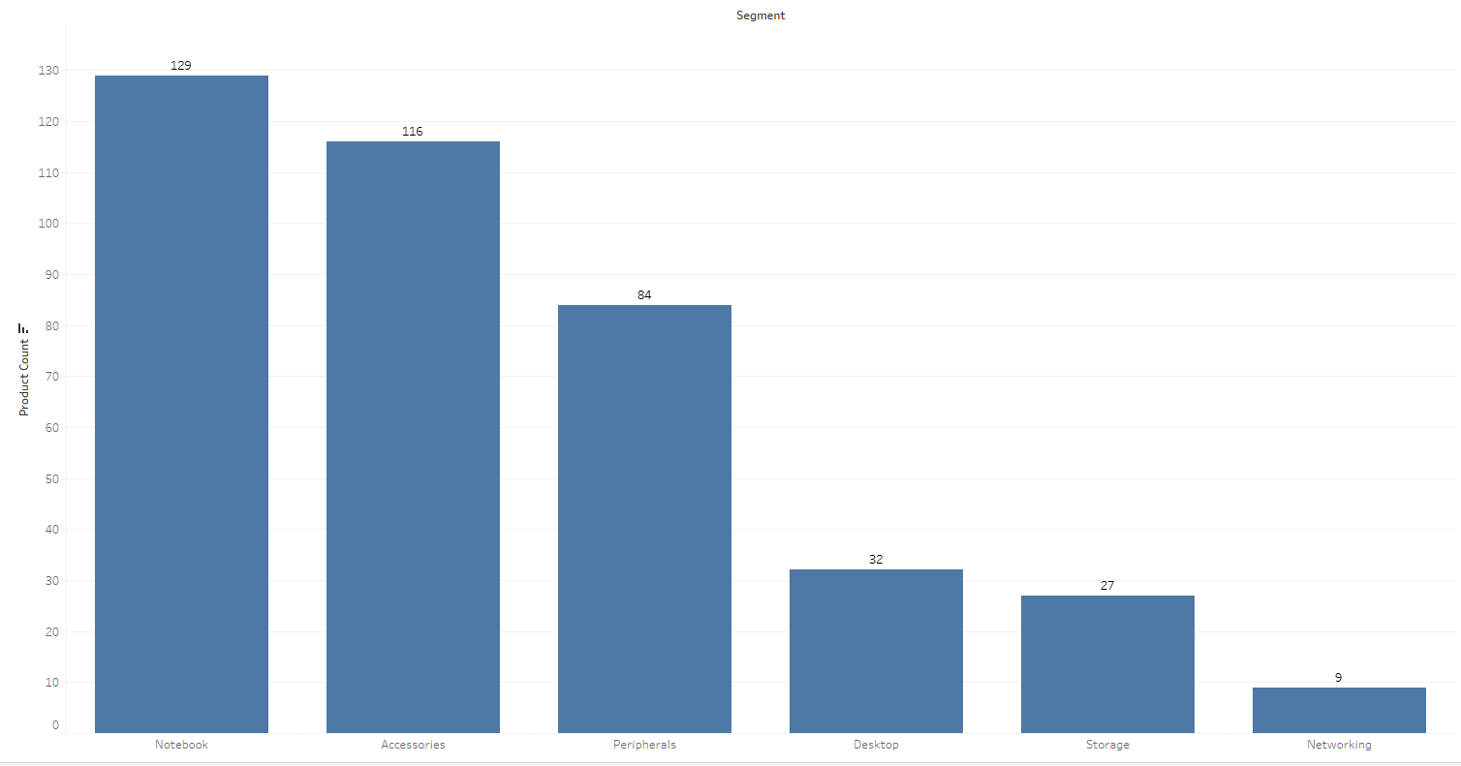
Data to Visual

Slide 7
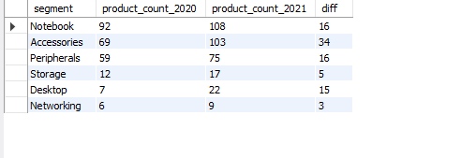
Request 4
Follow-up: Which segment had the most increase in unique products in 2021 vs 2020? The final output contains these fields,
Segment
product_count_2020
product_count_2021
difference
Output

Slide 8
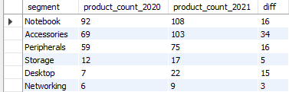
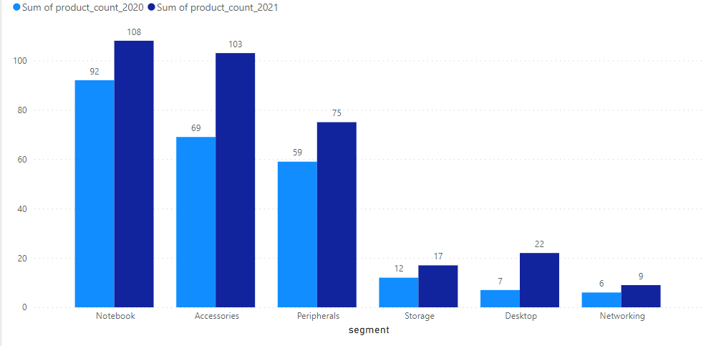
Data to Visual

Slide 9

Request 5
Get the products that have the highest and lowest manufacturing costs. The final output should contain these fields:
product_code, product, manufacturing_cost
Output

Slide 10
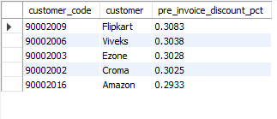
Request 6
Generate a report which contains the top 5 customers who received an average high pre_invoice_discount_pct for the fiscal year 2021 and in the Indian market. The final output contains these fields,
customer_code, customer, average_discount, percentage
Output

Slide 11
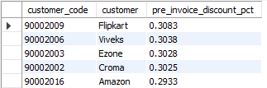
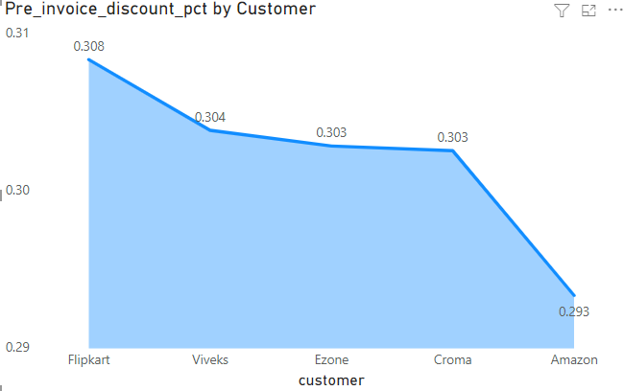
Data to Visual

Slide 12
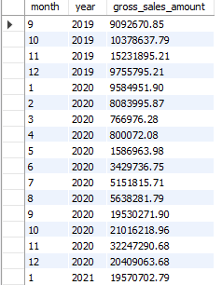
Request 7
Get the complete report of the Gross sales amount for the customer “Atliq Exclusive” for each month. This analysis helps to get an idea of low and high-performing months and take strategic decisions.
The final report contains these columns:
Month Year, Gross sales Amount
Output

Slide 13
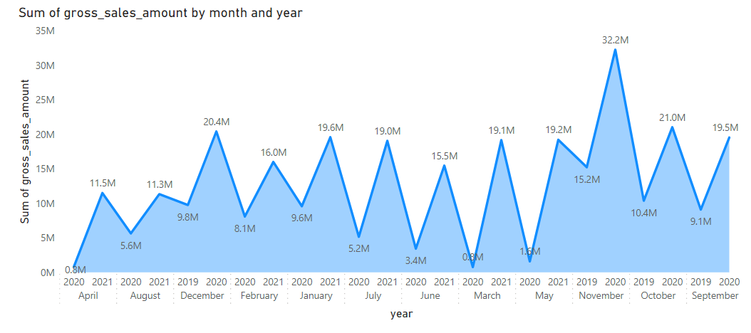
Data to Visual

Slide 14

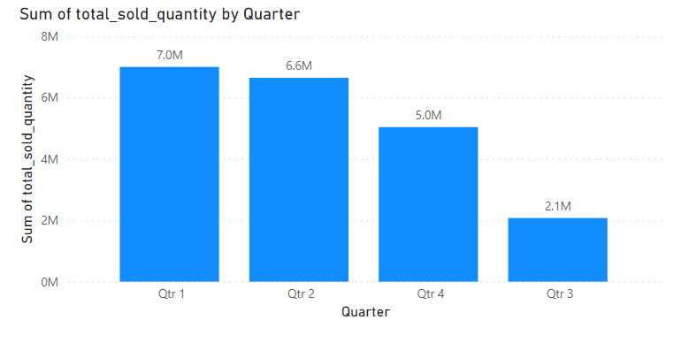
Request 8
In which quarter of 2020, got the maximum total_sold_quantity? The final output contains these fields sorted by the total_sold_quantity, Quarter andtotal_sold_quantity
Output
Visual

Slide 15

Request 9
Which channel helped to bring more gross sales in the fiscal year 2021 and the percentage of contribution? The final output contains these fields,
channel, gross_sales_mln, percentage
Output

Slide 16
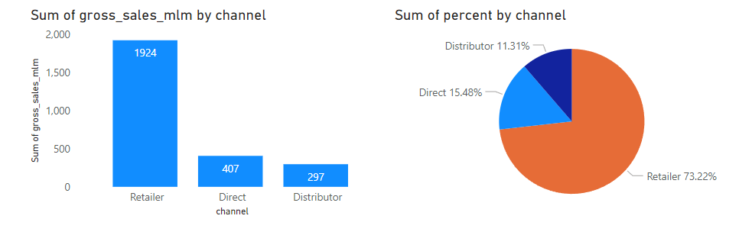
Data to Visual

Slide 17
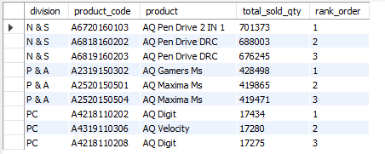
Request 10
Get the Top 3 products in each division that have a high total_sold_quantity in the fiscal_year 2021? The final output contains these fields,
Division,
product_code, Output product,
total_sold_quantity,
rank_order

