Slide 1
i
iNSIGHTS
RESEARCH & INNOVATION COPILOT
AI-Powered Research & Innovation Copilot for Students
“Search Less. Solve More. — with iNSIGHTS Layer 2”
8 / 8 LAYER 2 MODULES
FULL-STACK: REACT + NODE + SQLITE
WORKING PRODUCT
Team Name: FusionX
Team Members: Rohan Tarke, Khushi Mokani, Aarya Deshpande, Kalpesh Devre
iNSIGHTS TRACK • FINAL ROUND SUBMISSION

Slide 2
PROBLEM STATEMENT
Idea-to-Project Is Broken
Millions of students struggle to convert ideas into working projects — scattered across Google, YouTube, GitHub, papers, and forums.
What's Happening
Existing Approaches
Hours spent searching Google, YouTube, GitHub, papers & forums — per idea
Information is scattered, outdated, duplicated, or unreliable
Hard to validate an idea or pick the right approach before building
No single source shows research, architecture, and a build plan together
Google / ChatGPT search — no citations, no structure
Manual arXiv / GitHub browsing — slow, easy to miss gaps
Generic AI chatbots — no persistent workspace or plan
THE KEY GAP
Who's Affected
No single tool takes you from idea → validated research → implementation plan.
Students, hackathon teams, and early-stage developers trying to turn a raw idea into an implementation-ready project — quickly and correctly.
iNSIGHTS • 02 / 09

Slide 3
PROPOSED SOLUTION
Meet iNSIGHTS
A full-stack AI copilot — from a raw idea to a cited, cluster-organized, implementation-ready plan, with a Telegram companion that keeps you on track.
💡
01
🔍
02
🧠
03
🚀
04
📚
05
Idea Input
→
DeepSearch
→
Clustering
→
Project HUB
→
Workspaces + Agent
Type an idea; pick a summary language (8 supported)
Tavily + GitHub + arXiv merged & cited in parallel
Auto-grouped into 3–6 labeled thematic clusters
Architecture, stack, milestones & datasets — cached
Save citations; get /status on Telegram
Why It's Better
Verifiable citations, not guesses
Fully generated & cached project plans
A Telegram companion — not just a webpage
iNSIGHTS • 03 / 09

Slide 4
SYSTEM DESIGN
System Architecture
FRONTEND — React 19 + TypeScript + Tailwind CSS v4 (Vite)
Idea Input
DeepSearch + Clusters
Project HUB
Dashboard
Workspaces
↓ REST /api (JSON)
BACKEND — Node.js + Express 5 (5 route-mounted modules)
platform
search
clustering
planner
agent
Dashboard +
Workspaces
DeepSearch +
Real-time Intel
Knowledge
Clustering
Project
HUB
AI Agent
(Telegram)
↓ SQL queries + external API calls
DATABASE — SQLite (better-sqlite3)
EXTERNAL SERVICES
sessions · sources · plans · clusters · workspaces · workspace_items · telegram_links
Tavily (web)
GitHub API
arXiv API
Groq Llama-3.3-70B
Telegram Bot API
iNSIGHTS • 04 / 09

Slide 5
TECH STACK & API
Under the Hood
Tech Stack
Key REST Endpoints
POST /api/sessions
GET /api/sessions/:id/deepsearch
POST /api/sessions/:id/refresh
GET /api/sessions/:id/clusters
GET /api/sessions/:id/plan
GET /api/dashboard/:userId
GET /api/workspaces/:userId
POST /api/workspaces
POST /api/workspaces/:id/save
DELETE /api/workspaces/:id/items/:itemId
Frontend
React 19
TypeScript
Tailwind CSS v4
Vite
Lucide Icons
Backend
Node.js
Express 5
better-sqlite3
AI & Data Providers
Groq — Llama 3.3 70B
Tavily
GitHub API
arXiv API
Telegram Bot API
iNSIGHTS • 05 / 09

Slide 6
iNSIGHTS LAYER 2 — 8 / 8 MODULES IMPLEMENTED
Key Features
🔍
🌐
🧠
🚀
DeepSearch
Real-time Web Intel
Knowledge Clustering
Project HUB
Multi-source citation-backed synthesis: Tavily + GitHub + arXiv.
On-demand refresh surfaces new sources; citations stay stable.
Groups sources into 3–6 auto-labeled themes.
Architecture, stack, milestones & datasets — cached, exportable.
📊
📚
🤖
🌍
Personalized Dashboard
Research Workspaces
AI Agents
Multilingual Support
Ideas, sources & plans tracked at a glance.
Organize citations; one-click BibTeX / IEEE export.
Telegram bot: /status, /latest, /help & scheduled reminders.
Summaries in 8 languages — incl. Hindi, Marathi, Tamil.
iNSIGHTS • 06 / 09

Slide 7
WHY IT MATTERS
Impact & Feasibility
Who Benefits & Real-World Impact
Scalability & Feasibility
Students, hackathon teams & early-stage developers
Cuts idea-to-plan time from days to minutes
Reduces risk from outdated or unreliable information
Builds confidence with verifiable, cited research
Modular Express backend — each Layer 2 capability is its own module
SQLite today, drop-in swap to Postgres for real multi-user scale
Groq's fast free-tier inference keeps AI calls cheap & responsive
Optional features (Telegram bot, Tavily) degrade gracefully if unset
8 / 8
10x
100%
Layer 2 modules integrated
Faster idea-to-plan
Citation-backed research
iNSIGHTS • 08 / 09

Slide 8
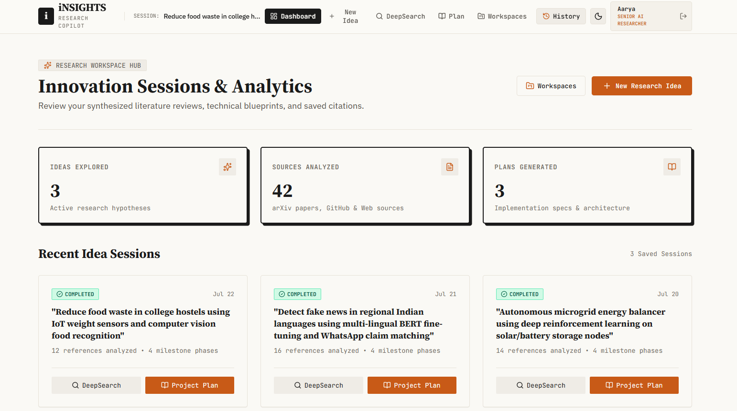
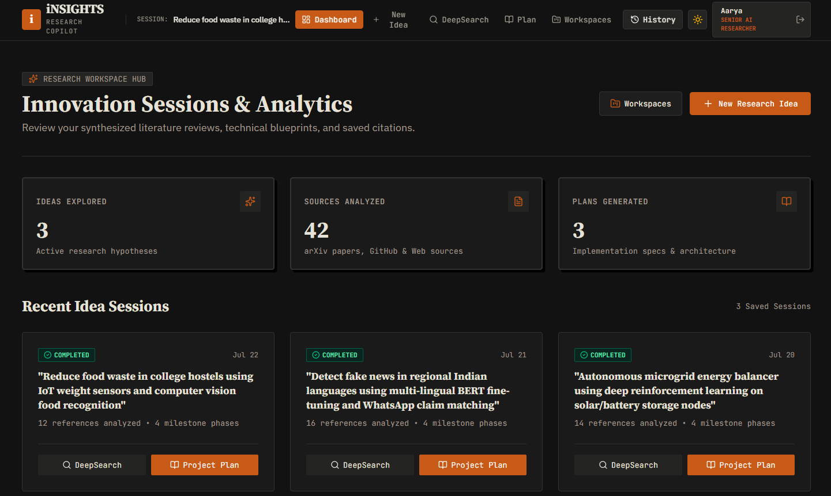
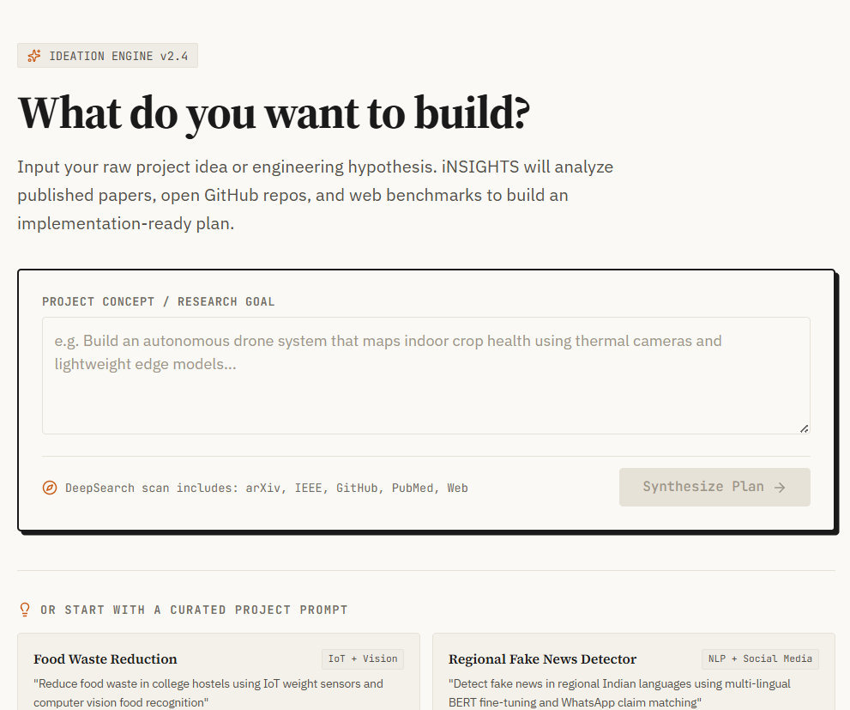
DASHBOARD — LIGHT & DARK MODE
Live Demo
LIGHT MODE
DARK MODE
IDEATION
“iNSIGHTS turns any raw idea into an implementation-ready project — in minutes, not weeks.”
✓ 8/8 Layer 2 modules
✓ Full-stack working prototype
✓ Verifiable citations
✓ Dual-theme, production UI

