Slide 1
SMTP
Simple Mail Transfer Protocol

Slide 2
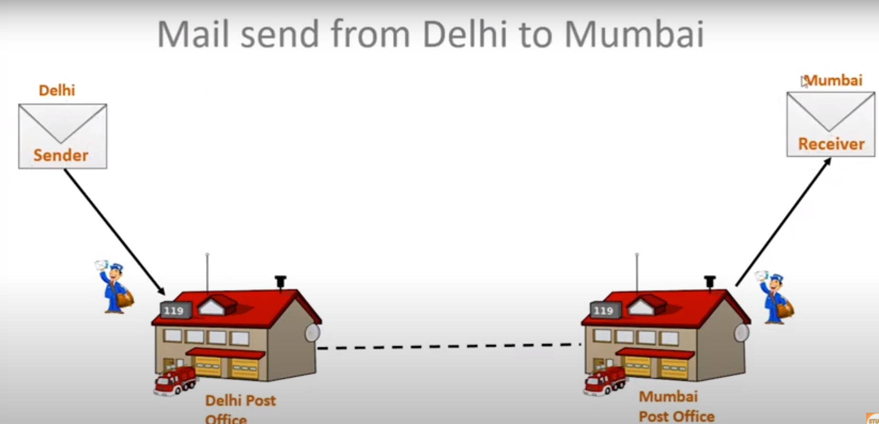

Slide 3
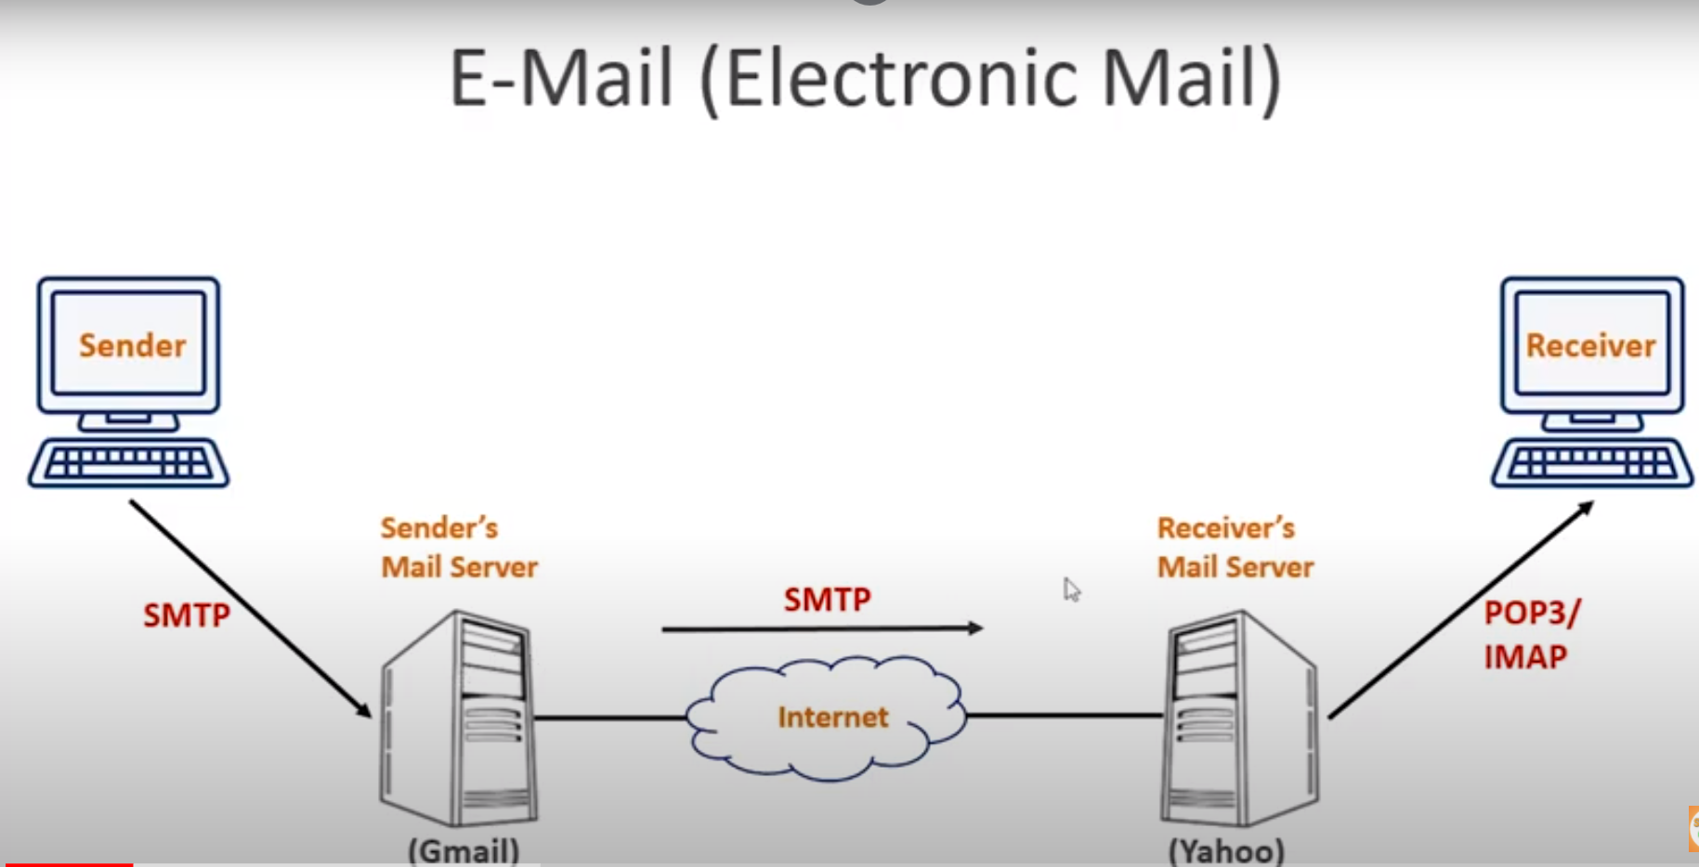
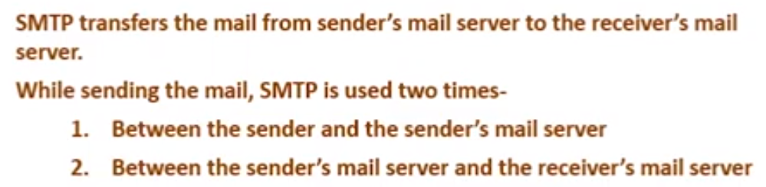

Slide 4
SMTP(SIMPLE MAIL TRANSFER PROTOCOL)
SMTP is a set of communicating guidelines that allow to transmit an e-mail over the internet.
It is a program used for sending messages to other computer users based on e-mail addresses.
The main purpose of SMTP is used to set up communication rule between servers.
It is an application layer protocol.
SMTP uses TCP at the transport layer.
SMTP uses TCP port number 25 and Port 465.
Port 25 – Default SMTP non- encrypted port.
Port 465 – Send message using SMTP securely
Port 587 – Default SMTP encrypted port.
SMTP is a connection oriented protocol.
SMTP is a push protocol.

Slide 5
SMTP & MIME
SMTP is a pure text based protocol-
SMTP can only handle the messages containing 7 bit ASCII text.
SMTP can’t transfer images, videos, audio etc.
SMTP can’t transfer executable file and binary objects.
SMTP can’t transfer the text data of other languages like French, Japanese, Chinese etc(represent 8 bit codes).
MIME extends the limited capabilities of email-
Multipurpose Internet Email Extension is an extension to the internet email protocol.
It extends the limited capabilities of SMTP to send and receive audio, video, images etc.
MIME was specially designed for SMTP.

Slide 6
SMTP Commands
HELO – identifies domain name at receiver server.
MAIL FROM – Verify the sender’s address.
RCPT TO - Verify the receiver address.
SIZE - Indicates size of the email.
DATA - Check the flow of data stream.
QUIT - Terminate the SMTP connection.
VRFY – Does email address exist or not?

Slide 7
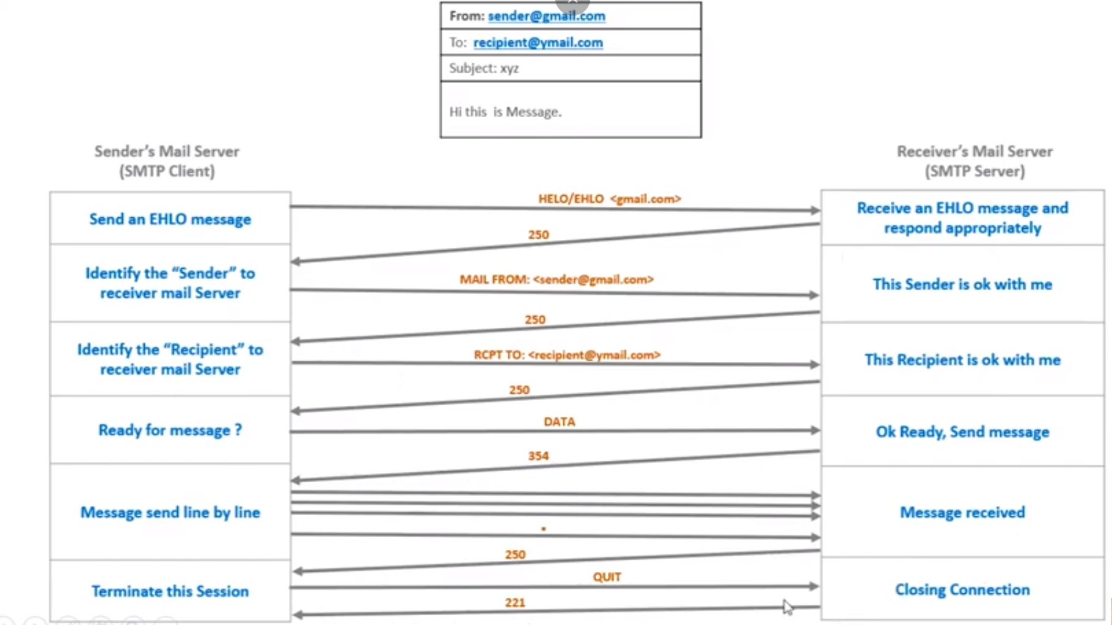

Slide 8
Wait…..
It is not over yet……

