Slide 1

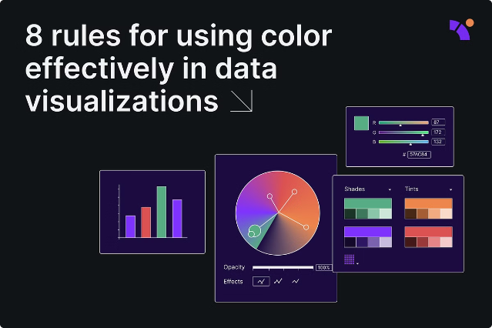

Data Visualization with Python
Dive into the world of data visualization using Python libraries. Explore how to manipulate data, create informative visuals, and build interactive applications.
by Rohan Thakur

Slide 2

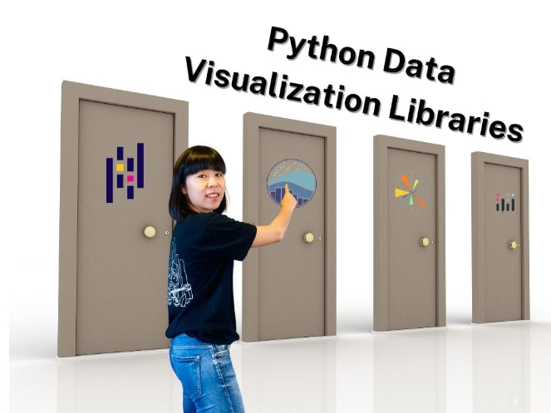
Overview of Python Libraries for Data Visualization
1
Pandas
A fundamental library for data manipulation, cleaning, and preparation. It offers powerful data structures like Series and DataFrames.
2
Matplotlib
The core library for creating static, interactive, and animated visualizations in Python. It provides a wide range of plotting functionalities.
3
Seaborn
A high-level library that builds upon Matplotlib. It focuses on statistical data exploration and visualization, providing elegant and informative plots.
4
Streamlit
A framework for building interactive data applications. It allows you to create web apps with minimal code, enabling you to share your insights with others.

Slide 3
Pandas: Data Manipulation and Preparation
Data Loading
Data Cleaning
Data Aggregation
Pandas seamlessly imports data from various formats, including CSV, Excel, and JSON files.
Handle missing values, remove duplicates, and transform data types for analysis.
Group data based on specific criteria, calculate summary statistics, and create new features.
Read data using pandas.read_csv(), pandas.read_excel(), or pandas.read_json()
Use methods like .fillna(), .dropna(), and .astype()
Employ .groupby(), .agg(), and .transform() for data aggregation.

Slide 4
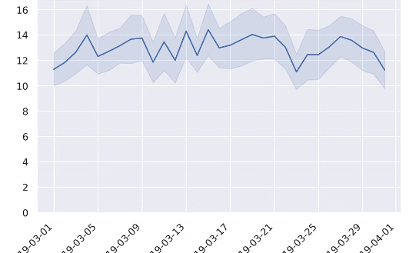
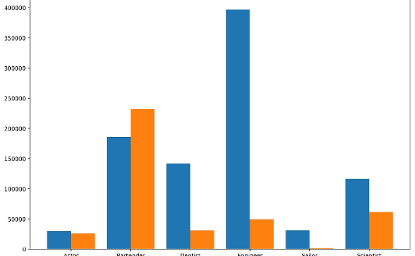
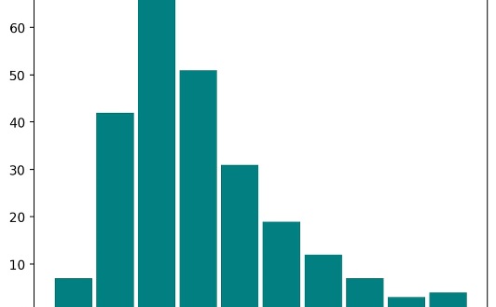
Matplotlib: Creating Basic Plots and Charts
Line Plots
Bar Charts
Histograms
Visualize trends and patterns over time, showcasing relationships between variables.
Compare categories or groups using bars, ideal for displaying categorical data.
Display the distribution of a single variable, showing the frequency of values within specific ranges.

Slide 5

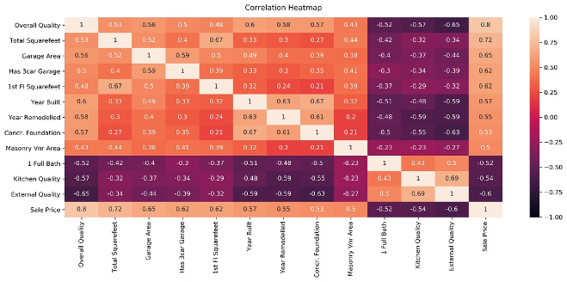

Seaborn: Advanced Statistical Visualizations
Type
Description
Heatmaps
Represent relationships between two variables, highlighting correlations with color intensity.
Scatter Plots
Show the relationship between two continuous variables, revealing patterns and clusters.
Box Plots
Display the distribution of a variable across different categories, emphasizing outliers and central tendencies.

Slide 6


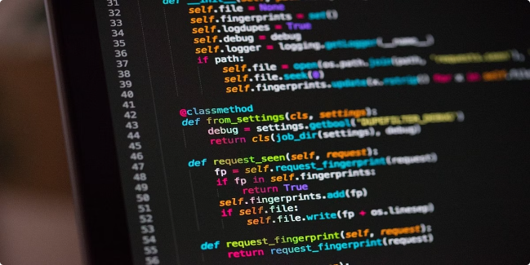


OS: Integrating with the Operating System
File System Interaction
Access and manipulate files and directories using OS module functions like mkdir(), chdir(), and getcwd().
Process Management
Start, stop, and interact with processes using commands like os.system() or subprocess.run().
Environment Variables
Read and manipulate environment variables to customize application behavior based on system configuration.

Slide 7

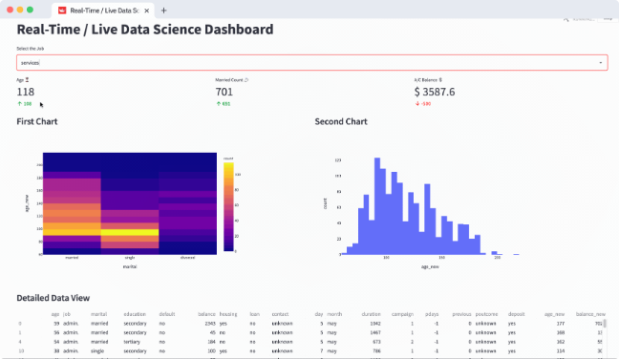
Streamlit: Building Interactive Data Apps
1
Data Loading and Preparation
Import data and prepare it for visualization using Pandas.
2
Visualization
Create interactive visualizations using Streamlit components, such as charts, maps, and tables.
3
User Interaction
Incorporate widgets like sliders, checkboxes, and text inputs to allow user interaction and filtering.

Slide 8

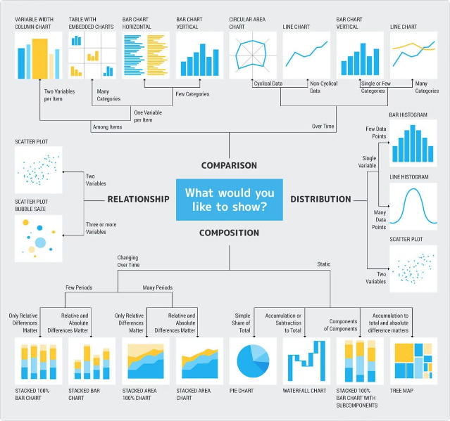
Conclusion and Key Takeaways
Python libraries provide powerful tools for data visualization. By combining the capabilities of Pandas, Matplotlib, Seaborn, and Streamlit, you can transform raw data into informative and interactive insights.

