Slide 1

SMART INDIA HACKATHON 2026
ARGUS 🕵
Explainable Dark-Web Threat Actor De-anonymization & Attribution Platform
Problem Statement: Dark Web Threat Actor De-anonymization · PS Category: Software
PS ID
26151
THEME
Blockchain & Cybersecurity
ORGANIZATION
NTRO
TEAM
Nexus2.O • 164739
FROM FRAGMENTED CLUES TO EXPLAINABLE INTELLIGENCE

Slide 2
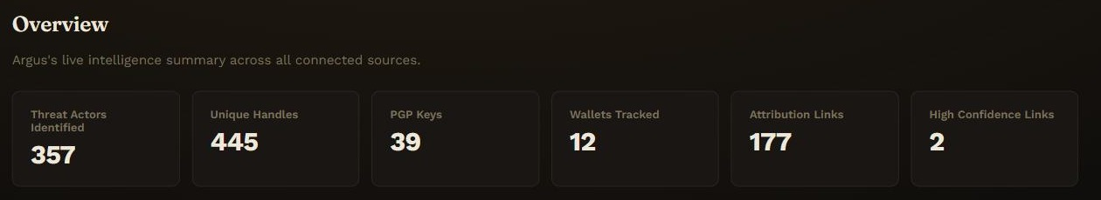
SMART INDIA HACKATHON 2026
The Problem → Our Solution
Dark-web investigations are fragmented across identities, platforms, infrastructure and linguistic traces.
Fragmented Clues
ARGUS
Unified Intelligence
01
Infrastructure
De-anonymization
👤 Pseudonyms
📈 Forums & Markets
Cross-Platform
Actor Correlation
🕸 Actor Graph
02
🔗 Evidence Chain
🖥 Infrastructure
📊 Confidence Score
🔐 Wallets & PGP
AI Persona
Attribution
📋 Explainable Attribution
03
🔗 Linguistic Traces
COLLECT
CORRELATE
ANALYZE
ATTRIBUTE
EXPLAIN

Slide 3
SMART INDIA HACKATHON 2026
Technical Approach
From raw intelligence to explainable, evidence-backed attribution.
🗄
Data
Sources
⚙
Ingestion
📄
Normalization
🧠
Multi-Modal
Analysis
🔗
Entity
Resolution
🕸
Neo4j
Evidence Graph
📈
Attribution
Engine
🖥
ARGUS
Dashboard
📡
Infrastructure
Analysis
📇
Identity / IOC
Extraction
✍
Stylometry
(Burrows’ Delta)
📉
Behavioral
Analysis
Key Metrics
5
Infrastructure
signals checked
65/20/15%
Infrastructure /
Identity / Behavior
6 HRS
Autonomous
re-collection
3
Export formats
CSV / JSON / PDF
Technology Stack
React + TS | FastAPI | Python | PostgreSQL | Neo4j | Redis | Celery | MISP

Slide 4
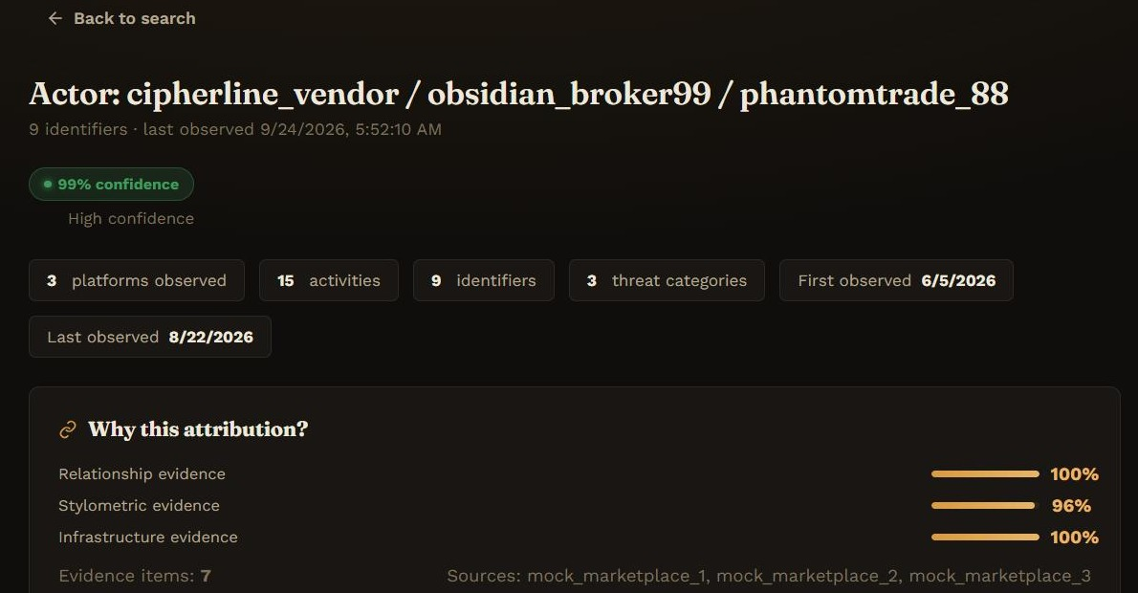
SMART INDIA HACKATHON 2026
Feasibility and Viability
Real-world challenges, practical solutions, working prototype.
Challenge
Our Engineering Response
Actor Profile (Evidence)
📡 Restricted / changing
dark-web sources
Authorized intelligence feeds + public research datasets + controlled datasets
🔍 Sparse or incomplete
evidence
Multi-signal attribution across infrastructure, identity, and behaviour
❌ False attribution
Confidence scoring + evidence provenance + explainability
🔄 Dynamic / migrated
personas
Temporal analysis + incremental re-analysis every 6 hours
🔒 Sensitive data
Data minimization + controlled, authorized sources only
WORKING PROTOTYPE
NOT JUST A CONCEPT
Why ARGUS is Feasible
✅ Functional prototype — not a concept slide
✅ Working Neo4j relationship graph
✅ Stylometric analysis (Burrows’ Delta)
✅ MISP threat-intel integration
✅ CSV / JSON / PDF export

Slide 5
SMART INDIA HACKATHON 2026
Impact and Benefits
Transforming dark-web intelligence into actionable insights.
Fragmented
Intelligence +
Manual Correlation
ARGUS
Unified
Evidence Graph
Explainable
Attribution
Faster
Investigation
🛡
LAW ENFORCEMENT
✓ Actor attribution
✓ Evidence discovery
✓ Investigation timelines
🏛
NATIONAL SECURITY
✓ Threat ecosystem mapping
✓ Infrastructure intelligence
✓ Actor monitoring
👥
CYBER THREAT INTEL TEAMS
✓ Cross-platform correlation
✓ IOC enrichment
✓ Threat actor profiling
👤
SECURITY RESEARCHERS
✓ Persona evolution
✓ Behavioural analysis
✓ Dark-web ecosystem research
Key Outcomes
4
Real-world OSINT
sources integrated
6 HRS
Autonomous
re-collection cycle
3
Attribution signals
fused per actor
100%
Evidence traced
to source

Slide 6
SMART INDIA HACKATHON 2026
Research and References
Built on established research, proven methods and real intelligence sources.
📡 TOR / DARK-WEB
✍ STYLOMETRY
🛡 THREAT INTELLIGENCE
🔗 GRAPH / AI
✓ Tor hidden services
✓ Onion infrastructure research
✓ Authorship attribution
✓ Burrows’ Delta method
✓ MISP (CIRCL, botvrij.eu)
✓ IOC correlation
✓ Entity resolution
✓ Knowledge graphs (Neo4j)
Research
Foundations
ARGUS Investigator Dashboard
ARGUS
Capabilities
Explainable
Outputs

