Slide 1
Django project- to do
S M Rohanul Islam

Slide 2
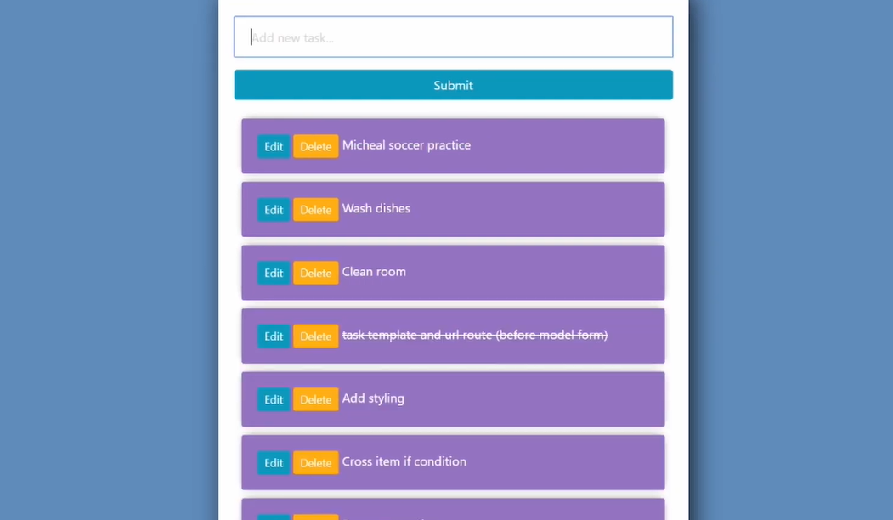
Interface:

Slide 3
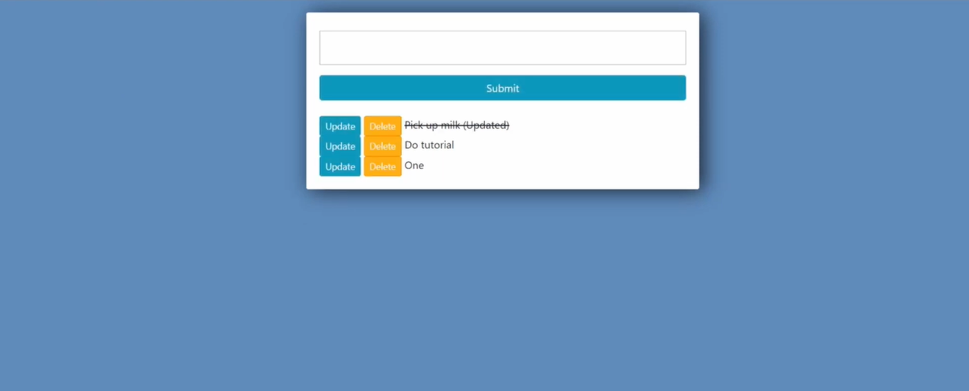
Update:

Slide 4
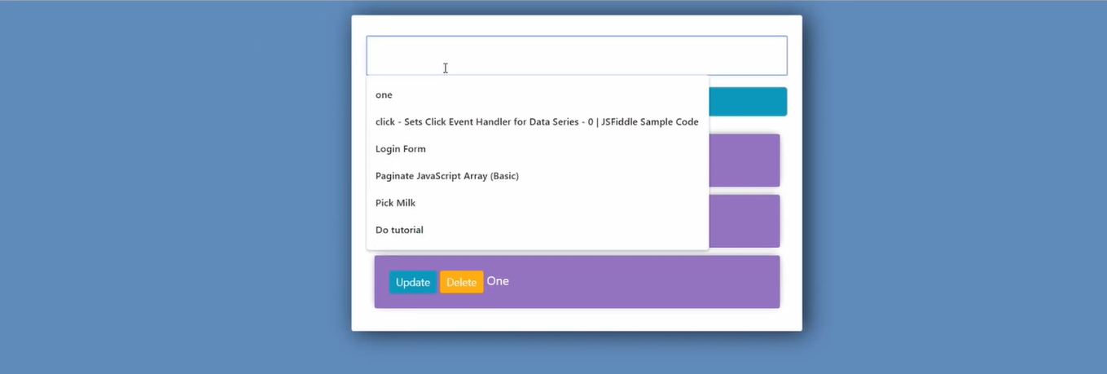
Search:

Slide 5
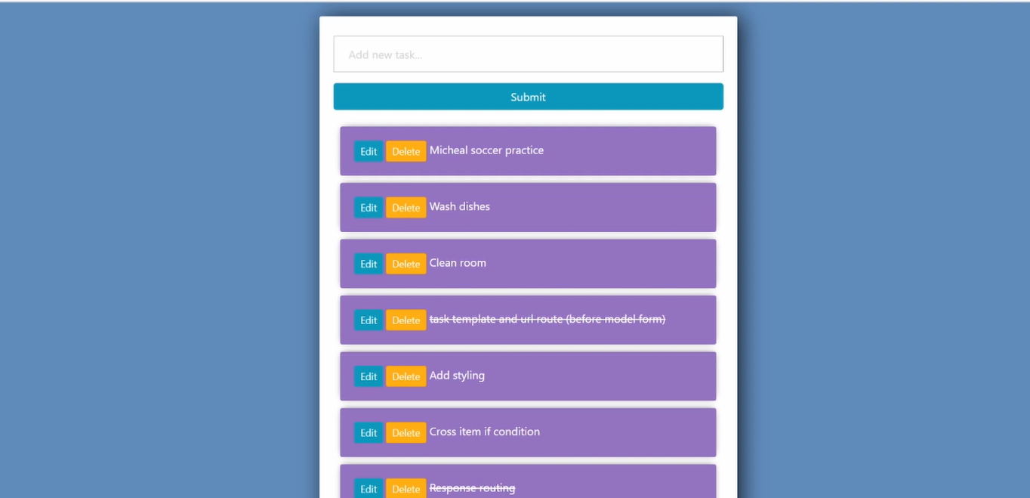
Creating task: Write and submit

