Slide 1
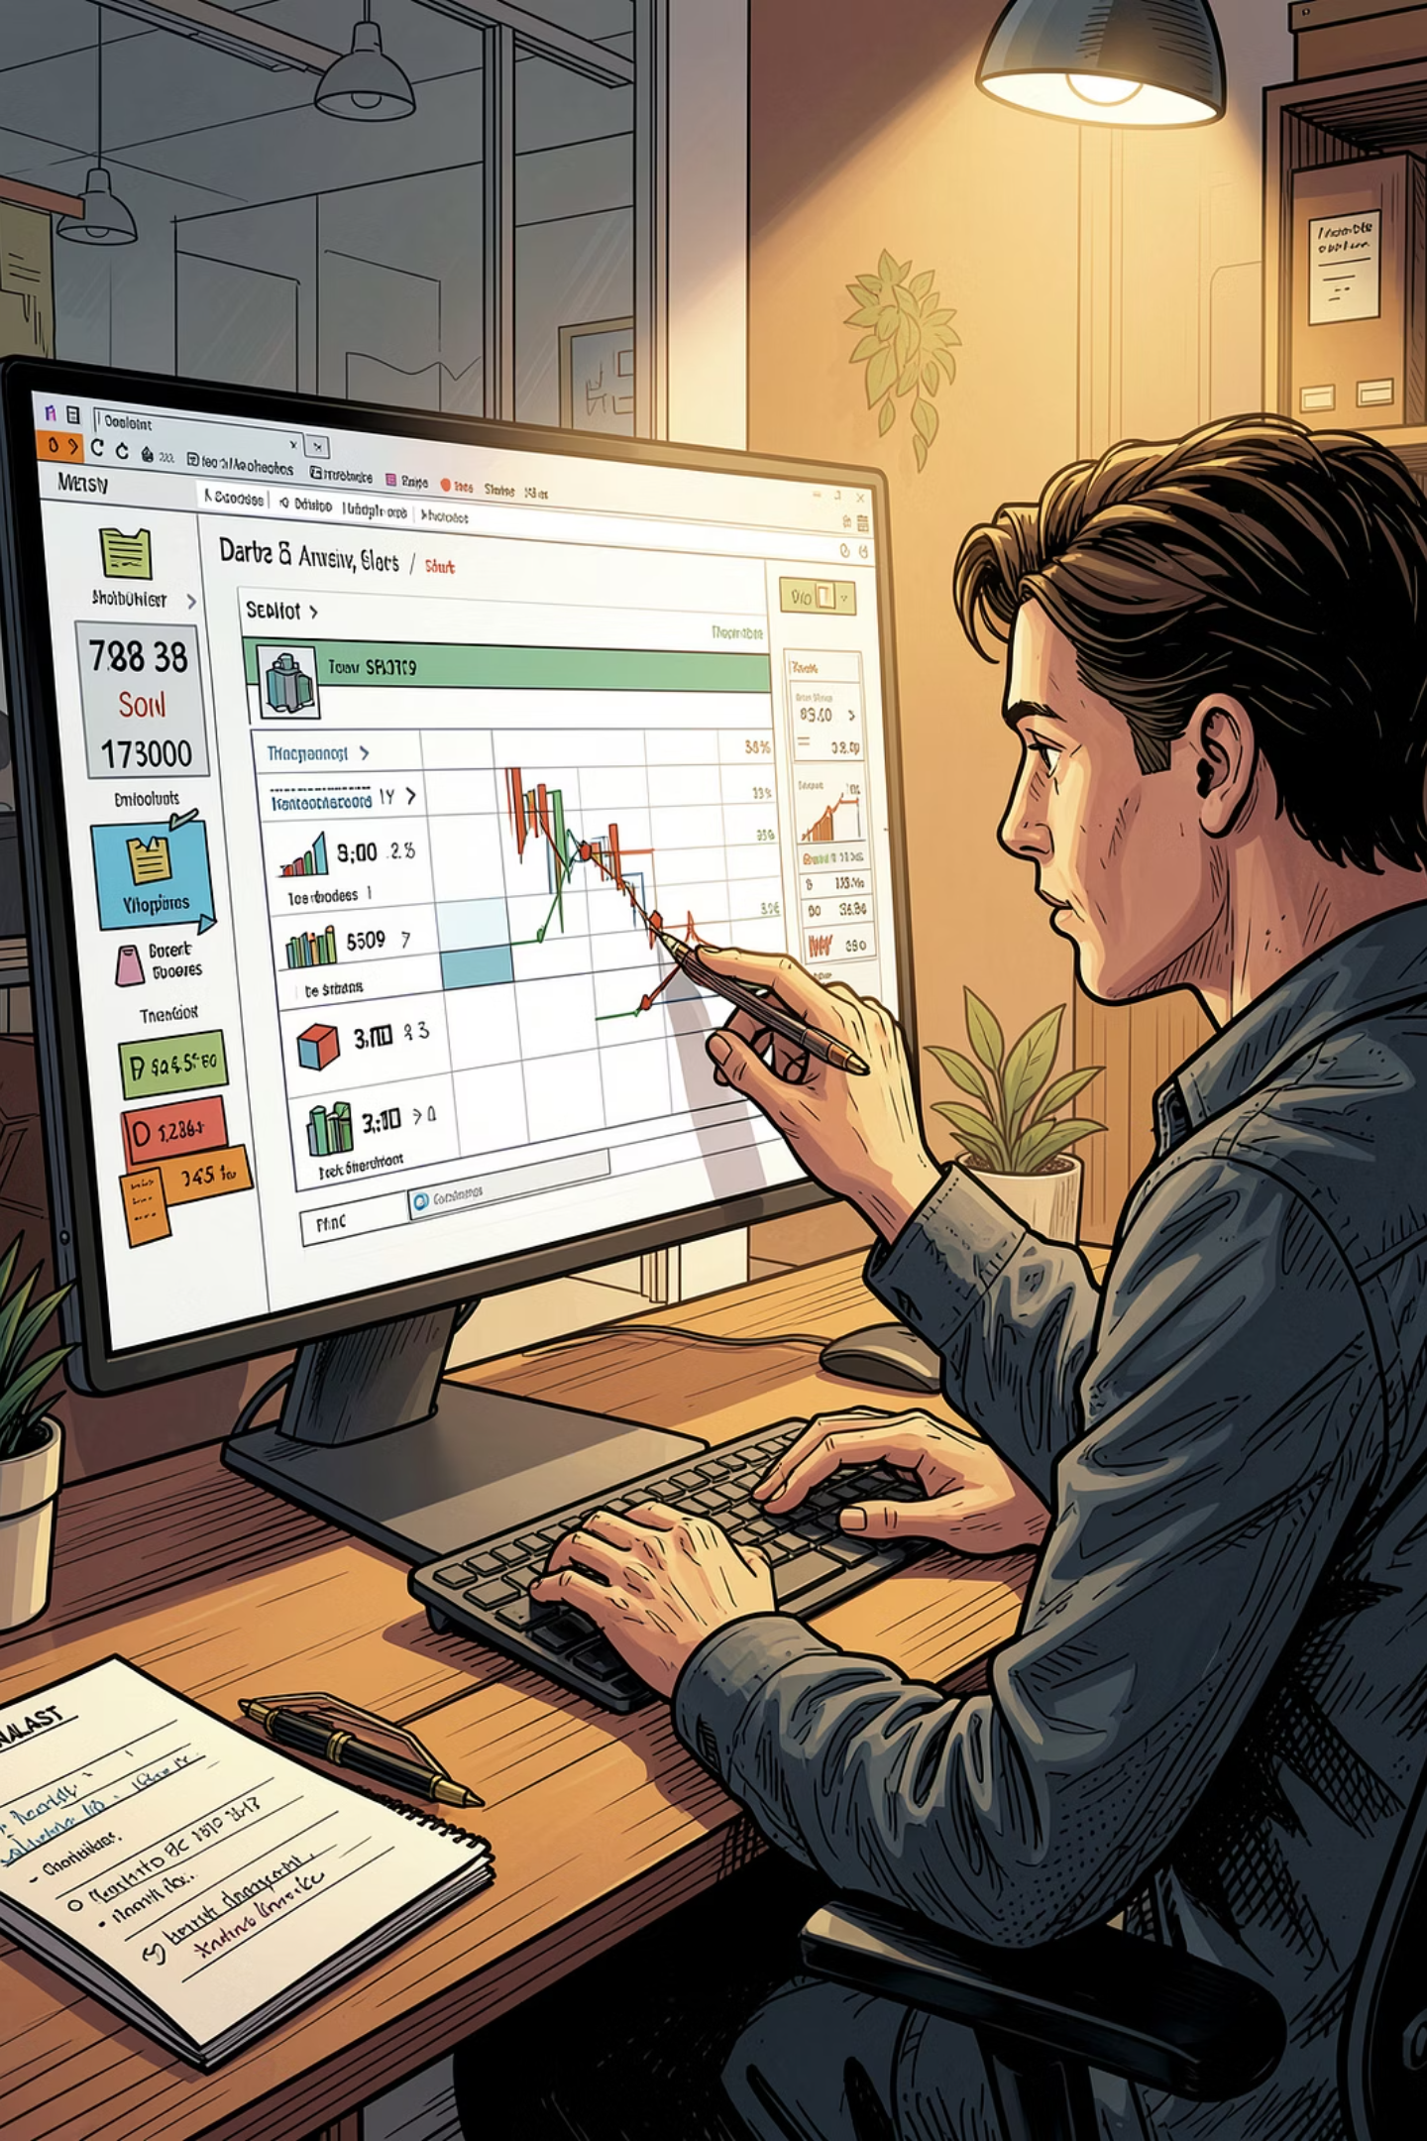
Customer Shopping Behavior Analysis
Uncovering spending patterns, customer segments, and product preferences from 3,900 transactions to guide strategic decisions.

Slide 2
Dataset at a Glance
3,900
18
37
Purchases
Columns
Missing Ratings
Key Features
Demographics: Age, Gender, Location, Subscription
Purchase: Item, Category, Amount, Season, Size
Behavior: Discounts, Frequency, Rating, Shipping

Slide 3

Data Preparation in Python
01
Load & Explore
Imported with pandas; used df.info() and .describe()
02
Clean & Standardize
Imputed missing ratings by category median; renamed columns to snake_case
03
Feature Engineering
Created age_group and purchase_frequency_days columns
04
Load to PostgreSQL
Connected Python to PostgreSQL; dropped redundant promo_code_used

Slide 4
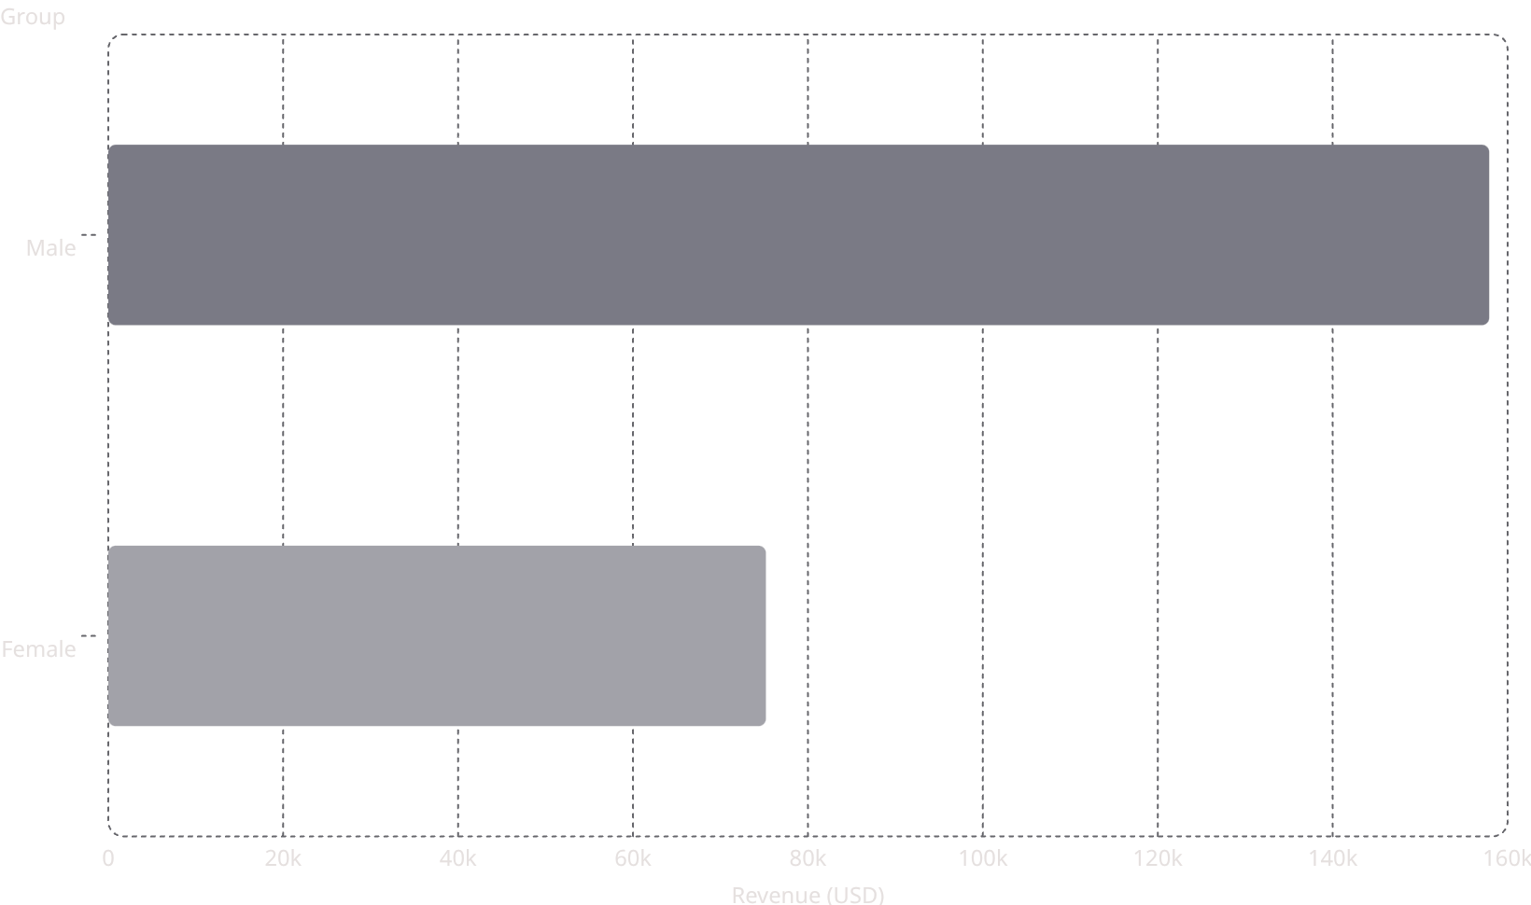

Revenue & Spending Insights
Shipping Type vs. Spend
158k
Shipping
Avg. Spend
Standard
$58.46
Express
$60.48
75.2k
839 discount users still spent above average — high-value segment.

Slide 5
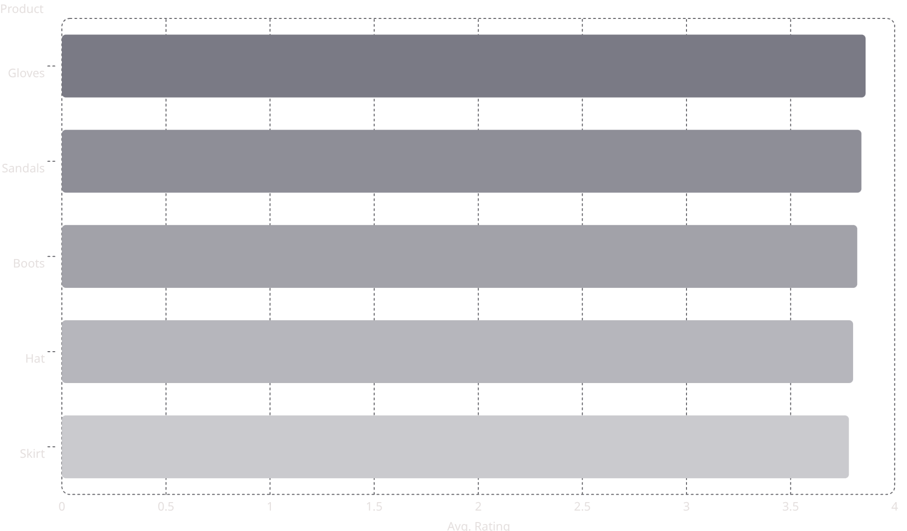
Top-Rated Products
Discount-Heavy Products
3.86
Item
Discount Rate
3.84
Hat
50.00%
3.82
Sneakers
49.66%
3.8
Coat
49.07%
3.78
Sweater
48.17%
Pants
47.37%

Slide 6


Customer Segmentation
2.13%
Repeat Buyers & Subscriptions
17.97%
Customers with >5 purchases:
Subscribed
Count
Loyal·79.9%
·79.9%
·
Returning·17.97%
·17.97%
·
New·2.13%
No
2,518
·2.13%
·
Yes
958
79.9%
Most repeat buyers are not subscribed — a key conversion opportunity.

Slide 7
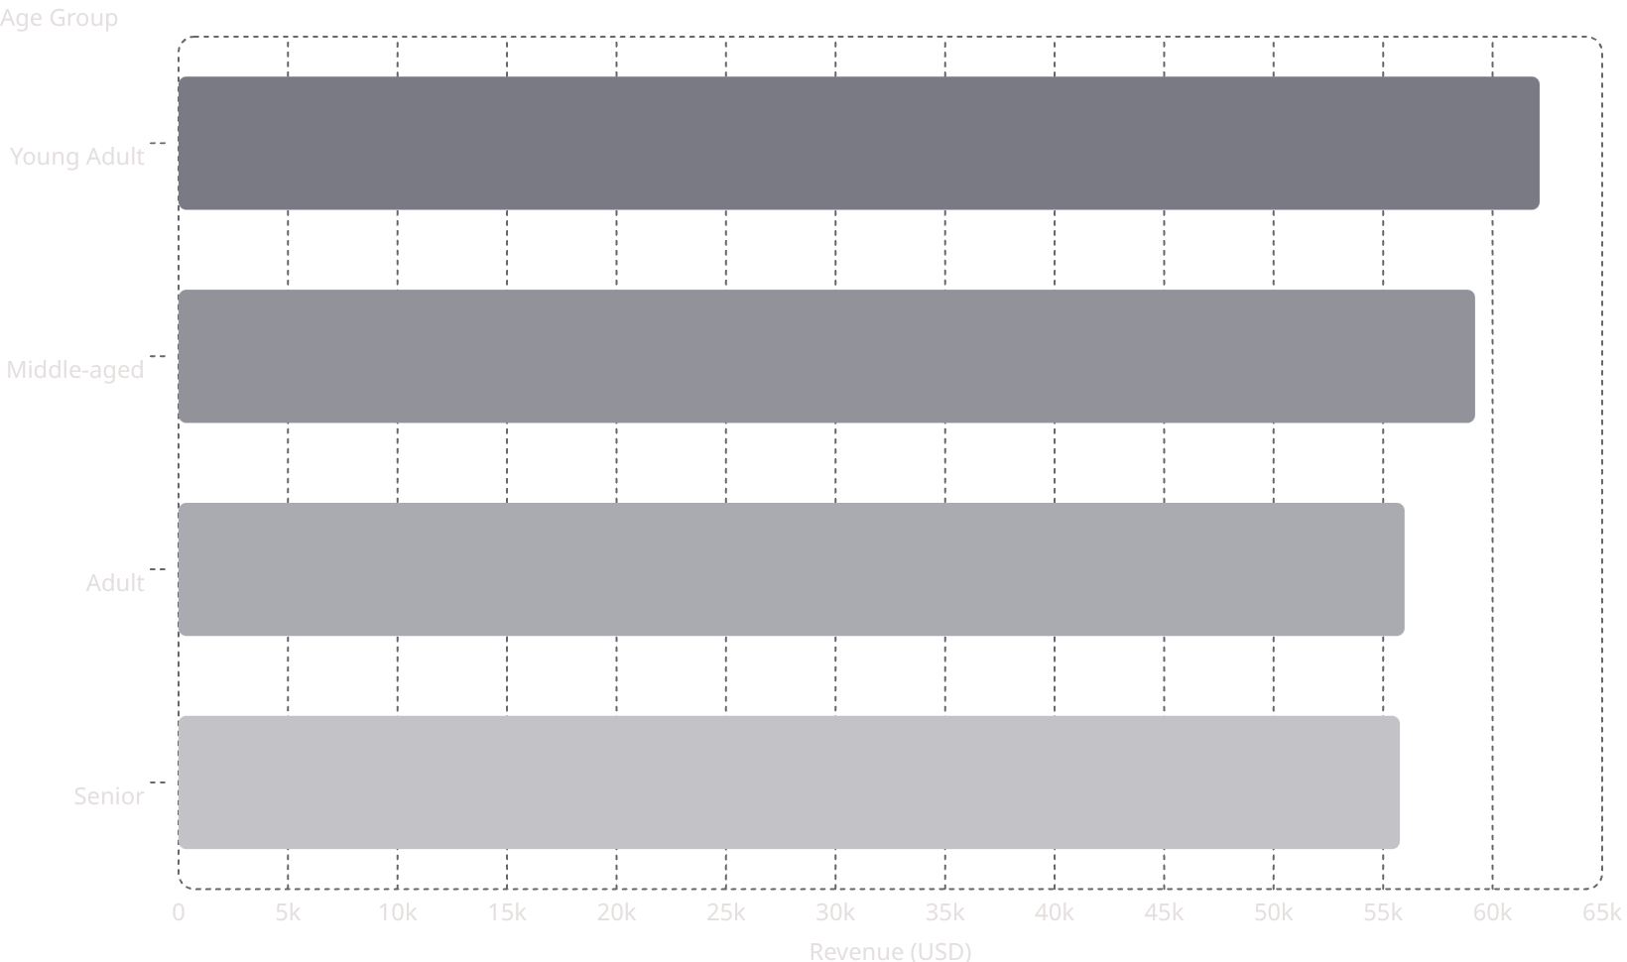
Subscription & Revenue by Age
Subscribers vs. Non-Subscribers
62.1k
Status
Customers
Avg. Spend
Revenue
59.2k
Yes
1,053
$59.49
$62,645
56k
No
2,847
$59.87
$170,436
55.8k
Avg. spend is nearly identical — volume drives the gap.

Slide 8
Top Products by Category
👗 Clothing
💍 Accessories
Blouse — 171
Pants — 171
Shirt — 169
Jewelry — 171
Sunglasses — 161
Belt — 161
👟 Footwear
🧥 Outerwear
Sandals — 160
Shoes — 150
Sneakers — 145
Jacket — 163
Coat — 161

Slide 9
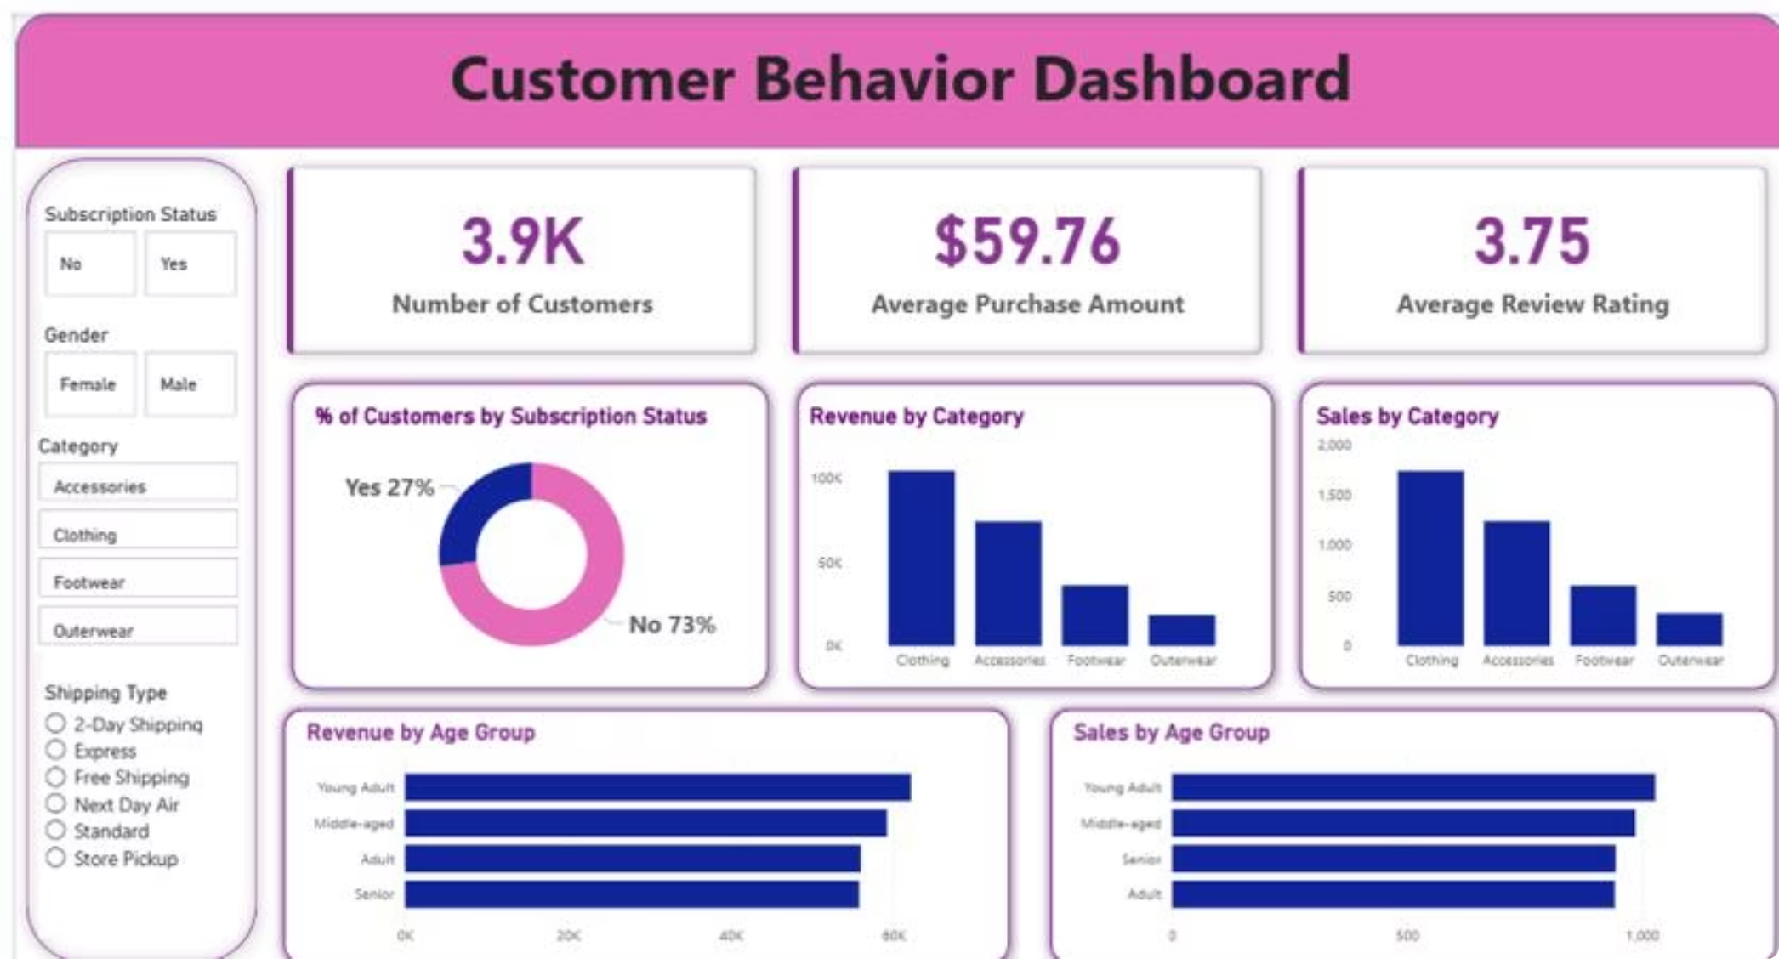
Power BI Dashboard
3.9K
$59.76
Customers
Avg. Purchase
3.75
27%
Avg. Rating
Subscribed

Slide 10


Business Recommendations
Boost Subscriptions
Promote exclusive benefits to convert repeat buyers
Loyalty Programs
Reward returning customers to grow the Loyal segment
Review Discount Policy
Balance sales boosts with margin control
Targeted Marketing
Focus on Young Adults and express-shipping users

