Slide 1

PORTFOLIO PROJECT
LEARNING & TALENT ANALYTICS
DATA ANALYSIS
ROHAN VAIYATA · OCTOBER, 2026

Slide 2
WHY THIS PROJECT ?
  Organizations invest heavily in employee training but lack visibility into participation, completion, and course effectiveness.
  Raw learning data often contains quality issues - missing dates, invalid scores, negative hours - that distort reporting and decisions.
  This project transforms raw learning data into actionable business insights using Python, MySQL, and Tableau.
OBJECTIVE:
  Turn raw training data into a clear,decision-ready view of learning performance.

Slide 3
THE DATA
RAW DATASET
  1030 Rows
  26 Columns
  28 rows removed
CLEANED DATASET
  1002 Rows
  26 Columns
  Ready for analysis
DATA QUALITY EXCEPTIONS FOUND: 37
Label | Count
Missing completion dates | 25
Invalid scores | 5
Invalid ratings | 3
Negative learning hours | 4
Total | 37
  Source: LMS export · 26 columns · analyzed in Python & MySQL

Slide 4
TOOLS & METHODOLOGY
📄
RAW CSV
🐍
PYTHON
🗄️
MySQL
📊
TABLEAU
→
→
→
  Python → Data cleaning, validation, quality logging
  MySQL → Structured storage + SQL analysis queries
  Tableau → 4 interactive dashboards with filters
Every step is scripted - the pipeline can be re-run on new data

Slide 5
KEY FINDINGS
1,002
ENROLLMENTS
67.2%
COMPLETION
80.95
AVG SCORE
4.006
AVG RATING
100
OVERDUE
  Completion varies by department and course category
  Roughly 1 in 3 enrollments is not completed
  100 overdue records flag where follow-up is needed
Average score of 81 and rating of 4.0 show courses well-received when learners complete them

Slide 6
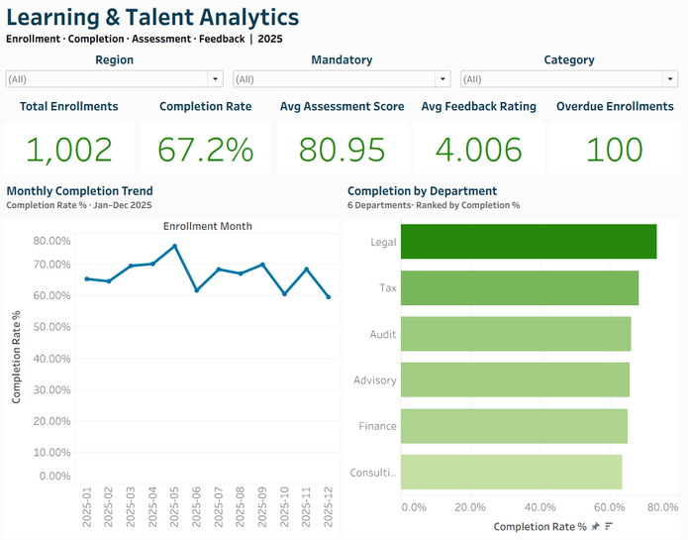
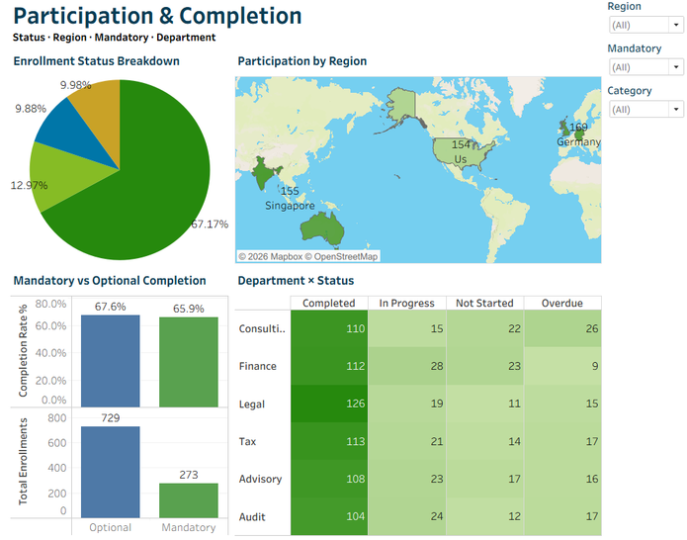
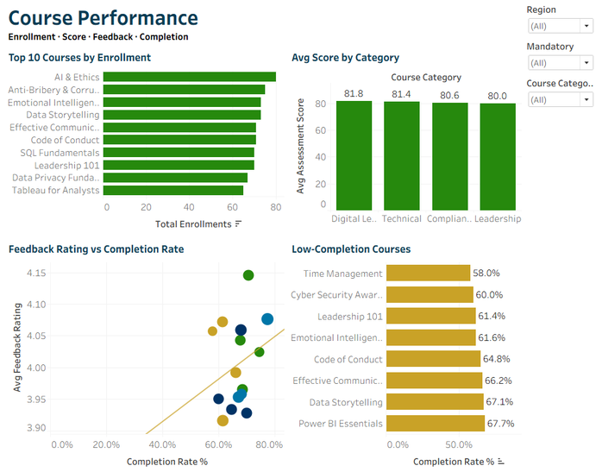
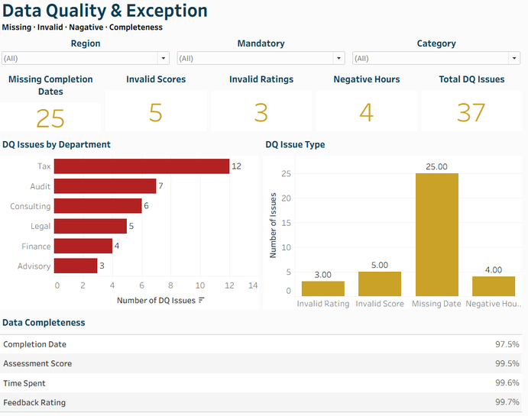
THE DASHBOARDS
High-level KPIs
Engagement patterns
Scores & feedback
37 logged exceptions

Slide 7
RECOMMENDATIONS
01 Target the 100 overdue records with automated reminders
02 Investigate low-completion departments surfaced in Dash 2
03 Fix the data pipeline - 25 missing completion dates
04 Use high-rated courses as templates for underperformers
NEXT STEPS
→ Connect live LMS data for automated refresh
→ Add predictive model for completion likelihood
→ Publish dashboards to Tableau Public / internal server

