Slide 1
Transcript Intelligence
AegisCloud Meeting Analytics
Theme classification and actionable insights from 100 customer meetings
Vikrant Potnis | vikrant.potnis@gmail.com | Prepared for Aziro (client Rubrik) | May 11, 2026

Slide 2
Approach 1 — Rule-Based Keyword Matching
For: All
• Every theme must be hand-coded — anything unexpected is invisible to the rules
• "Pipeline failure" and "ingestion outage" mean the same thing; the rules treat them as different
• Each product change or new customer term requires a manual update — breaks silently with no warning
Vikrant Potnis | vikrant.potnis@gmail.com | Prepared for Aziro (client Rubrik) | May 11, 2026

Slide 3
Approach 2 — TF-IDF + KMeans
For: All
• Number of themes must be guessed upfront — wrong K forces unrelated topics together
• Bag-of-words misses meaning: "outage remediation" and "post-mortem" treated as unrelated
• Theme names are mechanical — top centroid terms like "renewal / competitive / pricing / outage"
Vikrant Potnis | vikrant.potnis@gmail.com | Prepared for Aziro (client Rubrik) | May 11, 2026

Slide 4
Approach 3 — Embeddings + HDBSCAN + LLM
For: All
• Each topic phrase embedded independently — a meeting about HIPAA and API failures maps to two distinct clusters
• HDBSCAN found 26 themes from the data — no K required, density-adaptive
• LLM names the clusters, it does not form them — the hard work is done by the algorithm
Vikrant Potnis | vikrant.potnis@gmail.com | Prepared for Aziro (client Rubrik) | May 11, 2026

Slide 5
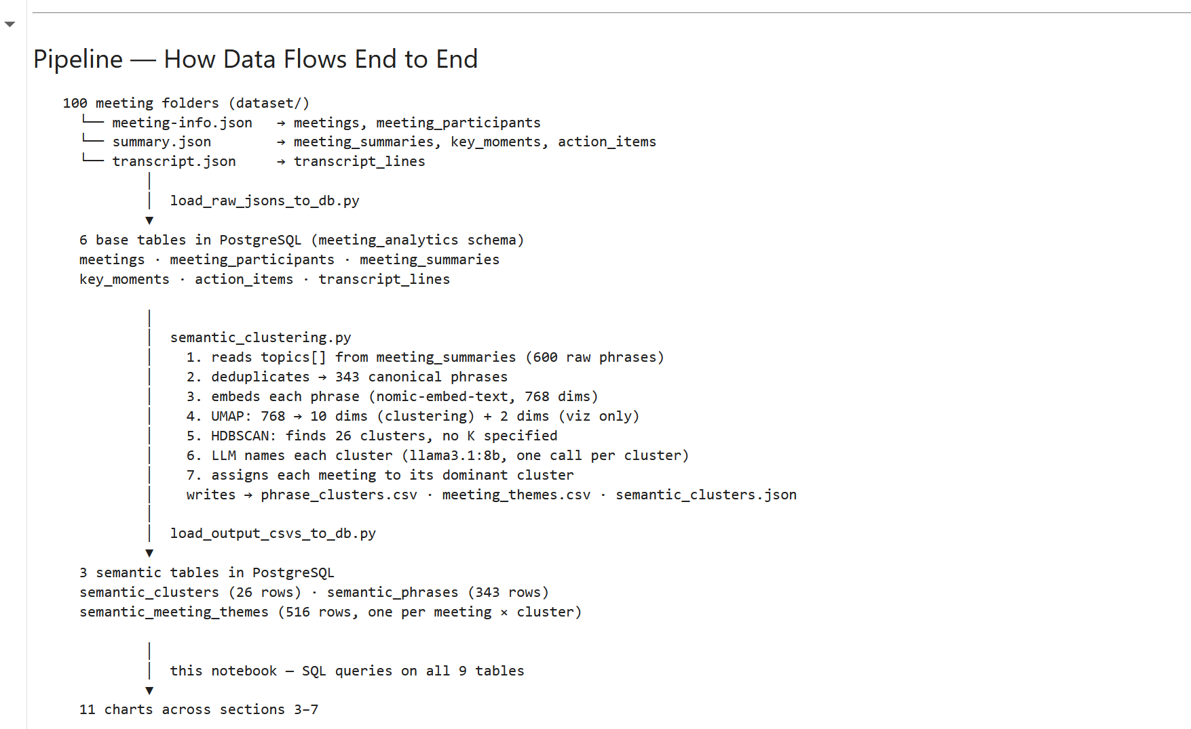
Theme Pipeline
Vikrant Potnis | vikrant.potnis@gmail.com | Prepared for Aziro (client Rubrik) | May 11, 2026

Slide 6
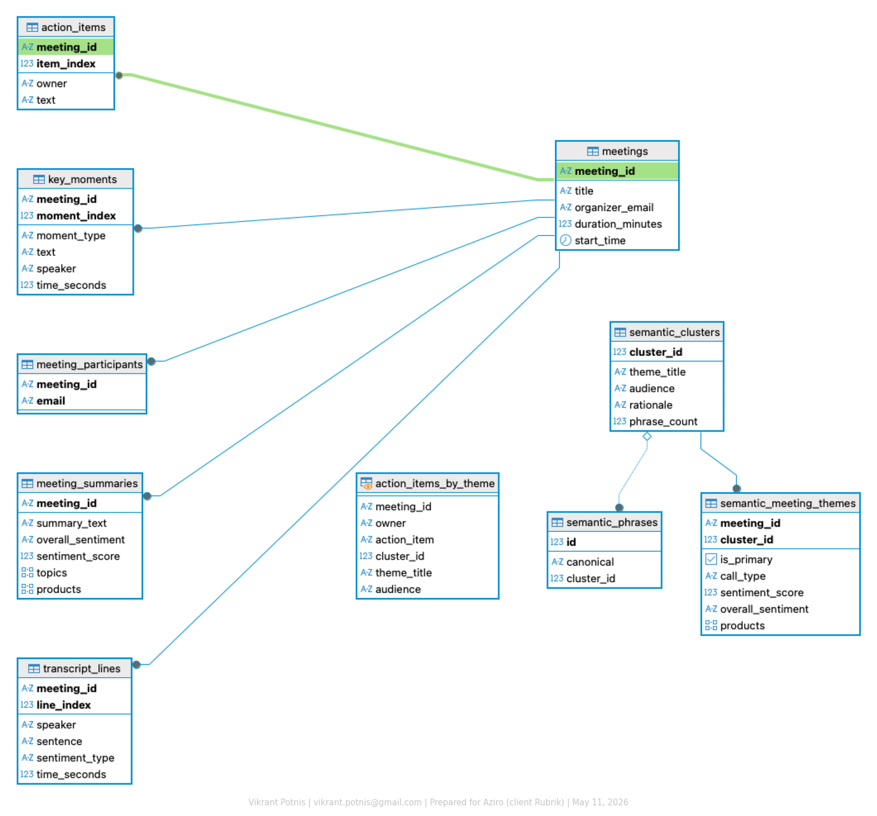
Database Schema
• 6 base tables loaded from raw JSON — meetings, summaries, key moments, action items, participants, transcripts
• 3 semantic tables loaded from clustering — all insight queries join both layers in one schema with no cross-database joins
Vikrant Potnis | vikrant.potnis@gmail.com | Prepared for Aziro (client Rubrik) | May 11, 2026

Slide 7
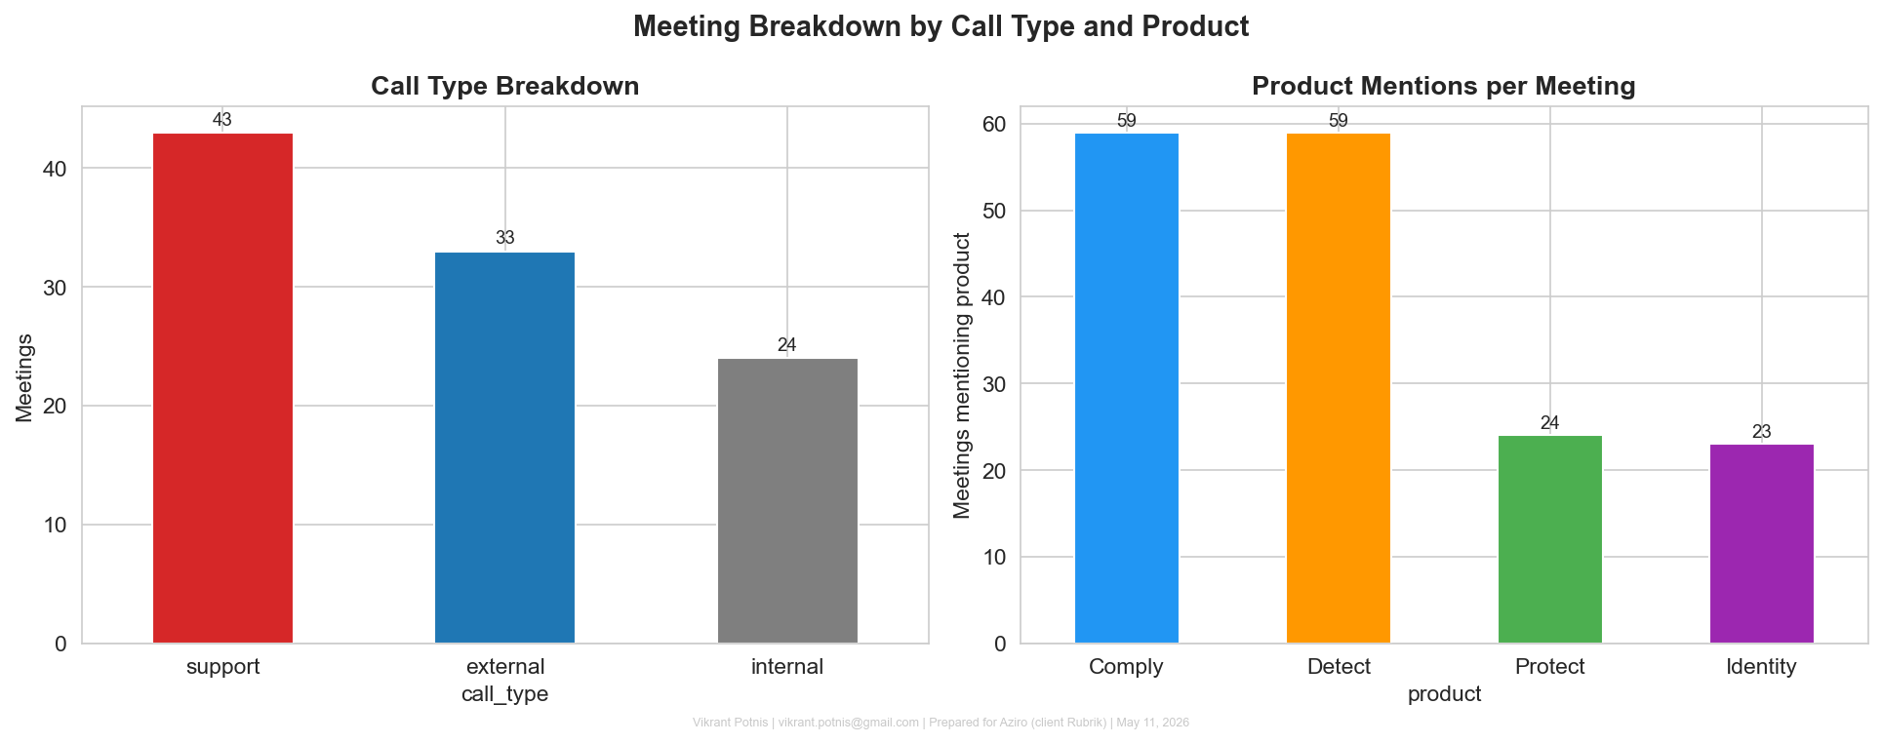
Meeting Breakdown by Call Type and Product
For: All
• 100 meetings: roughly half support, a quarter renewals, a quarter internal
• Detect and Comply appear in the most meetings across the dataset
• Sets the scale before any analysis begins
Vikrant Potnis | vikrant.potnis@gmail.com | Prepared for Aziro (client Rubrik) | May 11, 2026

Slide 8
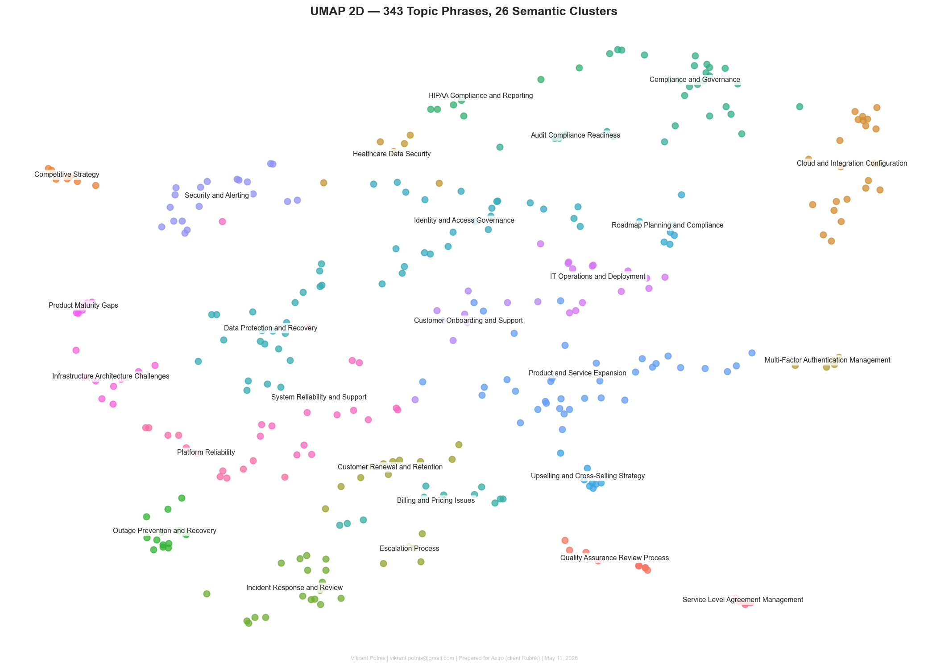
UMAP Scatter — 343 Topic Phrases, 26 Clusters
For: All
• Each dot is a topic phrase from meeting summaries, coloured by cluster
• 26 themes emerged naturally — no K was specified
• Detect phrases cluster tightly together; Comply sits as a separate island
Vikrant Potnis | vikrant.potnis@gmail.com | Prepared for Aziro (client Rubrik) | May 11, 2026

Slide 9
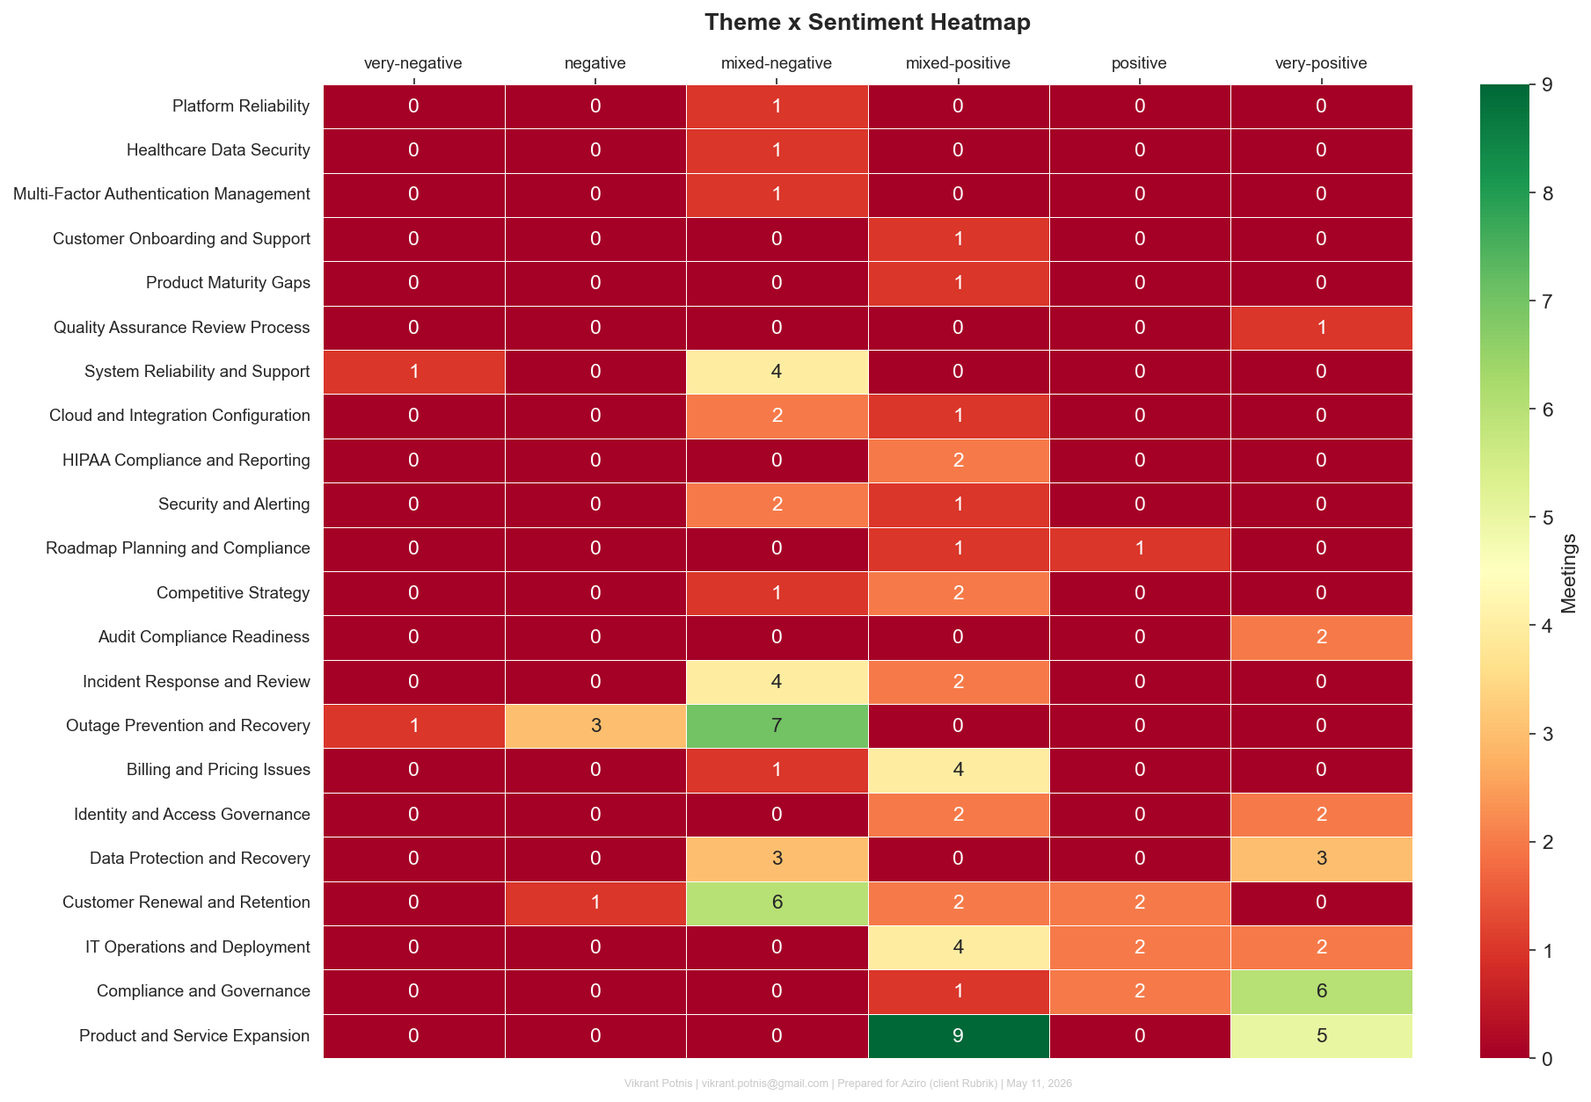
Theme Sentiment Heatmap
For: All Leadership
• Sorted most negative (top) to most positive (bottom)
• Detect-related themes dominate the red zone; Comply dominates the green zone
• One product is in crisis — the other is the strongest asset in the portfolio
Vikrant Potnis | vikrant.potnis@gmail.com | Prepared for Aziro (client Rubrik) | May 11, 2026

Slide 10
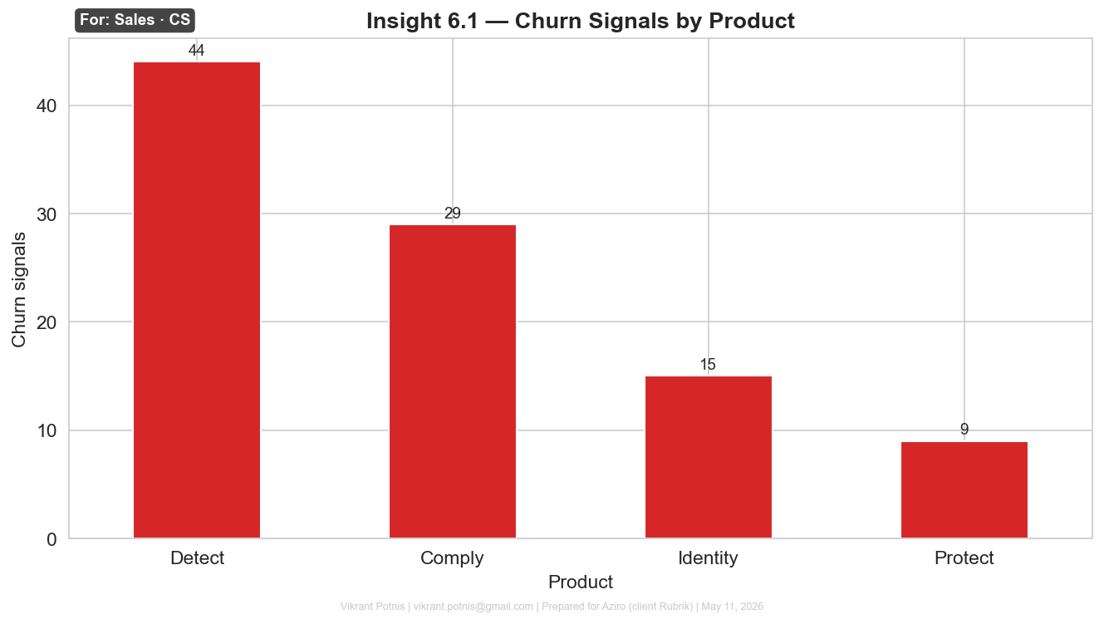
Churn Signals by Product
For: Sales, CS
• Churn signals = moments where customers explicitly expressed risk of leaving
• Detect generates far more churn signals than any other product
• Direct input for account prioritisation and recovery planning
Vikrant Potnis | vikrant.potnis@gmail.com | Prepared for Aziro (client Rubrik) | May 11, 2026

Slide 11
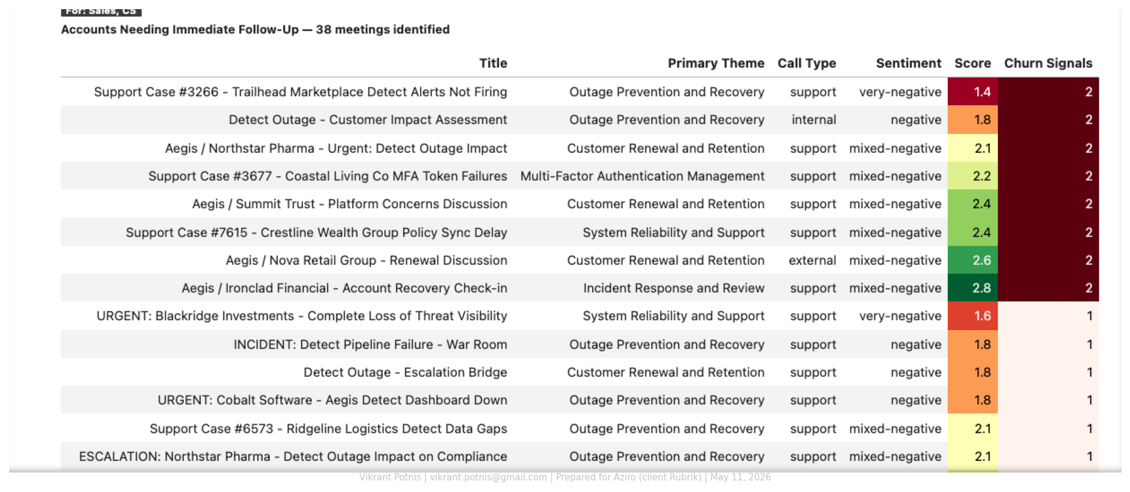
Accounts Needing Immediate Follow-Up
For: Sales, CS
• 38 meetings with negative sentiment and explicit churn signals
• Ranked by severity — top rows are the most urgent accounts
• Action list, not a trend — these accounts need a call this week
Vikrant Potnis | vikrant.potnis@gmail.com | Prepared for Aziro (client Rubrik) | May 11, 2026

Slide 12
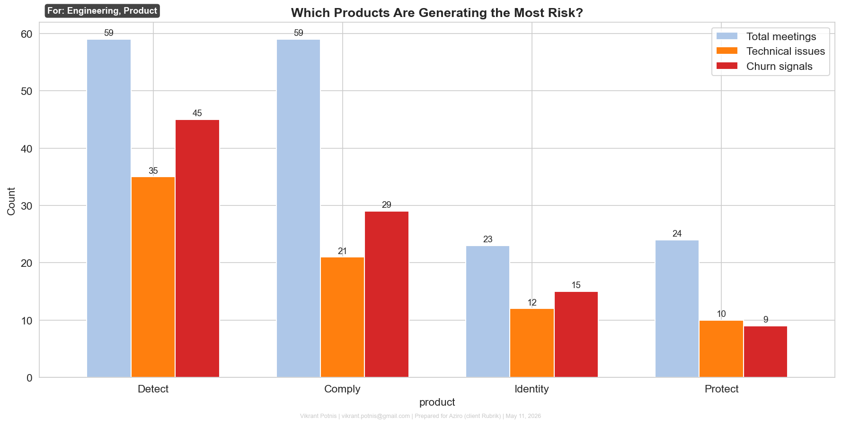
Which Products Are Generating the Most Risk?
For: Engineering, Product
• Three signals per product: total meetings, technical issues, and churn signals
• Detect leads on both technical issues and churn — the outage created a long tail
• Shows which product needs reliability investment first
Vikrant Potnis | vikrant.potnis@gmail.com | Prepared for Aziro (client Rubrik) | May 11, 2026

Slide 13
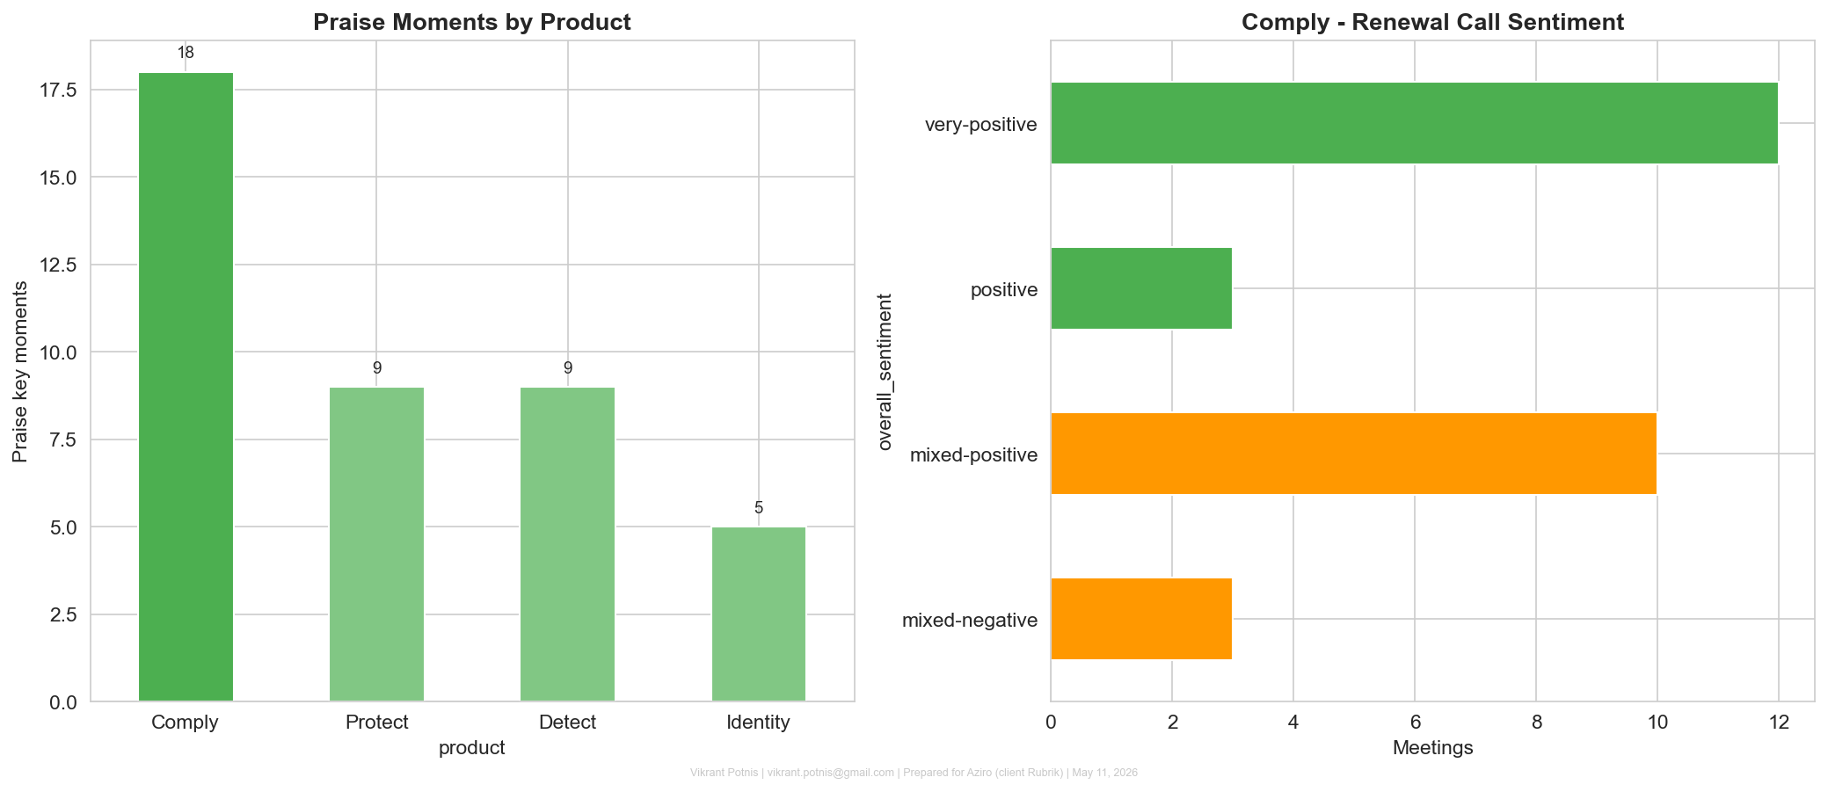
Where Customers Are Happy
For: Product, Marketing, Sales, CS
• Comply has the highest praise density of any product
• Comply renewal conversations are the most positive in the dataset
• Comply v2 is the good news story to pair with the Detect recovery message
Vikrant Potnis | vikrant.potnis@gmail.com | Prepared for Aziro (client Rubrik) | May 11, 2026

Slide 14
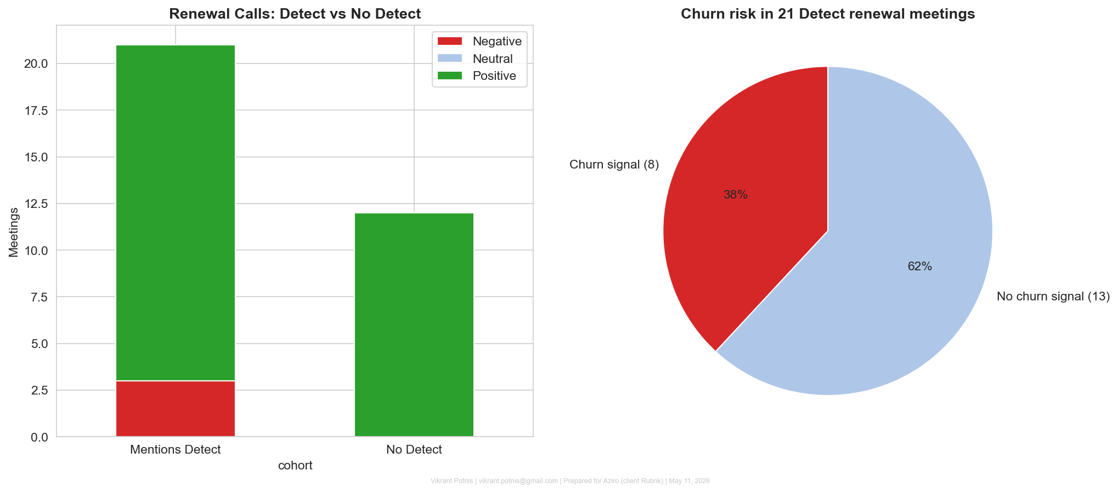
How the Detect Outage Affected Renewal Calls
For: Engineering, Sales
• Renewal meetings mentioning Detect are significantly more negative than those that do not
• Over half of Detect renewal meetings carry an explicit churn signal
• Outage conversations are bleeding into commercial calls that should be about growth
Vikrant Potnis | vikrant.potnis@gmail.com | Prepared for Aziro (client Rubrik) | May 11, 2026

Slide 15
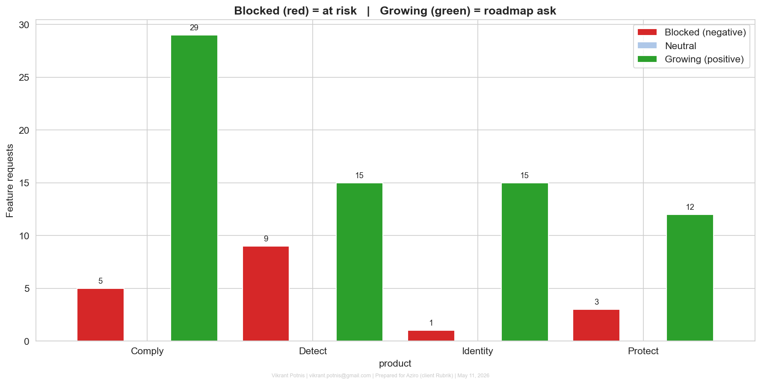
What Customers Are Asking For and How Urgently
For: Product (CPO)
• Same feature request carries different urgency depending on the account situation
• Blocked (red) = at-risk customer — treat as P0 and act immediately
• Growing (green) = healthy account asking for more — add to the roadmap
Vikrant Potnis | vikrant.potnis@gmail.com | Prepared for Aziro (client Rubrik) | May 11, 2026

Slide 16
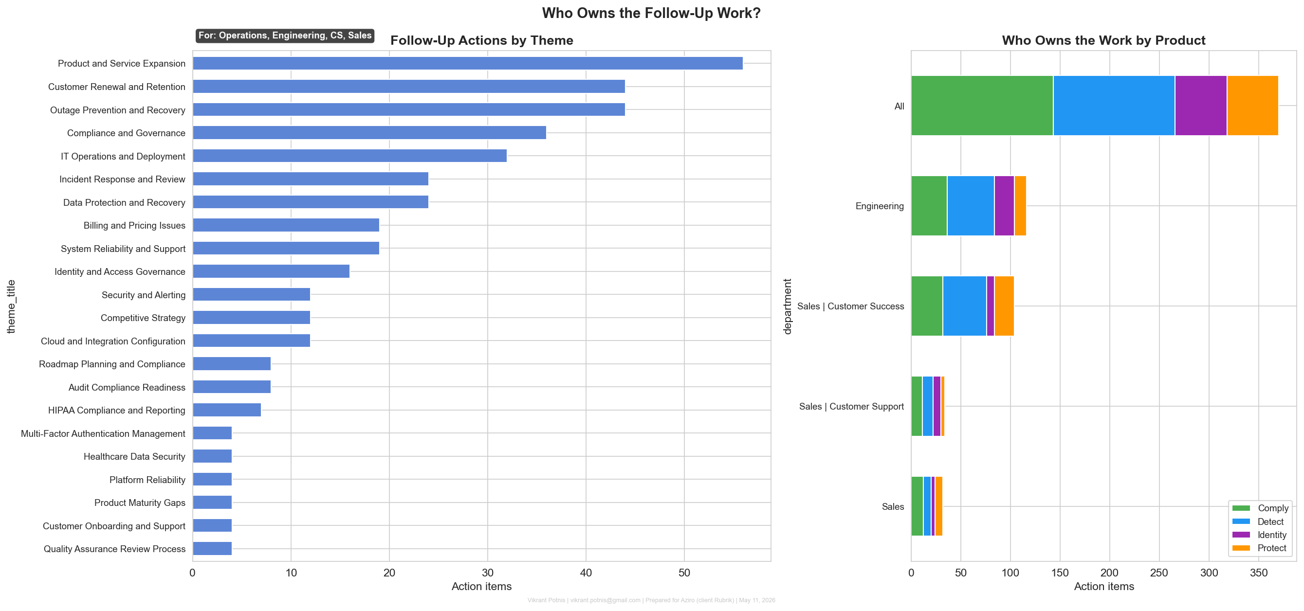
Who Owns the Follow-Up Work?
For: Operations, Engineering, CS, Sales
• Left: which themes generate the most follow-up actions across all meetings
• Engineering carries the heaviest Detect load — reliability slips delay Comply v2
• Identifies where capacity bottlenecks sit before they become a problem
Vikrant Potnis | vikrant.potnis@gmail.com | Prepared for Aziro (client Rubrik) | May 11, 2026

Slide 17
Three Things to Act On
1
Fix Detect reliability before the next QBR
It is the #1 churn driver across the dataset
2
Call the 38 high-risk accounts this week
They have negative sentiment and explicit churn signals
3
Lead with Comply v2 for at-risk Detect accounts
Give them a reason to stay, not just an apology
Vikrant Potnis | vikrant.potnis@gmail.com | Prepared for Aziro (client Rubrik) | May 11, 2026

