Slide 1

AUTHORIZED LOCAL LAB | KALI LINUX
ETHICAL HACKING
VAPT LAB
Vulnerability Assessment & Penetration Testing
Evidence-based practical project
$ nmap -sV -p 8000 127.0.0.1
8000/tcp open SimpleHTTP/0.6
$ curl http://127.0.0.1:8000
[!] .ssh/ .gnupg/ Documents/ ...
A tiny Python server exposed private folders. What went wrong?
Rohan Yethekar Kali Linux lab | 127.0.0.1:8000

Slide 2
1. Project Scope
What was tested and why
Objective
Scope
Method
Learn and demonstrate a basic VAPT workflow using a controlled Kali Linux environment.
Local host / localhost services created by the learner for authorized testing.
Network identification → connectivity → port discovery → service enumeration → finding → remediation → retest.
No unauthorized external target was used.
Evidence in this presentation comes from the uploaded Kali terminal photos.
Screenshots are presented as practical evidence, not fabricated mockups.

Slide 3
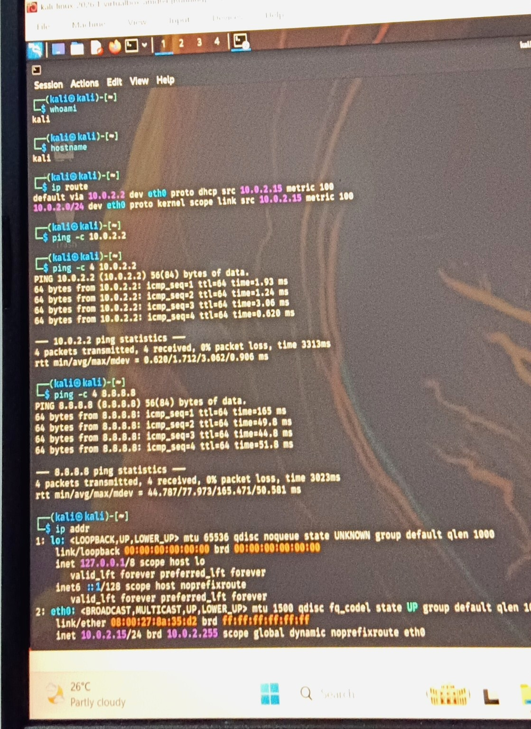
2. Network Identification
IP address, gateway and interface evidence
Kali IPv4
10.0.2.15/24
Default Gateway
10.0.2.2
Interface / MAC
eth0
08:00:27:8a:35:d2
Evidence: ip route / ping / ip addr
Ethical Hacking – VAPT Security Assessment Lab
3

Slide 4
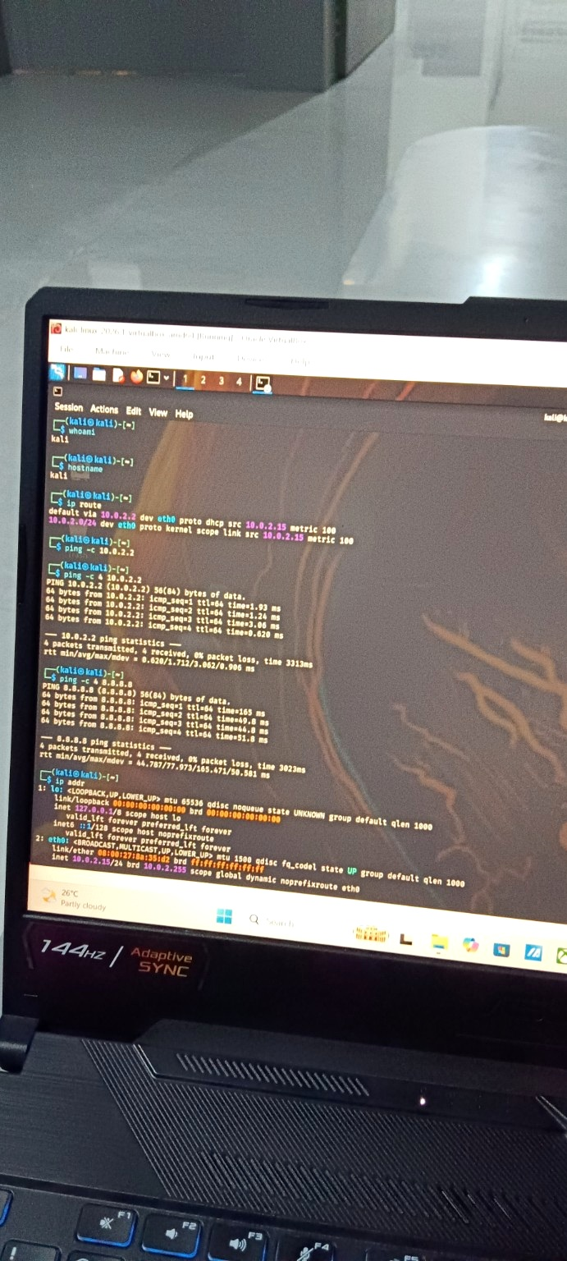
3. Connectivity Verification
Gateway and Internet reachability
Gateway Test
4/4 replies • 0% packet loss
Avg ≈ 1.712 ms
Internet Test
4/4 replies • 0% packet loss
Avg ≈ 77.973 ms
Result: network connectivity was working before the security testing steps.
Evidence: ping -c 4 10.0.2.2 and ping -c 4 8.8.8.8
Ethical Hacking – VAPT Security Assessment Lab
4

Slide 5
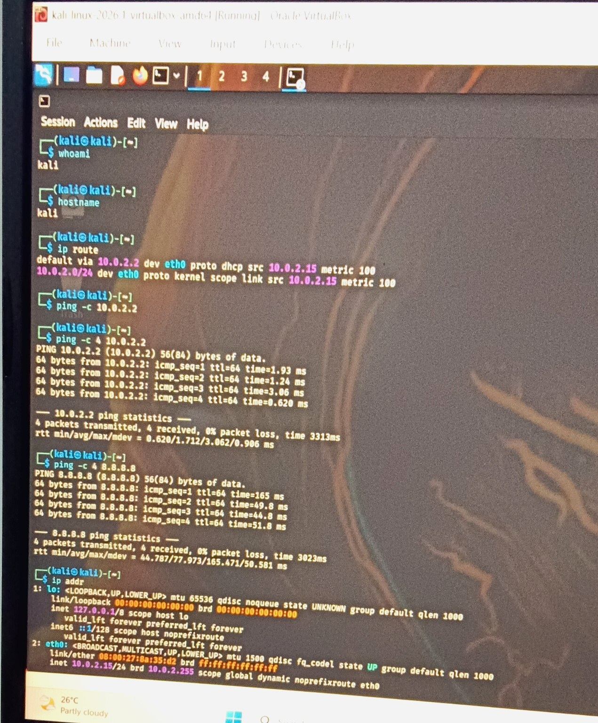
4. Port Discovery & Local Service
Checking listening services in the controlled lab
Initial State
ss -tuln showed no listening port in the first check.
Lab Service
Python HTTP server started on TCP port 8000.
Purpose
Created only to practice authorized port/service enumeration.
Evidence: ss -tuln + python3 -m http.server 8000
Ethical Hacking – VAPT Security Assessment Lab
5

Slide 6
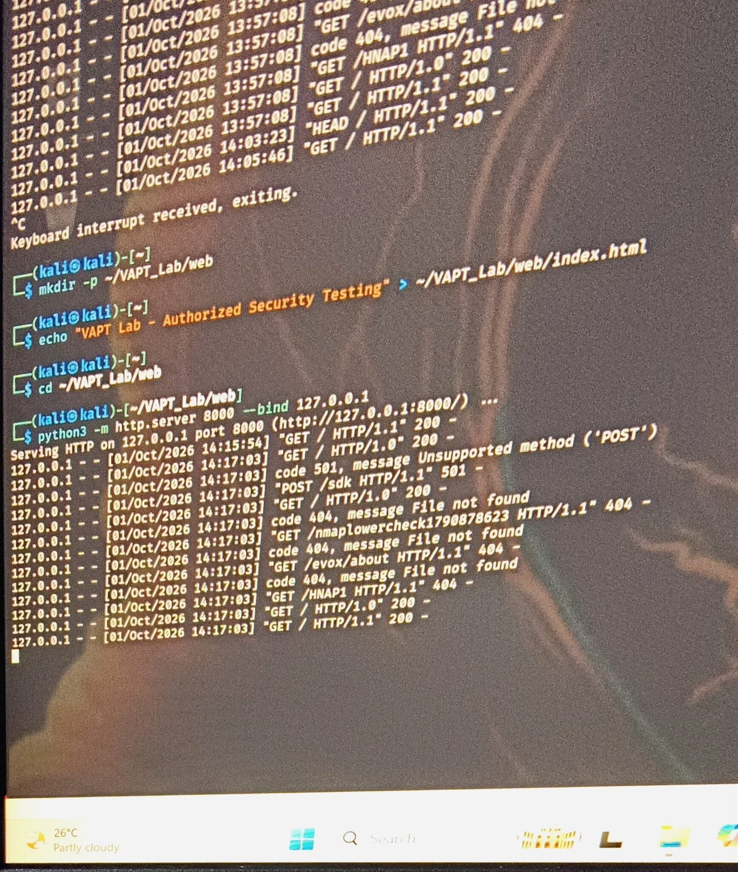
5. Nmap Service Enumeration
Identifying the service and version on the lab port
Target
127.0.0.1 (localhost)
Port
8000/tcp • open
Detected Service
HTTP
SimpleHTTPServer 0.6
Python 3.13.12
Evidence: curl + nmap -sV -p 8000 127.0.0.1
Ethical Hacking – VAPT Security Assessment Lab
6

Slide 7
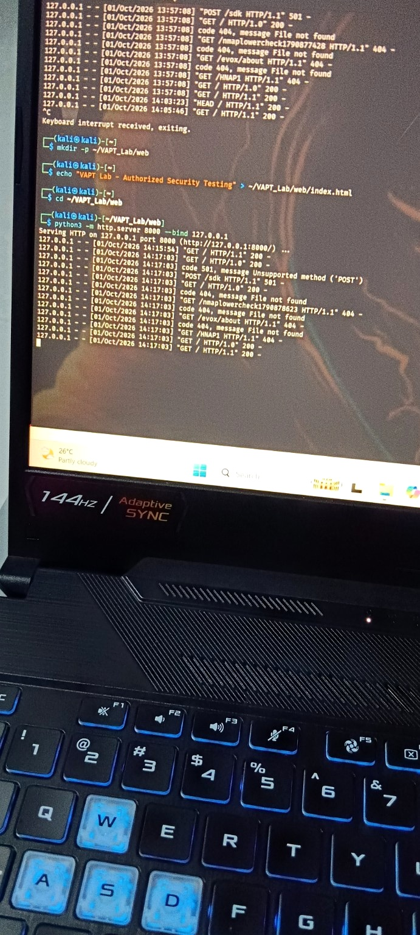
6. Finding: Directory Exposure
The initial HTTP server exposed the home-directory contents
Finding
Directory listing exposed entries beyond the intended web content.
Security Impact
Could reveal filenames, hidden directories or configuration-related paths depending on deployment context.
Assessment
Observed in a local lab. This is evidence of exposure, not proof of compromise.
Evidence: directory listing returned many home-directory entries
Ethical Hacking – VAPT Security Assessment Lab
7

Slide 8
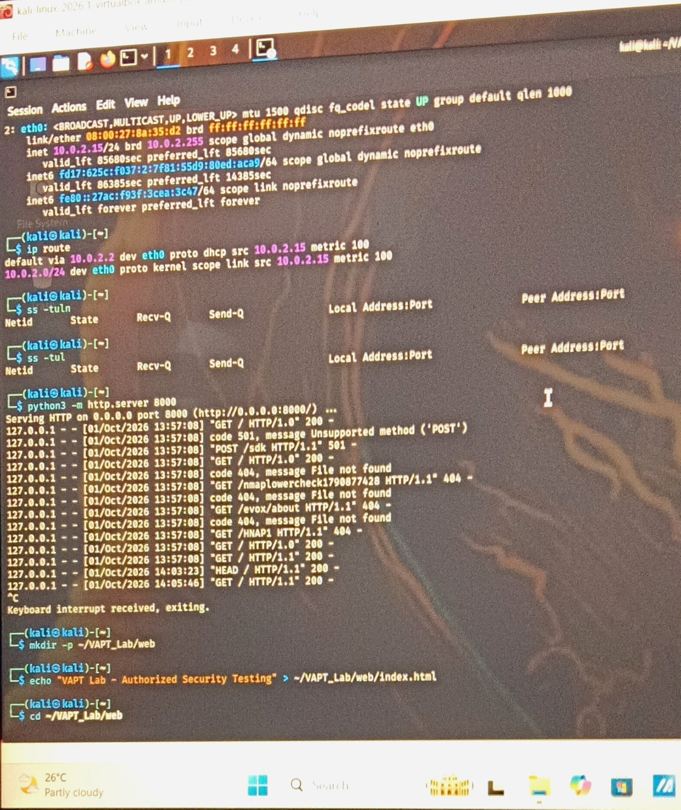
7. Remediation
Move the service into a dedicated lab directory and bind it to localhost
Created: ~/VAPT_Lab/web
Added a dedicated index.html containing only the lab message.
Restarted the HTTP server with --bind 127.0.0.1.
This removes the earlier home-directory exposure from the served content.
Remediation Status
Applied successfully in the controlled lab.
Evidence: ~/VAPT_Lab/web + index.html + --bind 127.0.0.1
Ethical Hacking – VAPT Security Assessment Lab
8

Slide 9
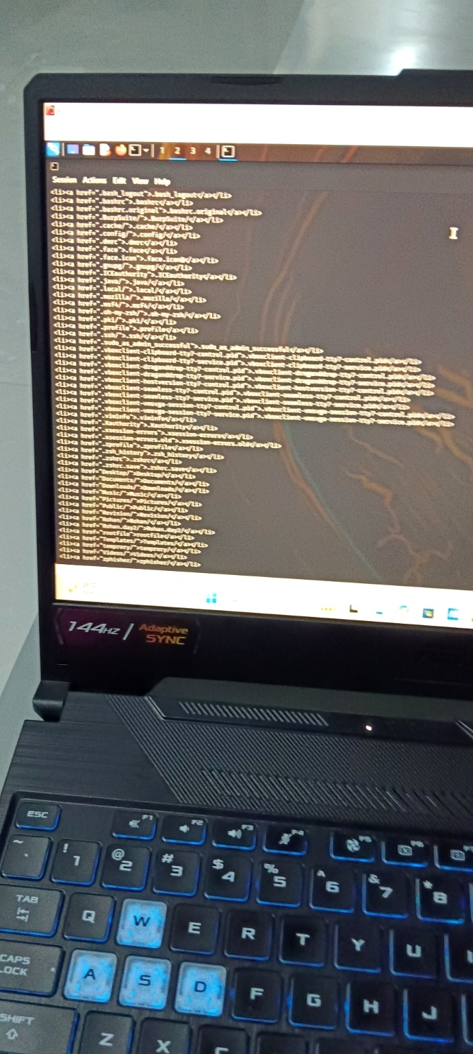
8. Retest & Verification
Confirming the remediated service is still available locally
Service
HTTP server running on 127.0.0.1:8000
Expected Behavior
The lab service remains reachable locally for testing.
Retest Note
The evidence confirms the service was restarted with the localhost bind. The earlier home-directory content was no longer the intended serving location.
Evidence: post-remediation server activity
Ethical Hacking – VAPT Security Assessment Lab
9

Slide 10
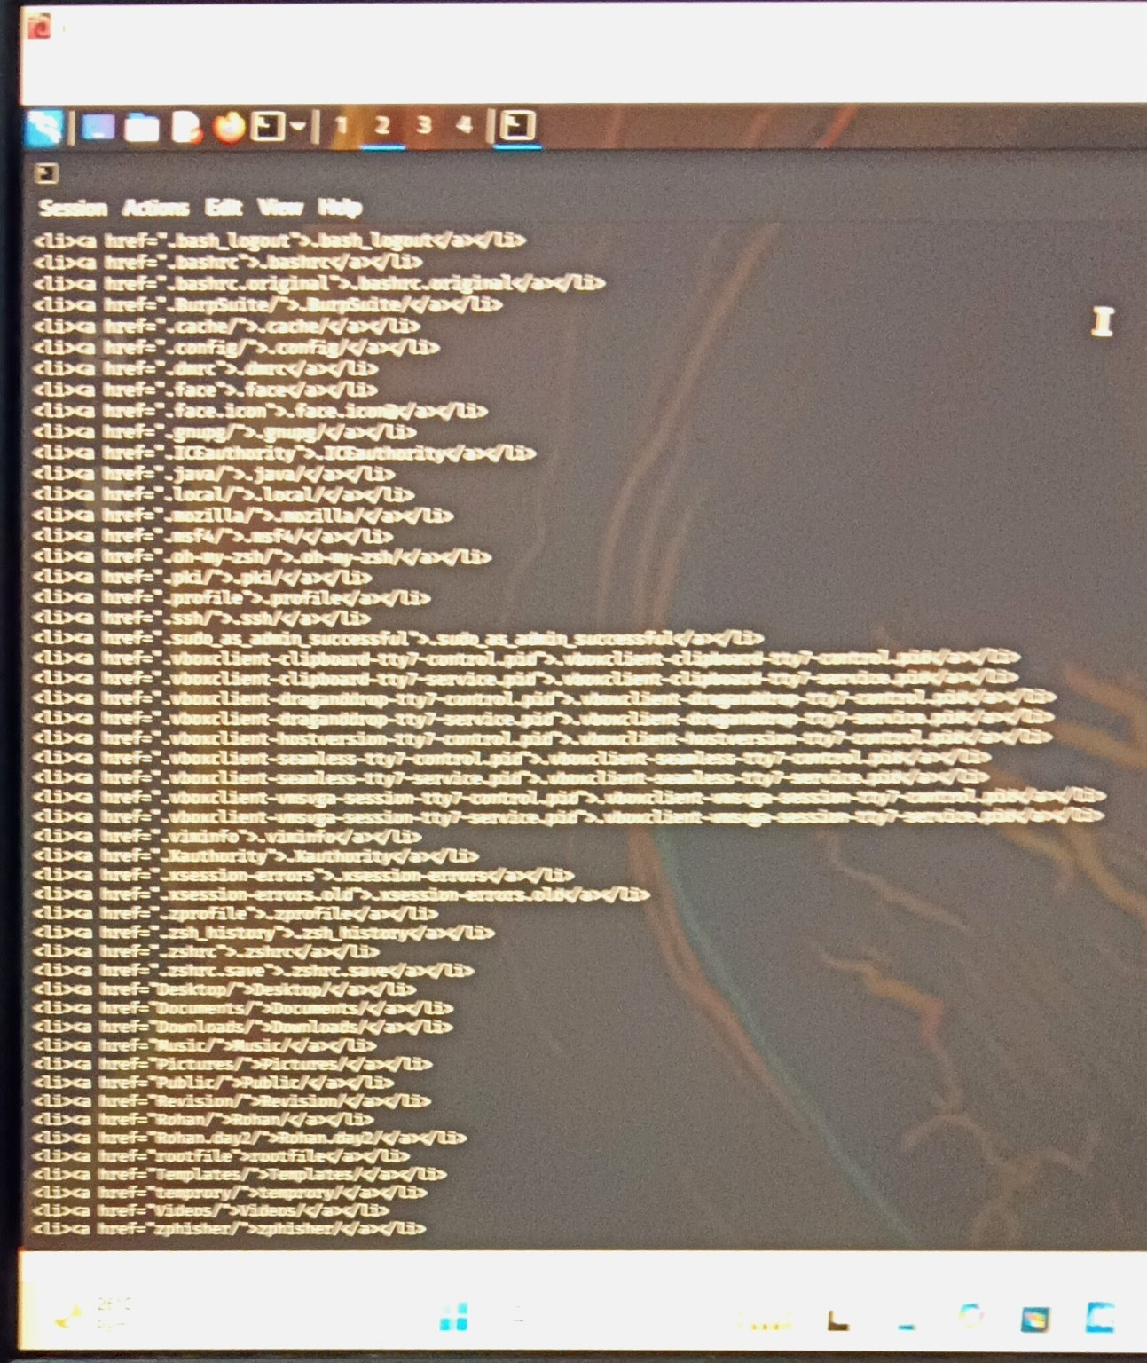
9. Evidence Index
Selected screenshots from the uploaded activity
Network setup
IP route, gateway, ping, ip addr
Port/service setup
ss -tuln and HTTP server
Enumeration
Nmap service/version scan
Finding
Initial directory listing
Remediation
Dedicated VAPT_Lab/web + localhost bind
Retest
Post-remediation HTTP activity
Ethical Hacking – VAPT Security Assessment Lab
10

Slide 11
10. Findings Summary
Evidence → impact → remediation
Finding 01 — Directory Exposure
Observation — Service Banner
Retest
Evidence: initial HTTP server served a directory listing containing home-directory entries.
Impact: information disclosure risk in a real deployment.
Remediation: serve only a dedicated lab directory.
Nmap identified SimpleHTTPServer 0.6 / Python 3.13.12.
Impact: version disclosure can provide useful context to an attacker, but is not by itself proof of a vulnerability.
Next step: minimize unnecessary banner disclosure in production.
The service was restarted using a dedicated VAPT_Lab/web directory and bound to 127.0.0.1.
Result: the intended local lab service remained available after remediation.
Ethical Hacking – VAPT Security Assessment Lab
11

Slide 12
11. Conclusion & Interview Explanation
A concise way to explain the project
“I performed a controlled VAPT lab on localhost using Kali Linux.”
“I identified the local IP and gateway, verified connectivity, checked listening ports, and used Nmap for service enumeration.”
“I observed a directory exposure in the initial HTTP setup, documented the evidence, moved the content into a dedicated lab directory, and rebound the server to localhost.”
“I then retested the service to verify that the intended lab service was still working.”
Project Outcome
Hands-on practice of a basic VAPT lifecycle: Recon → Enumeration → Finding → Remediation → Retest.
Ethical Hacking – VAPT Security Assessment Lab
12

Slide 13

SESSION COMPLETE | VAPT LAB
THANK YOU
Any questions?
Found Directory listing exposed home folders
Fixed Dedicated ~/VAPT_Lab/web + --bind 127.0.0.1
Verified Retest confirmed the service stays available
Test only what you are authorized to test.
Learn the weaknesses. Protect the system.
Rohan Yethekar Ethical Hacking | VAPT

