Slide 1
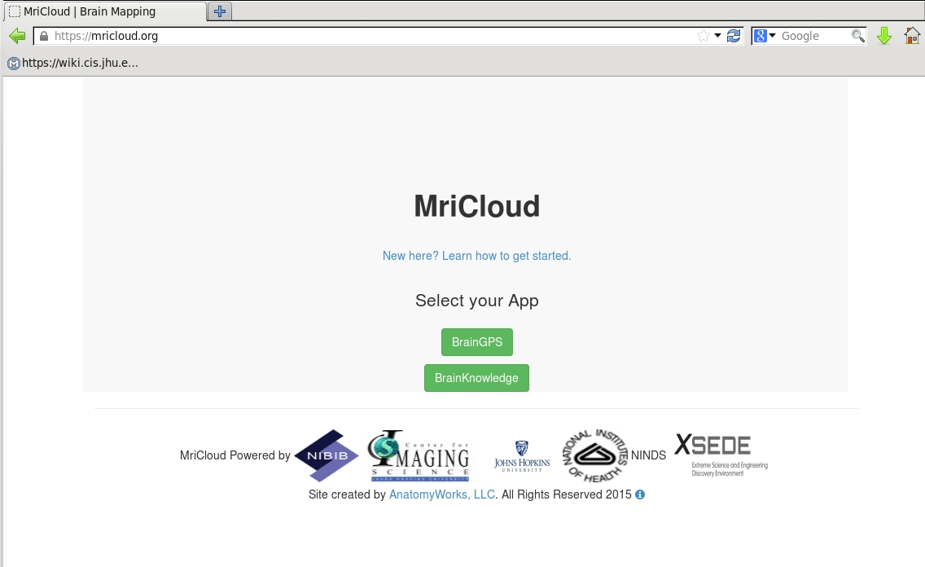
Mri Cloud
https://mricloud.org/
Select BrainGPS

Slide 2
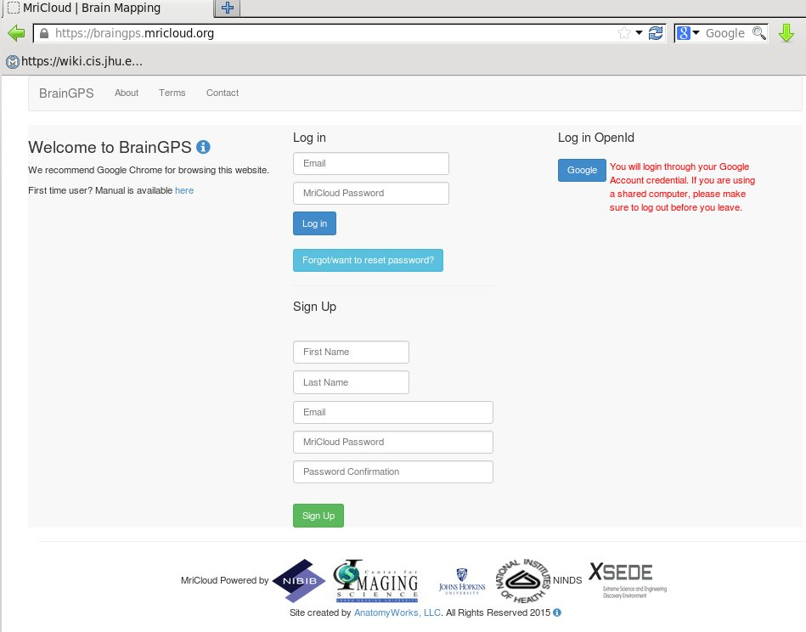
Mri Cloud – log in to BrainGPS
User can log in using Google ID
Or user can register for an
MRICloud account

Slide 3
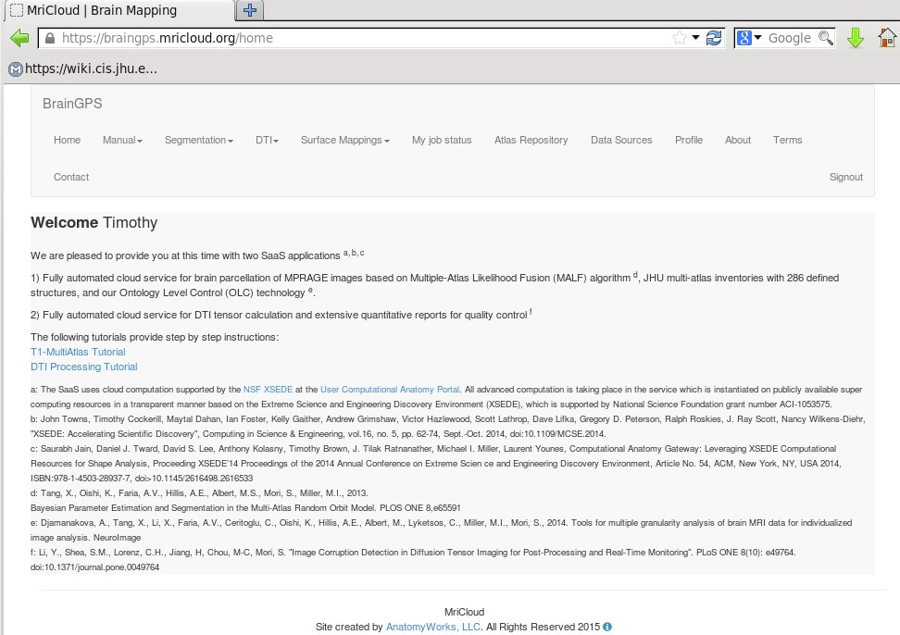
Mri Cloud Welcome Page
Menu items and Reference List
User name is displayed

Slide 4
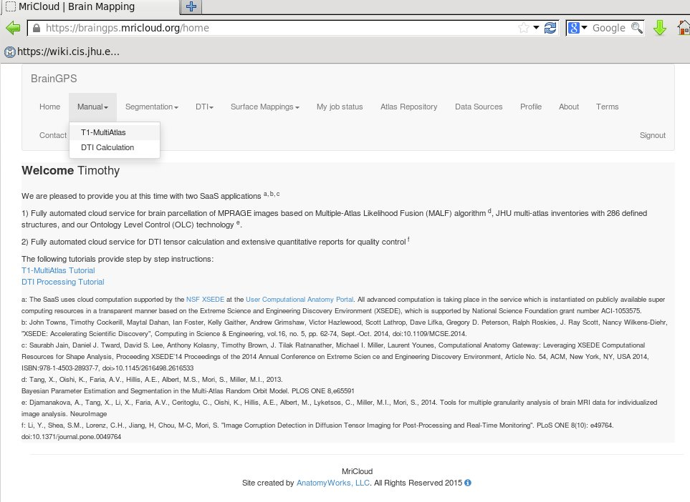
Mri Cloud
To Select T1-MultiAtlas Tutorial
1) Select Manual Menu Item
2) Select T1-MultiAtlas

Slide 5
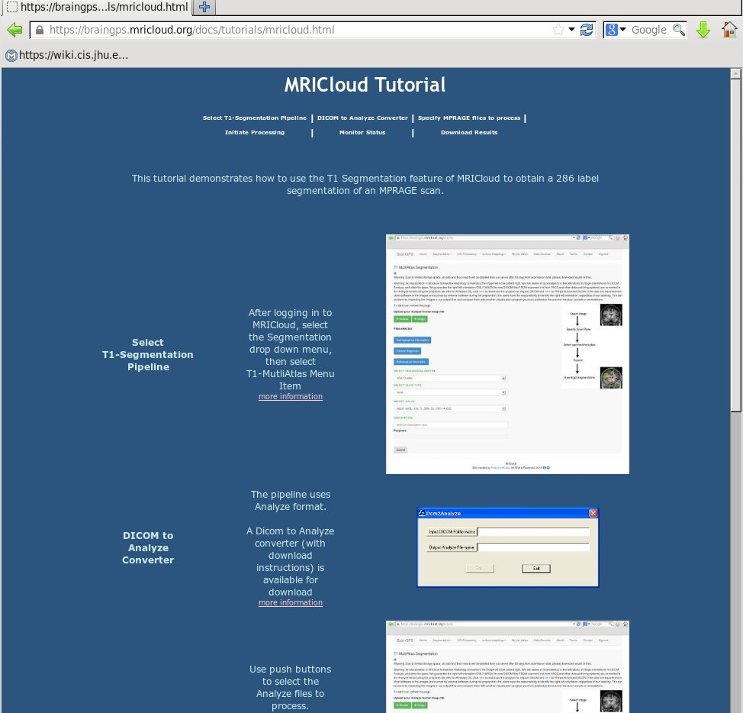
Mri Cloud Tutorial
Tutorial provides user with documentation on MRICloud features
User can navigate to detailed documentation by selecting the function of interest.

Slide 6
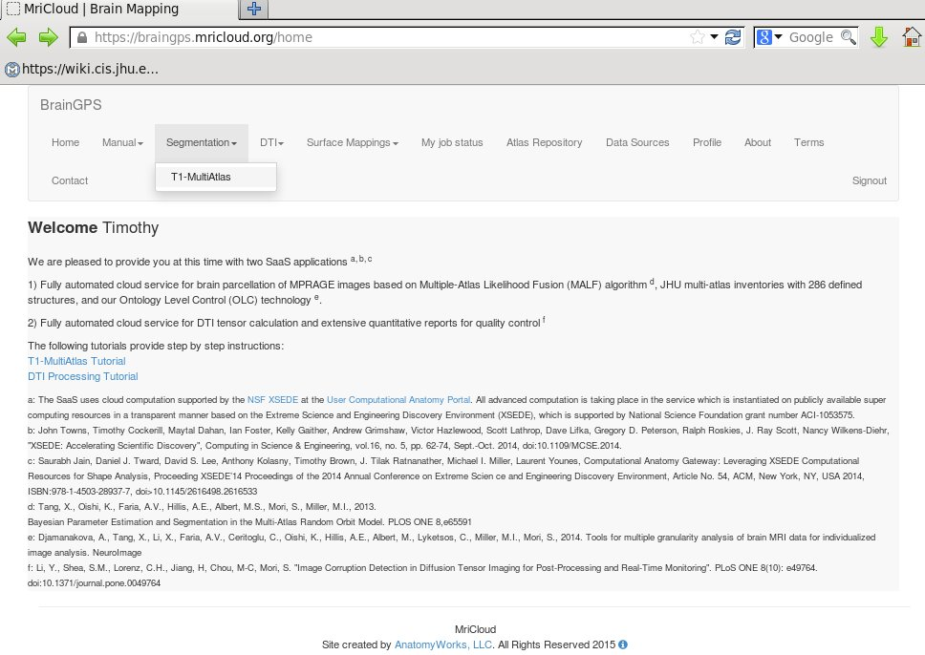
Mri Cloud
To Submit a brain to MRICloud
1) Select Segmentation Menu Item
2) Select T1-MultiAtlas

Slide 7
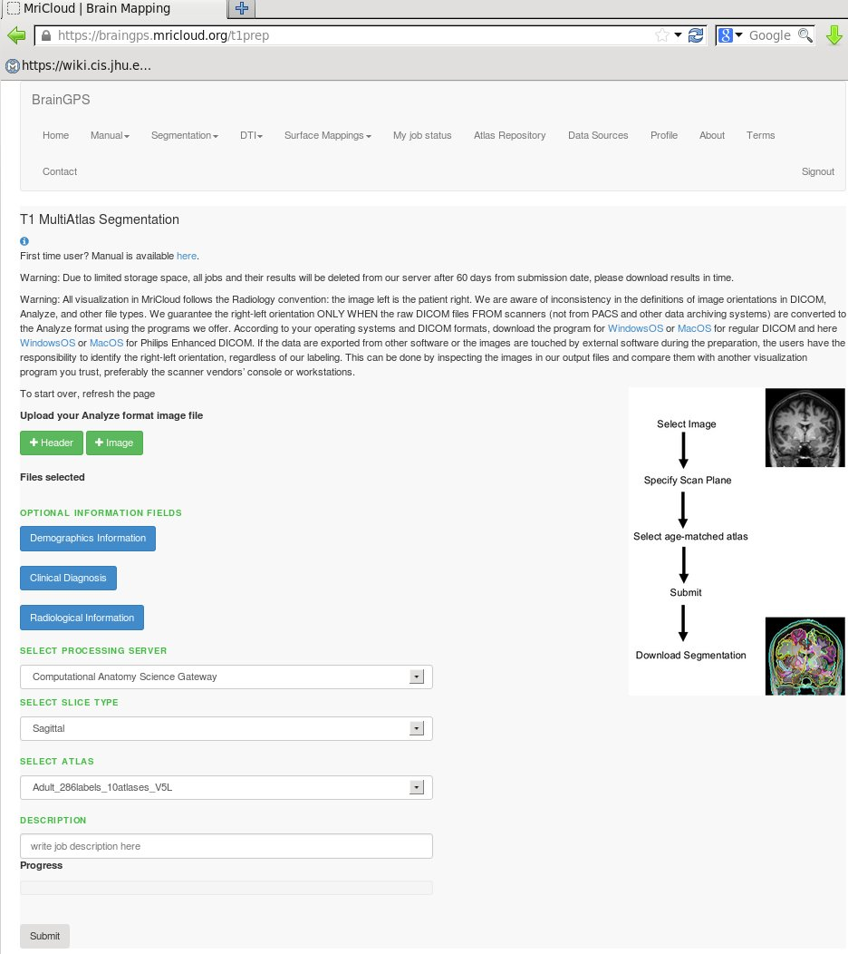
Mri Cloud
To Submit a brain to MRICloud
1) Use Header and Image buttons
To specify file location
2) Select Atlas
3) Enter description
4) Press submit

Slide 8
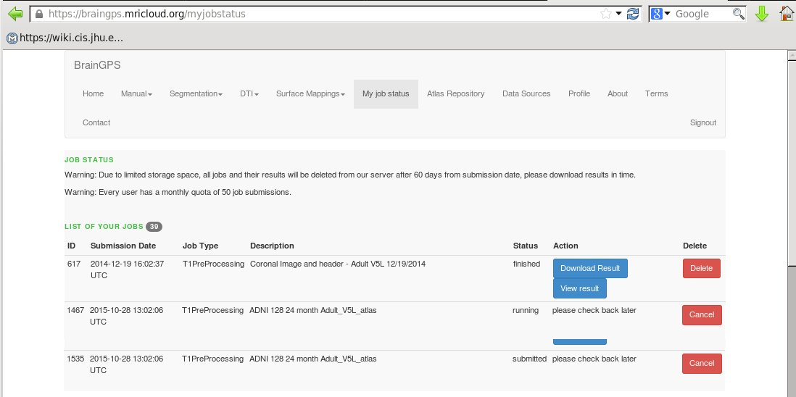
Mri Cloud
Check job status/retrieve results
1) Select My Job Status Menu Item
3) Download Result
2) Check status

Slide 9
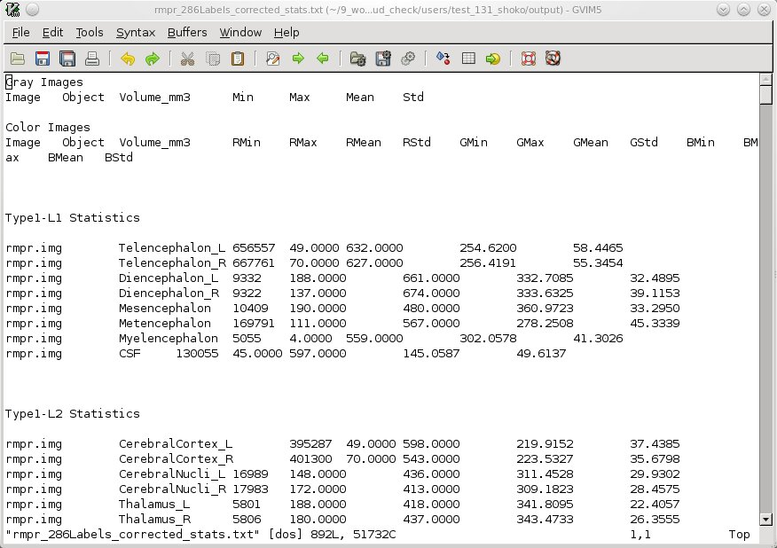
Mri Cloud
Obtain structure volumes from results
1) Unzip Results.zip file
2) In output directory, file *_286Labels_corrected_stats.txt contains volumes for brain structures. Volumes are included for various aggregations of labels.

Slide 10
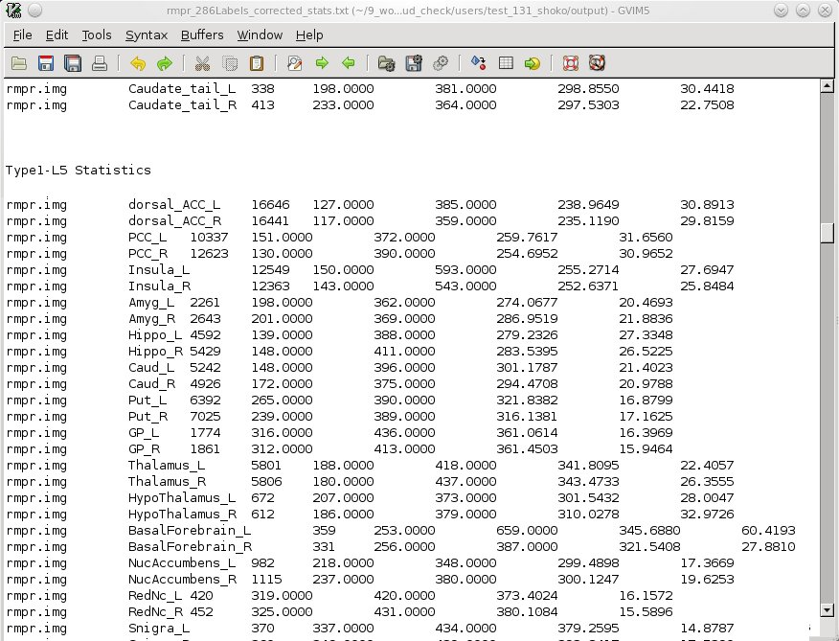
Mri Cloud
Obtain structure volumes from results
1) Level 5 is the finest level of detail
Left caudate volume = 5,242 cu. mm

