Slide 1
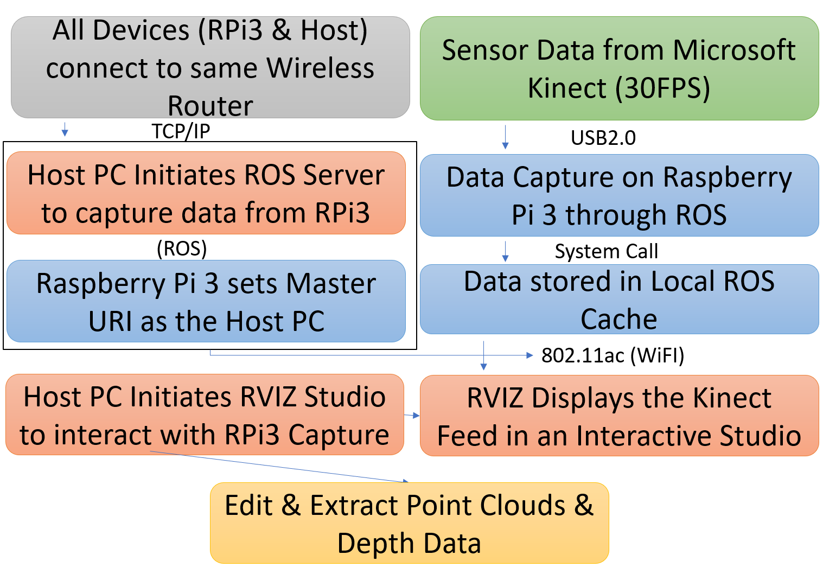
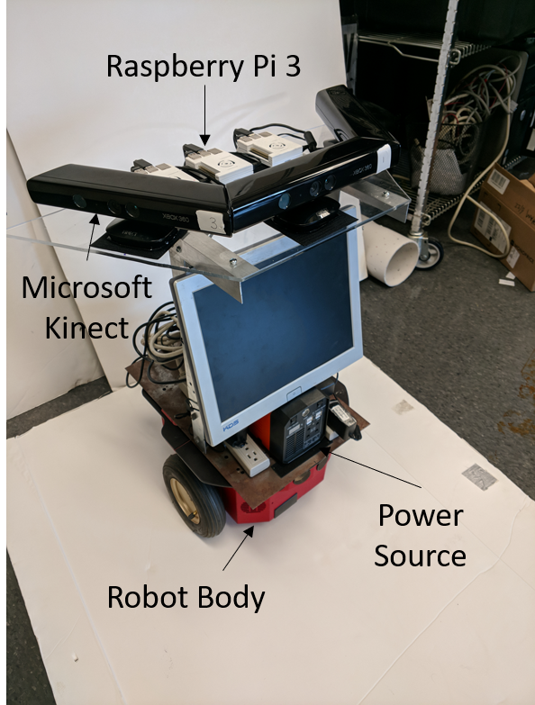
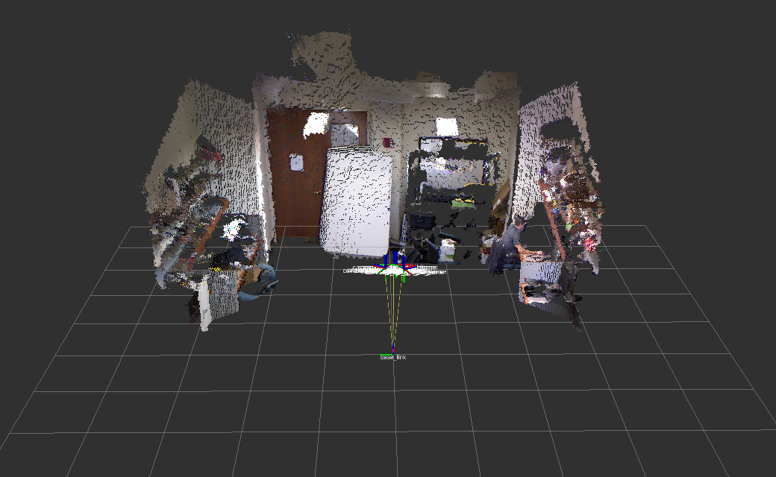
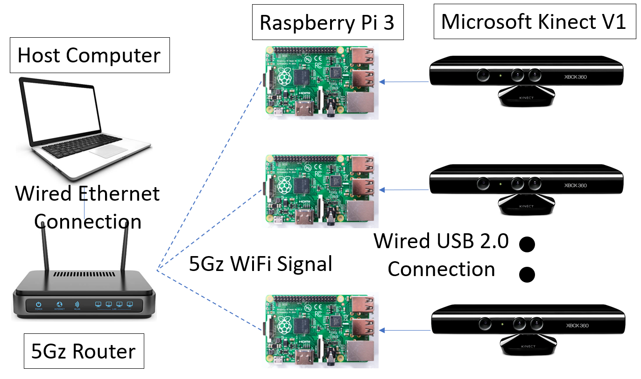
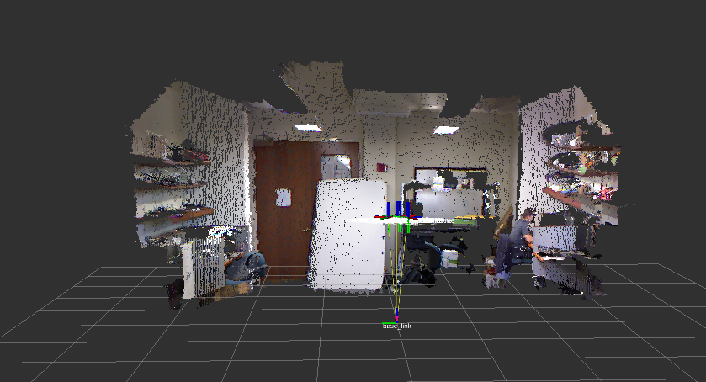
409
Modular Wireless Xbox Kinect Data Transfer Device
Team members: Eric Olson, Ayush Rohatgi, Dat Doan, Millad Nooristani | Faculty adviser: Yuichi Motai, Ph. D.
Purpose
MWXKDTD is the development of a modular Kinect data transfer solution that seeks to alleviate issues a Microsoft Xbox Kinect user may experience when attempting to operate multiple devices with their Personal Computer. Problems faced:
Installation of PCI card per Kinect device
Motherboard may not have multiple PCI card slots
Each Kinect device requires unique serial ID
Each Kinect utilizes full power capacity of PCI card
Goals
Develop software to interpret data from Raspberry Pi
Adapt existing Raspberry Pi Kinect API for wireless data transmission
Implement software to virtualize Kinect video
Test functionality by operating the our solution with an existing computer vision project that uses multiple Kinects
Results
Our 3 Kinects send video data [30 images per second, infrared, and depth] to a Raspberry Pi device via USB connection. The Raspberry Pi processes the video stream using ROS and wirelessly transfers the video stream to a Linux host PC over a Wi-Fi network. The host PC virtualizes the video stream at 30 FPS using ROS.
Figure 3: System design protocol
Design
Our solution is a combination of hardware and software that seamlessly integrate to allow the wireless transfer:
The Kinect transfers information to the Pi via USB
The Pi captures the information using the ROS framework
The Pi transmits this information to the main Desktop (Linux) over a 802.11ac connection
The Main Desktop decodes he information using the ROS framework
The bitmap is displayed in RVIZ as point clouds
Figure 4: Sample point cloud from Kinect delivered wirelessly to host PC.
Figure 1: Schematic diagram of system
Figure 2: System on Pioneer 2 robot

