Slide 1


NILKAMAL SCHOOL OF MATHEMATICS, APPLIED STATISTICS & ANALYTICS
Application of Exponential-Gamma(3,$θ$)
in Epidemiology
Group 7
Members:
A002 – Maaz Attar
A004 – Linette Correia
A005 – Fiza Dalwai
A010 – Rohit Fuke
A017 – Angela Job
Project Mentor:
Dr. KS Madhava Rao
Professor, Statistics SVKM NMIMS

Slide 2
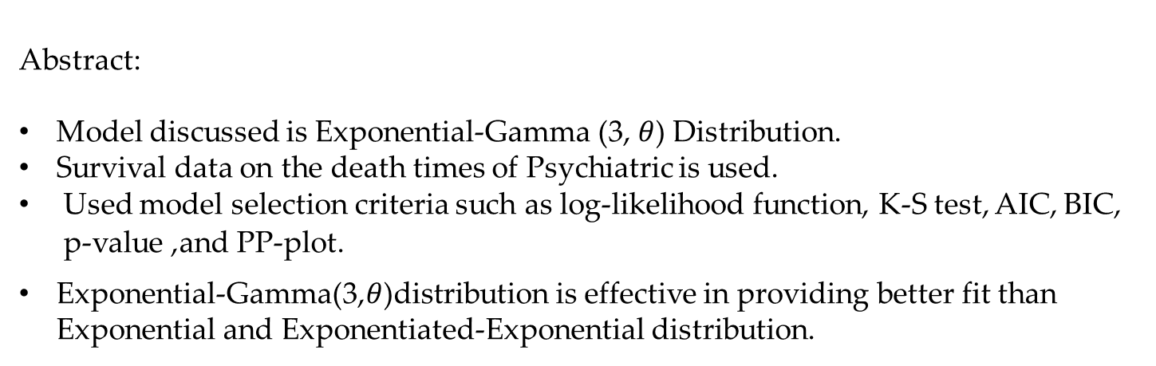
Exponential-Gamma (𝟑, 𝜽) Distribution and its Applications
by Beenu Thomas & V M Chacko
Thrissur, Kerala, India
published in Sept 2020
Research
Paper Used
Abstract:
Model discussed is Exponential-Gamma (3, $θ$) Distribution.
Survival data on the death times of Psychiatric is used.
Used model selection criteria such as log-likelihood function, K-S test, AIC, BIC, p-value ,and PP-plot.
Exponential-Gamma(3,$θ$)distribution is effective in providing better fit than Exponential and Exponentiated-Exponential distribution.

Slide 3

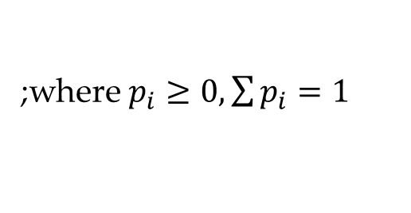
Epidemiology is the study of how often diseases occur in different groups of people and why.
What is mixture distribution ?
Given a finite set of probability density functions $f_{1}\left(x\right), f_{2}\left(x\right),…, f_{n}\left(x\right)$ with weights $p_{1}, p_{2},…,p_{n}$
Introduction
The mixture distribution can be represented by;
$$f\left(x\right)=\sum_{i=1}^{n}{p_{i}{ f}_{i}(x)}$$
;where $p_{i}≥0, \sum{p_{i}=1}$
This type of mixture is called finite mixture

Slide 4
Need for mixture distribution:
Height
Weight
Introduction
Factors
Gender
People with height or weight issues.
Age

Slide 5
Objectives of the Project
Objective of the Project
To study and discuss the properties of Exponential-Gamma (3, 𝜃) distribution. To fit an Exponential-Gamma distribution to real-life datasets and ascertain the goodness-of-fit.
1
To compare the fitted Exponential-Gamma (3, 𝜃) distribution with alternatives such as Exponential Distribution and Exponential-Exponential distribution.
2

Slide 6
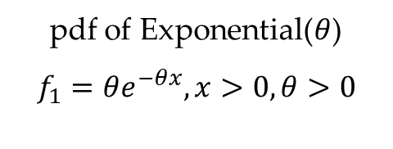
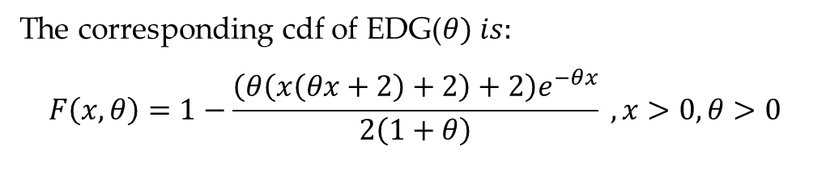
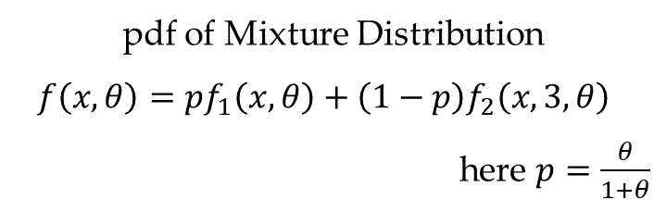
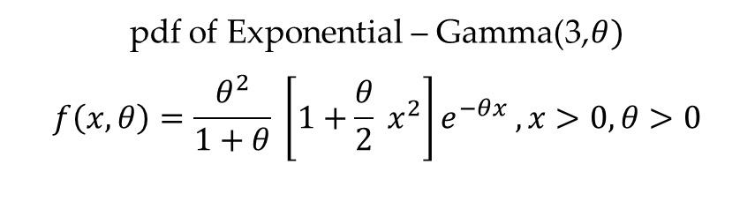
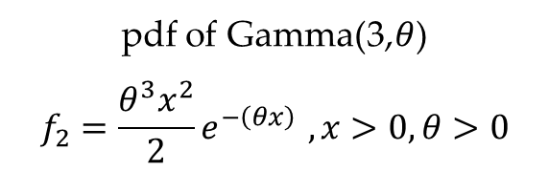
Formation of pdf for EGD($θ$)
pdf of Exponential($θ$)
$$f_{1}=θe^{−θx}, x>0, θ>0$$
pdf of Gamma(3,$θ$)
$$f_{2}=\frac{θ^{3}x^{2}}{2}e^{−\left(θx\right) }, x>0, θ>0$$
pdf of Mixture Distribution
$$f\left(x,θ\right)=pf_{1}\left(x,θ\right)+\left(1−p\right)f_{2}\left(x,3,θ\right)$$
here $p=\frac{θ}{1+θ}$
pdf of Exponential – Gamma(3,$θ)$
$$f\left(x,θ\right)=\frac{θ^{2}}{1+θ} \left[1+\frac{θ}{2} x^{2}\right]e^{−θx} , x>0, θ>0$$
The corresponding cdf of EDG($θ) is:$
$$F\left(x,θ\right)=1−\frac{\left(θ\left(x\left(θx+2\right)+2\right)+2\right)e^{−θx}}{2\left(1+θ\right)} , x>0, θ>0$$

Slide 7


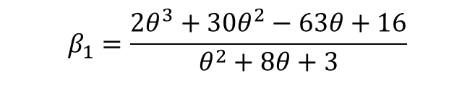
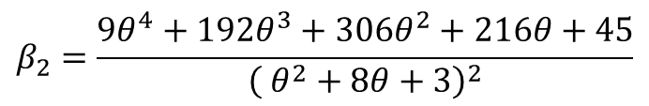

Moments
$$μ_{r}^{′}=\frac{2θr!+γ\left(r+3\right)}{2\left(1+θ\right)θ^{r}}$$
Statistical
Measures
Mean
Variance
$$μ=\frac{θ+3}{θ\left(1+θ\right)}$$
$$σ^{2}=\frac{θ^{2}+8θ+3}{θ^{2}{\left(1+θ\right)}^{2}}$$
Skewness
Kurtosis
$$β_{1}=\frac{2θ^{3}+30θ^{2}−63θ+16}{θ^{2}+8θ+3}$$
$$β_{2}=\frac{9θ^{4}+192θ^{3}+306θ^{2}+216θ+45}{{\left( θ^{2}+8θ+3\right)}^{2}}$$

Slide 8
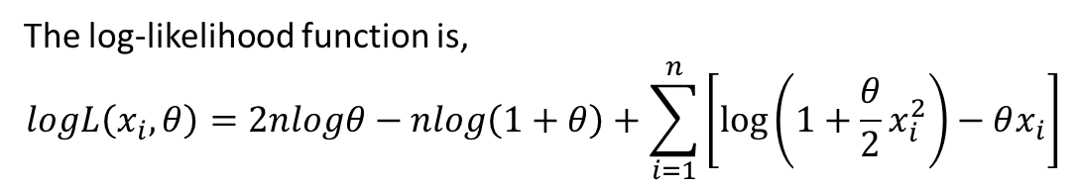
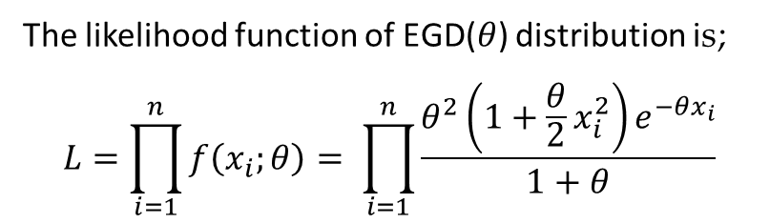
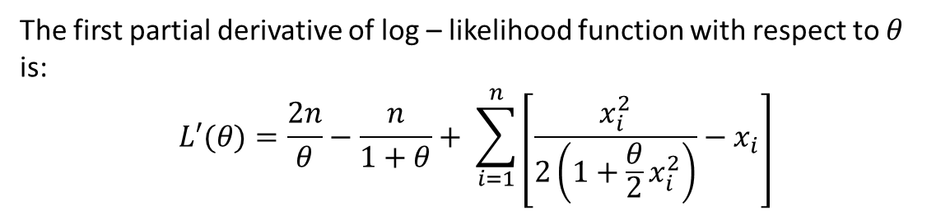
Parametric Estimation
The likelihood function of EGD($θ$) distribution is;
$$L=\prod_{i=1}^{n}{f\left(x_{i};θ\right)= \prod_{i=1}^{n}{\frac{θ^{2}\left(1+\frac{θ}{2}x_{i}^{2}\right)e^{−θx_{i}}}{1+θ}}}$$
Method of Maximum Likelihood
The log-likelihood function is,
$$logL\left(x_{i},θ\right)=2nlogθ−nlog\left(1+θ\right)+\sum_{i=1}^{n}{\left[\log\left(1+\frac{θ}{2}x_{i}^{2}\right)−θx_{i}\right]}$$
The first partial derivative of log – likelihood function with respect to $θ$ is:
$$L′(θ)=\frac{2n}{θ}−\frac{n}{1+θ}+ \sum_{i=1}^{n}{\left[\frac{x_{i}^{2}}{2\left(1+\frac{θ}{2}x_{i}^{2}\right)}−x_{i}\right]}$$

Slide 9

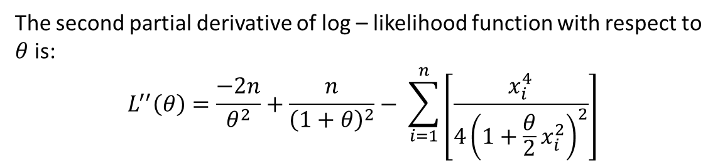
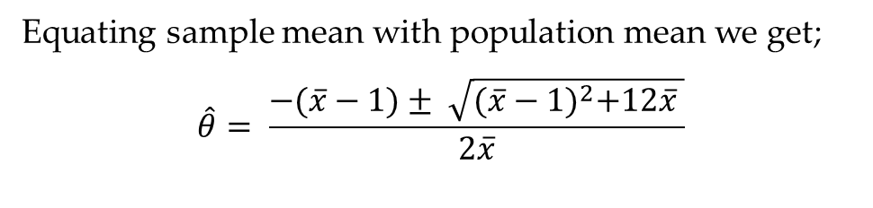
Parametric Estimation
The second partial derivative of log – likelihood function with respect to $θ$ is:
$$L^{′′}\left(θ\right)=\frac{−2n}{θ^{2}}+\frac{n}{{\left(1+θ\right)}^{2}}− \sum_{i=1}^{n}{\left[\frac{x_{i}^{4}}{4{\left(1+\frac{θ}{2}x_{i}^{2}\right)}^{2}}\right]}$$
It is one of the most widely used methods for root finding.
$$θ_{n+1}=θ_{n}−\frac{L^{′}\left(θ\right)}{L"(θ)}$$
Newton Raphson Method
Equating sample mean with population mean we get;
$$\hat{θ}= \frac{−(\overline{x}−1)± \sqrt{{(\overline{x}−1)}^{2}+12\overline{x} }}{2\overline{x}}$$
Method of Moments

Slide 10
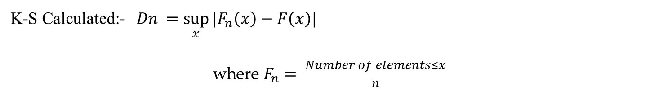


Goodness of Fit
Kolmogorov-Smirnov Goodness of Fit Test (K-S test)
H₀: The data comes from the specified distribution.
v/s
H₁: The data does not follow the specified distribution.
K-S Calculated:- $Dn =\sup_{x}{|F_{n}\left(x\right)−F\left(x\right)|}$
where $F_{n}= \frac{Number of elements≤x}{n}$
K-S Critical:- At level of significance; $α=0.05$
Critical value = $\frac{1.36}{\sqrt{n}}$
Conclusion:-
Reject H₀ if, K-S Calculated $≥$ K-S Critical

Slide 11
Goodness of Fit
Akaike Information Criterion (AIC)
AIC= 2k - 2ln(L)
where, k is the number of independent variables used by default k is 2
L is the likelihood estimate
Bayesian Information Criterion (BIC)
BIC=k ln(n)-2ln(L)
where n is the sample size
k is the number of parameters which your model estimates
L is the likelihood estimate

Slide 12
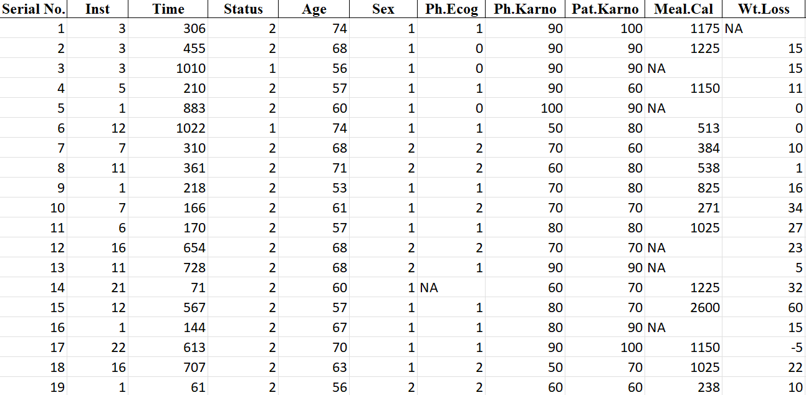
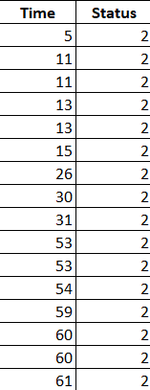
Data Used
The variables considered are: 1)Time
2) Status (containing value 2 i.e. dead)

Slide 13
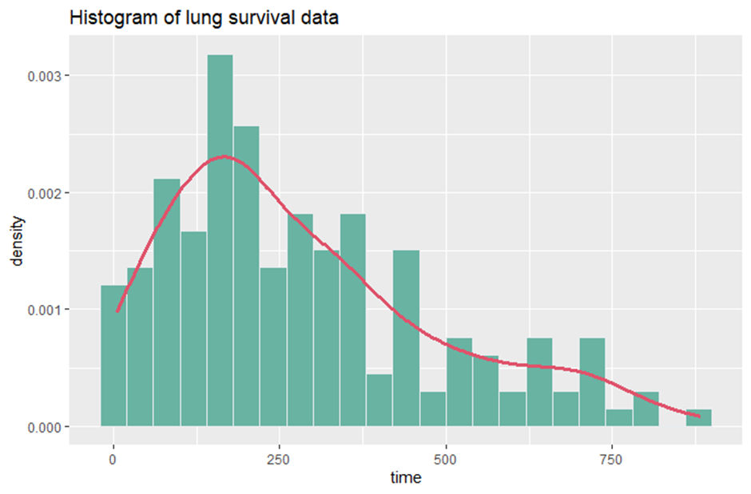
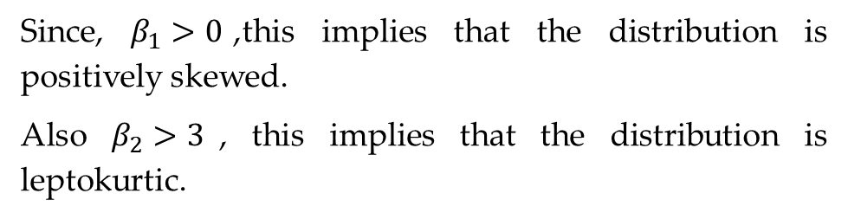
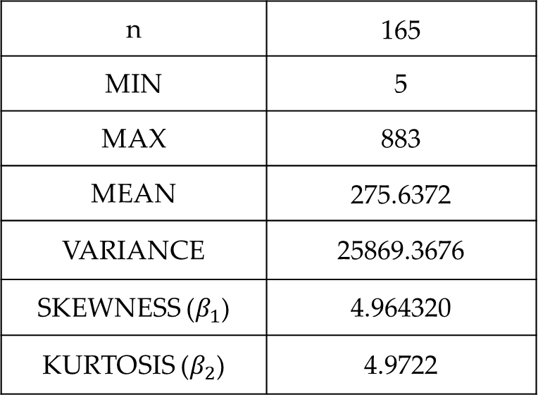
Statistical Summary of EGD($θ)$
n | 165
MIN | 5
MAX | 883
MEAN | 275.6372
VARIANCE | 25869.3676
SKEWNESS ($β_{1}$) | 4.964320
KURTOSIS ($β_{2}$) | 4.9722
Since, $β_{1}>0$,this implies that the distribution is positively skewed.
Also $β_{2}>3$, this implies that the distribution is leptokurtic.

Slide 14
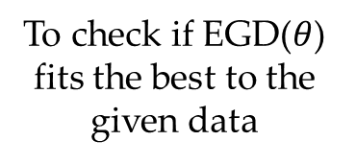
Model Selection
1
To check if EGD($θ$) fits the best to the given data
Estimating the required parameters
3
Comparing the distributions using the criteria for selecting the best model fit
K-S Goodness of Fit Test
Log - Likelihood
AIC
BIC
P-P Plot
2
4
Considering 2 more distributions of the similar type

Slide 15
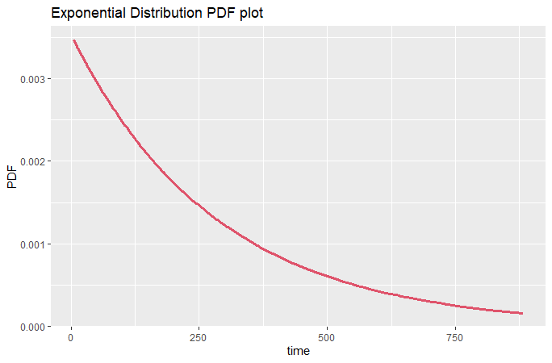
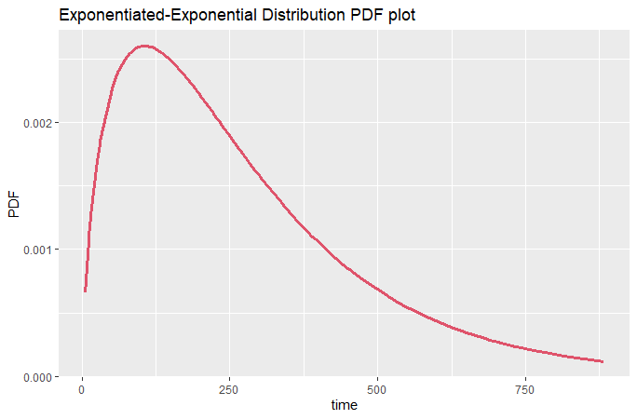
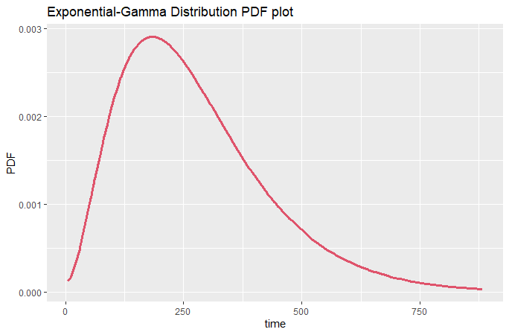
Graphical Representation

Slide 16
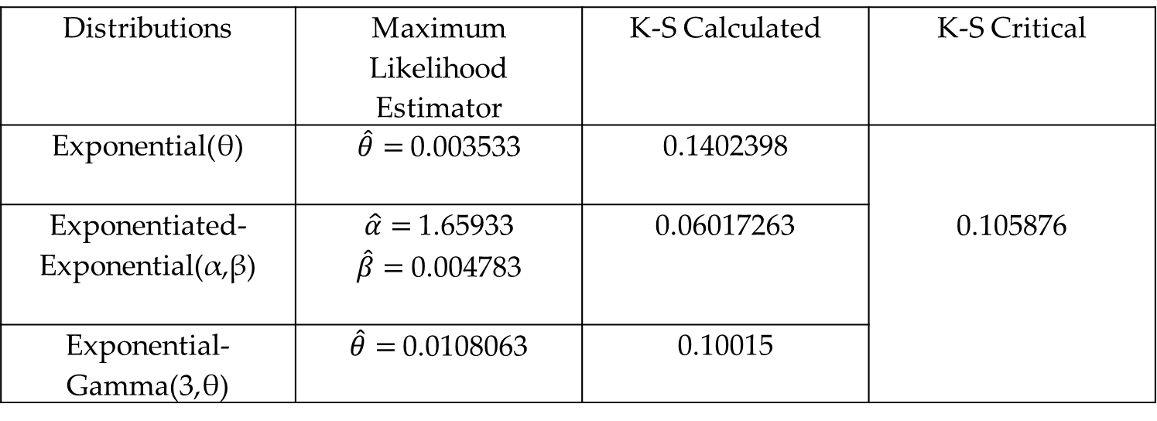
Analysis
Table of Parametric Estimators and Test Statistic:
Distributions | Maximum Likelihood Estimator | K-S Calculated | K-S Critical
Exponential(θ) | $\hat{θ}=$0.003533 | 0.1402398 | 0.105876
Exponentiated-Exponential(α,β) | $\hat{α}=$1.65933 $\hat{β}=$0.004783 | 0.06017263
Exponential-Gamma(3,θ) | $\hat{θ}=$0.0108063 | 0.10015
From the above test we conclude that the data follows Exponential – Gamma($3,θ$) as well as
Exponentiated – Exponential distribution but not Exponential distribution.

Slide 17
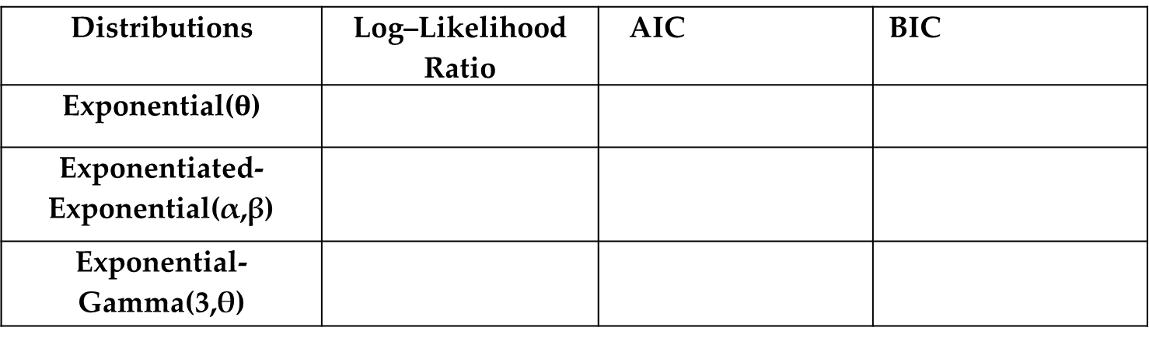
Analysis
To identify the distribution that fits the best using model selection criteria
= 2k - 2ln(L)
= kln(n)-2ln(L)
Distributions | Log–Likelihood Ratio | AIC | BIC
Exponential($θ$)
Exponentiated-Exponential(α,β)
Exponential-Gamma(3,θ)
-1096.499
-1087.905
-1074.336
2194.997
2179.809
2150.673
2198.103
2186.021
2153.76
Exponential-Gamma has the highest score in Log-Likelihood and lowest score AIC and BIC.
Hence, Exponential-Gamma provides the better fit to the data.

Slide 18
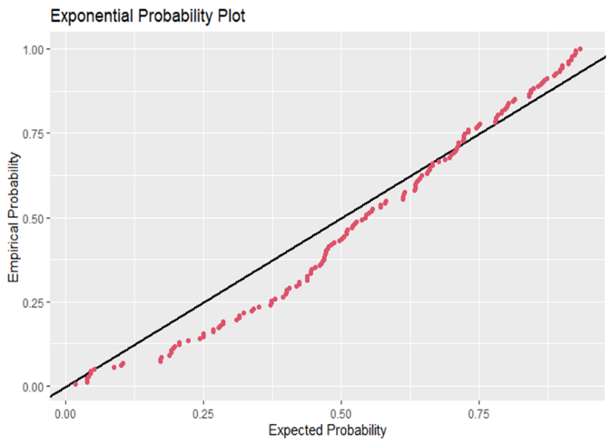
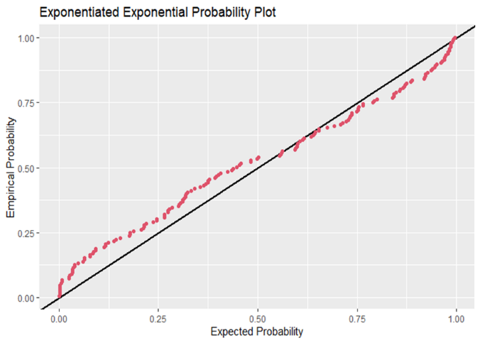
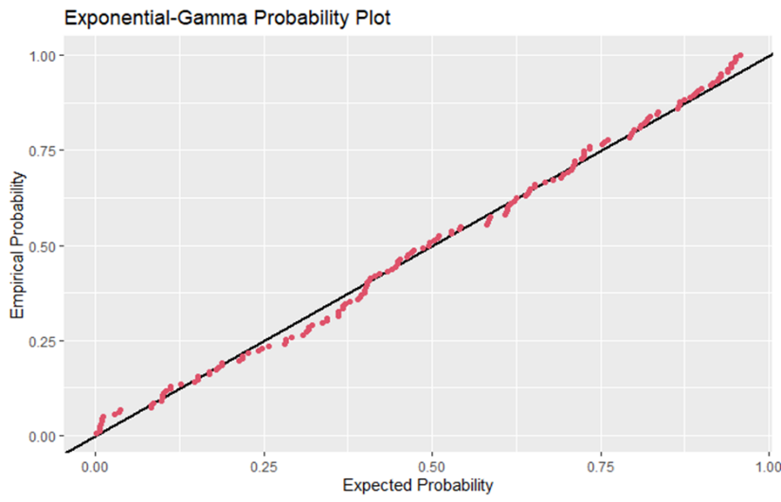
Analysis
PP Plot
From the above plots, the points lie very close to the reference line for Exponential- Gamma Distribution. Hence, Exponential- Gamma(3, 𝜃) Distribution provides a better fit than Exponential distribution and Exponentiated-Exponential distribution.

Slide 19
Applications of Exponential-Gamma (3, 𝜃) distribution to real data shows that Exponential-Gamma (3, 𝜃) distribution is effective in providing better fits than the Exponential and Exponentiated Exponential distribution.
Conclusion
Kolmogrov - Smirinov test, AIC & BIC values , PP plot indicates that Exponential-Gamma(3, 𝜃) provides better fit then the other two distributions.

Slide 20
https://digitalcommons.wayne.edu/cgi/viewcontent.cgi?article=1916&context=jmasm
https://www.researchgate.net/publication/358743397
https://home.iitk.ac.in/~kundu/paper59
https://www.statisticshowto.com/kolmogorov-smirnov-test/
https://en.wikipedia.org/wiki/Akaike_information_criterion
https://en.wikipedia.org/wiki/Bayesian_information_criterion
https://en.wikipedia.org/wiki/P%E2%80%93P_plot
https://www.kaggle.com/code/saychakra/survival-analysis-of-lung-cancer-patients/data
References

Slide 21
Thank You

