Slide 1

FAKE NEWS
DETECTION
GROUP 10
NANDANA RAJAN - A046
ROHIT FUKE – A010

Slide 2
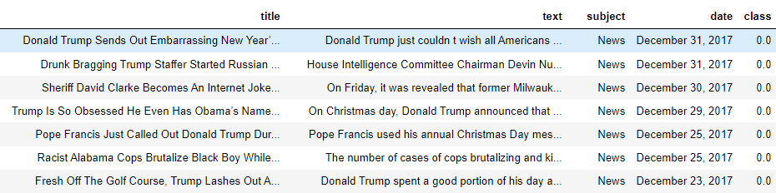
DATA DESCRIPTION
Size of the data
44961
Number of variables
5

Slide 3
PROJECT RECAP
Data Preprocessing
Data Visualization
No missing values in the data
Deleted variables which were not useful
Text processing using NLP
Barplot to understand the most frequent words
WordCloud

Slide 4

Logistic Regression
MODELS
USED
Random Forest
Decision tree
nandana

Slide 5
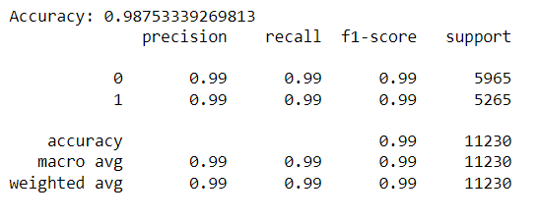
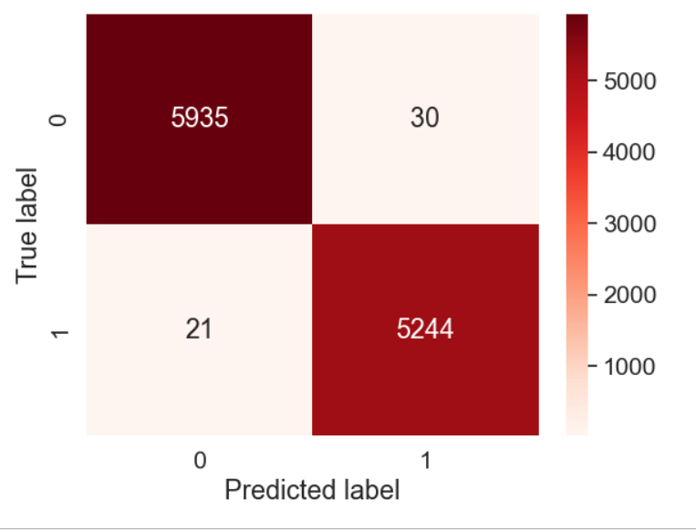
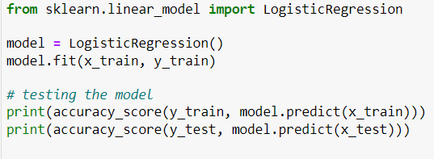
LOGISTIC REGRESSION
Library used
Scikit-learn
Model

Slide 6
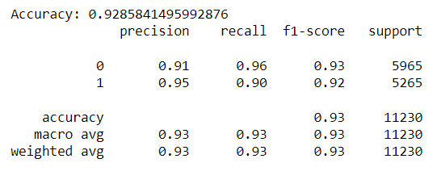
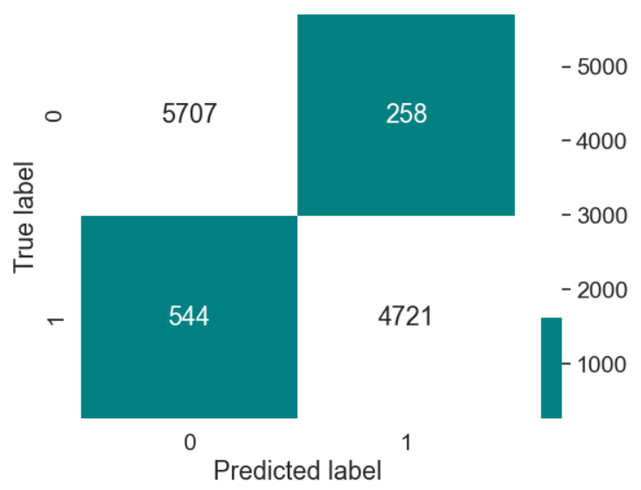
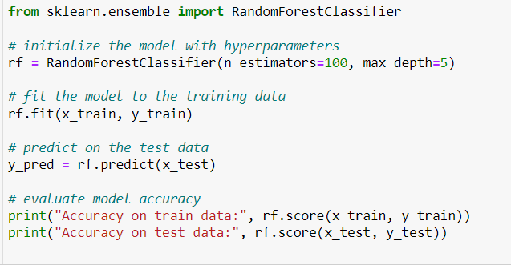
RANDOM FOREST
Library used
Scikit-learn
Model

Slide 7
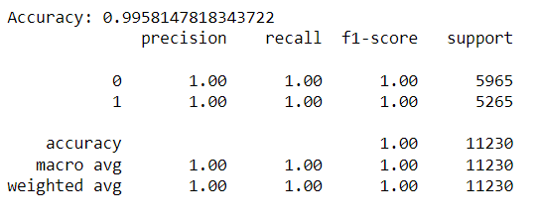
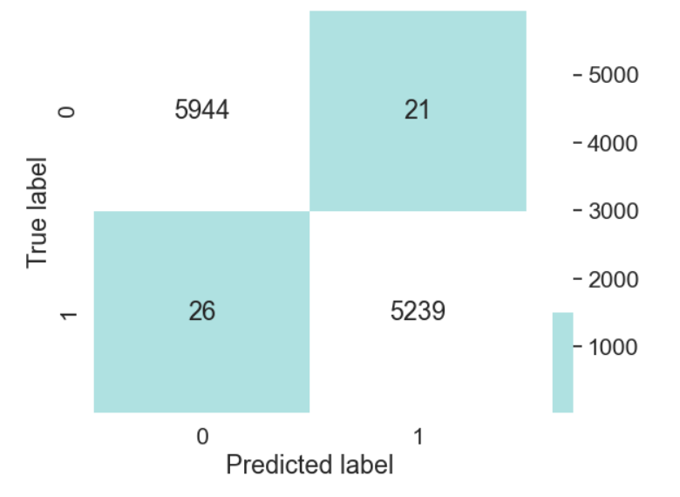
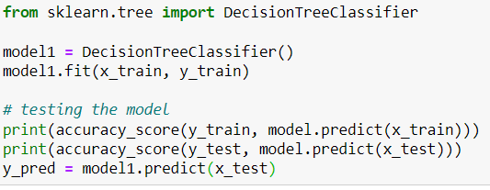
DECISION TREE
Library used
Scikit-learn
Model

Slide 8
CONCLUSION
Model | Accuracy
Logistic Regression | 0.9875
Random Forest | 0.9285
Decision Tree | 0.9958
Comparing the model performance, We can conclude that the Logistic Regression model gives the best result for our dataset.

Slide 9
THANK YOU !

