Slide 1
introduction to omegalib and omicron
Alessandro Febretti
Electronic Visualization Lab – University of Illinois at Chicago

Slide 2
omicron vs omegalib
omicron: input management library
Can be integrated directly as library or used as input server
omicronConnector.h
Input device
Tcp / Udp
omicron input server
user application
Input device

Slide 3
omicronConnector example
#include <connector/omicronConnectorClient.h>
using namespace omicronConnector;
int main(int argc, char** argv)
{
OmicronConnectorClient<ConnectorListener> client;
client.connect("127.0.0.1");
while(true) client.poll();
}
class ConnectorListener
{
public:
static void onEvent(const EventData& e) { printf(“Received event!\n”); }
};

Slide 4
omicron events
omicron events designed as generic input data containers
information about event source
service class (wand, gamepad, pointer, ui)
Services of same class have similar event generation semantics
event type, position, orientation, binary flags
variable length extra data
can be float array, vector3 array, generic char*
more information: http://code.google.com/p/omicron-sdk/wiki/EventReference

Slide 5
omicron event services
event service = source of omicron events
some built-in event services:
VRPN-supported trackers
Optitrack native
XBox360, PS3, Wiimote controllers
PQLabs touch overlays
Kinect skeletons
ThinkGear
iPad app (prototype)
SAGE Pointer

Slide 6
omicron utilities
omicron also offers utility APIs for app developers (used by omegalib)
config file support (libconfig)
xml reading/writing (tinyxml)
multithreading (tinythreads)
tcp client/server API (asio)
math library (Eigen)

Slide 7

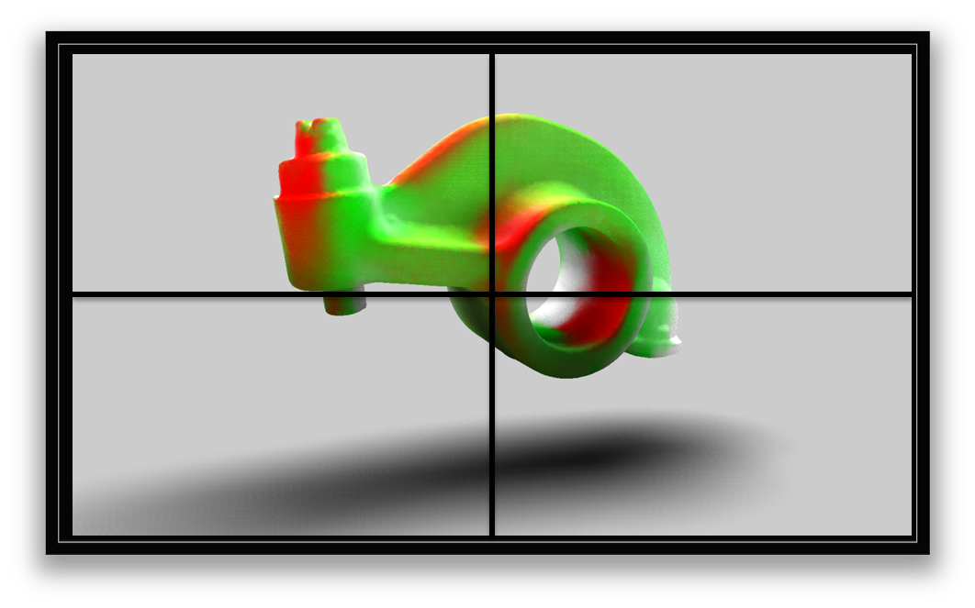
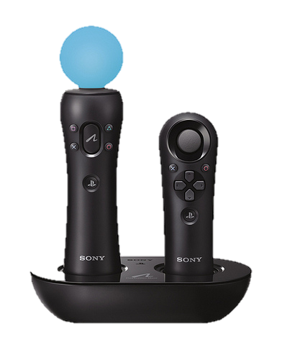
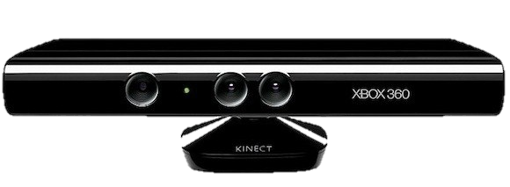
VR toolkit built on top of omicron (input) and Equalizer (display)
user application
graphics frontend
omegalib core
omicron
Equalizer

Slide 8
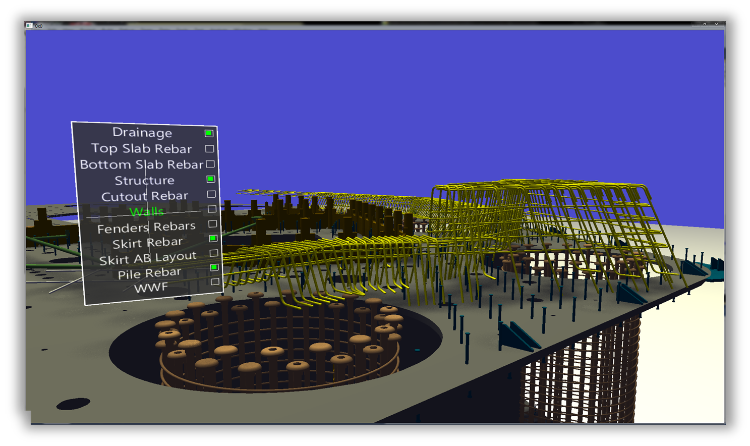
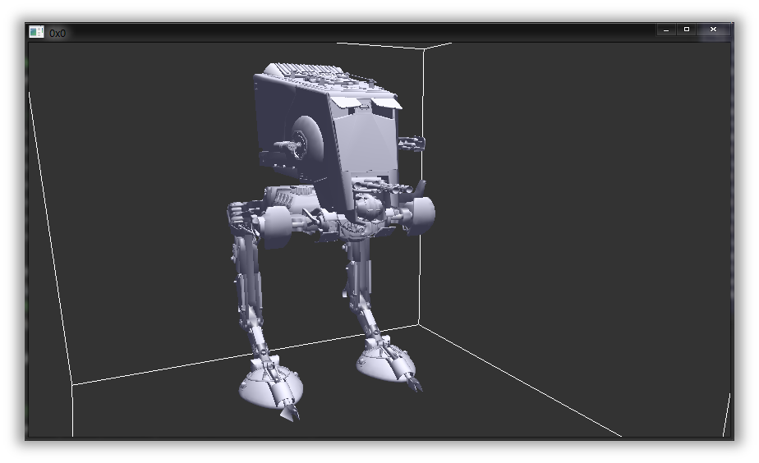
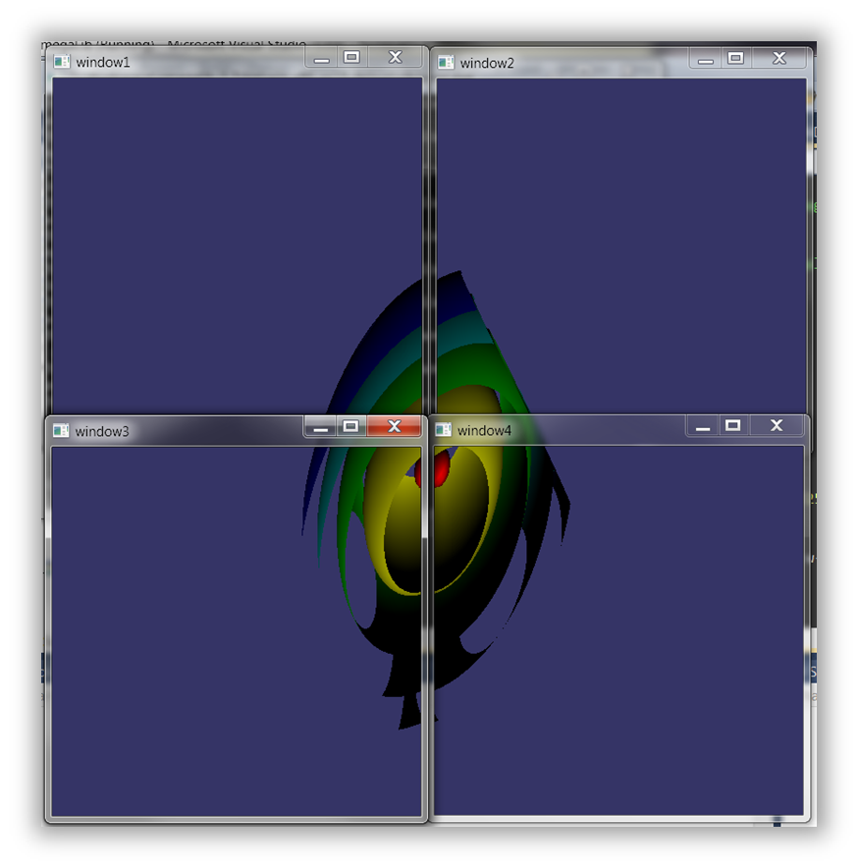
omegalib core = support backend for different graphics frontends
Currently supported frontends:
OpenSceneGraph
Vtk
Plain OpenGL

Slide 9
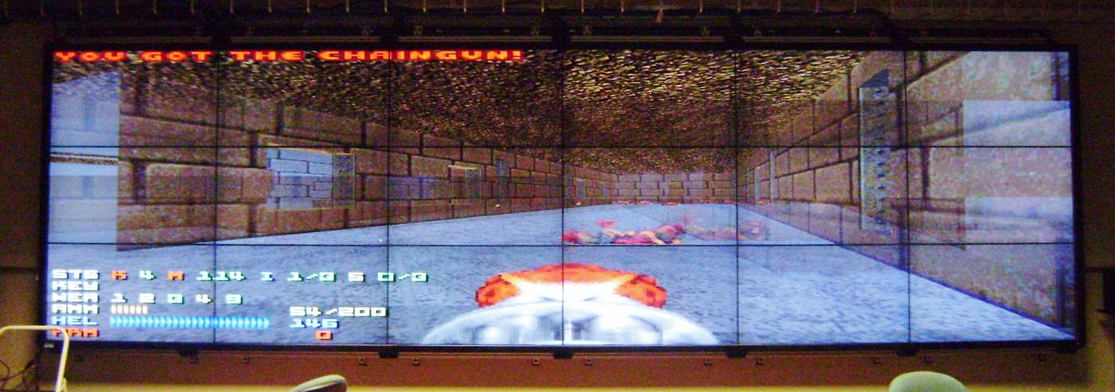
some legacy applications can be ported to omegalib
(https://code.google.com/p/omegadoom/)

Slide 10
Research direction: multi-application VR
run multiple applications inside separate viewports / windows (a la SAGE)
Allow applications to switch to ‘fullscreen mode’ and take over entire display
Challenges:
Load balancing (equalizer helps a bit)
Interaction

Slide 11
That’s all folks!
Links:
omicron: http://code.google.com/p/omicron-sdk/
omegalib: https://code.google.com/p/omegalib/
Equalizer: http://www.equalizergraphics.com/

