Slide 1
WOLF QUANT MODEL
Investment committee briefing
A disciplined global-equity decision system with portfolio constraints, stress testing and governance.
DECISION: CONTINUE PAPER AND SHADOW OPERATION
55,504
89
75 / 100
0
active equities
monthly decisions
governance score
hard breaches
As of 19 August 2026 | CONDITIONALLY_APPROVED | Research evidence

Slide 2
The decision in one page
02
The controls improved materially; the alpha claim did not.
Recommendation
What still blocks full deployment
Continue paper and shadow operation. Do not allocate live capital while validation components still fail.
Observed PIT evidence is incomplete, and Wolf trailed equal weight by 3.80% per year in this 60-month sample (p=0.250).
What works today
Decision area | Evidence | Action
Process | Checksummed | Use
Risk backtest | 15 / 15 | Pass
Cost controls | 5 / 10 | Warning
Hard constraints | 10 / 10 | Pass
PIT evidence | 7.5 / 15 | Warning
Deployable alpha | Not established | Do not claim
• Repeatable screening across six equity regions
• Chronological VaR governance gate: Pass
• Net-of-cost implementation controls: Warning
• Hard portfolio constraints: Pass
Approval means: Pilot capital, pre-trade review, monthly risk reporting and explicit stop conditions. It does not mean automatic execution.
Wolf Quant Model | Research use
Validation 19 August 2026; research through 19 August 2026

Slide 3
What the model actually does
03
A monthly decision pipeline with risk controls at the end.
1 OBSERVE
2 FEATURE
3 FORECAST
4 COMPARE
5 CONSTRAIN
6 GOVERN
Prices, filings, macro and portfolio
Point-in-time quality, value and risk signals
Distributional and supervised 3/6/9/12m signals
Portfolio-aware, clean-sheet and LLM branches
CVaR, liquidity and concentration limits
Stress, validation and committee reporting
The output is a decision package
ML challengers cannot override governance
Ranked equities, target weights, trade direction, exposure limits, risk tests, stress results and an approval status.
PPO, bandit, convex and supervised challengers remain research-only. Their legacy OOS results are diagnostics; the baseline remains at 100%.
Human review stays between model recommendation and execution.
Wolf Quant Model | Research use
Repository pipeline stages and current resolved outputs

Slide 4
Design architecture: ML remains inside the governed stack
04
Nine supervised families and adaptive allocators challenge, but cannot bypass, the classical baseline.
1 EVIDENCE
2 RESEARCH PANEL
3 MODEL LAYER
4 PORTFOLIO
5 GOVERNANCE
• Prices, volume and actions
• Filings and macro vintages
• Portfolio and benchmarks
• UTC lineage and snapshots
• Point-in-time features
• Regional and sector peers
• Matured forward labels
• 3/6/9/12m horizons
• Distributional forecasts
• Linear and robust models
• Tree ensembles and XGBoost
• PPO, bandit and convex
• Scorecard and branches
• CVaR baseline: 100%
• Supervised overlay: 0%
• DRL overlay: 0%
• Costs and uncertainty
• Risk and stress tests
• Acceptance gates
• Final IC package
TRAIN AND CONFIGURE
MODEL CODE AND LOCAL BUNDLES
PUBLISHED AGGREGATE EVIDENCE
scripts/run_supervised_alpha.py configs/ml_forecasting.yaml
src/models/supervised_alpha.py data/processed/supervised_alpha/*.joblib
reports/outputs/supervised_alpha/ validation, OOS, calibration and plots
Current decision: All ML challengers remain research-only until their independent prospective evidence gates pass.
Wolf Quant Model | Research use
Repository architecture and governed supervised-alpha runner

Slide 5
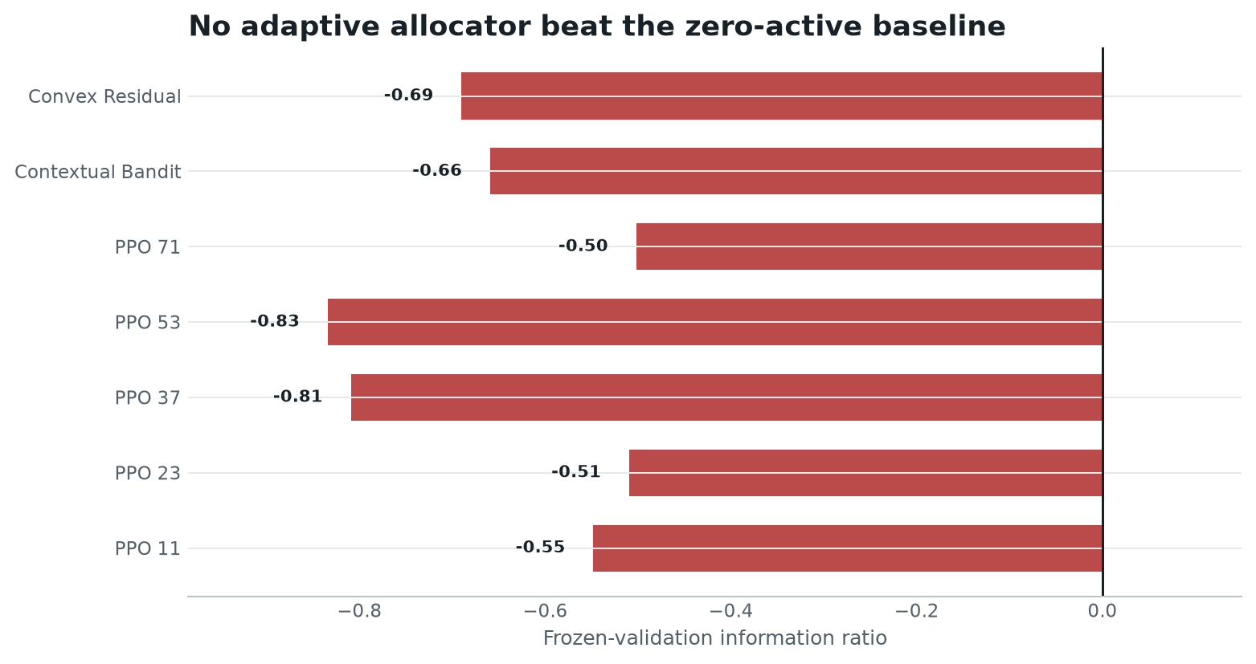
DRL learned safely, but did not earn capital
05
Five real PPO seeds and two simpler challengers failed frozen validation.
348
268
regional history months
training months
65
12
validation months
legacy OOS months
Measured result
Best PPO validation information ratio was -0.50. 4 contiguous train-only bootstrap environments per seed produced 0 constraint violations.
Governed decision: PPO receives 0%; the classical optimiser remains 100%. That is a successful safety decision, not a failed software run.
Wolf Quant Model | Research use
Checksummed regional history, train-only bootstrap and validation-only selection

Slide 6
The new supervised alpha research stack
06
Benchmark-relative stock ranking across four investment horizons.
1,374
16
4
0%
research securities
fixed candidate specifications
forecast horizons: 3/6/9/12m
live supervised blend
Evidence and targets
Model challengers
Controls before prediction
• 88 monthly decision dates
• 67 numeric plus 4 categorical features
• Returns measured versus regional and sector peers
• PIT status remains reconstructed proxy
• OLS with train-only Fama-MacBeth screening
• Ridge, Elastic Net and robust Huber regression
• Random Forest, Extra Trees and histogram boosting
• XGBoost return and learning-to-rank models
• Expanding-window purged cross-validation
• Preprocessing and screening fitted inside each fold
• One linear, tree and ranker winner per ensemble
• Explicit turnover, impact, FX and 25bp bank fee
Governance boundary: The supervised ensemble and every DRL challenger remain research-only. The governed baseline still receives 100% of portfolio weight.
Wolf Quant Model | Research use
Supervised dataset, validation checkpoints and model manifests

Slide 7
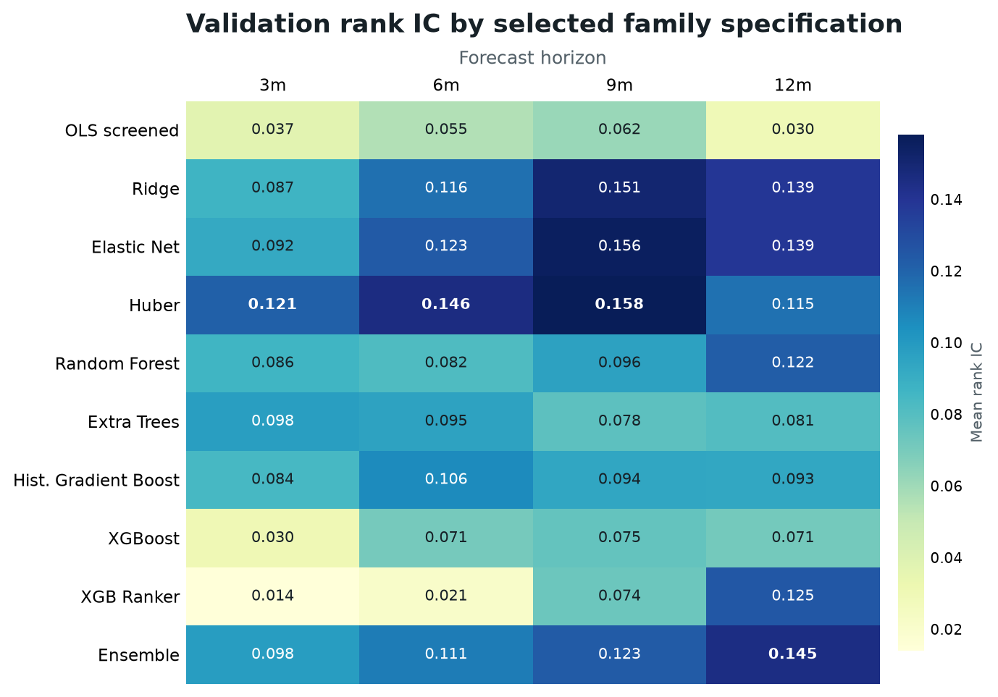
How the supervised models compared
07
Validation rank IC is positive across most families, but no model is approved for capital.
Horizon | Best individual | Ensemble val. | Legacy OOS | Indep.
3m | Huber / 0.121 | 0.098 | 0.157 | 4
6m | Huber / 0.146 | 0.111 | 0.182 | 2
9m | Huber / 0.158 | 0.123 | 0.226 | 1
12m | Elastic Net / 0.139 | 0.145 | 0.253 | 1
What won validation
Huber led raw rank IC at 3, 6 and 9 months; Elastic Net led at 12 months. The ensemble diversifies model risk instead of chasing one winner.
Governance result: Only four independent 3-month legacy OOS cohorts exist, so the supervised deployment blend stays at 0%.
Wolf Quant Model | Research use
Expanding purged validation and already-inspected legacy OOS diagnostics

Slide 8
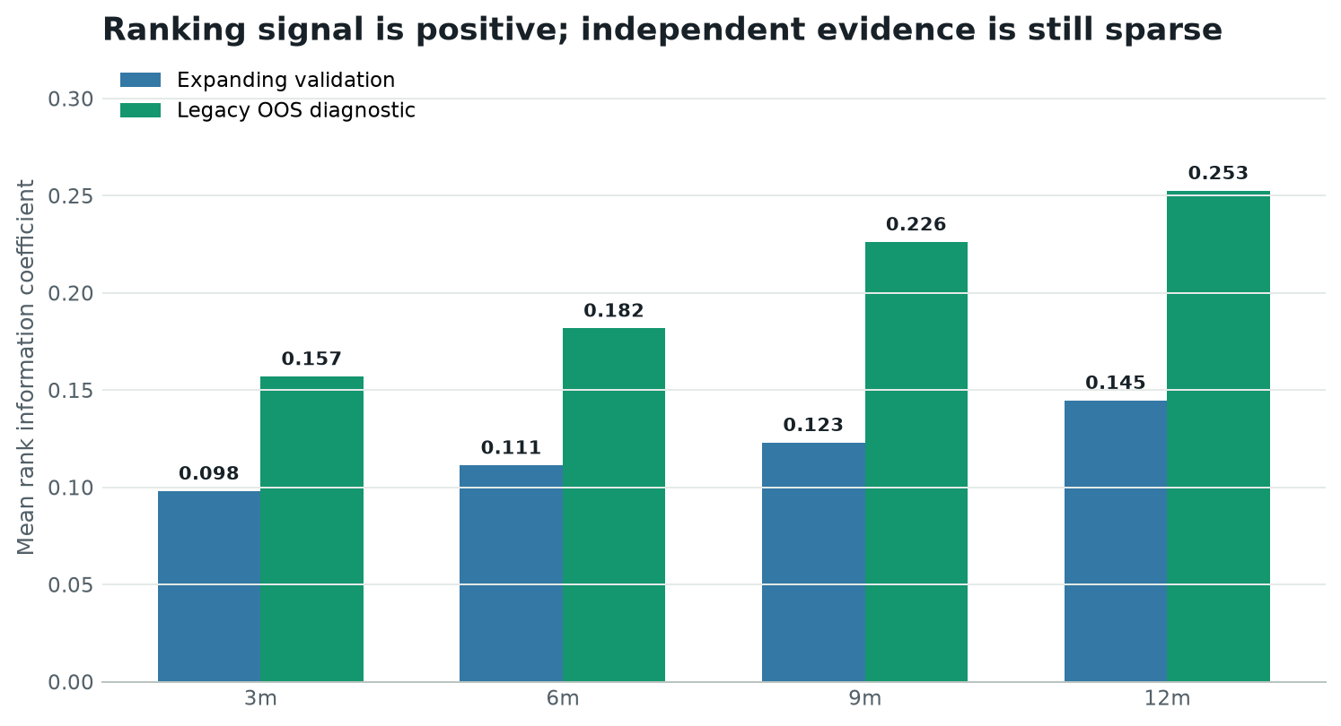
Supervised signal: encouraging, not yet proven
08
Positive ranking results do not overcome four independent 3-month samples.
Horizon | Monthly | Independent | Rank IC | Sign p | Net cohort
3m | 11 | 4 | 0.157 | 0.062 | 7.4%
6m | 7 | 2 | 0.182 | 0.250 | 14.2%
9m | 4 | 1 | 0.226 | 0.500 | 24.8%
12m | 1 | 1 | 0.253 | 0.500 | 37.0%
Primary 3-month diagnostic
Rank IC 0.157; mean net active cohort return 7.4%; exact sign-test p=0.0625.
What is deliberately absent: No headline CAGR, Sharpe, t-statistic or confidence interval is reported until 12 independent prospective cohorts exist.
Wolf Quant Model | Research use
Frozen validation and already-inspected legacy OOS diagnostics

Slide 9
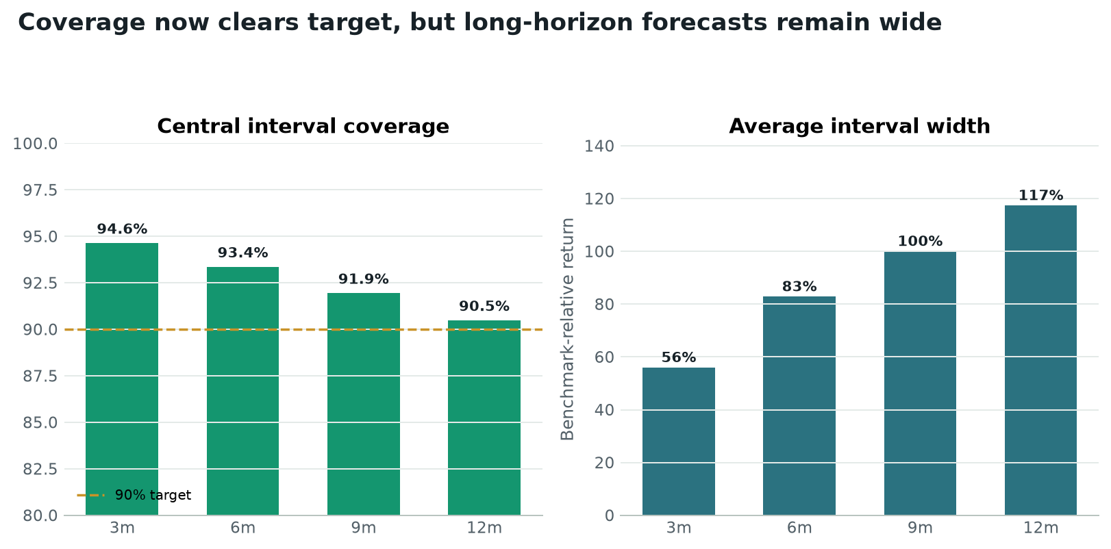
Uncertainty and implementation are now controlled
09
Coverage clears target; wide long-horizon bands still signal low precision.
Horizon | Turnover | Cost drag | 90% cover | Band width
3m | 0.54x | 0.50% | 94.6% | 56%
6m | 0.47x | 0.47% | 93.4% | 83%
9m | 0.35x | 0.42% | 91.9% | 100%
12m | N/A | N/A | 90.5% | 117%
Implementation result
Recurring turnover is 0.54x, 0.47x and 0.35x at 3/6/9 months. The 12-month record has no recurring rebalance, so it remains unestimable.
Interpretation: Calibration is fixed; precision is not. A 117% average 12-month band is a warning against confident long-horizon stock claims.
Wolf Quant Model | Research use
Purged conformal calibration and cost-aware legacy OOS cohorts

Slide 10
Recommendations: target portfolio versus research challengers
10
Only the governed CVaR target is actionable; challenger names remain shadow evidence.
20
20
9 / 20
0%
governed target equities
regional challenger equities
names shared by both
supervised live blend
Governed-only names
Shared core
Regional-only names
000001.SHE, 000538.SHE, 002352.SHE, 0823.HK, 601816.SHG, ELE.MC, EN.PA, ESSITY-B.ST, HIG.US, SEB-A.ST, SHELL.AS
000333.SHE, 600036.SHG, AD.AS, ALV.XETRA, CA.PA, HEN3.XETRA, IMB.LSE, NOVN.SW, ORA.PA
002415.SHE, 600406.SHG, CVX.US, DG.PA, DHL.XETRA, GILD.US, LOW.US, PGR.US, PUB.PA, SHEL.LSE, T.US
Highest supervised 3-month research rank in each region
Ticker | Region | Score | Cost-adj alpha | Q05 | Q95
NA9.XETRA | DACH | 99.6 | 4.2% | -33% | 41%
SESG.PA | EU ex-DACH | 99.2 | 3.7% | -31% | 41%
0354.HK | Hong Kong | 99.4 | 4.5% | -32% | 43%
000009.SHE | Mainland China | 85.5 | 2.9% | -31% | 49%
GEN.LSE | UK | 100.0 | 4.9% | -32% | 39%
HPQ.US | US | 100.0 | 3.6% | -30% | 36%
Research watchlist only. These are not buy orders; uncertainty bands are wide and the deployment gate is closed.
Wolf Quant Model | Research use
Resolved portfolio, regional-alpha target and supervised 3-month rankings

Slide 11
Evidence breadth and point-in-time progress
11
Public identifiers, macro vintages and China/HK volume improved; historical membership remains the main gap.
55,504
1,409
263,048
48,577
active equities
walk-forward eligible
historical forecasts
current FIGI mappings
Region | Active | Master | Active share
DACH | 21,603 | 38,792 | 55.7%
EU ex-DACH | 2,436 | 5,088 | 47.9%
Hong Kong | 3,504 | 4,130 | 84.8%
Mainland China | 5,103 | 5,373 | 95.0%
UK | 3,932 | 6,664 | 59.0%
US | 18,926 | 52,523 | 36.0%
PIT evidence | Coverage | Status
Delisting events | 59,183 | Archived
Fundamentals with filing date | 32,321 | Mostly reconstructed
Observed acceptance times | 0 | Missing
Dated membership events | 0 | Missing
Inactive names with prices | 0 | Missing
Names with historical volume | 8,494 | Observed
Free-data checkpoint and publication boundary: yfinance volume: 5,142 China/HK names; AKShare: 12,188,157 bars across 3,374 names; FRED/ALFRED: 21 series; OpenBB: 7 benchmark checks; SEC: blocked_or_unavailable. OpenFIGI is a current snapshot, not historical membership. Only aggregate counts and checksums are published.
Wolf Quant Model | Research use
Universe, walk-forward manifest and aggregate PIT coverage

Slide 12
Equities to establish in the target portfolio
12
Model trade direction versus current holdings; weights are targets.
19
1
5.0%
20
6
buy actions
reduce actions
maximum name
equity holdings
equity regions
Ticker | Company | Region | Action | Target
000001.SHE | Ping An Bank Co Ltd | Mainland China | Buy | 5.0%
000333.SHE | Midea Group Co Ltd | Mainland China | Buy | 5.0%
000538.SHE | Yunnan Baiyao Group Co Ltd | Mainland China | Buy | 5.0%
002352.SHE | S.F. Holding Co. Ltd | Mainland China | Buy | 5.0%
0823.HK | Link Real Estate Investment T | Hong Kong | Buy | 5.0%
600036.SHG | China Merchants Bank Co Ltd | Mainland China | Buy | 5.0%
601816.SHG | Beijing-Shanghai High Speed R | Mainland China | Buy | 5.0%
AD.AS | Koninklijke Ahold Delhaize NV | EU ex-DACH | Buy | 5.0%
ALV.XETRA | Allianz SE VNA O.N. | DACH | Buy | 5.0%
CA.PA | Carrefour SA | EU ex-DACH | Buy | 5.0%
Ticker | Company | Region | Action | Target
ELE.MC | Endesa SA | EU ex-DACH | Buy | 5.0%
EN.PA | Bouygues SA | EU ex-DACH | Buy | 5.0%
ESSITY-B.ST | Essity AB (publ) | EU ex-DACH | Buy | 5.0%
HEN3.XETRA | Henkel AG & Co. KGaA vz. (Pre | DACH | Buy | 5.0%
HIG.US | Hartford Financial Services G | US | Buy | 5.0%
IMB.LSE | Imperial Brands PLC | UK | Buy | 5.0%
ORA.PA | Orange S.A. | EU ex-DACH | Buy | 5.0%
SEB-A.ST | Skandinaviska Enskilda Banken | EU ex-DACH | Buy | 5.0%
SHELL.AS | Shell PLC | EU ex-DACH | Buy | 5.0%
NOVN.SW | Novartis AG | DACH | Reduce | 5.0%
Execution note: recalculate orders using live NAV, FX, liquidity and prices. Manual review remains mandatory.
Wolf Quant Model | Research use
Final portfolio weights and portfolio trade list

Slide 13
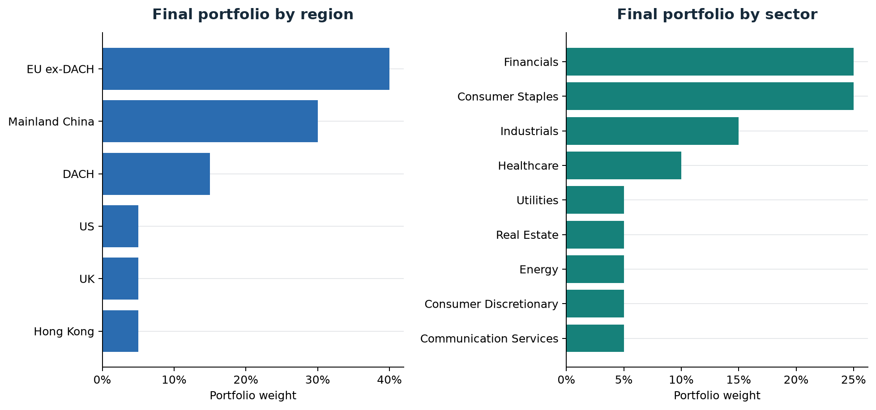
A deliberately diversified target
13
The portfolio uses equal name weights and explicit exposure caps.
Construction rules
• 20 equities at no more than 5.0% each
• 0% cash reserve
• No sector above 25%
• No country above 30%
• No region or currency above 40%
• One listing per issuer
Largest allocations
EU ex-DACH 40%; Consumer Staples 25%. Cash is excluded from equity exposure caps.
Wolf Quant Model | Research use
Final portfolio weights and constraint report

Slide 14
Why the CVaR portfolio is the baseline
14
It balances expected return, downside loss and diversification.
Portfolio | Volatility | CVaR 5% | Yield | Hard breaches
Equal weight | 14.0% | -24.9% | 4.1% | 0
Score weighted | 12.2% | -9.4% | 4.4% | 0
Risk parity | 11.2% | -14.9% | 3.5% | 0
Mean variance | 11.7% | -6.9% | 4.5% | 0
CVaR constrained | 11.8% | -6.7% | 4.5% | 0
regional_benchmark_relative_cost_aware | 14.0% | -15.3% | 4.3% | 0
Dividend income | 13.7% | -14.1% | 5.2% | 0
Regime aware | 13.0% | -12.1% | 5.0% | 0
Selected: CVaR constrained
The baseline keeps the forecast return target while reducing the average loss in the worst 5% of modeled outcomes to 5.10%.
Why this matters
• Focuses on severe downside, not only average volatility
• Maintains 20 effective holdings
• Passes every hard portfolio constraint
• Produces the final 20-name equal-weight target
Interpret carefully: Expected-return inputs are model forecasts, not guaranteed market returns. Live sizing still depends on trading capacity.
Wolf Quant Model | Research use
Portfolio optimisation summary

Slide 15
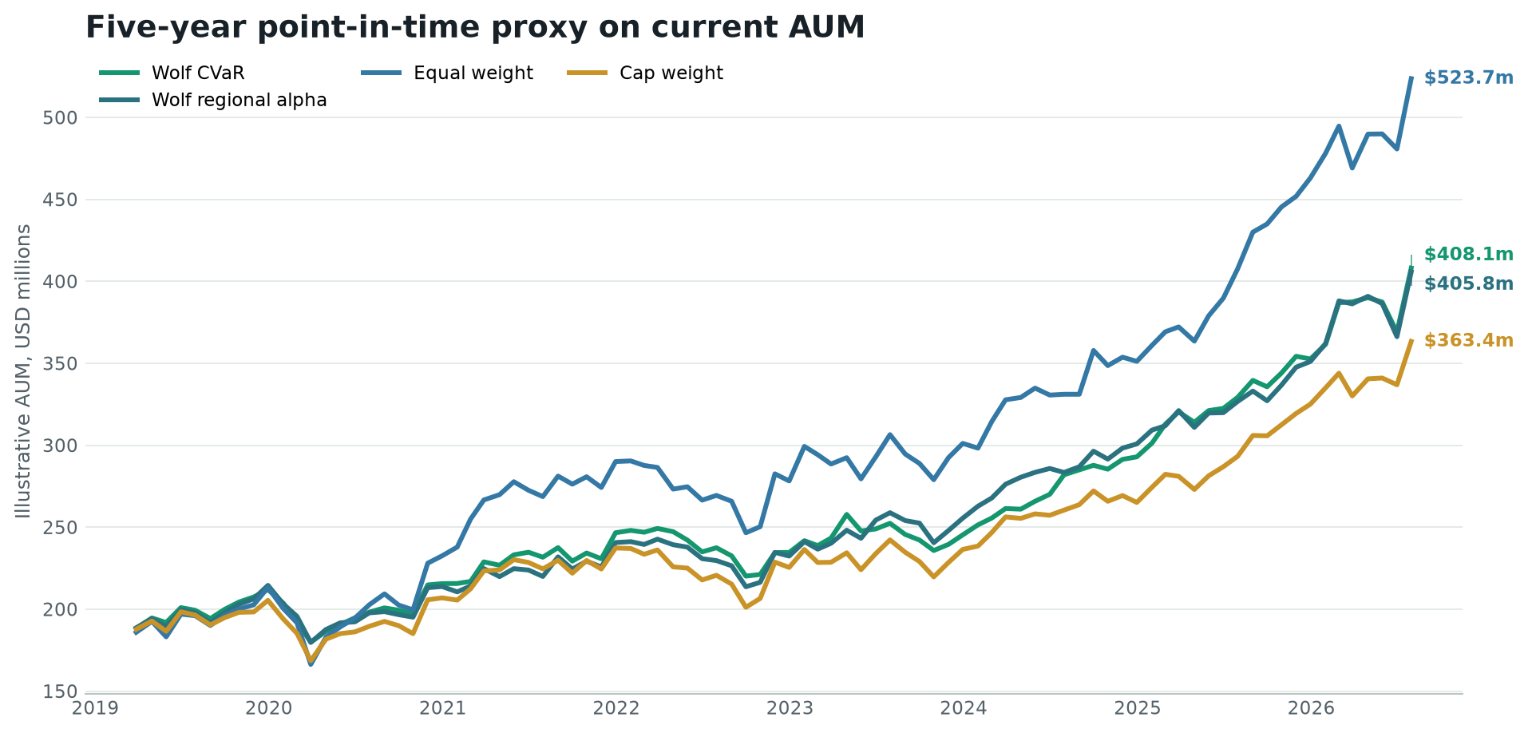
Five-year point-in-time proxy
15
The relevant model evidence uses dated monthly decisions.
Illustrative current-AUM result
$186.1m grows to $408.1m; net PnL is $222.1m after trading costs and before the bank fee.
• Net annualised return: 11.2%
• Sharpe ratio: 1.08
• Maximum drawdown: -15.2%
• Positive months: 66.3%
Not a forecast
This scales the realised proxy path to current AUM. The 25 bp annual bank fee is modeled separately in the long replay.
Wolf Quant Model | Research use
60-month reconstructed point-in-time portfolio returns

Slide 16
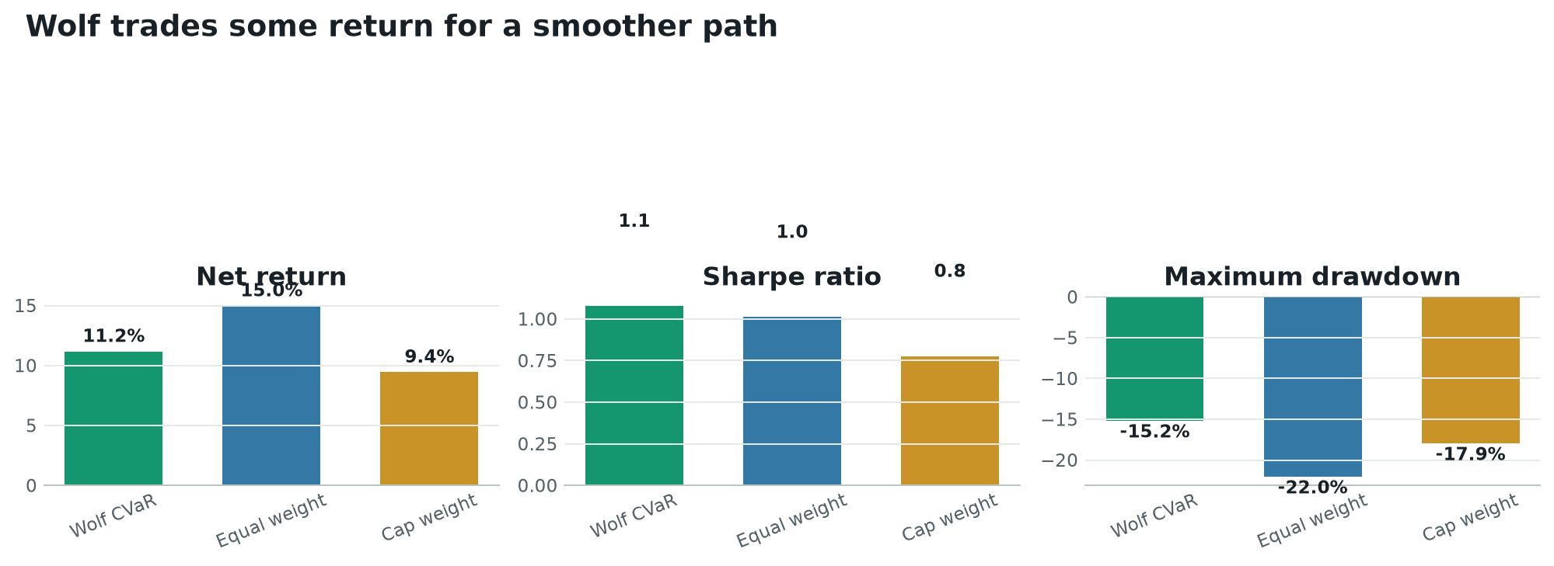
What beat what over 60 months
16
Wolf delivered the best risk-adjusted result, not the best return.
The useful result
Wolf Sharpe was 1.08 and drawdown was 15.2%, better than both simple controls on these risk measures.
The honest result
Equal weight returned 14.97% versus Wolf at 11.17%. The model did not beat the simplest control on net return.
Investment interpretation
The current case is risk control and decision discipline. Incremental stock-selection alpha remains unproven.
Highest return: Equal weight | Highest Sharpe: Wolf | Smallest drawdown: Wolf
Wolf Quant Model | Research use
Point-in-time strategy comparison, net of modeled costs

Slide 17
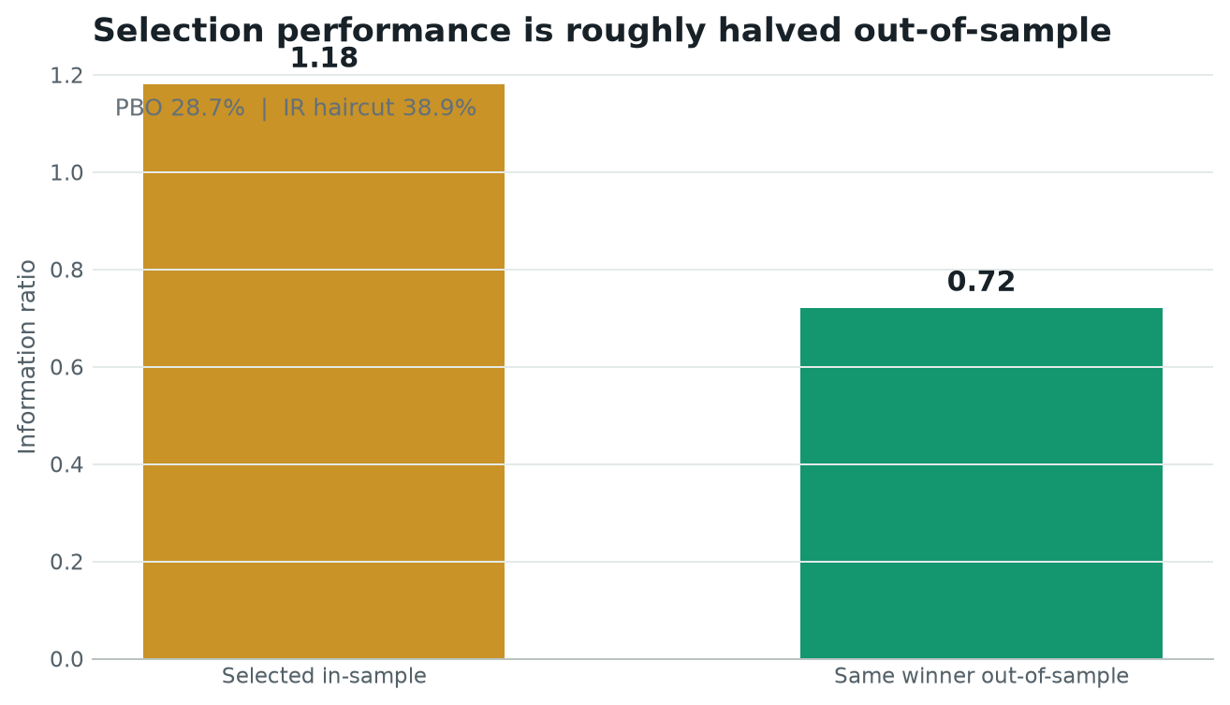
Alpha and overfitting: the hard truth
17
The retrospective strategies are interesting; deployable alpha is not established.
Benchmark | Active return | Reg. alpha | p-value | Verdict
Cap weight | 1.38% | 4.00% | 0.028 | NOT SIGNIFICANT
Equal weight | -3.94% | 2.88% | 0.212 | NOT SIGNIFICANT
Wolf regional alpha | -0.01% | 1.67% | 0.258 | NOT SIGNIFICANT
What the 50.3% fall means
When history selects the apparent winner, its information ratio typically drops from 1.32 in-sample to 0.66 out-of-sample. About half the apparent edge does not survive selection.
Decision
Use Wolf for disciplined ranking and risk control. Do not market it as a proven alpha engine until native live evidence clears the benchmark and cost hurdles.
Wolf Quant Model | Research use
Point-in-time alpha tests and CSCV overfitting diagnostics

Slide 18
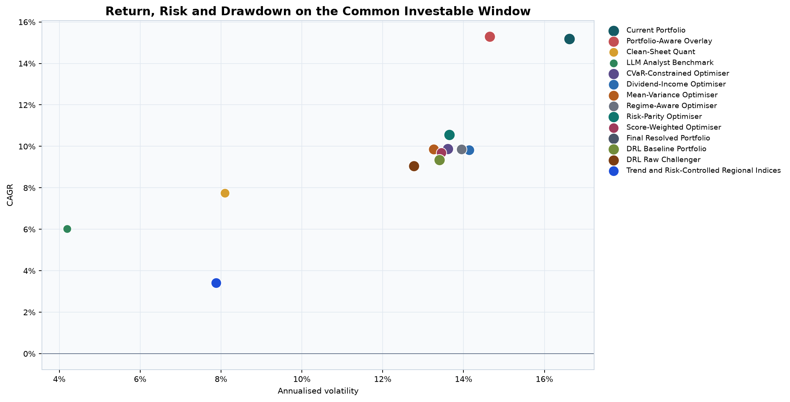
The 1997 replay is a stress map
18
It shows how today's holdings behaved through history, not what the model knew then.
Portfolio | Start | CAGR | Sharpe | Max DD | End
Current Portfolio | $186.1m | 14.1% | 0.75 | -42.6% | $9.0bn
Portfolio-Aware Overlay | $186.1m | 13.1% | 0.74 | -46.4% | $7.0bn
Risk-Parity Optimiser | $100.0k | 11.8% | 0.79 | -31.8% | $2.7m
LLM Analyst Benchmark | $100.0k | 4.8% | 0.66 | -10.2% | $403.1k
Final Resolved Portfolio | $186.1m | 9.2% | 0.62 | -35.8% | $2.5bn
What looks strongest
Why it cannot prove selection skill
Current Portfolio PnL: $8.8bn. Final Resolved PnL: $2.3bn. Risk Parity led the independent optimisers.
The securities were chosen with current information and then replayed backward. Survivorship and selection look-ahead make the long PnL unsuitable as a live promise.
Wolf Quant Model | Research use
1997-present retrospective holdings replay

Slide 19
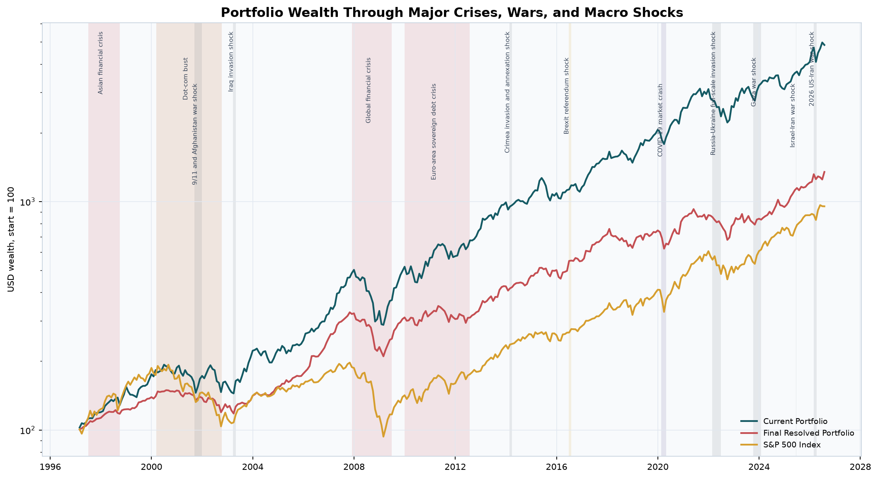
Performance through major market shocks
19
Event windows are descriptive overlaps, not causal estimates.
COVID-19: -12.58% return; -15.19% event drawdown
2008 crisis: -27.12% event drawdown
2026 Iran war: +3.57% return; -5.27% drawdown
Wolf Quant Model | Research use
Macro-event timeline and event performance table

Slide 20
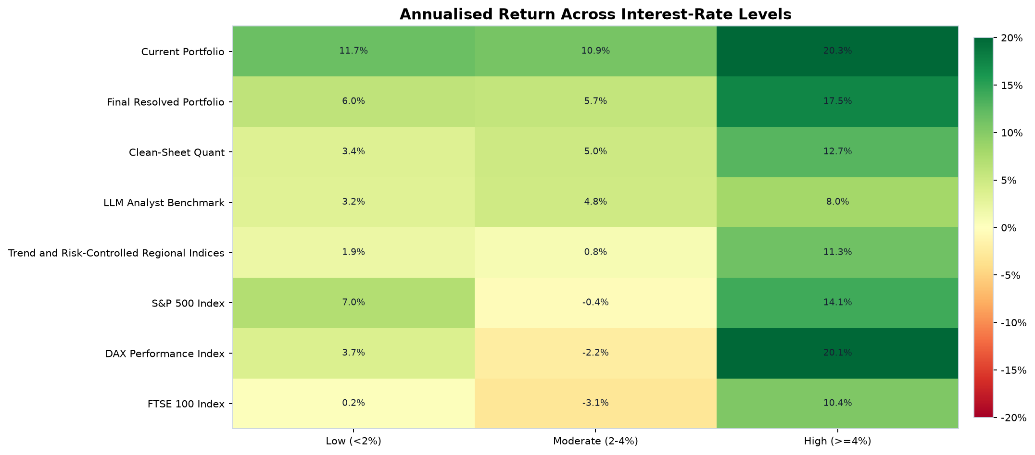
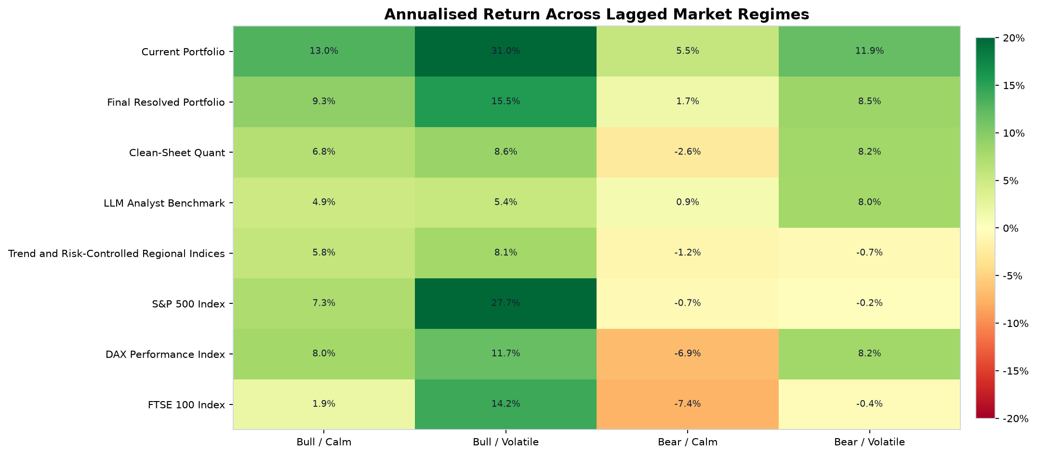
Interest-rate and market-regime context
20
Conditional groupings show where the final portfolio was most comfortable.
Rate reading: Final Portfolio was strongest in high-rate months (15.77%) and when rates were rising (13.03%).
Regime reading: Its strongest market group was Bull / Volatile (14.09%). Expansion months returned 9.91% annualised.
Wolf Quant Model | Research use
Lagged rate and market-regime performance

Slide 21
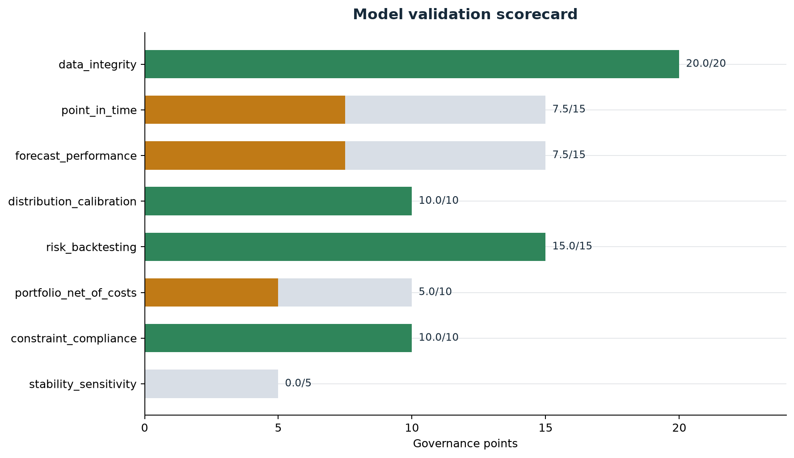
Risk holdout passes; approval stays conditional
21
Blocked development CV controls coverage without hiding PIT and alpha limits.
VaR coverage and independence
Sample | VaR | Exceptions | Kupiec p | Indep. p | Status
Overall | 95% | 98/1773 | 0.316 | 0.003 | Warning
Overall | 99% | 28/1773 | 0.024 | 0.343 | Fail
Holdout | 95% | 29/709 | 0.252 | 0.140 | Pass
Holdout | 99% | 7/709 | 0.973 | 0.708 | Pass
Chronological holdout gate: Pass (15 / 15)
DCC-IGARCH Student-t, filtered historical simulation, EWMA Normal and EWMA Student-t are selected using trailing data. 3 blocked development fold(s) selected a 1.000x scale and 1.20x buffer for 10 day after a breach. Overall rows remain diagnostics; the configured holdout is the gate. It is reconstructed evidence, not a pristine future shadow period.
Overall 75/100 | 4 pass | 3 warnings | 1 fail | 0 critical failures
Wolf Quant Model | Research use
Validation scorecard and overall/holdout VaR tests

Slide 22
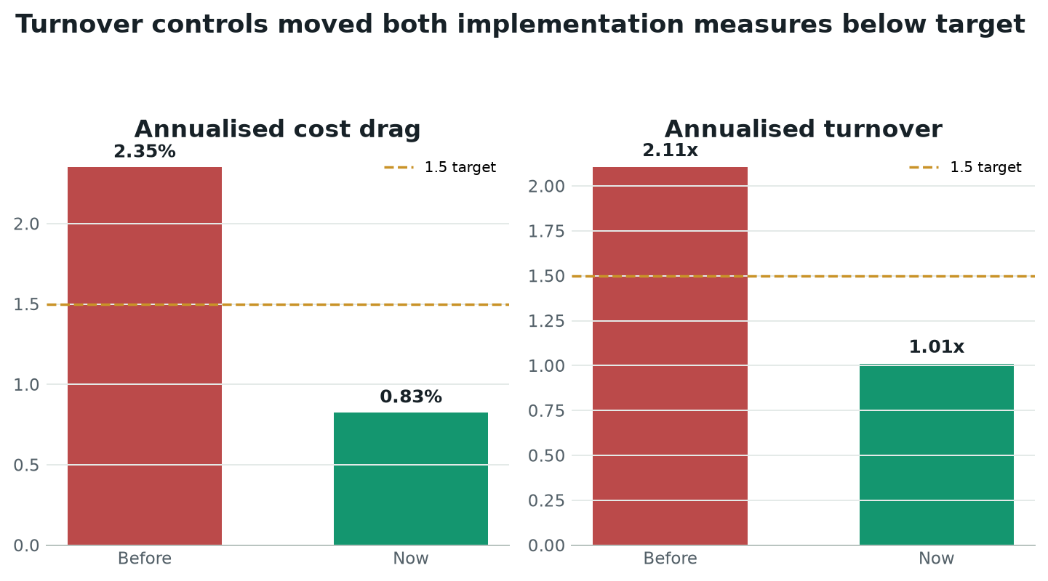
Turnover and modeled cost drag now meet target
22
Retention hysteresis and minimum-turnover transitions reduced churn.
0.83%
modeled cost drag; target <= 1.50%
1.01x
annual turnover; target <= 1.50x
$465k
0.25% annual bank fee at reference AUM
Why portfolio remains a warning
Both cost gates pass, but Wolf trailed equal weight by 3.80% per year in this 60-month sample (p=0.250).
Retention and capped/minimum-turnover transitions drove the improvement; the configured no-trade band did not trigger in this sample.
Wolf Quant Model | Research use
Before/after point-in-time cost and turnover validation

Slide 23
A controlled path to live use
23
Scale only when operations, costs and evidence earn it.
0 SHADOW
1 PILOT
2 SCALE
4 weeks
6 to 12 months
Evidence gated
Generate orders, do not trade. Validate data, NAV, FX and fills.
Use limited capital with human approval and staged execution.
Increase capital only after cost, risk and benchmark hurdles hold.
Proposed pilot gates
Immediate stop conditions
• Zero hard constraint or data-lineage breaches
• Pre-trade cost estimate approved for every rebalance
• Keep turnover <=1.5x; stretch goal <=1.0x in the pilot
• Net performance tracked against equal and cap weight
• Monthly model-risk and investment-committee review
Stale critical data, any hard breach, a failed live risk test, failed reconciliation or trading costs above the approved budget.
Alpha gate: Full-scale alpha claims require native live evidence and at least 60 months under the existing governance policy.
Wolf Quant Model | Research use
Proposed implementation and model-risk controls

Slide 24
How to read the results
24
Plain-language definitions for the investment committee.
Measure | Simple meaning
CAGR | Average compounded annual growth.
Sharpe | Return earned per unit of overall variability.
Sortino | Return earned per unit of harmful downside variation.
Max drawdown | Largest peak-to-trough loss.
CVaR | Average loss among the worst modeled outcomes.
Information ratio | Active return per unit of benchmark-relative risk.
p-value | How surprising the result is if true alpha were zero.
PBO | Chance that selecting the backtest winner overfits history.
Three evidence layers
1. Dated 89-month proxy: primary model evidence. 2. 1997 replay: stress and exposure history. 3. Native live record: required before full alpha approval.
Higher is not always better
A portfolio can have a higher return but a deeper drawdown, more turnover or weaker statistical evidence. The committee should judge the package, not one headline number.
Where to verify
The GitHub release contains the full PDF, plain-language interpretation, CSV evidence, plots, manifests and checksums.
Wolf Quant Model | Research use
Backtest methodology and validation framework

Slide 25
THE RECOMMENDATION
Continue paper and shadow operation.
Wolf is ready to improve how decisions are made: broad screening, explicit risk, consistent portfolio construction and an audit trail. It is not yet ready to promise alpha.
USE NOW
PROVE LIVE
FIX NEXT
Ranking, diversification, adaptive risk and governance
Net benchmark edge in a genuine future shadow record
Observed PIT vintages and prospective model evidence
Investment edge today: a better-controlled process. Investment edge tomorrow: only what live evidence proves.
CONDITIONALLY_APPROVED | Governance 75/100 | As of 19 August 2026

