Slide 1


Naan Mudhalvan -NM1009 Generative AI for Engineering
PROJECT TITLE : COVID forecasting analysis using Recurrent Neural Network (RNN)
Presented By :
Name : ROHINI G
Reg No : 730321104041
Department : Computer Science and Engineering
Date:07.05.2024
Venue: IIT Remote Center

Slide 2


AGENDA :
Problem Statement
Project Overview
End Users
Our Solution
Special Features
Modelling Approach
Results
Conclusion

Slide 3

PROBLEM STATEMENT :
The ongoing COVID-19 pandemic has led to unprecedented challenges worldwide, including significant public health, social, and economic implications.
Accurate forecasting of COVID-19 transmission dynamics is crucial for guiding public health interventions, resource allocation, and policy decisions.
Traditional epidemiological models have limitations in capturing the complex, nonlinear relationships inherent in the pandemic's spread.

Slide 4

PROJECT OVERVIEW :
Preprocess the data, including handling missing values, scaling the data, and splitting it into training, validation, and test sets.
Design the architecture of the RNN model, including the number of layers, units, and any additional components like dropout or batch normalization layers.
Select relevant features to include as input to the RNN model, such as historical COVID-19 data, weather conditions, mobility trends, and interventions.

Slide 5

WHO ARE THE END USERS?
Public Health Authorities,
Policymakers,
Healthcare Providers,
Researchers and Epidemiologists,
Educational Institutions,
General Public.

Slide 6

YOUR SOLUTION AND ITS VALUE PROPOSITION
The solutions offered by COVID-19 forecasting analysis using RNNs provide actionable insights, empower decision-makers with timely information.
support effective management and control of the pandemic, ultimately saving lives and mitigating the socio-economic impact of the crisis.
RNN models can continuously learn from new data, allowing for real-time monitoring of COVID-19 trends and dynamics.

Slide 7
SPECIAL FEATURES :
Multivariate Time Series Analysis:
RNNs can handle multivariate time series data effectively, allowing them to capture complex interactions between different variables and improve forecasting accuracy.
Real-Time Updates:
This capability is crucial for monitoring and responding to changes in the pandemic situation, such as emerging variants, changes in public behavior, or the impact of vaccination campaigns.
Temporal Dynamics Modeling:
RNNs can effectively capture the time-evolving patterns of virus spread, including seasonality, trends, and periodic fluctuations.

Slide 8
MODELLING :
Data Collection and Preprocessing:
Gather COVID-19 data from reliable sources such as government health agencies, research institutions, or public datasets.
Training:
Train the RNN model using the training data. During training, the model learns to predict future COVID-19 cases based on past data.
Validation:
Validate the model using the validation set to ensure it generalizes well to unseen data.
Deployment:
Monitor the model's performance regularly and retrain it as needed to adapt to changing trends in COVID-19 data.

Slide 9
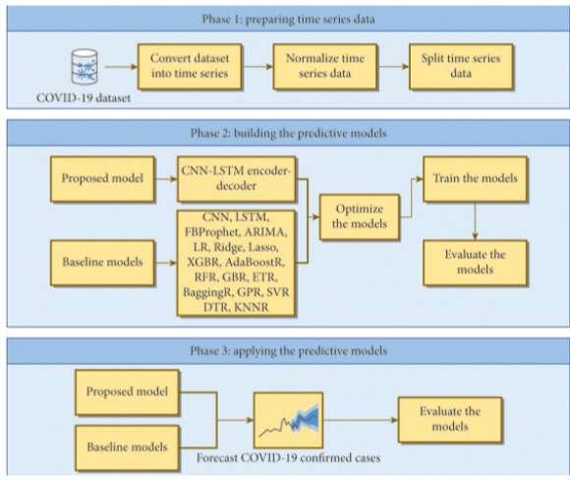
DRAW ANY FLOW DIAGRAM OR SEQUENCE DIAGRAM

Slide 10
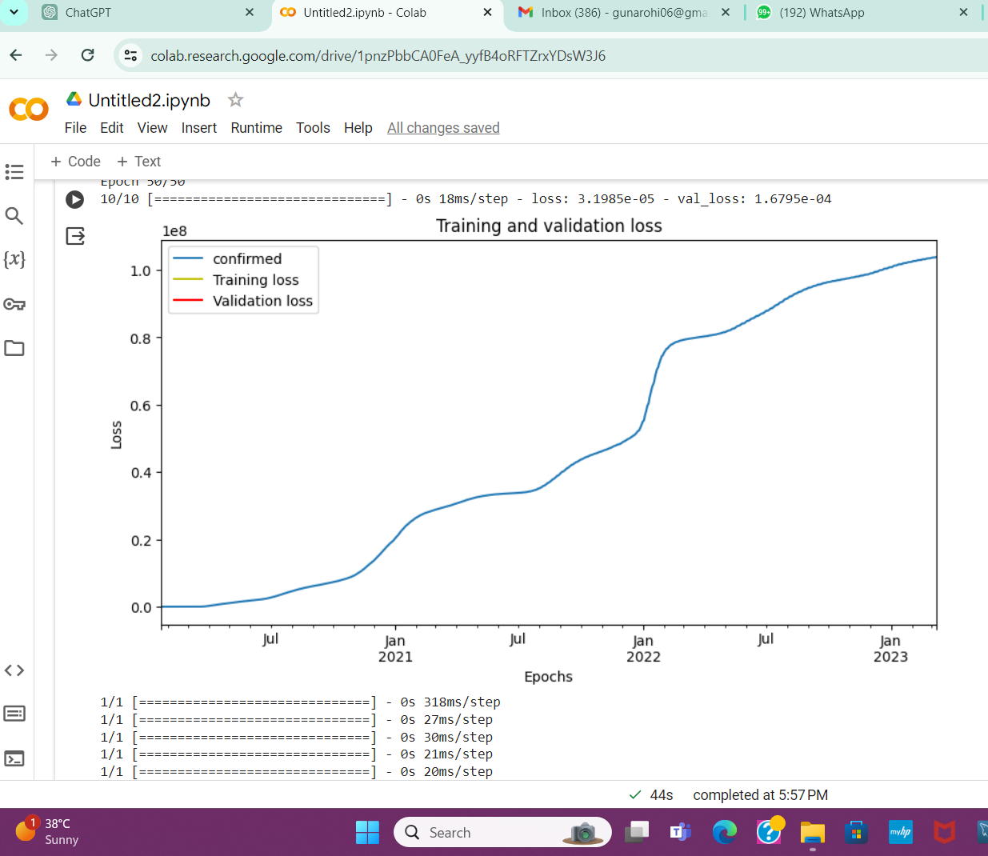
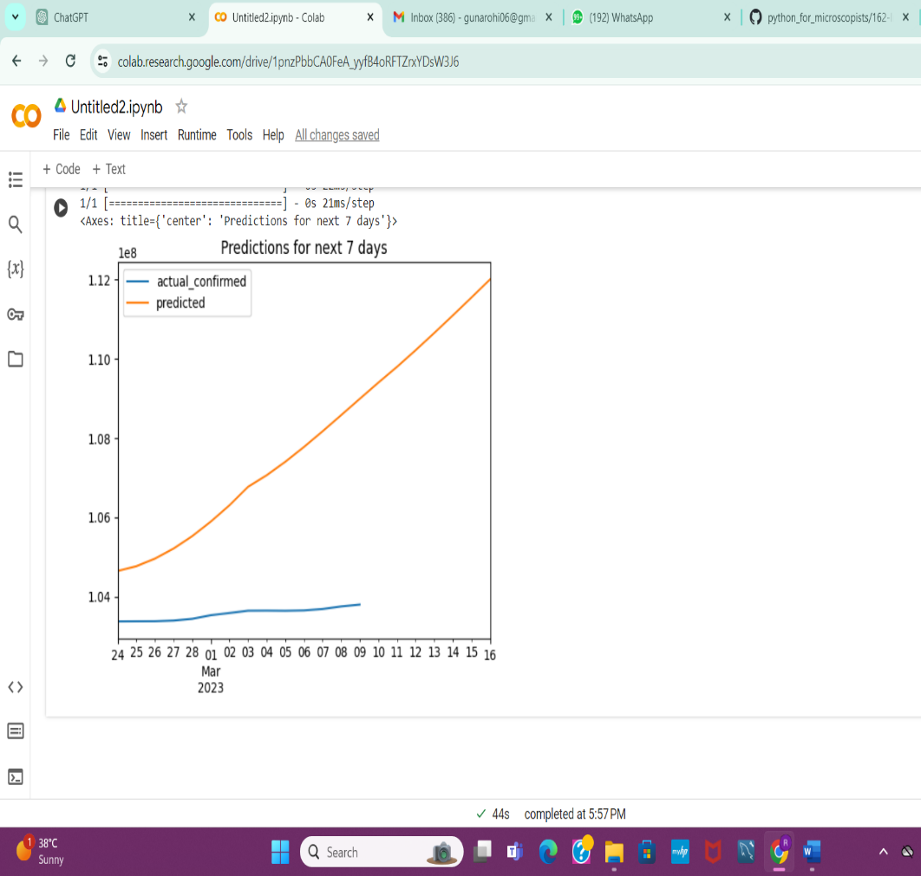
RESULTS :
OUTPUT
OUTPUT
10

Slide 11

CONCLUSION :
In conclusion, the utilization of RNNs for COVID-19 forecasting analysis presents a promising avenue for understanding and predicting the trajectory of the pandemic.
Finally, we successfully predicted the covid-19 using the Recurrent Neural Network Algorithm.
THANK YOU

