Slide 1
Task 3 - Dashboard Design
Data Analyst Internship
By: Rohit Dilip Pawar

Slide 2
Objective
Design an interactive dashboard for business stakeholders using Power BI to analyze Sales, Profit, and Profit Margin.

Slide 3
Key KPIs in Dashboard
• Total Sales: 2.30M
• Total Profit: 286.4K
• Profit Margin: 12.47%

Slide 4
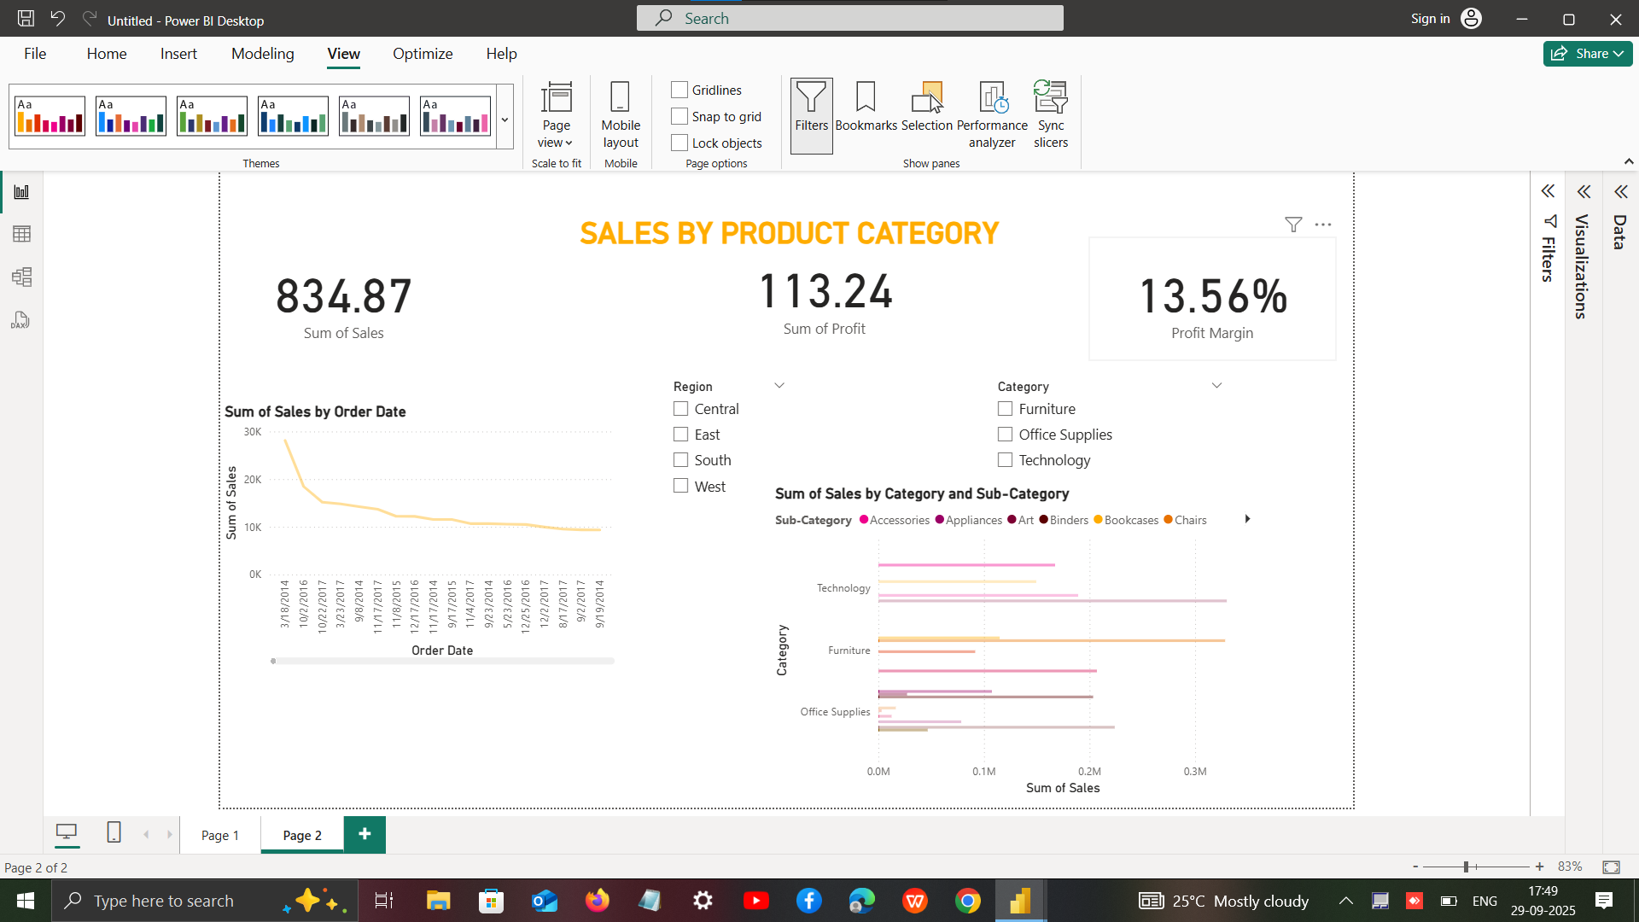
Dashboard Snapshot

Slide 5
Dashboard Features
• Interactive filters by Region and Category
• Cards for KPIs (Sales, Profit, Profit Margin)
• Trend Analysis (Sales by Order Date)
• Comparative Analysis (Category & Sub-Category)
• Clean and consistent design

Slide 6
Key Learnings
• Importance of KPIs in decision-making
• Using slicers/filters for interactivity
• Time-series and categorical analysis
• Dashboard storytelling for business insights

