Slide 1
AUGUST 2026
IDP PLATFORM
4 / 4
+ K8s
Wave 1
Complete.
Wave 2 Live.
WORKFLOWS DELIVERED
POD SELF-SERVICE
All live in P-1 · Wave 1 complete
Restart · Start · Stop services live
Wave 2
14 / 20
All 4 developer workflows live in P-1. K8s pod self-service delivered. Wave 2 firmly underway.
FIRMLY UNDERWAY
PUBLIC CLOUD CONVERSION
Catalog · CMDB seeding · Cloud parity
Payload parity is the next gate
01 Wave 1 Complete + K8s Self-Service 02 now.yaml + Catalog 03 Wave 2 Progress 04 Live Demo
TODAY'S SESSION
01
WAVE 1 COMPLETE + K8s SELF-SERVICE
4 workflows · pod restart/start/stop live
02
NOW.YAML + CATALOG ARCHITECTURE
How two files power two value streams
03
WAVE 2 IN PROGRESS
Cloud parity · catalog · CMDB seeding
04
LIVE DEMO
AD Group + K8s pod self-service

Slide 2
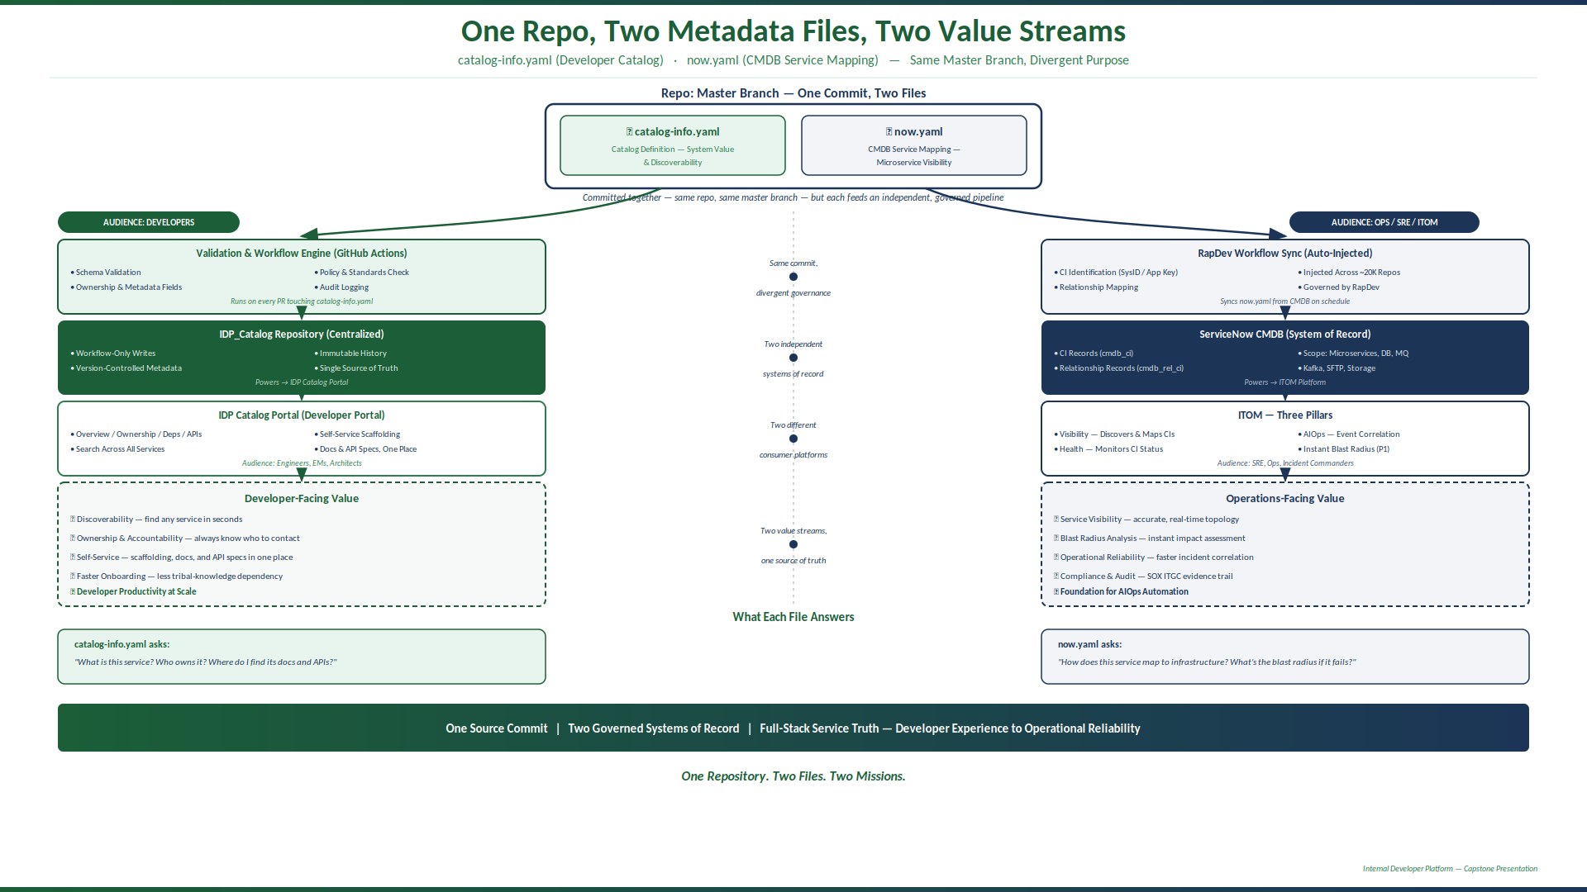
WAVE 2 · SERVICE MAPPING & CATALOG
now.yaml · catalog-info.yaml · Master Branch
One Repo, Two Files, Two Value Streams
catalog-info.yaml feeds the Developer Portal · now.yaml feeds ServiceNow CMDB — same commit, independent governed pipelines.
One Repo · Two Files · Two Value Streams | IDP Platform · Platform Engineering
Notes:
Diagram: catalog-info.yaml (left lane) → GitHub Actions validation → IDP_Catalog Repo → IDP Portal. now.yaml (right lane) → RapDev Workflow Sync → ServiceNow CMDB → ITOM. Centre rail shows they diverge from the same master branch commit.

Slide 3
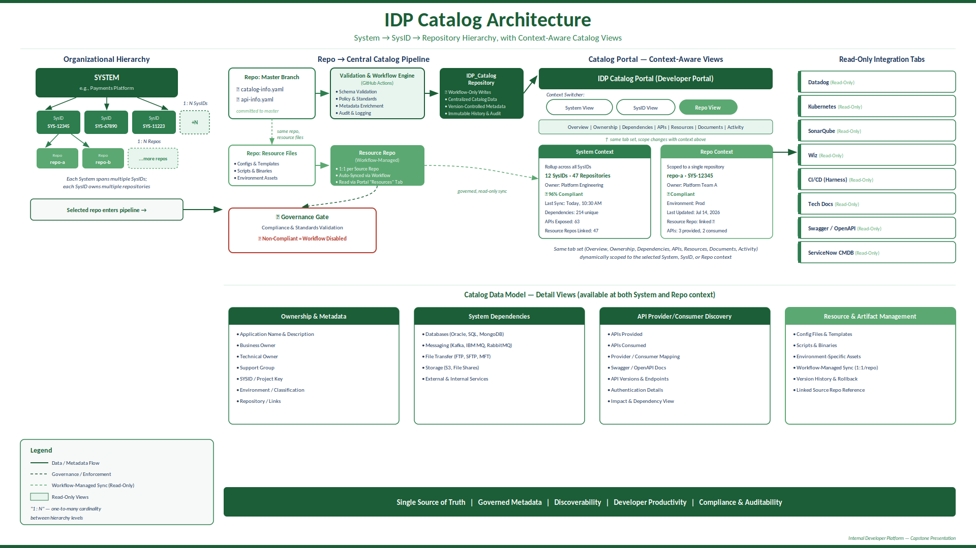
WAVE 2 · IDP CATALOG ARCHITECTURE
How catalog-info.yaml becomes the Developer Portal
IDP Catalog Architecture
Every catalog-info.yaml commit triggers validation, lands in the central IDP_Catalog repo, and surfaces as a discoverable developer portal page.
Catalog items are read-only views — developers use them to find context, not to edit data | IDP Platform · Platform Engineering
Notes:
Architecture: Source repos → GitHub Actions validation → IDP_Catalog central repo → IDP Portal tabs (Overview, CI/CD, Code Quality, Security, K8s, Observability, TechDocs). Read-only views by audience: Engineers, Architects, SRE.

Slide 4
WAVE 3 · PUBLIC CLOUD · DELIVERY PROGRESS
IDP Platform · Platform Engineering
Public Cloud — Wave 3 Delivery Status
23 of 25 workflows converted · payload match progressing · edge cases and custom capabilities in focus.
23 / 25
5 / 25
20 / 25
WORKFLOWS CONVERTED
PAYLOAD MATCH DONE
PAYLOAD IN PROGRESS
IDP workflow build complete
Full parity confirmed end-to-end
Active comparison underway
Payload match: 5 / 25 complete (20%)
Target: 25 / 25
⚠ Edge Cases — Harness Support
IN FLIGHT
📊 Report Generation (Non-Harness Data)
IN BUILD
· 2 of 25 workflows have edge cases requiring Harness platform support
· Reporting workflow pulls data from external APIs (not native Harness data)
· Ticket raised with Harness engineering team — resolution tracked
· Custom API integration layer under development
· Workarounds documented; not blocking payload parity progress
· Output: automated report delivery via IDP workflow trigger
🤖 Custom Chatbot Integration
IN BUILD
✓ Remaining 2 Workflows
PLANNED
· Chatbot-assisted onboarding path requires custom IDP integration
· 2 workflows pending build — scoped and sequenced
· Architecture designed — build underway
· Dependencies on edge case resolution before completion
· Deferred from Wave 2; now actively resourced in Wave 3
· Target: all 25 complete before Wave 3 close
Wave 3 target: full 25-workflow parity with legacy system | IDP Platform · Platform Engineering

Slide 5
LIVE DEMO
K8s Pod Self-Service
Restart · Start · Stop — from the IDP portal, no kubectl, no ticket, no wait.
1
🔍
2
⚡
3
✅
Navigate to Service
Select Pod Action
Confirm & Monitor
Open the IDP catalog · find your target service · open the catalog card
Choose: Restart Service · Start Service · Stop Service
Action executes · rolling restart or lifecycle change visible in real time
Service catalog shows all K8s-hosted services with live pod status
All three actions available from the self-service panel — no kubectl required
Status updates live · email confirmation on completion
What this replaces: kubectl exec → kubectl rollout restart → Slack the platform team → Wait for confirmation → Now: one click in IDP
Switching to live screen-share now...

Slide 6
Catalog Communication Plan
Guiding Principle: “Ease of Use Is the North Star” — one Point of Contact, plain language, right-sized outreach per tier.
Audience Tiers
Channels & Cadence
Rollout Timeline
Tier | SysIDs | Approach
T1 — High Importance | ~50 | White-glove: 1:1 + brown bag
T2 — High Value | ~150 | Targeted brown bag + email
T3 — Standard | ~300 | Self-service video + email
Channel | Cadence
Video (On-Demand) | At rollout, refreshed quarterly
Brown Bag Sessions | Bi-weekly → monthly
Email Announcements | Weekly (T1) → monthly (T3)
Point of Contact | Ongoing / as-needed
Phase 1 • Wks 1–2 • Tier 1
1:1 briefings + kickoff video + brown bag
Phase 2 • Wks 3–5 • Tier 2
Brown bag sessions + targeted email
Tier counts illustrative — confirm vs. governed SysID tiering model.
Phase 3 • Wks 6–9 • Tier 3
POC
One accountable owner — no conflicting guidance, clear escalation, feedback to roadmap.
Broadcast email + self-service video
500 SysIDs total — intensity of outreach scales with business importance, not a one-size broadcast.
Ongoing: monthly brown bag • quarterly video refresh • POC always available
Driving This to Completion: Tiered rollout schedule is locked, Point of Contact is staffed, and the brown bag calendar is set — Phase 1 (Tier 1) begins as planned.
Internal Developer Platform | Catalog Communication Plan

