Slide 1
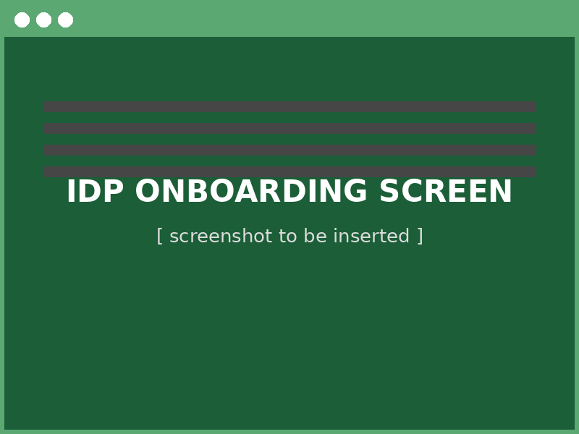
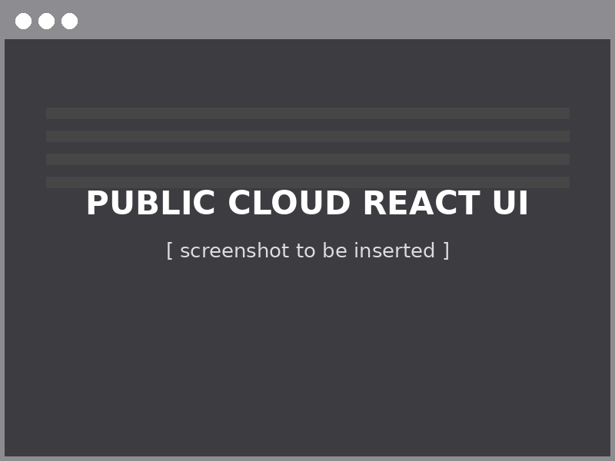
Internal Developer Platform — July RTB Capstone
11 / 17
Workflow Conversion Progress & Payload Parity
workflows converted to IDP
Goal: Achieve 1:1 payload match between Public Cloud React UI and IDP for Payload Submission — closing the gap that drives duplicate tickets and escalations to the Public Cloud team.
Payload Submission — Screen Comparison
Target: identical fields, validation, and submission payload across both UIs
IDP ONBOARDING SCREEN
PUBLIC CLOUD REACT UI
1:1
Status: 11 of 17 workflows live on IDP | Payload Submission parity in progress | Outcome: reduced noise and duplicate escalations to Public Cloud team

