Slide 1
JULY 2026 · IDP PLATFORM
Wave 1 Complete.
All 4 high-value developer workflows live in P-1. Wave 2 underway — public cloud workflow conversion and catalog development now in progress.
4 / 4
14 / 20
Wave 2
WORKFLOWS DELIVERED
PUBLIC CLOUD CONVERSION
NOW IN PROGRESS
All live in P-1 · Wave 1 complete
Public cloud UI workflows converted to IDP
Catalog development · CMDB seeding
TODAY'S SESSION
01
02
03
04
WAVE 1 COMPLETE
PUBLIC CLOUD CONVERSION
THREE PILLARS RECAP
LIVE DEMO
4 workflows · all live in P-1
Create Repo · K8s · AD Group · Add Users
Conversion complete: 14/20
Payload parity is the next gate
Workflow · Catalog · Scorecard
Where each one stands today
AD Group creation & user management
2-minute walkthrough

Slide 2
WAVE 1 · COMPLETE · ALL LIVE IN P-1
✓ ALL LIVE
4 High-Value Workflows — Delivered
P-1
The most frequently requested developer actions — now fully automated, no ticket, no wait.
USE CASE 1
USE CASE 2
Create Repository
K8s Namespace Onboarding
GitHub repo from approved template. Branch protection, team permissions, webhook config — fully automated from a single IDP form submission.
10-stage pipeline: namespace, AD groups, PaaS repo, Ops repo, Jenkins folder, Vault repo and pipeline. Email confirmation on completion.
Template-based
Branch protection
10-stage pipeline
~5 min runtime
USE CASE 3
USE CASE 4
Create AD Group
Add Users to AD Group
New Azure AD group provisioned via an API provided by the SailPoint team. No ServiceNow ticket, no wait — instantaneous from the IDP self-service form.
Bulk or individual user assignment via the same SailPoint-provided API. Validates group and user existence before assignment. Confirmation sent to developer on completion.
SailPoint API
No ticket · No wait
SailPoint API
Validation built-in
Next: Public cloud conversion complete (14/20) — payload parity now in focus · IDP Platform · Platform Engineering

Slide 3
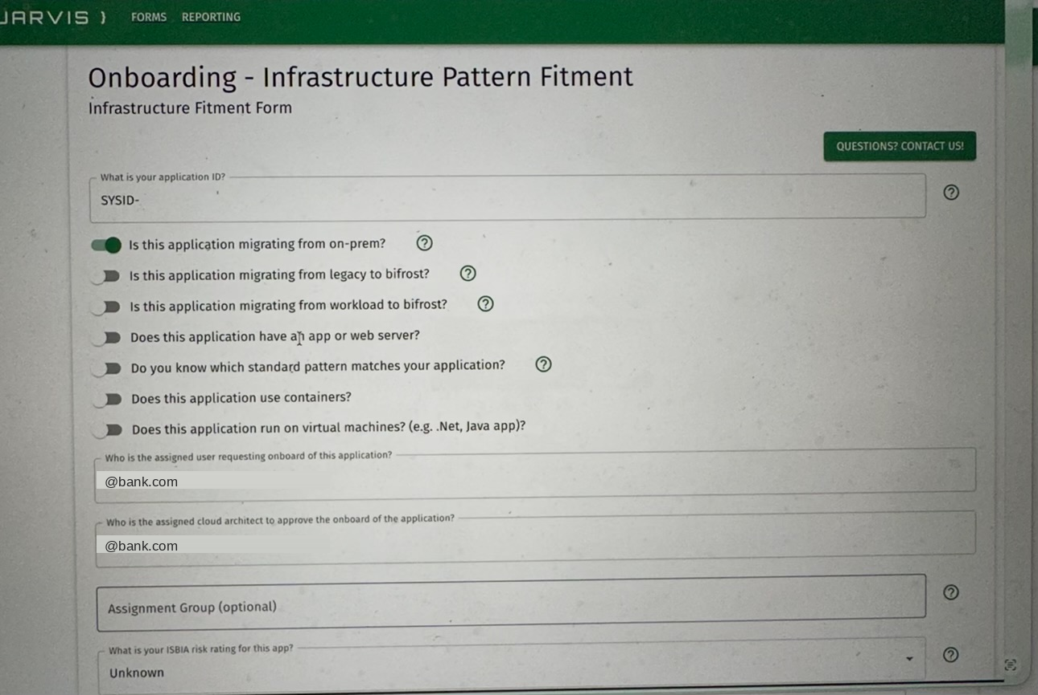
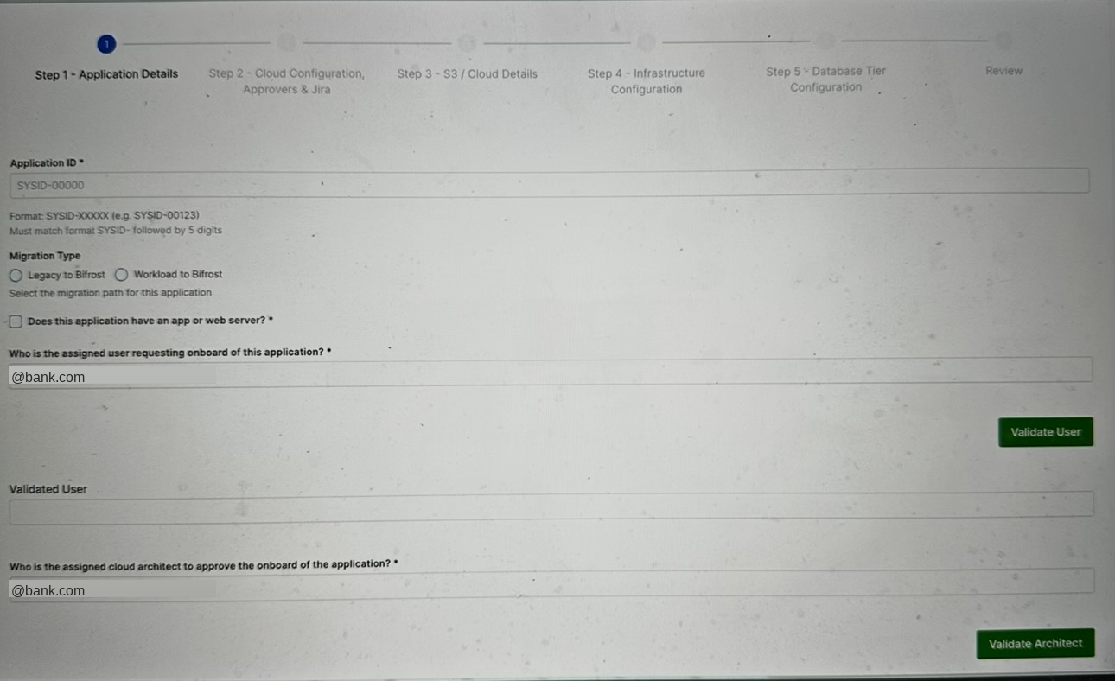
WAVE 2 · PUBLIC CLOUD CONVERSION · CONVERSION COMPLETE
14 / 20
Workflow Conversion Complete — Payload Parity Next
workflows converted to IDP
Status: React UI → IDP workflow conversion is complete for 14 of 20 workflows. Remaining gate: match payload submission 1:1 across both systems.
Screen Comparison — Application Onboarding
LEGACY SYSTEM
IDP ONBOARDING (TARGET STATE)
1:1
GATE
6 of 20 remaining
for payload parity
01
All automation workflow-driven
02
Native IDP reporting
Every onboarding action runs through IDP workflows, end to end.
Reports generate from IDP directly — no custom reports to maintain.
Edge cases (e.g. chatbot-assisted onboarding) deferred to a later wave | IDP Platform · Platform Engineering

Slide 4
WAVE 2 · SERVICE MAPPING · RAPDEV ENGAGEMENT
now.yaml — Closing the Service Mapping Gap
The gap: Today there is no reliable map of which microservices depend on which others. now.yaml closes that gap by registering every microservice as a Configuration Item (CI) in CMDB — automatically.
01
02
03
04
now.yaml
→
Event Fires
→
ServiceNow
→
CMDB Populated
Each microservice declares its identity, ownership, and tags.
A platform event triggers a message based on that declaration.
The message is sent to ServiceNow, carrying CI and dependency data.
CMDB tables are seeded — the microservice and its child services are recorded.
Mapping runs on tags
Cross-team build
Service relationships in CMDB are derived from tags — not a manually maintained relationship table.
Delivered with RapDev, spanning multiple teams across platform and service-owning groups.
Outcome: accurate, automated service mapping — not previously available | IDP Platform · Platform Engineering

Slide 5
PLATFORM FOUNDATIONS · RECAP
The Three Pillars of IDP
A quick recap before we go deeper on Catalog
01
02
03
Workflow
Catalog
Scorecard
Self-service onboarding
Component & system inventory
Health & compliance checks
Teams provision K8s namespaces, AD groups, and repos directly through IDP — no tickets, no platform-team hand-offs.
Every service, pipeline, and system is a discoverable entity — ownership, metadata, and relationships in one place.
Automated checks turn platform standards into a visible, trackable score for every team and system.
K8s namespace onboarding
AD group provisioning
Repo creation
Component entities
System entities
Ownership & metadata
Health checks
Compliance checks
Trackable scoring
4 of 4 live in P-1
In progress
Planned
Together: teams self-serve through Workflow, every result lands in Catalog, and Scorecard keeps it all honest.

Slide 6
WAVE 2 · IDP CATALOG · TARGETING AUGUST 2026
One Place for Everything a Developer Needs
A Developer's Morning — Today
With the IDP Catalog — One Service Page
✗
Harness CI/CD to check last pipeline run
✓
CI/CD Last pipeline run — Jenkins or Harness
✗
SonarQube to see code quality gate
✓
Code Quality SonarQube gate · coverage · DORA metrics
✗
Wiz to check security posture
✓
Security (Wiz) Security posture for this service
✗
Datadog to find the right dashboard
✓
Kubernetes Pod health · deployments · no kubectl needed
✗
Teams / Slack to ask who's on-call
✓
Observability Datadog or Dynatrace — direct link, right dashboard
✗
Confluence / Wiki to search for the runbook
→
✓
On-call / Incidents Who's on-call · rotation · incident dashboard
✗
kubectl to check pod health
✓
TechDocs Team-owned docs · versioned with the code
7 tools. 7 context switches. Every morning.
Catalog items are read-only views — developers use them to switch context, not to edit data.
One tab. Zero context switching. Everything about your service.
IDP Platform · Platform Engineering

Slide 7
LIVE DEMO
~2 MIN
Creating & Managing
AD Group Users in IDP
DEMO RUNTIME
Self-service AD group creation and user management — no ServiceNow ticket, no wait.
1
Create AD Group
2
Manage Users
Provision a new Azure AD group directly from the IDP self-service form — no ticket, no wait.
Add or remove users in the group, individually or in bulk, with validation before assignment.
Switching to live screen-share now...

