Slide 1
AUGUST 2026
IDP PLATFORM
4 / 4
+ K8s
Wave 1
Complete.
Wave 2 Underway.
WORKFLOWS DELIVERED
POD SELF-SERVICE
Complete · in P-2
Restart · Start · Stop services live
Wave 2
Wave 3
All 4 developer workflows complete, now in P-2. K8s pod self-service live. Wave 2 firmly underway.
FIRMLY UNDERWAY
23 / 25 SERVICES COMPLETE
now.yaml service mapping · IDP catalog build
5 / 25 payload submission match complete
01 Wave 1 + K8s Self-Service 02 Catalog Architecture 03 Wave 3 — Public Cloud 04 Live Demo 05 Communication Plan

Slide 2
WAVE 1 · COMPLETE · IN P-2
IDP Platform · Platform Engineering
Wave 1 + K8s Self-Service — Delivered
All 4 high-value developer workflows complete, now in P-2. K8s pod management self-service — no kubectl, no ticket, no wait.
UC 1
Create Repository
✓ LIVE
UC 2
K8s Namespace Onboarding
✓ LIVE
Template-based
Branch protection
Webhook config
10-stage pipeline
~5 min runtime
Resume on fail
· GitHub repo from approved template
· 10-stage pipeline: namespace, AD groups, repos
· Branch protection · team permissions · webhooks
· PaaS repo · Jenkins folder · Vault repo + pipeline
· Template-based · fully automated from IDP form
· ~5 min (existing AD) · ~40 min (new AD) · resume on fail
UC 3
Create AD Group
✓ LIVE
UC 4
Add Users to AD Group
✓ LIVE
SailPoint API
No ticket · No wait
Validation built-in
SailPoint API
Bulk or individual
Confirmation
· SailPoint API · no ServiceNow ticket
· Bulk or individual via SailPoint API
· Instantaneous from IDP self-service form
· Validates group and user before assignment
· Validation built-in before provisioning
· Confirmation sent on completion
NEW
K8s Pod Self-Service — Restart Services · Start Services · Stop Services
✓ LIVE P-2
No kubectl · No ticket · No platform team — developers manage pod lifecycle directly from IDP
Next: Wave 2 underway — catalog, CMDB, K8s pod self-service expanding | IDP Platform · Platform Engineering

Slide 3
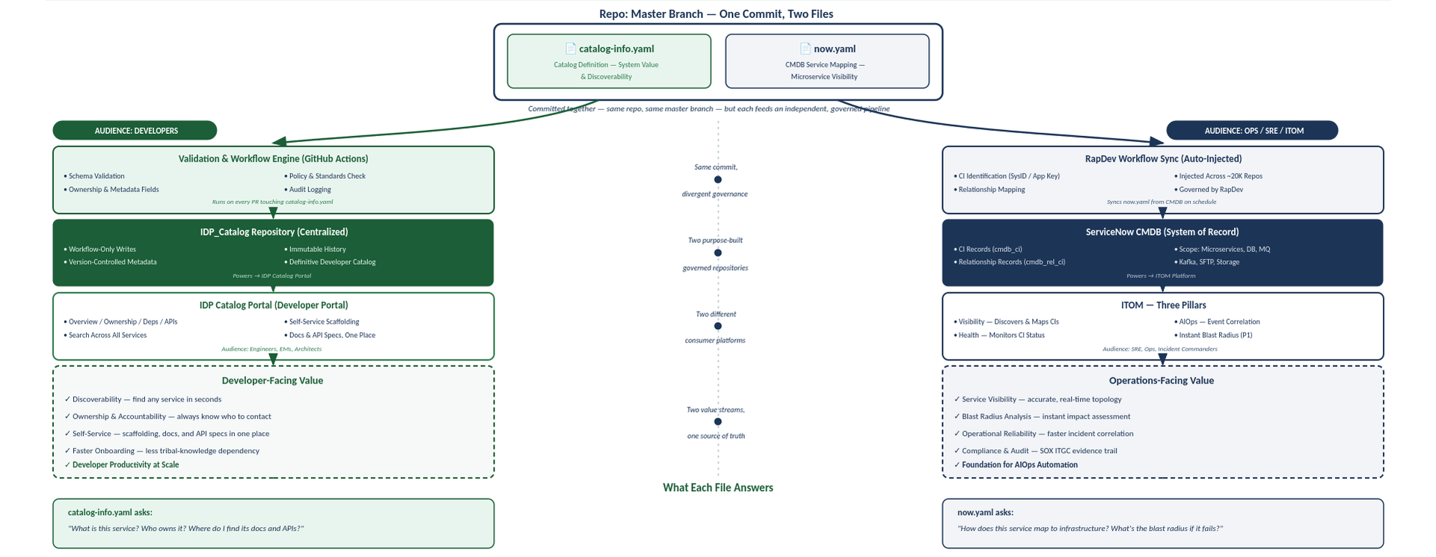
WAVE 2 · SERVICE MAPPING & CATALOG
now.yaml · catalog-info.yaml · Master Branch
One Repo · Two Files · Two Value Streams | IDP Platform · Platform Engineering

Slide 4
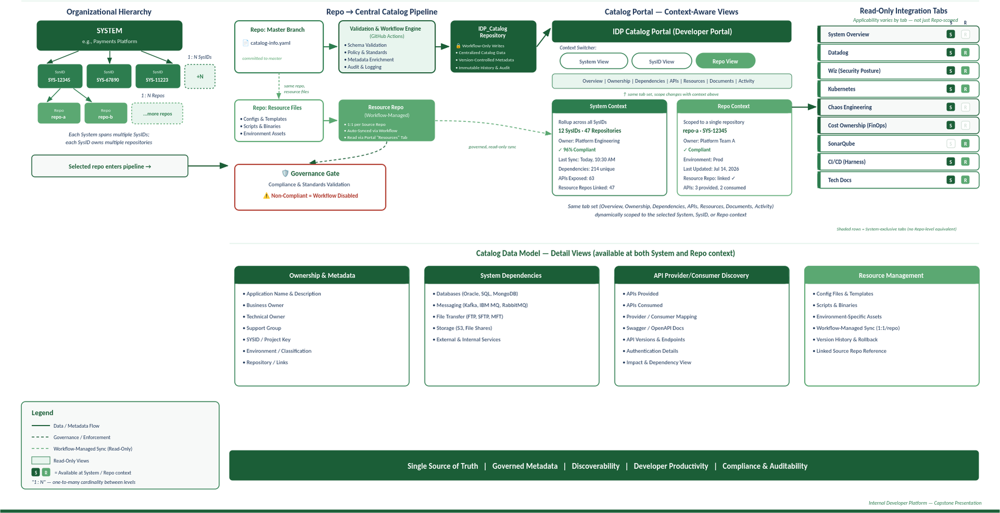
WAVE 2 · CATALOG ARCHITECTURE
System → SysID → Repository → Portal
IDP Catalog Architecture — Reference | IDP Platform · Platform Engineering
Notes:
Diagram: catalog-info.yaml (left lane) → GitHub Actions validation → IDP_Catalog Repo → IDP Portal. now.yaml (right lane) → RapDev Workflow Sync → ServiceNow CMDB → ITOM. Centre rail shows they diverge from the same master branch commit.

Slide 5
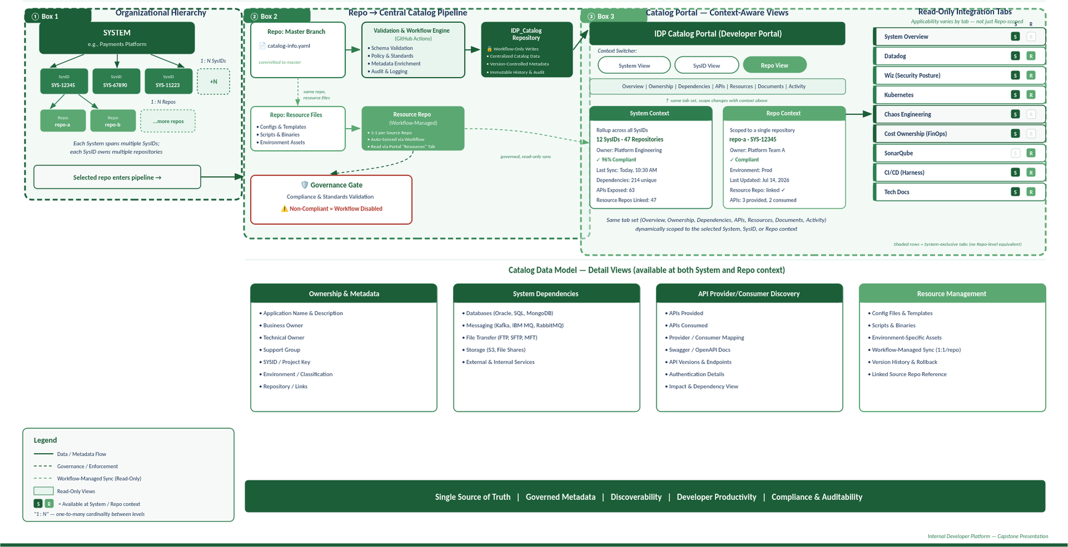
WAVE 2 · LIVE WALKTHROUGH
Follow the numbered flow: hierarchy → pipeline → portal
Catalog items are read-only views — developers use them to find context, not to edit data | IDP Platform · Platform Engineering
Notes:
Architecture: Source repos → GitHub Actions validation → IDP_Catalog central repo → IDP Portal tabs (Overview, CI/CD, Code Quality, Security, K8s, Observability, TechDocs). Read-only views by audience: Engineers, Architects, SRE.

Slide 6
WAVE 3 · PUBLIC CLOUD · DELIVERY PROGRESS
IDP Platform · Platform Engineering
Public Cloud — Wave 3 Delivery Status
23 of 25 workflows converted · payload match progressing · edge cases and custom capabilities in focus.
23 / 25
5 / 25
20 / 25
WORKFLOWS CONVERTED
PAYLOAD MATCH DONE
PAYLOAD IN PROGRESS
IDP workflow build complete
Full parity confirmed end-to-end
Active comparison underway
Payload match: 5 / 25 complete (20%)
Target: 25 / 25
⚠ Edge Cases — Harness Support
IN FLIGHT
📊 Report Generation (Non-Harness Data)
IN BUILD
· 2 of 25 workflows need Harness support — ticket raised, tracked
· Custom reports in public cloud — pulls from non-Harness APIs
· Workarounds documented; not blocking payload parity
· Working with Harness on a Report Builder for custom API data
🤖 Custom Chatbot Integration
IN BUILD
✓ Remaining 2 Workflows
PLANNED
· Chatbot onboarding needs custom IDP integration — designed
· 2 workflows pending build — scoped and sequenced
· Deferred from Wave 2; now actively resourced in Wave 3
· Target: all 25 complete before Wave 3 close
Wave 3 target: full 25-workflow parity with legacy system | IDP Platform · Platform Engineering

Slide 7
LIVE DEMO
K8s Pod Self-Service
Restart · Start · Stop — from the IDP portal, no kubectl, no ticket, no wait.
1
🔍
2
⚡
3
✅
Navigate to Service
Select Pod Action
Confirm & Monitor
Open the IDP catalog · find your target service · open the catalog card
Choose: Restart Service · Start Service · Stop Service
Action executes · rolling restart or lifecycle change visible in real time
Service catalog shows all K8s-hosted services with live pod status
All three actions available from the self-service panel — no kubectl required
Status updates live · email confirmation on completion
What this replaces: kubectl exec → kubectl rollout restart → Slack the platform team → Wait for confirmation → Now: one click in IDP
Switching to live screen-share now...

Slide 8
Catalog Communication Plan
Guiding Principle: “Ease of Use Is the North Star” — one Point of Contact, plain language, right-sized outreach per tier.
Audience Tiers
Channels & Cadence
Rollout Timeline
Tier | SysIDs | Approach
T1 — High Importance | ~50 | White-glove: 1:1 + brown bag
T2 — High Value | ~150 | Targeted brown bag + email
T3 — Standard | ~300 | Self-service video + email
Channel | Cadence
Video (On-Demand) | At rollout, refreshed quarterly
Brown Bag Sessions | Bi-weekly → monthly
Email Announcements | Weekly (T1) → monthly (T3)
Point of Contact | Ongoing / as-needed
Phase 1 • Wks 1–2 • Tier 1
1:1 briefings + kickoff video + brown bag
Phase 2 • Wks 3–5 • Tier 2
Brown bag sessions + targeted email
Tier counts illustrative — confirm vs. governed SysID tiering model.
Phase 3 • Wks 6–9 • Tier 3
500 SysIDs total — intensity of outreach scales with business importance, not a one-size broadcast.
POC
One accountable owner — no conflicting guidance, clear escalation, feedback to roadmap.
Broadcast email + self-service video
Ongoing: monthly brown bag • quarterly video refresh • POC always available
Driving This to Completion: Tiered rollout schedule is locked, Point of Contact is staffed, and the brown bag calendar is set — Phase 1 (Tier 1) begins as planned.
Internal Developer Platform | Catalog Communication Plan

