Slide 1
Pollution Prediction System
Team 21

Slide 2
Introduction

Slide 3
Introduction
Air pollution has been a looming issue of the 21st century that has also significantly impacted the surrounding environment and societal health.In this project, the Pollution Prediction System is proposed to perform air pollution prediction for outdoor sites for various pollution parameters. Here in this project we are predicting the values of air pollution measurements over time, based on basic weather information (temperature and humidity) and the input values of 5 sensors. The three target values to predict are: carbon monoxide, benzene, and target nitrogen oxides

Slide 4
Feature Extraction and Pre-Processing

Slide 5
There are 12 feature column in the dataset:
1. Date - Date and time of the record measurement
2. Deg_C - Temperature in Celcius
3. Relative Humidity - Relative humidity is the percentage of the current absolute humidity to the highest possible absolute humidity
4. Absolute Humidity - Absolute humidity is the mass of water vapor divided by the mass of dry air in a volume of air at a given temperature.
5. Sensor_1 - (tin oxide) hourly averaged sensor response (nominally CO targeted)
6. Sensor_2 - (titania) hourly averaged sensor response (nominally NMHC targeted)
7. Sensor_3 - (tungsten oxide) hourly averaged sensor response (nominally NOx targeted)
8. Sensor_4 - (tungsten oxide) hourly averaged sensor response (nominally NO2 targeted)
9. Sensor_5 - (indium oxide) hourly averaged sensor response (nominally O3 targeted)
10. Target_Carbon_Monooxide - Amount of Carbon Monoxide in air, which we need to predict
11. Target_Benzene - Amount of Benzene in air, which we need to predict
12. Target_nitrogen_oxide - Amount of Nitrogen Oxide in air, which we need to predict

Slide 6
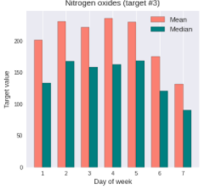
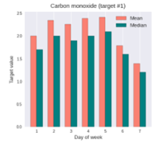
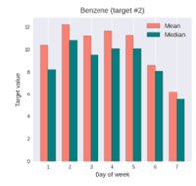
Date-Time column
While performing EDA, we observed that the target values of the 3 pollutants were less during weekends as compared to weekdays.
We performed onehot encoding for distinguishing between weekday and weekend.

Slide 7
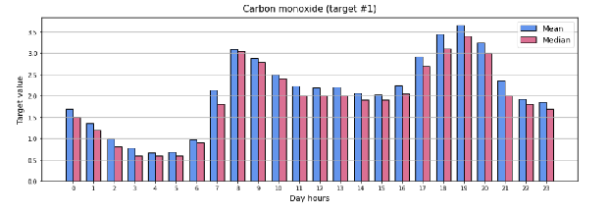
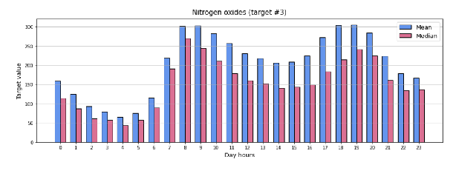
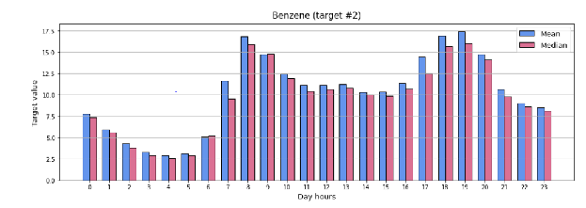
While performing EDA, we observed that the target values of the 3 pollutants were high during a range in the day hours.
We performed onehot encoding for distinguishing between high range and low range of the day hours.

Slide 8
Models

Slide 9
Linear Regression

Slide 10
Linear regression is the simplest model used for statistical technique for predictive modeling.
It basically gives us an equation, where we have our features as independent variables, on which our target variable [nitrogen, benzene, carbon ] is dependent upon.
In our case we observed that on implementing linear regression error values of nitrogen-oxide were really high:
On performing regularization using ridge regression for different learning rates did not affect the error values significantly, so considered to perform polynomial regression for improvement.
Linear Regression
MAE(Nitrogen-oxide) | 64.82
RMSE(Nitrogen-oxide) | 100.34

Slide 11
Polynomial Regression

Slide 12
Polynomial Regression
Polynomial Regression is a form of linear regression in which the relationship between the independent variable x and dependent variable y is modeled as an nth degree polynomial.
Polynomial regression fits a nonlinear relationship between the value of features x and the corresponding target values y.
Considered degree 2 to degree 5 for polynomial model from which we analysed that degree 3 is giving the best results so degree 3 was chosen:
Degree/Pollutant Errors(RMSLE) | 2 | 3 | 4 | 5
Carbon-Monoxide | 0.139 | 0.132 | 0.146 | 0.221
Benzene | 0.112 | 0.114 | 0.121 | 0.223
Nitrogen-oxide | 0.506 | 0.489 | 0.539 | 1.12

Slide 13
Random Forest Regressor

Slide 14
What are Random Forests?
An ensemble classifier using many decision Trees.
Used for Classification or Regression.
It is a type of ensemble machine learning algorithm called Bootstrap Aggregation or Bagging.
Pseudo Code:-
Pick at random k data points from the training set.
Build a decision tree associated to these k data points.
Choose the number N of trees you want to build and repeat steps 1 and 2.
For a new data point, make each one of your N-tree trees predict the value of y for the data point and assign the new data point to the average across all of the predicted y values.

Slide 15
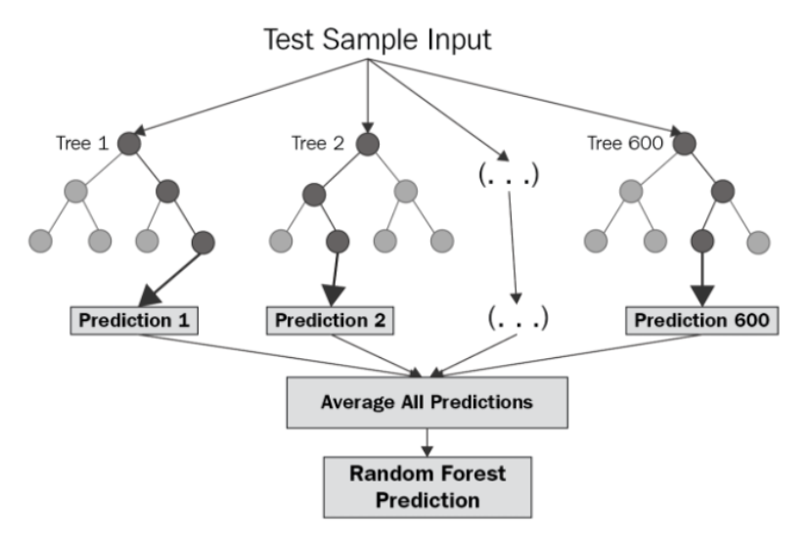

Slide 16
Steps to Perform Random Forest Regressor
Step 1: Identify your dependent (y) and independent variables (X)
Step 2: Split the dataset into the Training set , Validation set and Test set.
Step 3: Train the Random forest classifier and test it on validation Dataset . Here, we have used hyperparameter tuning for number of estimators i.e The number of trees in the forests.
Step 4: Predict the Test Set Result.

Slide 17
Neural Network
Feature extraction
Normalization
Most of the data have various ranges. Normalization of the data makes sure that all the input data have equal importance when the training starts
Number of Neurons in each layer
Starting with a basic Neural network which is 9 layers deep
Starting with 1024 neurons
Loss function
Root Mean Squared Log Error
Predicting each output separately
Benzene had a very low RMSLE value. While nitrogen was the worst
Number of epochs
Started with 200 epoch, but saw that we can reduce the loss with more epochs

Slide 18
Neural Network
Learning Rate
Use of ReduceLRonPlateau
EarlyCallback
Incase we hit the plateau
Problem of overfitting
We saw that other models were overfitting train data
Solving using Batch Normalization and dropout
We used BatchNormalization and dropout layer to try and solve the problem
Using LeakyReLU
To solve some of the dead ReLU neurons, we used LeakyReLU
Optimizer
Adam Optimizer

Slide 19
Evaluation

Slide 20
Metrics used
Root mean squared error
Root mean squared log error
Mean absolute error
Mean absolute percentage error
R-squared

Slide 21
Result

Slide 22
Model\Metric | RMSLE | MAE | MAPE | RMSE | R-square
LINEAR REGRESSION | 0.4523 | 22.121 | 38% | 34.16 | 0.8355
POLYNOMIAL REGRESSION(Degree=3) | 0.245 | 15.5573 | 24.33% | 25.2967 | 0.9089
RANDOM FOREST | 0.04403 | 15 | 19% | 45.020 | 0.90187
NEURAL NETWORK | 0.1550 | 14.218 | 23.98% | 26.853 | 0.8406

