Slide 1
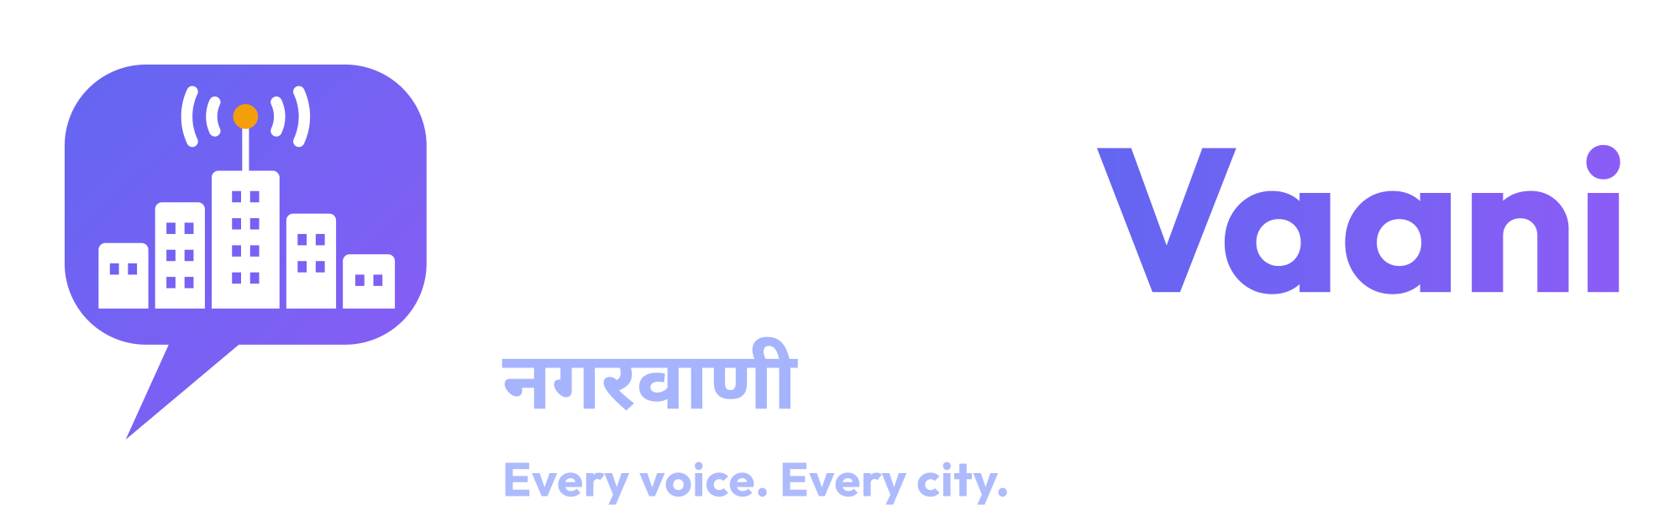

Multilingual AI that turns citizen voices into infrastructure priorities
Try the live demo
Track 01: AI for Digital Public Infrastructure & Governance
nagarvaani-636001394004
.asia-south1.run.app
Build with AI: Code for Communities, Second Edition (Google Cloud x Hack2skill)
Notes:
Open with the one-line pitch: NagarVaani turns what citizens say into what governments prioritise. Point to the QR code: the live demo needs no login.

Slide 2




Citizen needs are heard, but not prioritised
The Track 01 brief: development requests live in fragmented systems, so public spending drifts away from need and infrastructure gaps go unaddressed.
Fragmented intake
Complaints sit in separate portals, helplines and messages with no common structure.
Volume beats need
Citizens speak dozens of languages and reach out by voice and messaging apps, not forms.
Busy cities generate more reports, so quiet, under-served districts are easy to miss.
Language barrier
Forms and IVR menus cover only a few languages of a linguistically diverse country.
NagarVaani
2
Notes:
Use the language of the track brief. Avoid quoting statistics we cannot source. The point: intake is fragmented and priority setting is not evidence-based.

Slide 3



One platform, from a voice note to a ranked project
Collect, understand, prioritise, act
1. Collect
2. Understand
3. Prioritise
4. Act
Web form, voice, photo and WhatsApp, in the citizen's own language.
Gemini transcribes, translates, classifies and scores urgency. Duplicates are grouped.
Complaints are joined with Census, NITI Aayog and NFHS-5 district data and ranked by need.
Policymakers see hotspots and evidence-backed project recommendations.
NagarVaani
3
Notes:
Walk the four steps left to right. Stress that every step already works in the live demo.

Slide 4
How it works
Single Cloud Run container, Google Gemini, Firebase in live mode
INTAKE AND UNDERSTANDING
1
Citizen channels
2
Express API
3
Gemini
4
Storage
Web form, voice, photo, WhatsApp webhook (signed)
Cloud Run. PII redaction, rate limits, validation
Transcribe, translate, classify, urgency, duplicates
Firestore in live mode, in-memory sandbox in demo mode
PRIORITISATION AND DELIVERY
8
Dashboard + tracker
7
Gemini recommends
6
Need-weighted score
5
District data join
Heatmap, rankings, citizen tracking by ID
Structured projects with evidence and confidence
Per 100k population, urgency, deprivation, age
Census 2011, NITI aspirational flag, NFHS-5 indicators
NagarVaani
4
Notes:
Two bands. Top: getting a complaint in and understood. Bottom: turning many complaints into priorities. Gemini appears twice: once per complaint, once for recommendations over an aggregated table.

Slide 5




Google Gemini does the work, with guardrails
Where the AI is used, and how we keep it honest
Transcription
Classify and translate
Urgency scoring
Voice notes become text. The citizen confirms or edits the transcript before submitting.
Language detected, English translation stored, seven categories, schema-validated JSON.
A 1 to 5 urgency drives ranking and the age-of-unresolved factor.
Duplicate detection
Recommendations
Guardrails
Near-identical reports by text, category, district and location are grouped.
Gemini sees an aggregated, data-joined table and returns structured projects with evidence.
PII redacted first. Figures anchored to data. 'Insufficient data' allowed. Rule-based fallback is labelled.
NagarVaani
5
Notes:
This is the 25 percent criterion. Emphasise meaningful use of Gemini and the honesty of the fallback: results are tagged gemini or rule-based, never silently faked.

Slide 6



Grounded in national data, with provenance
Complaints are joined to district context so priorities reflect need
58
districts in the data layer
30
with NFHS-5 household indicators
3
official data sources
Census of India 2011
Honest by design
District population and literacy rate.
Sources, licences and retrieval dates are documented in data/SOURCES.md
Missing values stay empty. Nothing is estimated or filled in.
NFHS-5 covers 30 of 58 districts so far; road connectivity is not loaded yet.
Demo complaints are synthetic and labelled in the UI.
NITI Aayog
Aspirational-district flag for under-served districts.
NFHS-5 (2019-21)
Household electricity, improved water and improved sanitation.
NagarVaani
6
Notes:
Be upfront about coverage. Judges reward honesty about data limits more than inflated claims. Census figures are pending human verification per data/VERIFICATION.md.

Slide 7
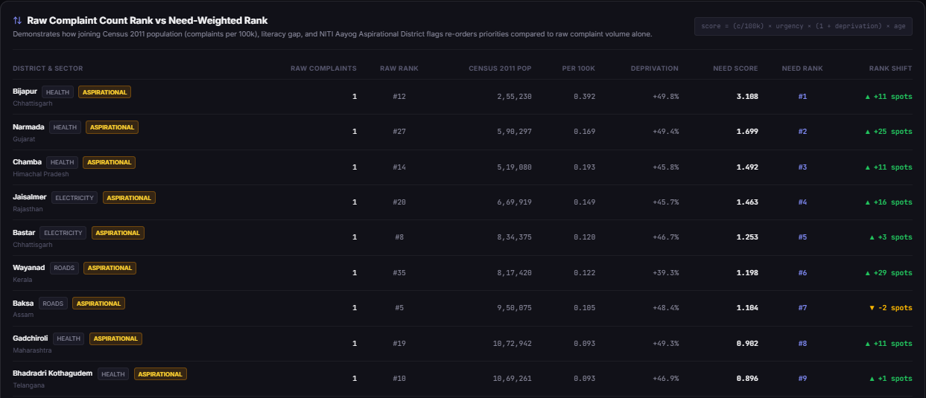
Need-weighted ranking re-orders priorities
Live demo screen (synthetic complaints): need per head and deprivation, not raw volume
Need-weighted score
complaints per 100k
x mean urgency
x (1 + deprivation)
x unresolved-age
Weights: lib/priority.ts
Why it matters
Small, aspirational districts rise because need is measured per head.
Honest note: in this demo every cluster has one complaint, so the raw rank is a tie-break. The re-ranking effect grows with real complaint volumes, which is what a pilot would measure.
NagarVaani
7
Notes:
Screenshot of the Priority Interventions view on synthetic demo data (rule-based engine, no Gemini key needed for this view). Be upfront: each cluster has one complaint, so raw rank is a tie-break. The point is the mechanism: per-100k need, deprivation and aspirational flags, with Census 2011 population and NFHS-5 where loaded.

Slide 8
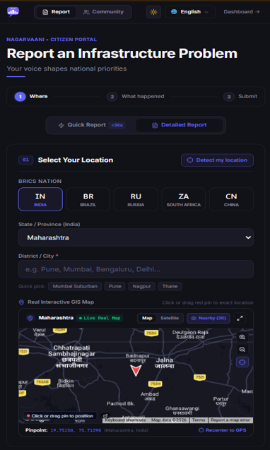
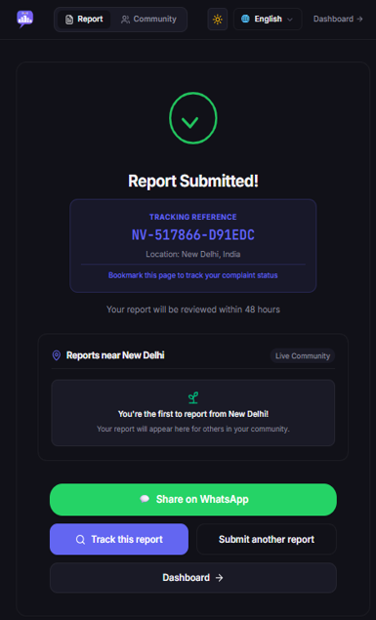
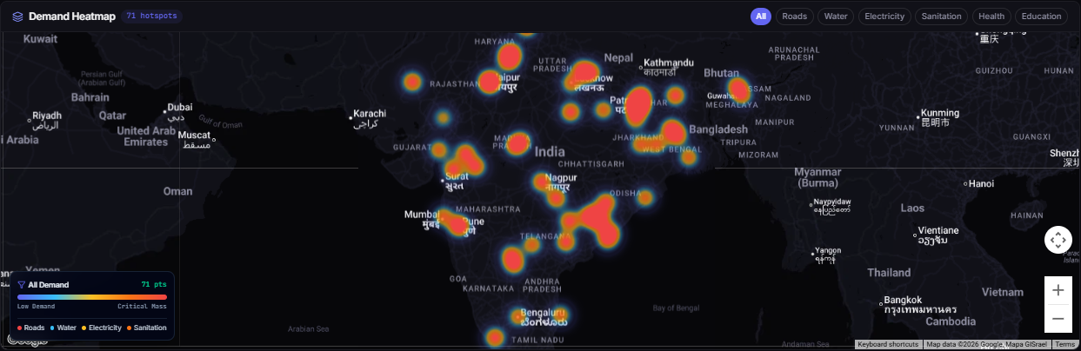
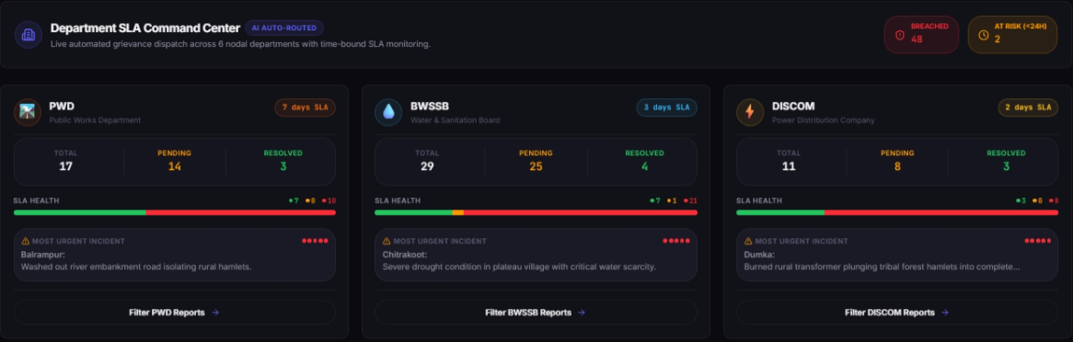
Product tour
Citizen side on a phone, policymaker side on the dashboard
Demand heatmap: hotspots by category
Report in your language
Tracking reference
Quick or detailed form with a map pin
Citizens follow status by ID
Department SLA centre: AI auto-routing
NagarVaani
8
Notes:
Real screenshots from the live demo (synthetic data). Left: citizen portal on a phone. Right: dashboard heatmap and the department SLA centre where complaints are auto-routed to nodal departments.

Slide 9
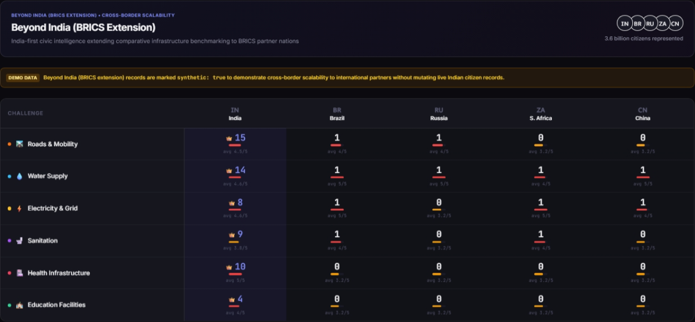
Built for India's linguistic diversity
Solving for India first, with BRICS as an extension
10
17
20+
5
Indian languages plus English
interface languages, six international
states in the Indian seed data
BRICS countries in the comparison view
Languages
Hindi, Bengali, Tamil, Telugu, Marathi, Gujarati, Kannada, Malayalam, Punjabi, Odia and English.
Gemini detects the language, so citizens never pick one. Original text and an English translation are both stored.
BRICS view uses synthetic data.
NagarVaani
9
Notes:
The BRICS comparison is an extension to show the same engine works with other countries by changing data, not code. Its records are marked synthetic. Do not quote population or beneficiary figures from that view unless you can source them.

Slide 10


Deployable in days, safe by default
Cloud Run today, a ministry pilot next
Deployability
Safety and privacy
One container on Cloud Run (asia-south1)
Demo mode needs only a Gemini key; live mode adds Firebase roles
Health and readiness endpoints, source-deploy guide
CI: lint, 39 unit tests, build, smoke test, Playwright browser check
PII redacted before any Gemini call
WhatsApp webhook verified with HMAC signatures
Firebase sign-in with admin, supervisor, operator, auditor roles; audit logs
Rate limits, size limits, daily Gemini cap, retention job
NagarVaani
10
Notes:
The demo is deliberately single-instance because its sandbox is in memory. Live mode uses Firestore. WhatsApp is tested with signed simulated payloads, not yet with a live Meta account.

Slide 11
From hackathon prototype to ministry pilot
Honest limits today, a clear path forward
Today
Next
Pilot
Scale
Working prototype: multichannel intake, Gemini triage, need-weighted ranking, live demo.
Finish national data coverage, verify Census figures, evaluate Gemini on real complaints.
Live-mode pilot with one state department: Firebase roles, WhatsApp Business, DPDP Act review.
More states and languages by adding data, shared queue for multi-instance retries, monitoring.
Impact: policymakers see evidence-backed priorities per district, so under-served communities are not lost behind high-volume ones.
NagarVaani
11
Notes:
Do not claim measured impact. Frame impact as the mechanism: need-weighted evidence. The pilot path matches the FAQ: winning solutions are evaluated for pilot deployment within relevant ministries.

Slide 12
Every citizen's voice.
Every city's priority.
Scan to try it
Thank you
Live demo nagarvaani-636001394004.asia-south1.run.app
Code github.com/rohilkohli/NagarVaani
Notes:
End on the tagline and the QR code. Add team member names before submitting.

