Slide 1
Asynchronous Javascript
Anshika Agarwal 24-06-2023

Slide 2
What is Asynchronous Programming?

Slide 3
Callback hell

Slide 4
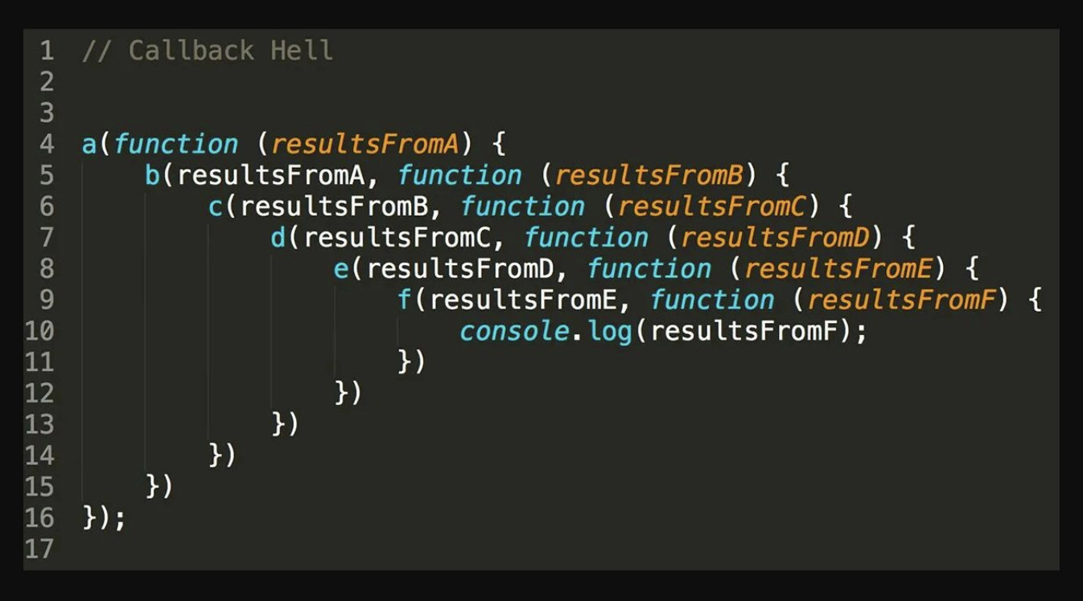
Pyramid of Doom

Slide 5
setTimeout()

Slide 6
Promises

Slide 7
Promise States
pending - the promise has been created and the asynchronous function with which it is associated has not succeeded or failed yet.
fulfilled - the asynchronous function has succeeded. When a promise is fulfilled, its then( ) handler is called.
rejected - the asynchronous function has failed. When a promise is rejected, its catch( ) handler is called.

Slide 8
Async/Await

Slide 9
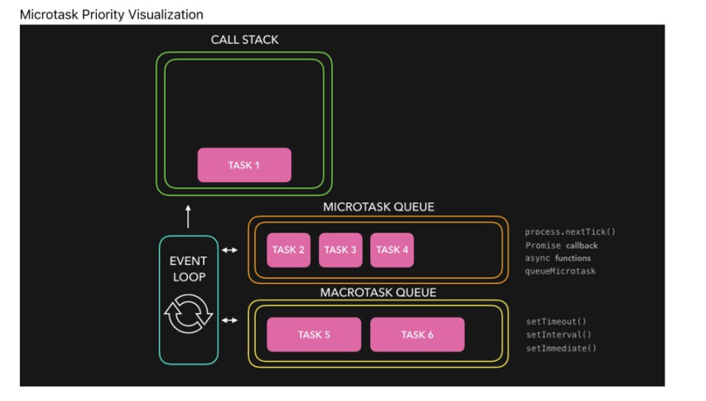

Slide 10
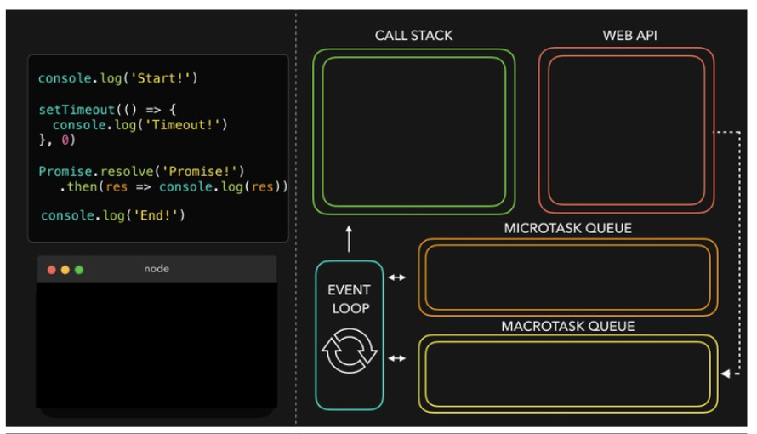

Slide 11
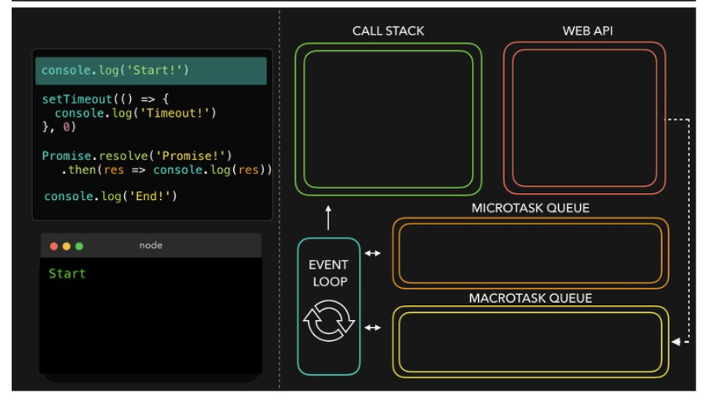

Slide 12
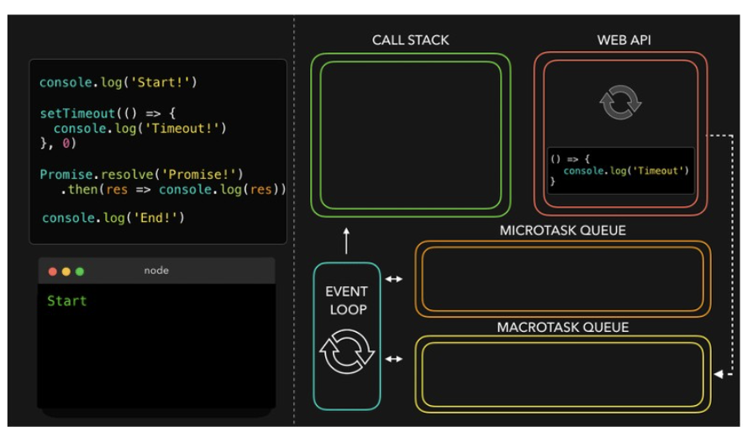

Slide 13
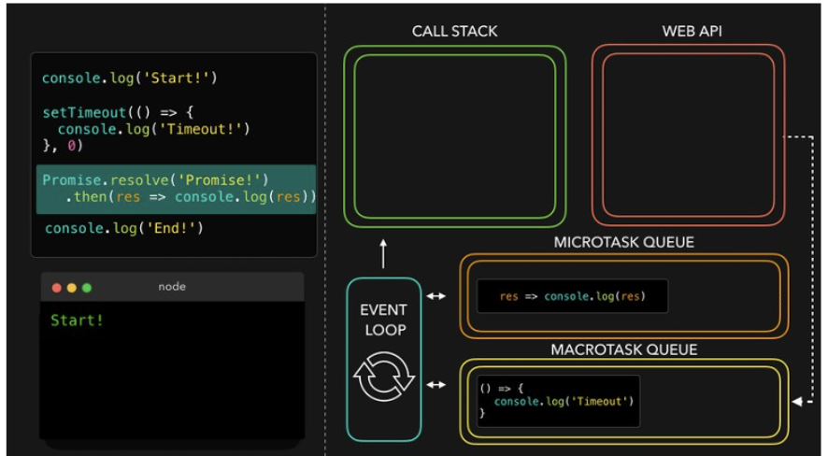

Slide 14
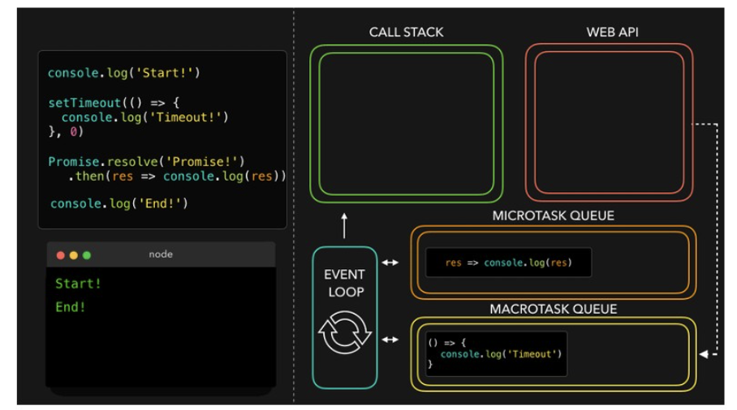

Slide 15
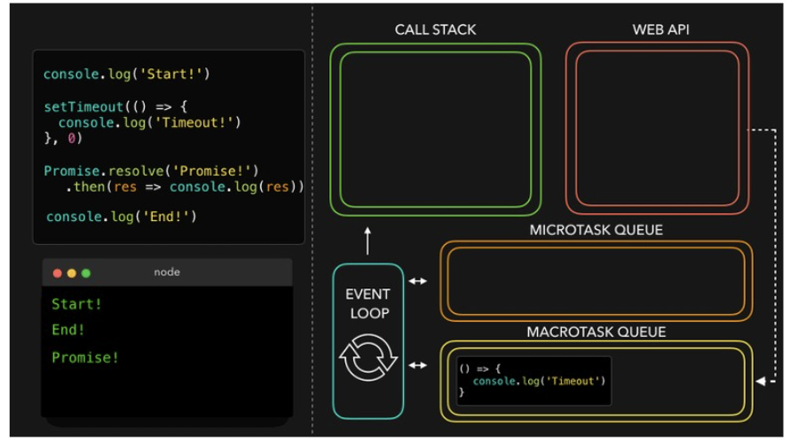

Slide 16
Thank You!!

