Slide 1
CSS Flexbox & Grid Layout
Anshika Agarwal 03-06-2023

Slide 2
Introduction to CSS Layout
Normal flow
Can change normal flow by updating following methods :
Display
Float
Position
Table
Multi-column layout

Slide 3
Flexible Box Layout
One dimensional layout method for arranging items in rows or columns
display: flex - set on parent element , children becomes flex items

Slide 4
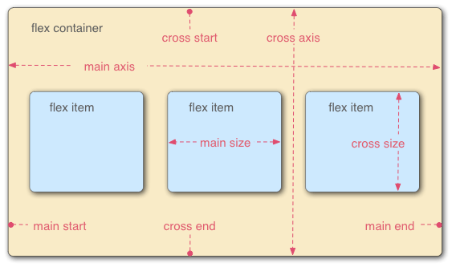
Flex Model

Slide 5
flex-direction
Row (default)
Column
Row-reverse
Column-reverse

Slide 6
Other flex properties
flex - Specifies the components of a flexible length
flex-wrap
flex-flow

Slide 7
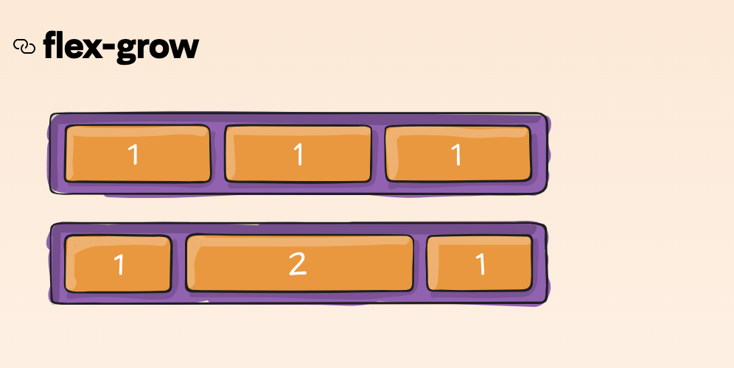
Flex-grow

Slide 8
Horizontal & Vertical Alignment
align-items controls where the flex items sits on the cross axis
Default value : stretch
flex-start
flex-end
Center
align-self - overrides align-items behaviour for individual flex items

Slide 9
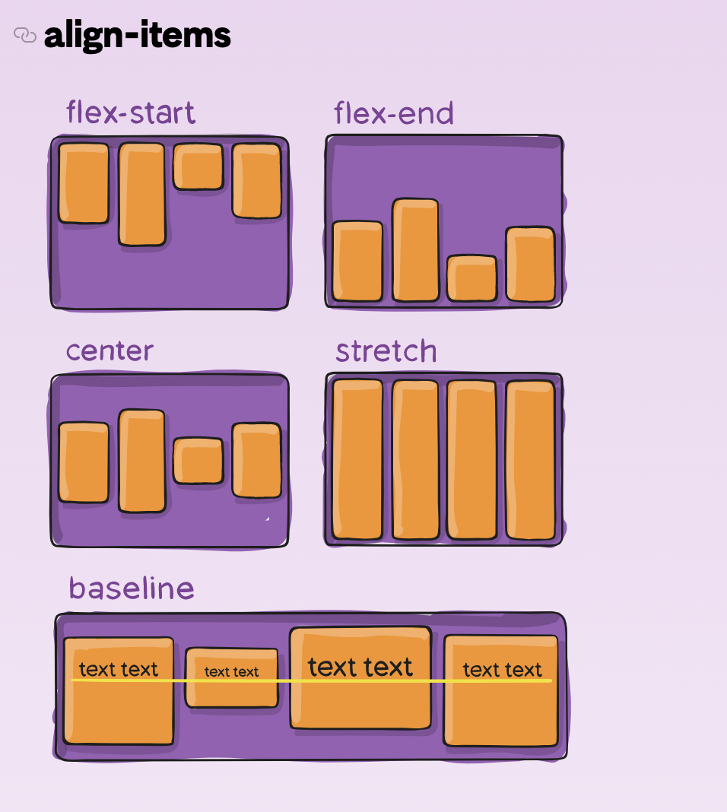

Slide 10
Horizontal & Vertical Alignment
justify-content controls where the flex items sits on the main axis
Default value : flex-start
flex-end
center
space-between
space-around

Slide 11
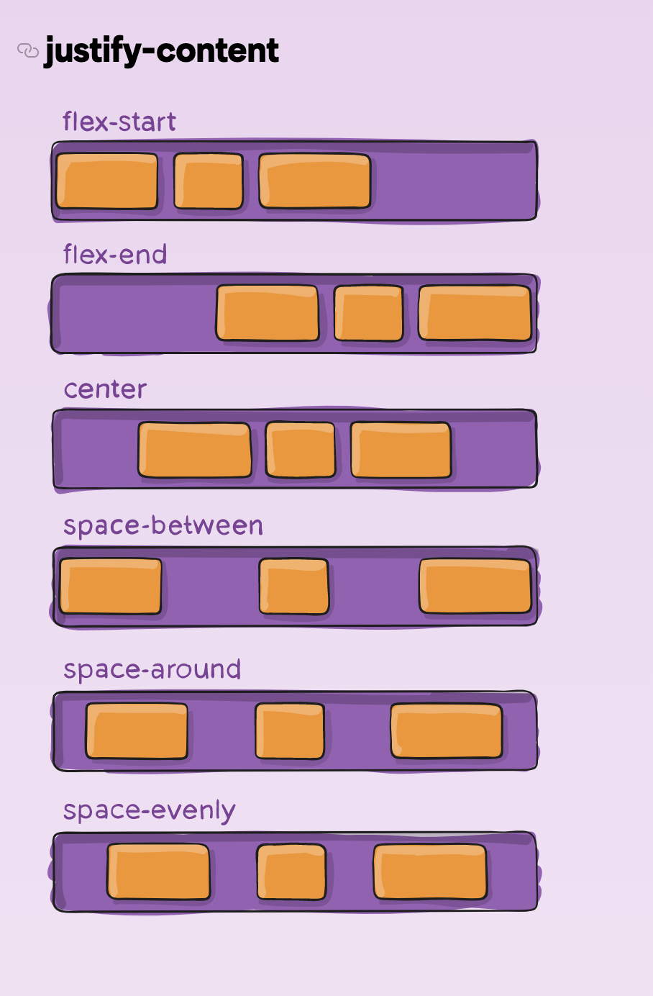

Slide 12
Ordering flex items
With flexbox, layout of flex items can be changed without affecting the source order.
By default, all flex-items have order value of 0.
Negative order values make flex items appear earlier than items whose value is 0.

Slide 13
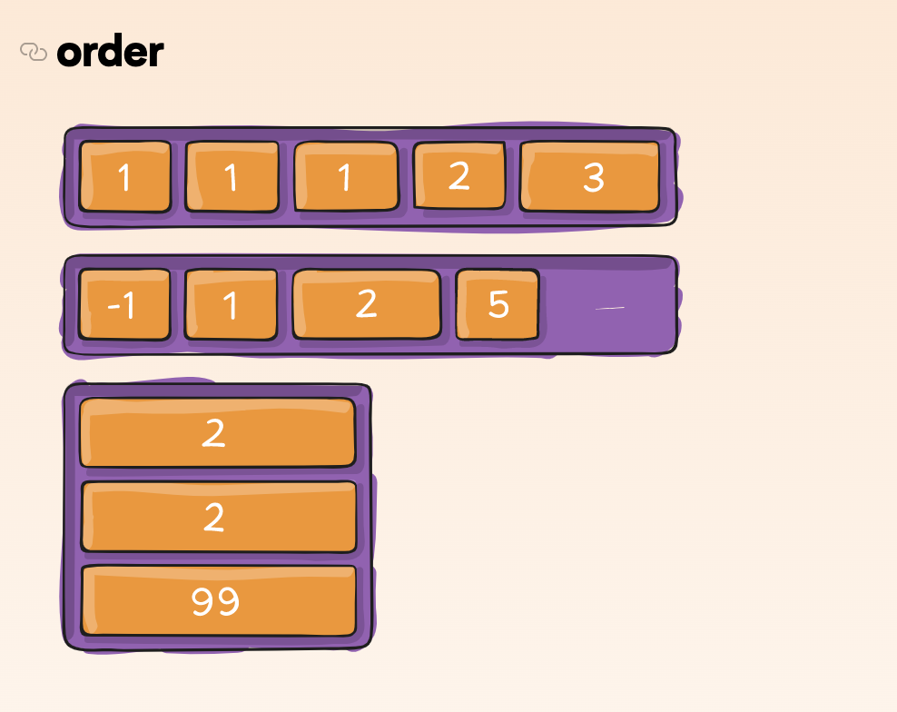

Slide 14
CSS Grid Layout
Two dimensional layout system for the web
display:grid - set on parent element and children becomes grid elements
By default, one column grid gets created
Can add columns using grid-template-columns

Slide 15
Gaps between tracks
column-gap
row-gap
gap

Slide 16
Flexible grids with the fr unit
The fr unit represents one fraction of the available space in the grid container to flexibly size grid rows and columns
grid-template-columns : 1fr 1fr 1fr

Slide 17
Repeating track listings
Can repeat track or section of track using the CSS repeat( ) function
grid-template-columns: repeat(3, 1fr)

Slide 18
The implicit and explicit grid
Explicit grid - Created using grid-template-columns or grid-template-rows
Implicit grid - Extends the defined explicit grid when content is placed outside of that grid, such as into our rows by drawing additional grid lines
grid-auto-rows and grid-auto-columns properties are used to give implicit grid tracks a size

Slide 19
The minmax() function
The minmax() function lets us set a minimum and maximum size for a track
minmax(100px, auto)

Slide 20
As many columns as will fit
We can create as many columns as will fit into the container by setting value of grid-template-columns using repeat( ) function and passing keyword auto-fill

Slide 21
Line-based placement
grid-column-start
grid-column-end
grid-row-start
grid-row-end
grid-column
grid-row

Slide 22
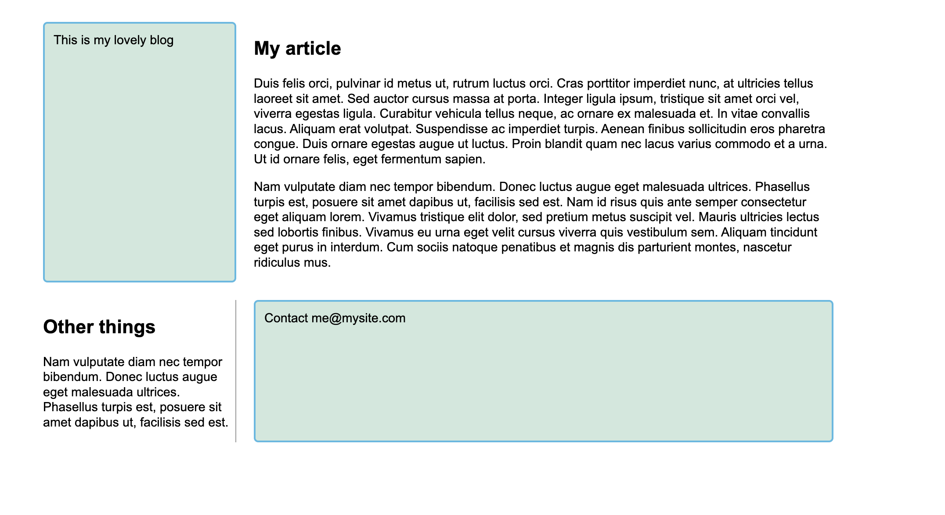

Slide 23
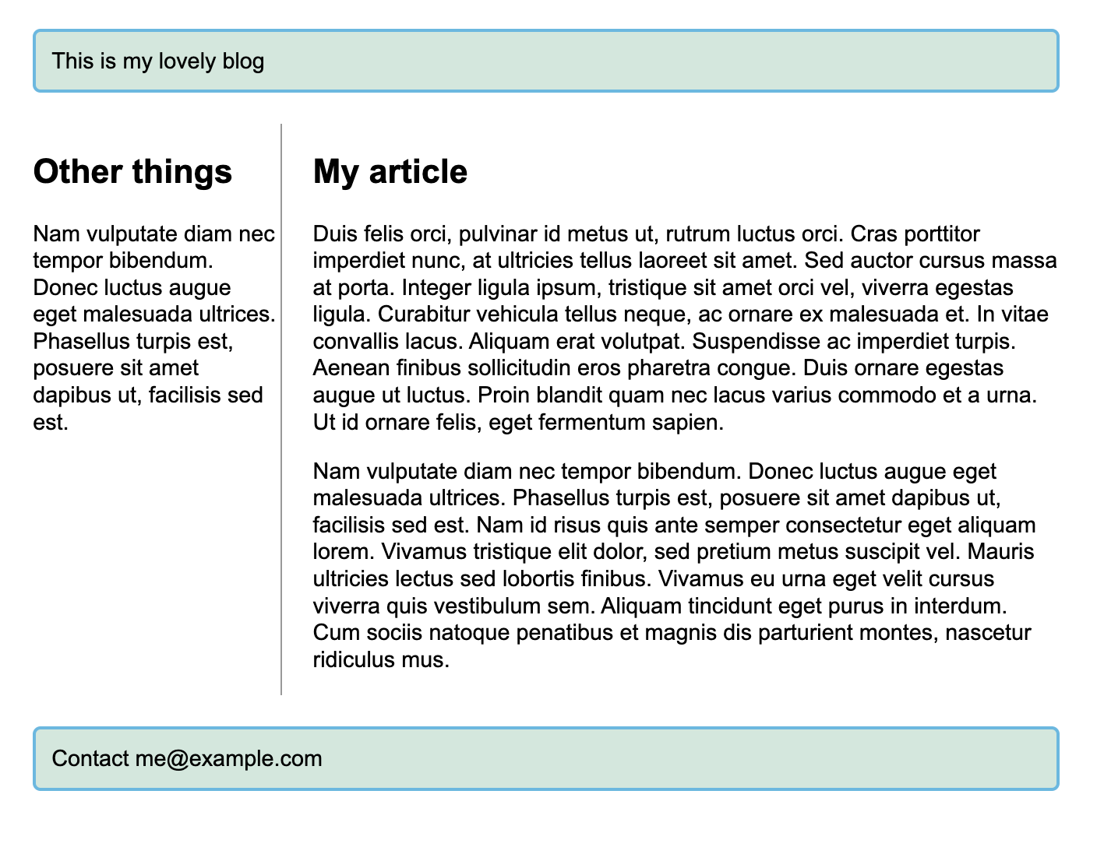
Add css such that page looks like this

Slide 24
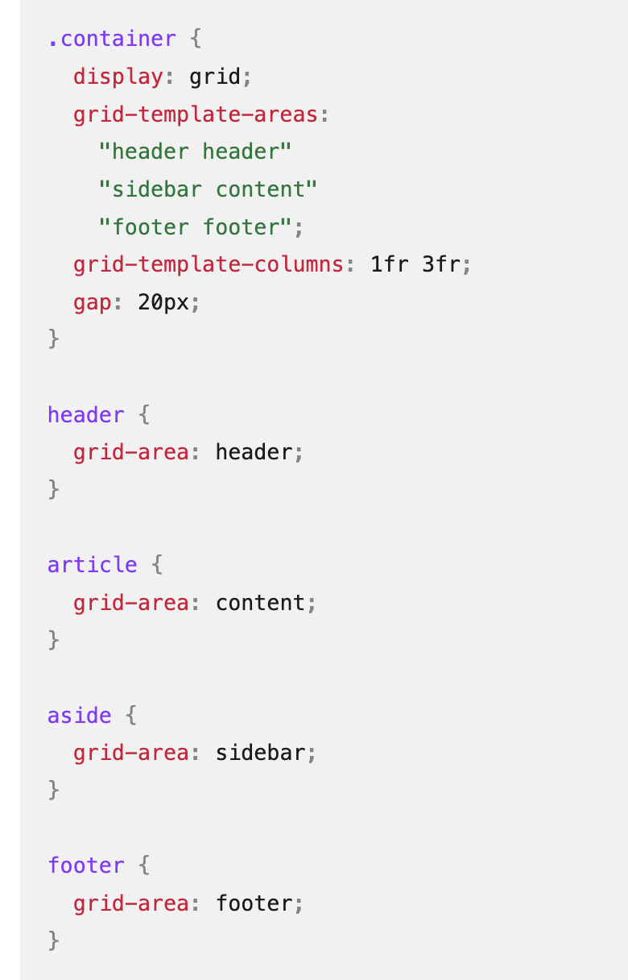
Positioning with grid-template-areas

Slide 25
Thank You !!

