Slide 1
Javascript Concepts
Anshika Agarwal 17-06-2023

Slide 2
Shortest JS Program

Slide 3
Undefined vs not defined
Undefined - Memory is allocated for the variable but no value is assigned
Not defined - Variable is not even declared in memory allocation phase
Not Defined !== Undefined

Slide 4
The Scope Chain, Scope & Lexical Environment

Slide 5
let & const in JS, Temporal Dead Zone

Slide 6
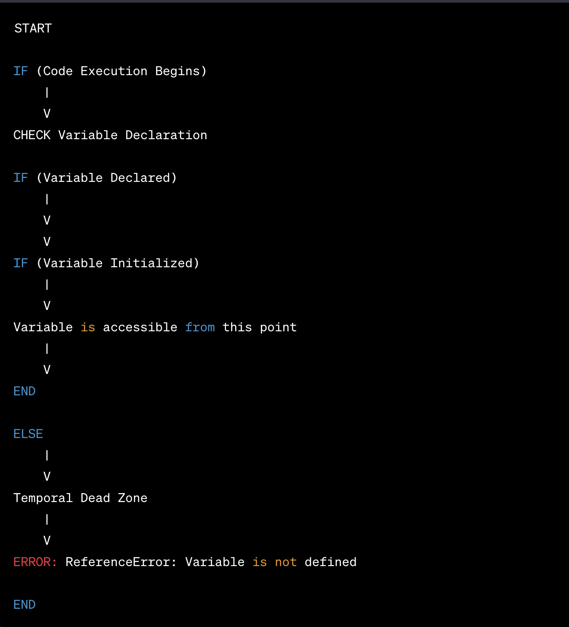
Temporal Dead Zone Flowchart

Slide 7
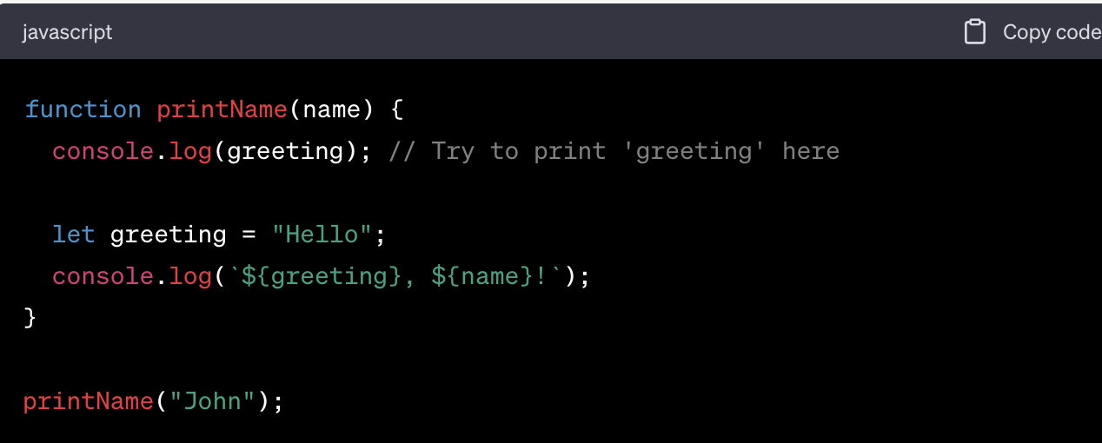

Slide 8
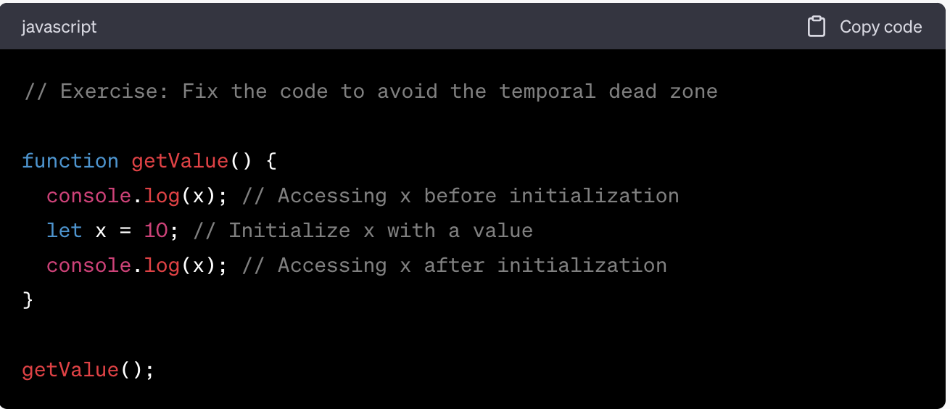

Slide 9
Some Good Practices
Try using const wherever possible
If not , use let, Avoid var
Declare and initialize all variables with let to the top to avoid errors to shrink temporal dead zone window to zero

Slide 10
Block Scope

Slide 11
Shadowing in JS

Slide 12
Illegal Shadowing
Cannot shadow let with var
Valid to shadow a let using a let
Can shadow var with let

Slide 13
Higher Order Functions

Slide 14
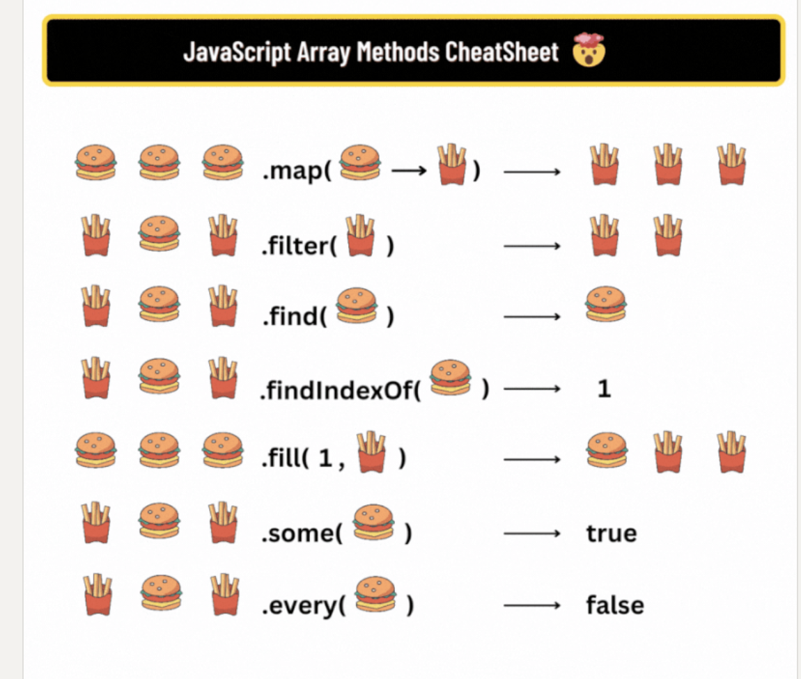

Slide 15
Thank You!!

