Slide 1
Introduction to Web Development
Anshika Agarwal 05-08-2023

Slide 2

Basics of Web Development
How the web works ?

Slide 3
Other parts of Web
Internet Connection
TCP/IP
DNS
HTTP

Slide 4
Front End Development
Creation of user interface
Look and feel of website
HTML , CSS and Javascript
HTML defines layout
CSS is used to styled format the content
Javascript adds functionality and interactivity

Slide 5
Back-end Development
Focuses on server-side of web development
Deals with logic and database operations required to make a website function properly
Server side languages - Python , Ruby, PHP or Javascript
Interact with APIs to retrieve and send data between the server and the front end

Slide 6
Full Stack Development
Involves proficiency in both front-end and back-end development
Capable of building complete web applications from designing and developing the user interface to handling server side logic and database management.

Slide 7
Client-side Programming
Code that runs on user’s device typically within a web browser
Focuses on presentation or interaction layer the application
Technologies - HTML, CSS and Javascript
Fast and responsive user interfaces - no waiting required for server responses
Reduced server load - less processing on server side and server only focuses on delivering data

Slide 8
Server-side Programming
Code that executes on the server
Handling requests from clients, processing data and generating responses
Manages application logic , data storage and business operations
Secure data processing
Access to system resources like database , file systems and network services
Cross-platform capability - support different clients (web browsers, mobile Apps )

Slide 9
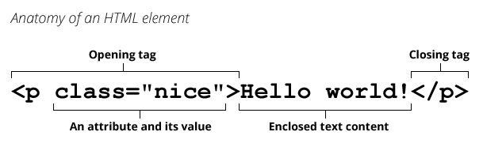
Introduction to HTML
HTML ( HyperText Markup Language) is a markup language that tells web browsers how to structure the web pages.
HTML contains series of elements which we use to make content appear in certain way

Slide 10
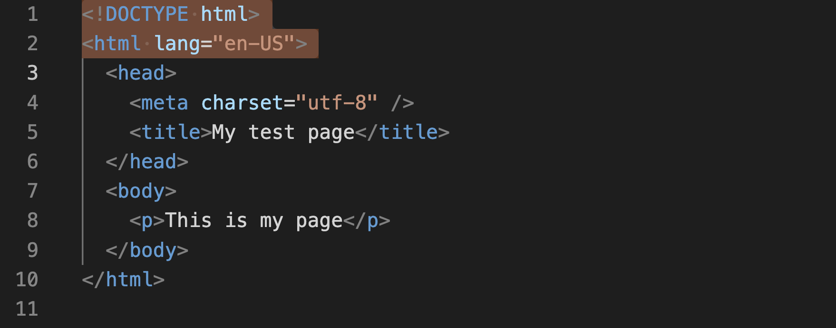
Basic Structure of HTML Document

Slide 11
What is HTML head ?
Contents of the <head> element.
Head’s content is not displayed on the page.
Contains metadata about the document.

Slide 12
Adding a title
The <title> element is metadata that represents the title of the overall HTML document.
When you bookmark a page , <title> contents are filled in as suggested bookmark name.

Slide 13
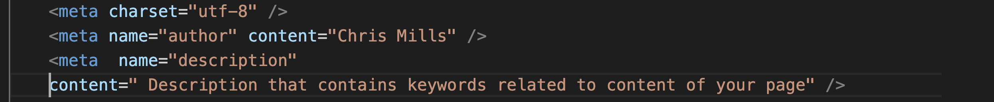
Metadata: the <meta> element
Data that describes data .
Charset represents document’s character encoding.
Providing a description helps in optimizing searches (Search Engine Optimization)

Slide 14
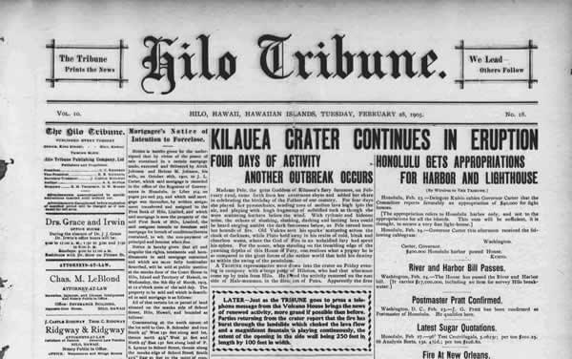
The Basics: headings and paragraphs

Slide 15
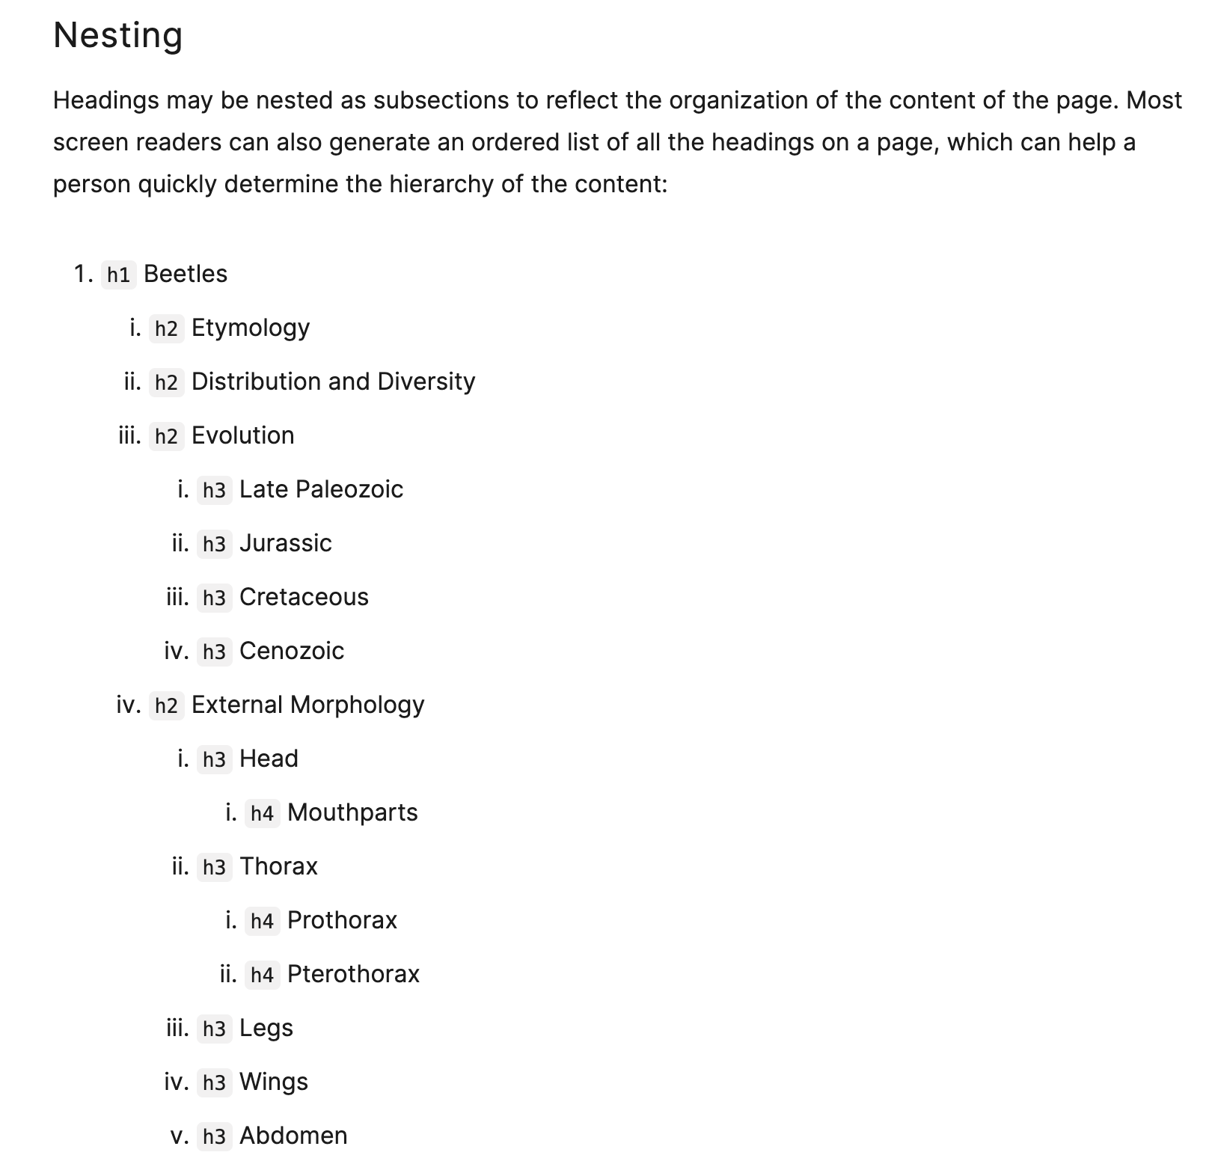

Slide 16
Why do we need semantics?

Slide 17
Lists
UnOrdered Lists
Lists of items for which the order of the items doesn’t matter
Starts with <ul> element — wraps around all list elements
Wrap each list item with <li> element

Slide 18
Lists
Ordered Lists
Lists of items for which the order of the items does matter
Starts with <ol> element — wraps around all list elements
Wrap each list item with <li> element

Slide 19
<b> vs <strong>
The <strong> element is for content that is of greater importance
<b> element is used to draw attention to text without indicating that it is more important

Slide 20
Image Tag
The <img> tag is an HTML element used to embed images in a web page.
Self enclosing tag (does not require a closing tag)
Attributes for img tag :
  src - specifies url of the image
  alt - alternative text for the image
  Width and height - specifies dimensions of the image

Slide 21
Hyperlinks
Link documents to other documents or resources
Any web content can be converted to a link
Basic link is created by wrapping content inside <a> element

Slide 22
Advanced Text Formatting
Description lists
Mark up a set of items and their associated descriptions, such as terms and their associated descriptions such as terms and definitions.
Wrapper element <dl>
Description term <dt>
Description definition <dd>

Slide 23
Superscript nd subscript
We need to use superscript and subscript when marking up items like dates, chemical formulae and mathematical equations.
The <sup> and <sub> elements handle this job

Slide 24
HTML Tables
Structured set of data made up of rows and columns (tabular data)
Content of table is enclosed in <table></table> tags.
Table cell is created by <td> element
Table row <tr> element

Slide 25
Document and Website Structure

Slide 26
Basic Sections a document
Header - <header>
Navigation bar - <nav>
Main Content - <main> with various subsections represented by <article>, <section> and <div> elements
Sidebar - <aside>; often placed inside <main>
Footer - <footer>

Slide 27
Planning a simple website

Slide 28
Style HTML using CSS

Slide 29
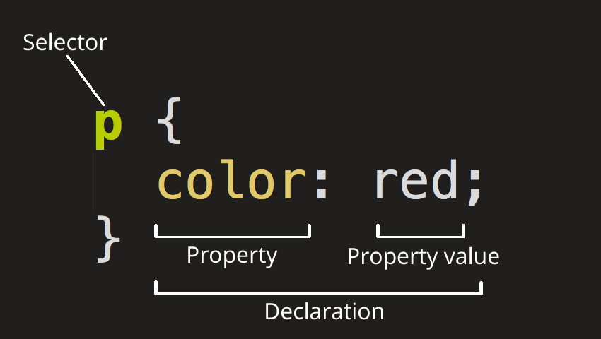
What is CSS ?
CSS is a stylesheet language
Used to selectively style HTML elements

Slide 30
How CSS is structured ?
External Stylesheet
Internal Stylesheet
Inline Styles

Slide 31
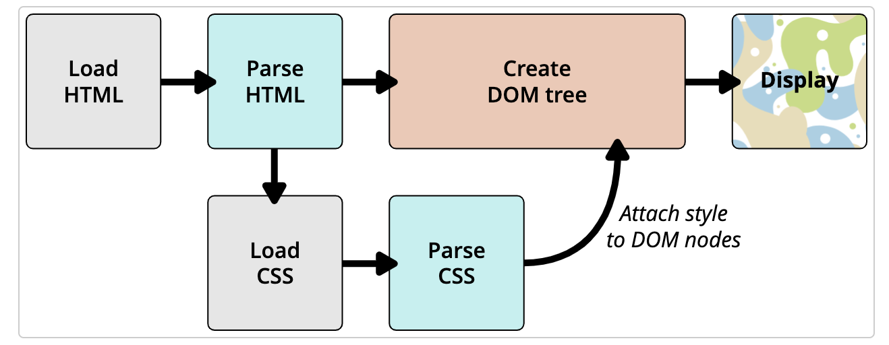
How does CSS actually work?

Slide 32
CSS Selectors
Type , class and ID selectors - p, #my-id, .my-class
Pseudo-classes and pseudo-elements - a:hover , p::first-line
Combinators - article > p
Attribute Selector - img[src]

Slide 33
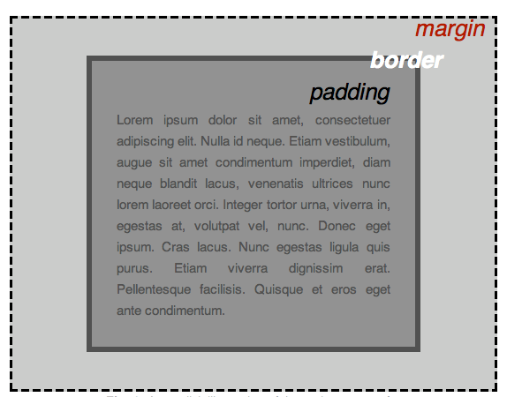
CSS Box Model

Slide 34
Margins and Margin Collapsing

Slide 35
CSS Positioning
Static
Relative
Absolute
Fixed
Sticky

Slide 36
Sizing items in CSS
Setting a specific size
Using percentages
Percentage margins and padding
Min and max sizes
Viewport Units

Slide 37
Border
border-style
border-width
border-color

Slide 38
Display Properties
block
inline
inline-block

Slide 39
Thank You !!

