Slide 1
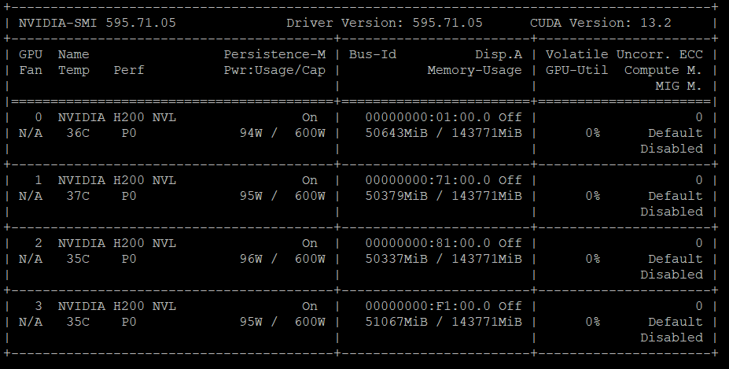
LLM Model Serving
Server Setup:
4 NVIDIA H200s (143gb VRAM)
Total VRAM: 143 * 4 = 572 gb
Our goals:
Run agents in parallel
Serve multiple users
Optimize server utilisation
Screenshot of server usage with multiple model requests

Slide 2
Testing the limits
Number of parallel requests: N (upto 40)
Number of repetitions per request: M = 10
So for each N we run M repetitions with the same prompt to get statistics
Prompt: "Give me a sentence with each letter used at least and at most once:",
Model: Mistral Small 3.2-24b

Slide 3
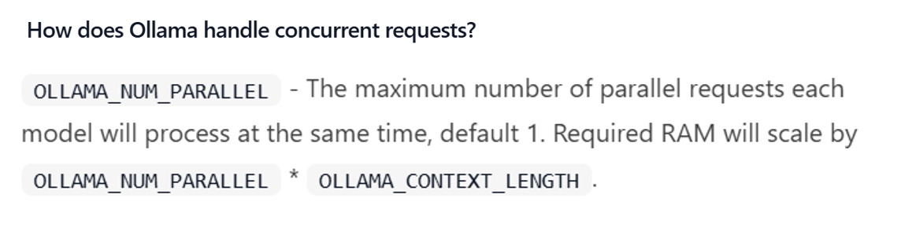
Factors considered
Context size
Number of parallel requests
Source: https://docs.ollama.com/

Slide 4
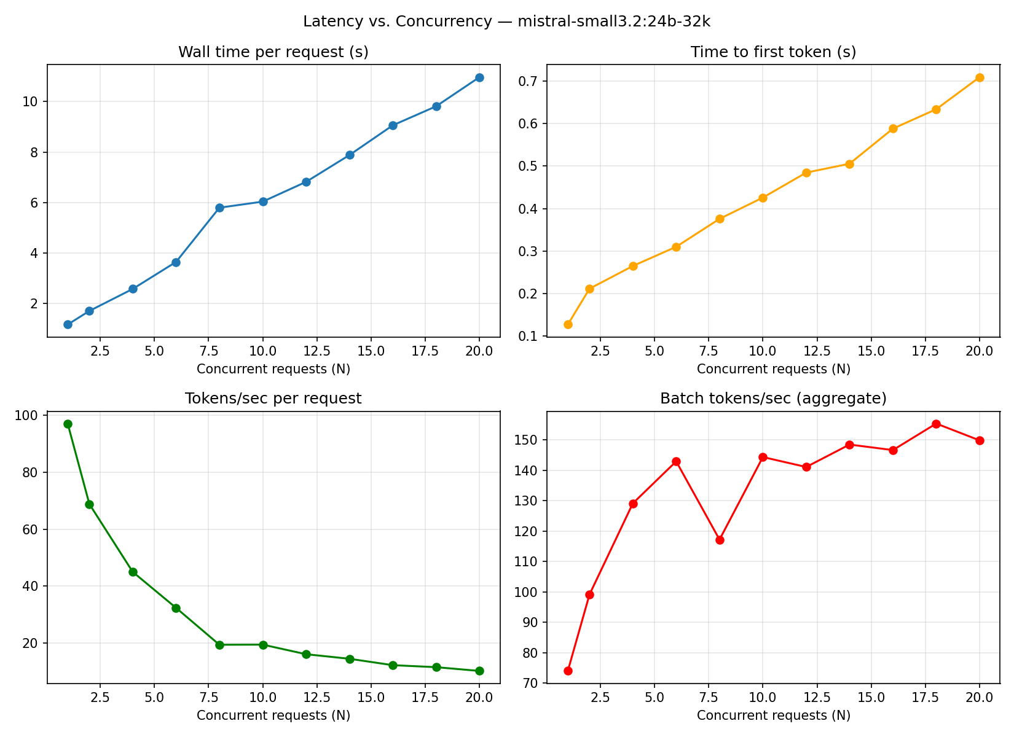
Latency benchmark
OLLAMA Container allows max parallel requests = 36
From a UX persepective: even at 20 parallel requests we are getting 4-5 tokens streamed per request
Interestingly batch tokens/sec increases with parallel requests and plateaus

Slide 5
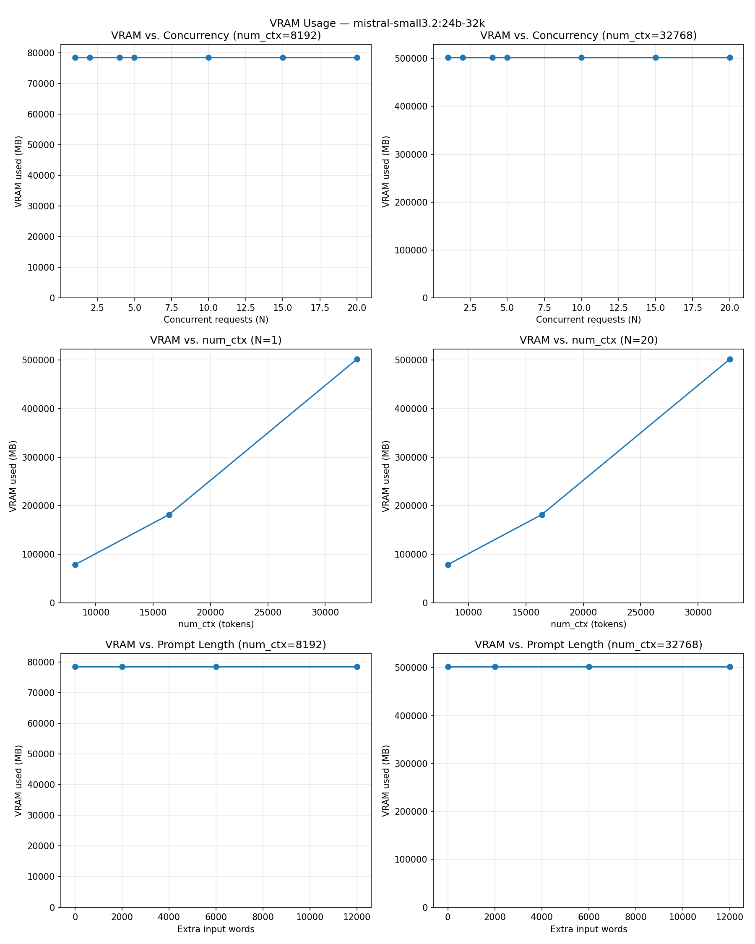
VRAM benchmark
Container can support upto N=20 requests
VRAM scales to 500 gb with context length whether we actually make N=1 requests of N=20 parallel requests – ollama allocates vram to handle the max number of requests

Slide 6
Configured max context length changes from 8K (left) to 32K (right)
VRAM allocated varies from 80gb (left) to 500gb (right)
VRAM allocated does not vary with number of concurrent requests actually made. Whether N=1 or N=20

Slide 7
num_ctx (contxt len) changes across left and right plots
VRAM doesnt change with concurrent reqs. Or with Prompt length.
But the Y-axis changed from 80gb to 500gb when context len was changed. Ollama already allocates max memory to handle N=max possible concurrent req.
Vram reserved increases with num_ctx. So whether N=1 or N=20, what matters is the context length.
The ollama container was initialized to serve upto 36 requests per request. And it allocates enough memory to handle this conditioned on context length.

Slide 8
Challenges along the way
Transferring huge models to the air-gapped server : )
Ollama updates to support:
Various model architectures
Tool calls
Model setup requires a variety of factors: Temperature, Model response template

Slide 9
Latency benchmark

Slide 10
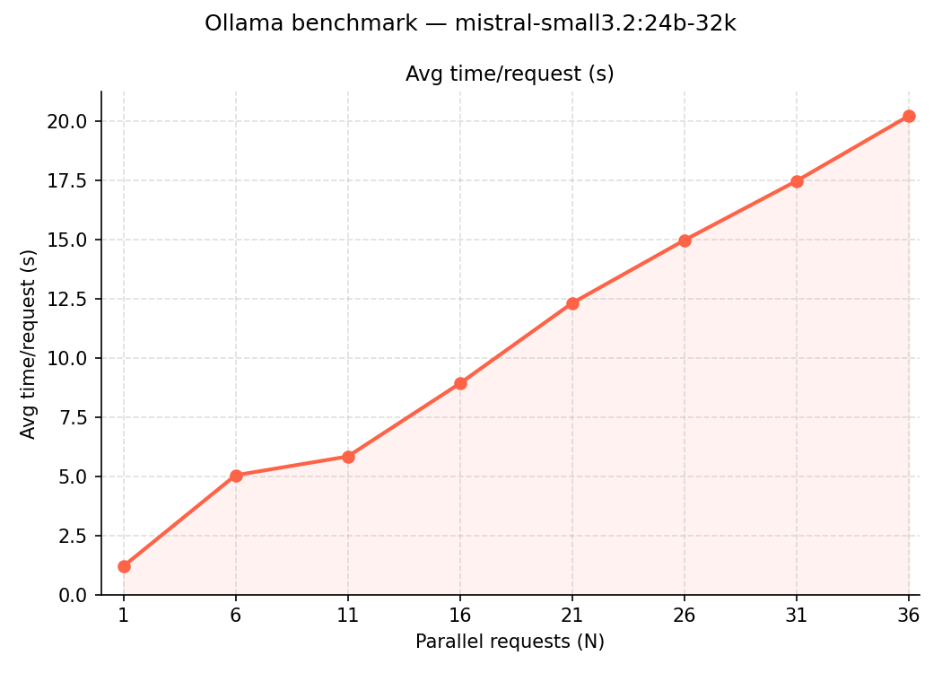
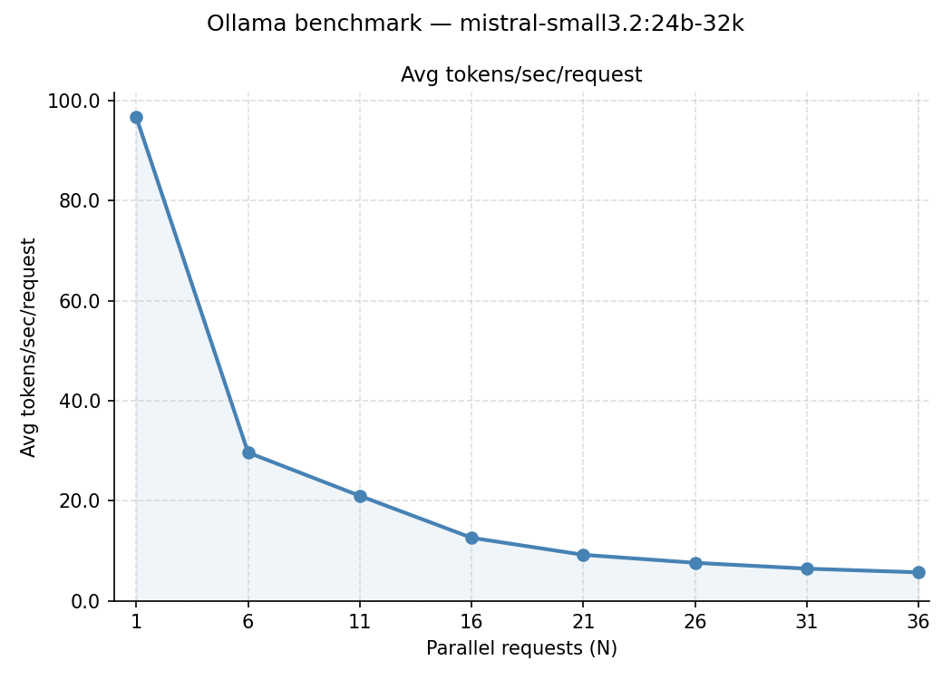
Ideally

Slide 11
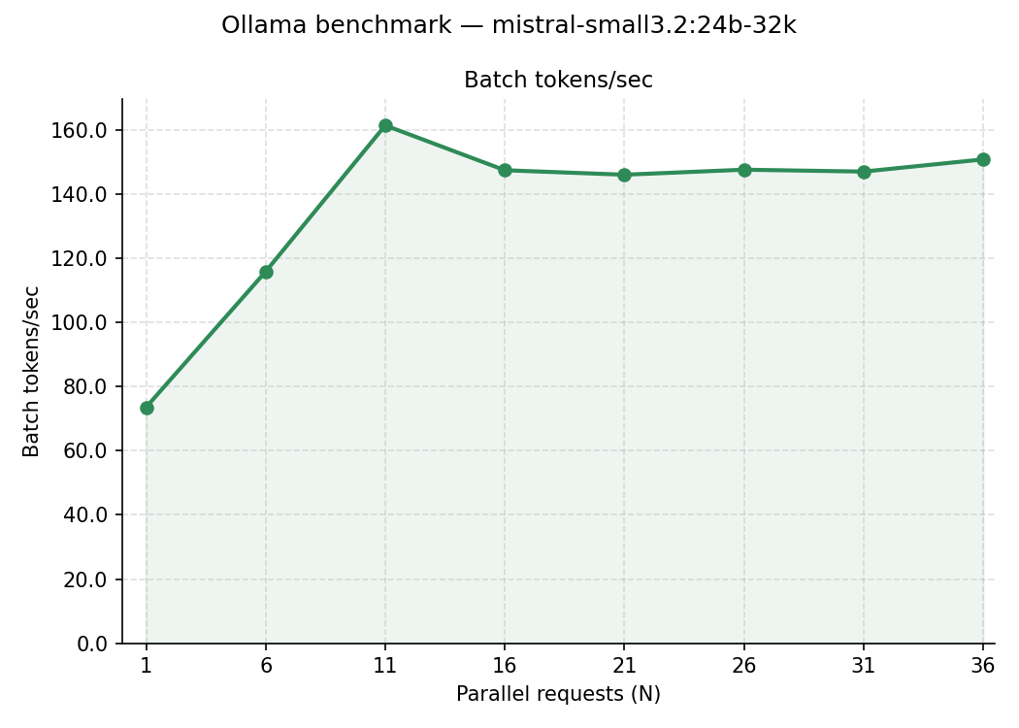

Slide 13
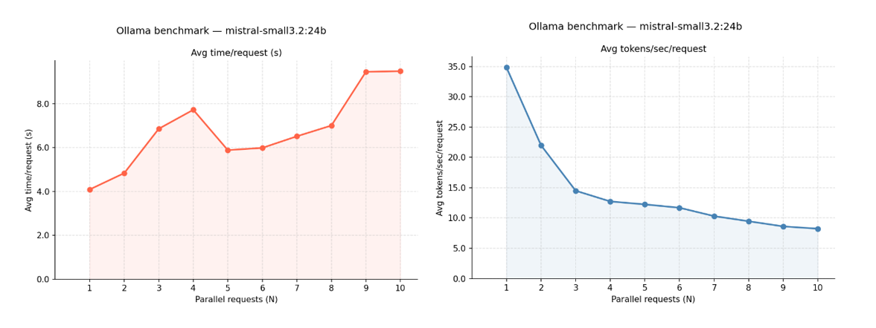
Number of parallel requests: N = 1 to 10
Number of repetitions per request: M = 10
Note: for each N we run M repetitions with the same prompt to get statistics like averages.
Prompt: "Give me a sentence with each letter used at least and at most once:",
Model: Mistral Small 3.2 24b

Slide 14
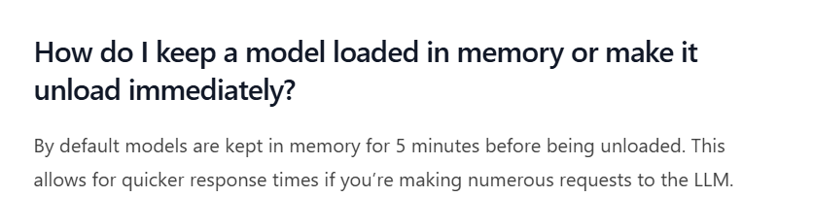
Things to note when benchmarking:
Cold starts. Pre loading the model. Ollama keeps it in-mem for 5 minutes. Can be changed with keep_alive parameter.
KV Cache : stores previous Key-Value calculations from the underlying transformer model to generate tokens faster
* If you use the same prompt multiple times the speed up you see is from the KV Cache *

Slide 15
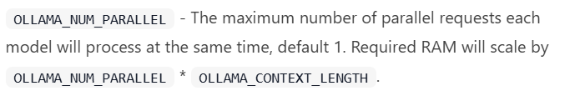

Current models:
- mistral-small3.2:24b – context length 128K
- mistral-v0.3:latest (7B) – context length 32K
Tried OLLAMA_NUM_PARALLEL = 32
- mistral24b with 128K context doesnt work
- mistral7b runs blazingly fast using only 1 gpu
Reducing the context size of mistral24b from 128K to 32K is possible via the Modelfile and is now added to the server

Slide 16
If ollama container started with N_parallel=4 and 8 parallel requests are made then the remaining 4 are queued. At a time only 4 will be processed.
If model (+kv cache) cannot be fit into gpu it will be loaded partially on cpu. Container might either respond very slowly (with cpu) OR crash
Ollama can be optimized based on our usage.
Something for the long term: What is an estimate of how many users we would have?

Slide 17
Model | Ollama container Max N (Max N) | Context Length (ctx_len) | Number of actual async requests made (N) | VRAM | Tokens/sec at max N | ?
mistral-small |  | 4K
 |  | 8K …
 |  | 128K
 | 4
 | ..
 | 12

Slide 18
Reasoning models have to be accounted for!

Slide 19
Model | Ollama container Max N (Max N) | Context Length (ctx_len) | Number of actual async requests made (N) | VRAM | Tokens/sec at max N | ?
mistral-small |  | 4K
 |  | 8K …
 |  | 128K
 | 4
 | ..
 | 12

