Slide 1
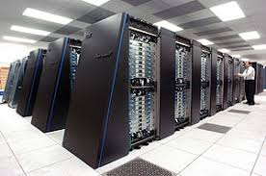
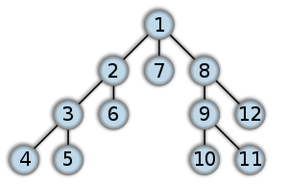

Reasoning About Parallelism

Slide 2
Parallelizing our lives
Many of the tasks we perform in our everyday lives include significant parallelism
Can you name some of these?
Form groups of 2 and write down a list of your daily activities (e.g., shower, get dressed, eat breakfast, dry your hair)
Identify at least 12-15 activities
Consider which of these activities could be carried out concurrently
Identify pairs of parallelizable activities

Slide 3
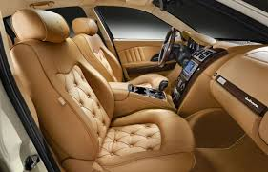


What is wrong with our world?
Next, consider why many of these cannot presently be carried out in parallel
What would need to be changed in our physical world (e.g., showers, cars, smartphones) to allow us to complete many of these activities in parallel
How often is parallelism inhibited by our inability of carrying out two things at the same time?
Estimate how much more quickly it would take to carry out these activities if you could change these physical systems

Slide 4
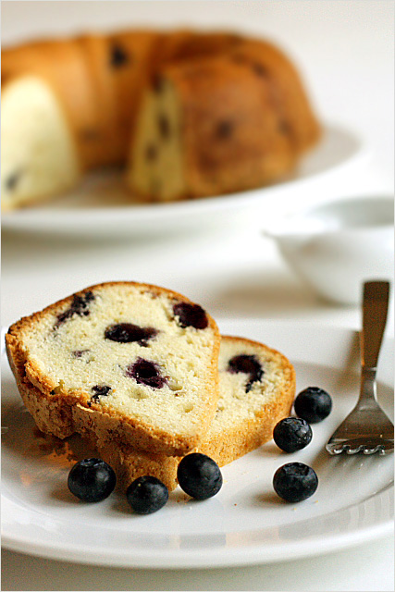
Let’s Bake Some Cakes
You are trying to bake 3 blueberry pound cakes
Cake ingredients are as follows:
1 cup butter, softened
1 cup sugar
4 large eggs
1 teaspoon vanilla extract
1/2 teaspoon salt
1/4 teaspoon nutmeg
1 1/2 cups flour 1 cup blueberries

Slide 5
Cake Baking 101
The recipe for a single cake is as follows:
Step 1: Preheat oven to 325°F (160°C). Grease and flour your cake pan.
Step 2: In large bowl, beat together with a mixer butter and sugar at medium speed until light and fluffy. Add eggs, vanilla, salt and nutmeg. Beat until thoroughly blended. Reduce mixer speed to low and add flour, 1/2 cup at a time, beating just until blended.
Step 3: Gently fold in blueberries. Spread evenly in prepared baking pan. Bake for 30 minutes.
Step 4: Allow to cool for 20 minutes in pan. Remove from pan

Slide 6
Cake Baking 101
Your task is to cook 3 cakes as efficiently as possible. Assuming that you only have one oven large enough to hold one cake, one large bowl, one cake pan, and one mixer, come up with a schedule to make three cakes as quickly as possible. Identify the bottlenecks in completing this task.
Assume now that you have three bowls, 3 cake pans and 3 mixers. How much faster is the process now that you have additional resources?
Assume now that you have two friends that will help you cook, and that you have three ovens that can accommodate all three cakes. How will this change the schedule you arrived at in Part a.) above?
Compare the cake-making task to computing 3 iterations of a loop on a parallel computer. Identify data-level parallelism and task-level parallelism in the cake-making loop.

Slide 7
Cake Baking 101
Your task is to cook 3 cakes as efficiently as possible. Assuming that you only have one oven large enough to hold one cake, one large bowl, one cake pan, and one mixer, come up with a schedule to make three cakes as quickly as possible. Identify the bottlenecks in completing this task.
Assume now that you have three bowls, 3 cake pans and 3 mixers. How much faster is the process now that you have additional resources?
Assume now that you have two friends that will help you cook, and that you have three ovens that can accommodate all three cakes. How will this change the schedule you arrived at above?
Compare the cake-making task to computing 3 iterations of a loop on a parallel computer. Identify data-level parallelism and task-level parallelism in the cake-making loop.

Slide 8
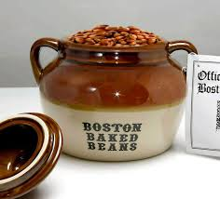
Cost/Performance
Next, consider the following costs associated with cake baking (computed in the number of Boston baked beans)
Ovens = 50 beans/oven
Cake pans = 10 beans/pan
Mixers = 25 beans/mixer
Cooks = 75 beans/cook
Bowls = 5 beans/bowl
Consider the following latencies
Grease and flour pan = 5 minutes
Mixing time = 40 minutes
Cooking time = 30 minutes
Cooling time = 20 minutes
Find the best cost vs. performance given these constraints
Cost in beans
Performance in cakes/minute

Slide 9
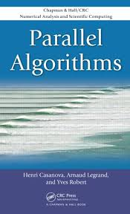
Parallel Algorithms
Always attempt to find an efficient algorithm before trying to find an efficient hardware mapping
Good algorithms are powerful in reducing research barriers, especially when Big Data is involved
Use computational resources efficiently

