Slide 1
Unix/Linux Tutorial
EECE 7352
Fall 2012

Slide 2
COE Lab
Access COE computer through putty/SSH
Open putty
Connect to gateway.coe.neu.edu
Enter COE username and password
Once connected to the COE network, you can access the rest of the computers using ssh
ssh -p 27 lingate

Slide 3
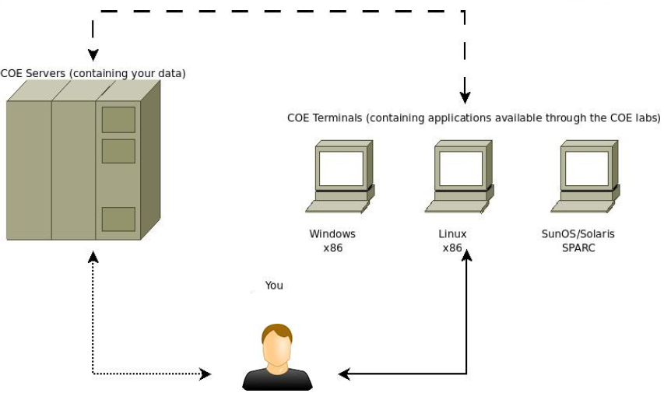
COE Lab Architecture

Slide 4
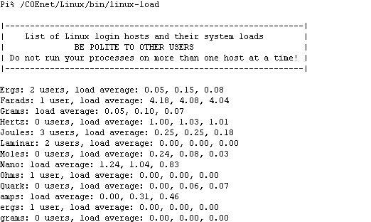
Linux Workstations

Slide 5
General Commands
Who is connected to the server/workstation?
who
Shells
Bourne Shell, Bourne-Again SHell, Korn Shell
sh, bash, ksh
Path
echo $path

Slide 6
General Commands
Executable location
Whereis <filename>
Home directory full name
pwd
Running processes
ps
Close connection
exit

Slide 7
Navigation Commands
Change directory
cd
cd .. (change to parent directory)
cd ~ (change to home directory)
cd / (change to root directory)
List files and folders
ls (ls -a, ls -l, etc)

Slide 8
Navigation Commands
Execute file
./a.out
Finding files
find / -name game (search starting with root)
Viewing File Content
more/less
Man pages
Man <comand>

Slide 9
File and Directory Commands
Copy file
cp file.doc newfile.doc
cp filename /tmp
Copy all files to a directory
cp * /home/tom/backup
Copy recursively
cp -R /currentdir/* /home/tom/backup

Slide 10
File and Directory Commands
Create directory
mkdir <dirname>
Rename file
mv <oldfile> <newfile>
Delete file
rm <filename>
Delete directory recursively
rm -R <dirname>

Slide 11
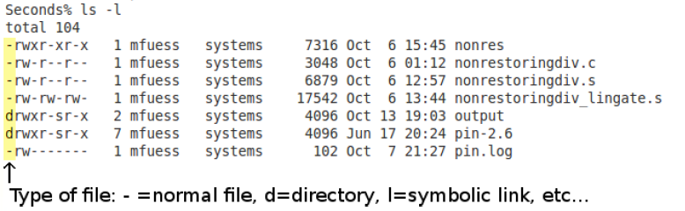
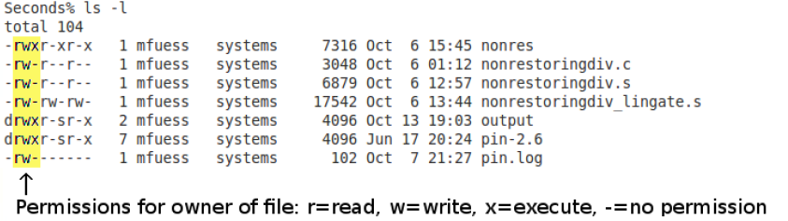
Files and Directories

Slide 12
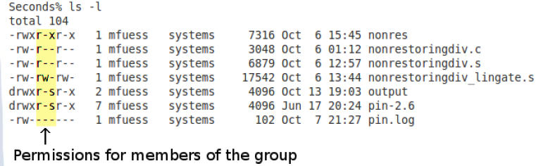
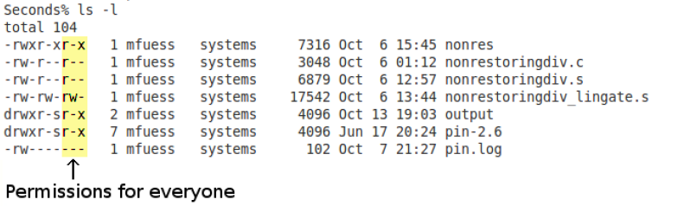
Files and Directories

Slide 13
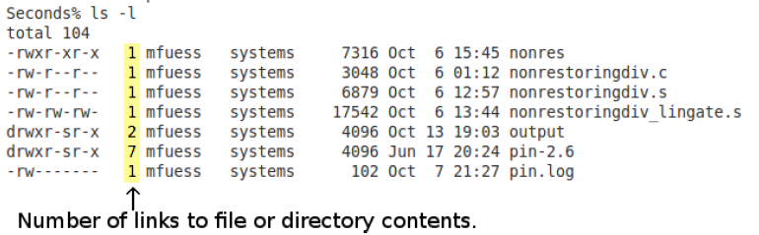
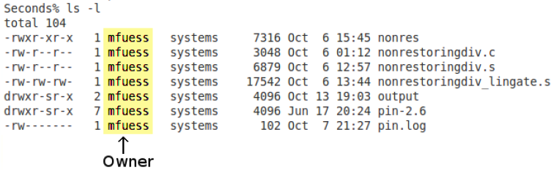
Files and Directories

Slide 14
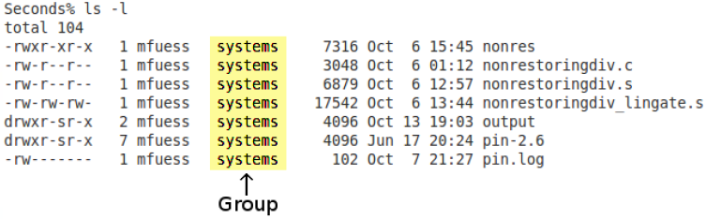
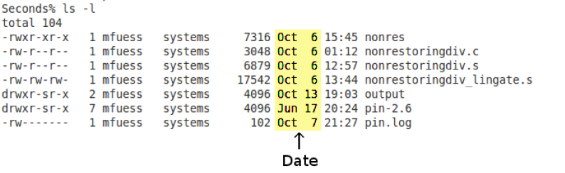
Files and Directories

Slide 15
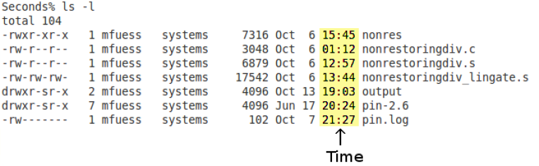
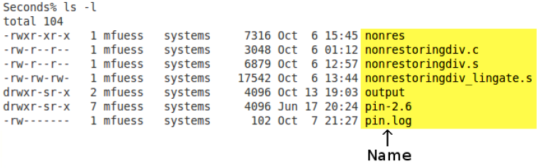
Files and Directories

Slide 16
SSH
A network protocol for secure data communication
Typically used to log into a remote machine and execute commands
Implementation has Windows GUI

Slide 17
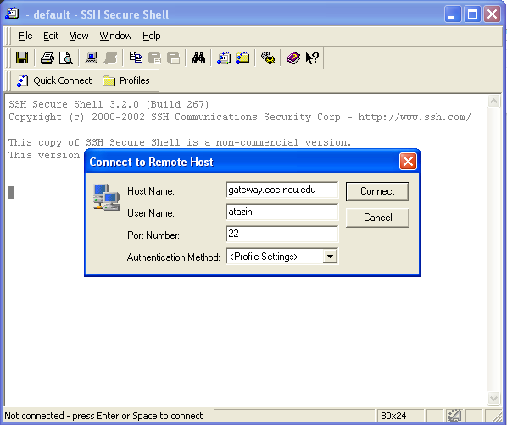
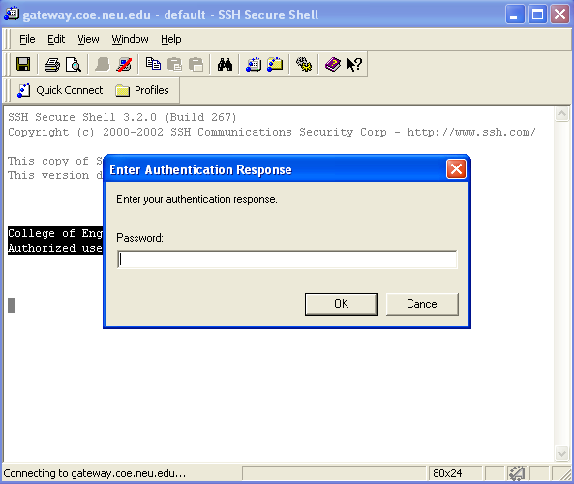
SSH
Loging into the gateway server

Slide 18
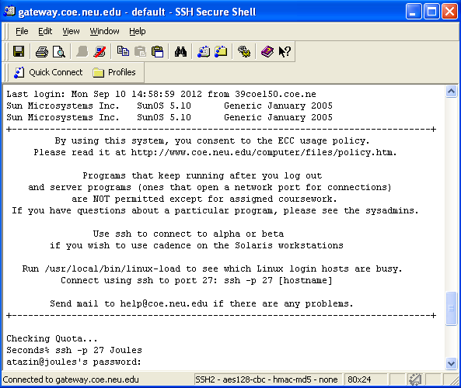
SSH
Login into a Linux workstation

Slide 19
Transfering Files
Two ways to transfer files
SFTP or SCP

Slide 20
SCP
Command line transfer
Use gateway.coe.neu.edu
Can move a file from local computer to your account on the COE computers
Example
scp localfile.txt user@gateway.coe.neu.edu:~/localfile.txt
scp user@gateway.coe.neu.edu:~/localfile.txt localfile.txt

Slide 21
SFTP
Secure file transfer protocol
Implementation has Windows GUI

Slide 22
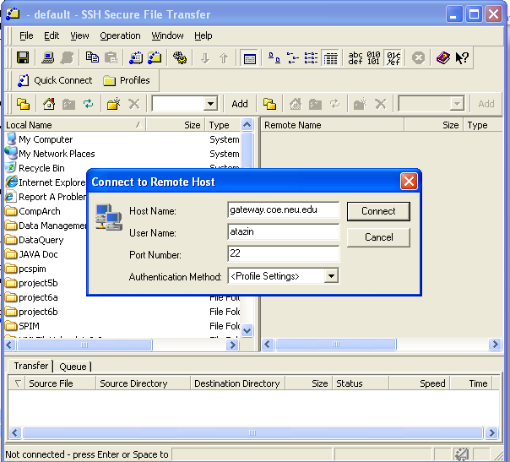
SFTP
Loging into the gateway server

Slide 23
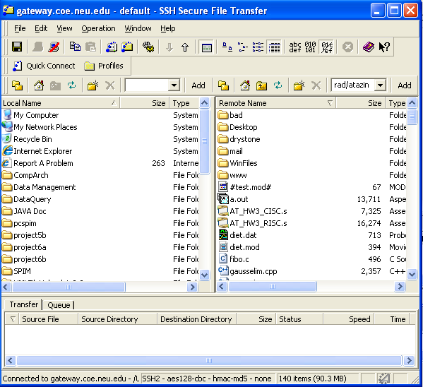
SFTP
Directory listing

Slide 24
gcc Compilation
Compile file
gcc myfile.c (produces a.out executable)
Build output to an output file
gcc myfile.c -o myfile
Generate assembly
gcc -S myfile.c
Compiler optimization levels
gcc -O<n> myfile.c

Slide 25
Text Editors
Emacs
Vi

Slide 26
Emacs
Start Emacs
emacs <filename>
Exit Emacs
CTRL-x CTRL-c
Save you work without exiting
CTRL-x CTRL-s
Undo last change
CTRL-x u

Slide 27
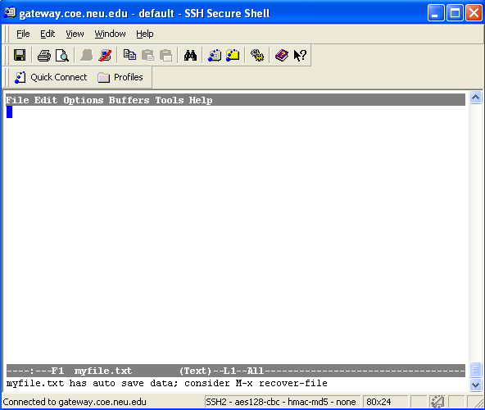
Emacs User Interface

Slide 28
Vi
Console (screen) oriented text editor
Has two modes of operation
Command mode with commands which cause action to be taken on the file
Insert mode in which entered text is inserted into the file

Slide 29
Vi Command Mode
To enter insert mode hit ESC, type the command, and hit RETURN

Slide 30
Vi Commands
Start Vi
vi myfile.txt
Save modified file
ESC, :w<return>
Save modified file and exit Vi
ESC, :x<return>
Exit Vi without saving changes
ESC, :q!<return>

Slide 31
Vi Insert Mode
Can edit text
Can move cursor using arrow buttons
To enter this mode and exit command mode hit ESC and then hit s.

Slide 32
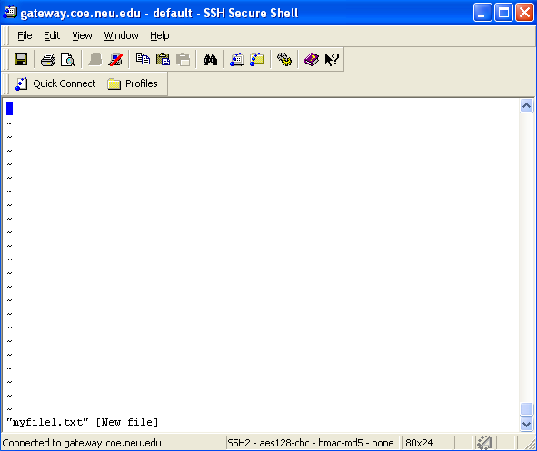
Vi User Interface

Slide 33
Find out More
http://www.coe.neu.edu/computer/UNIXhelp/

