Slide 1
Unix/Linux Tutorial
EECE 7352
Computer Architecture

Slide 2
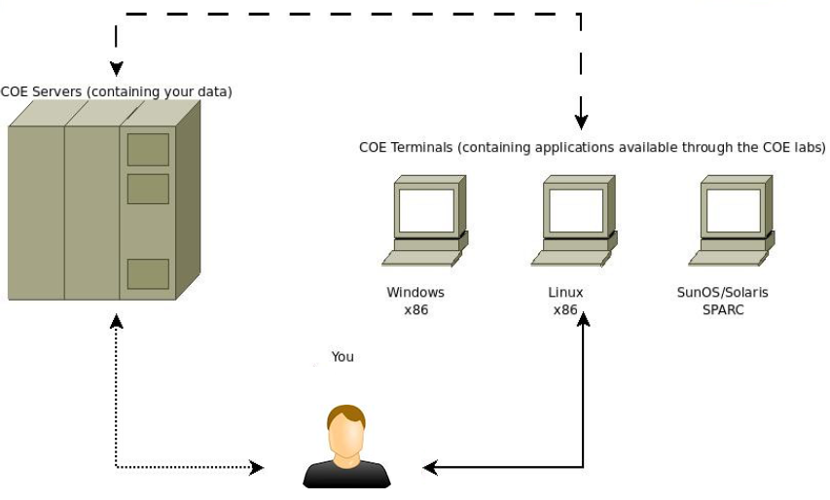
COE Lab Architecture

Slide 3
Access COE Lab remotely
SSH
“secure shell”: a network protocol for secure data communication
Typically used to log into a remote machine and execute commands in command-line
SSH tools
In Windows: putty
In Linux/Mac: ssh is already installed, can be used directly from a terminal

Slide 4
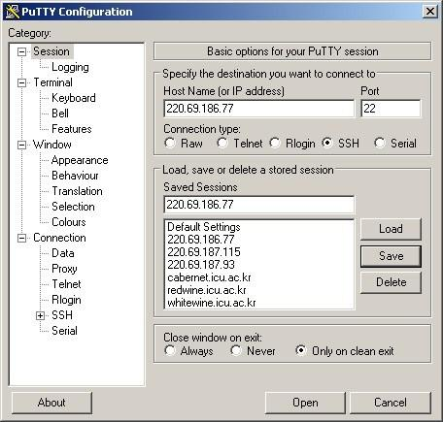
Under Windows
Putty:
http://www.chiark.greenend.org.uk/~sgtatham/putty/download.html

Slide 5
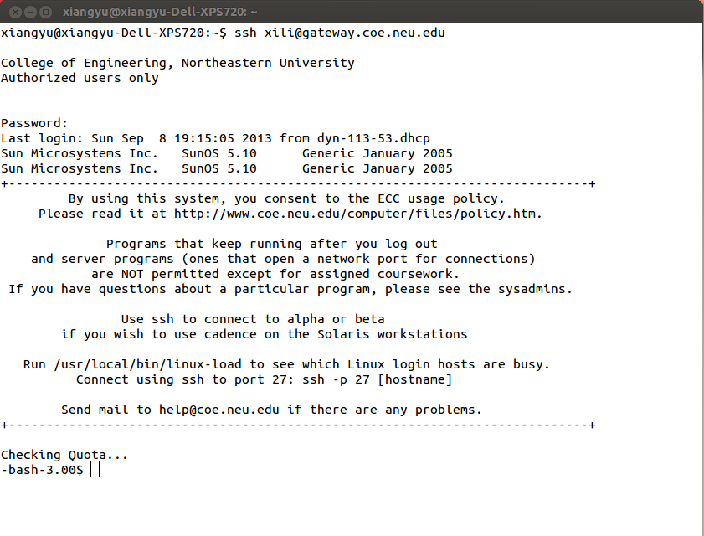
Under Linux
Terminal

Slide 6
Shell
A program that takes keyboard commands and passes them to the operating system to carry out.
Bourne Shell (sh)
Bourne-Again Shell (bash)
Korn Shell(ksh)
Tab completion
press key “Tab” to automatically fills in partially typed commands.
Ctrl + c
Abort current task and regain user control

Slide 7
General Commands
who
shows who is connected to the server
pwd (printing working directory)
shows the path of the current directory
ps (process status)
shows running processes on current machine
ls (list)
list files and directories
man (manual)
display the manual of the command

Slide 8
General Commands
whereis
locate the commands
exit
close ssh connection

Slide 9
Navigation Commands
cd (change directory)
cd .. (change to parent directory)
cd ~ (change to home directory)
cd / (change to root directory)
ls (list files and directories)
ls -a (list all entries)
ls -l (list in long format)
ls -al (options can be combined)
less / more
find (locate files or directory)
find / -name file-name.txt

Slide 10
File and Directory Commands
mkdir (make directory)
mkdir <directory-name>
mv (move): move file/directory, rename
mv <old-file> <new-file>
mv <old-directory> <new-directory>
mv <file> <directory>
rm (remove): delete file
rm <file-name>
rm -r: delete directory (recursively)
rm -r <directory-name>

Slide 11
File and Directory Commands
cp (copy file)
cp file.txt newfile.txt
cp file.txt ./TA
copy all files to a directory
cp ./TA/* ~/TA-backup
copy both files and directories (recursively)
cp -r ./TA/* ~/TA-backup

Slide 12
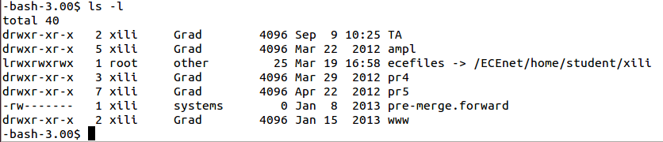
Files and Directories
Type of file: - = normal file, d = directory, l = symbolic link
Access rights by the owner of the file: r = read, w = write, x = execute, - = no permission

Slide 13
Files and Directories
Access rights by the users in the same group
Access rights by everyone

Slide 14
Files and Directories
number of links to the file or directory contents

Slide 15
Transferring Files
SCP
Secure copy protocol
Command-line tool in shell
can transfer files between your local machine and a COE lab machine
Example:
scp localfile.txt username@gateway.coe.neu.edu:~/remotefile.txt
scp username@gateway.coe.neu.edu:~/remotefile.txt localfile.txt
SFTP
Secure file transfer protocol
Typically used in Windows GUI mode
winscp: http://winscp.net/eng/index.php

Slide 16
GCC
GNU Compiler Collection
C programs compiler used under linux/unix
Example
gcc helloworld.c (generates an a.out executable binary, ./a.out to run it)
gcc helloworld.c -o helloworld.out (generate helloworld.out instead of a.out as default)
gcc -S helloworld.c (generates assembly code)
gcc -O<n> myfile.c (choose O0, O1,O2,O3 as optimization levels)

Slide 17
Text Editors
Vi
http://heather.cs.ucdavis.edu/~matloff/UnixAndC/Editors/ViIntro.html
Emacs
http://www.gnu.org/software/emacs/tour/

Slide 18
Vi
Two modes
Command mode: typing commands which cause actions to be taken on the file, type “i” to enter insert mode
Insert mode: where entered text is inserted into the file, type “ESC” to exit to command mode
Commands
vi myfile.txt (open myfile.txt using vi)
i (enter insert mode, then you can type)
ESC :w (save modified file)
ESC :q (exit file without saving)
ESC :wq (save & exit)
ESC :x (save & exit)

Slide 19
More
http://www.coe.neu.edu/computer/UNIXhelp/

