Slide 1
Classification of Breast Cancer Tumors: Benign or Malignant
INFS 795
Presented By:
Sanjeev Raman
4-01-04

Slide 2
OUTLINE
Introduction
Project Scope
Details about the Data Set
Implementation Plan
Naïve Bayes Algorithm
Results
Analysis of Results
Conclusion
Future Work

Slide 3
Introduction
Cancer is a group of diseases, more than 100 types, which occur when cells become abnormal and divide without control or order. When cells divide even though new cells are not needed, too much tissue is formed. This mass of extra tissue, called a tumor, can be benign or malignant.

Slide 4
TUMORS
Benign Tumors
are not cancerous
can usually be removed
don't come back in most cases
do not spread to other parts of the body and the cells do not invade other tissues
Malignant Tumors
are cancerous
can invade and damage nearby tissues and organs
metastasize - cancer cells can break away from a malignant tumor and enter the bloodstream or lymphatic system to form secondary tumors in other parts of the body

Slide 5
Breast Cancer
Breast cancer is an uncontrolled growth of breast cells. While cancer is always caused by a genetic "abnormality" (a "mistake" in the genetic material), only 5–10% of cancers are inherited from the mother or father. Instead, 90% of breast cancers are due to genetic abnormalities that happen as a result of the aging process and life in general.

Slide 6
Breast Cancer Tests
As a precaution, many women undergo screening tests to determine if they have benign conditions or malignant conditions that would lead to breast cancer. However, because of costs and time, most of these screening tests are just physical examinations that looks for lumps, changes in the nipples or the skin of the breast, and checks for lymph nodes under the armpit and above the collarbones. If uncertainty is concluded, then a series of expensive imaging tests are requested.

Slide 7
My Project Proposal
What I propose is to build a computational model that can classify with accuracy and probability if a woman has a benign or malignant tumor. This could be a great alternative for the “sometimes” unreliable screening tests or expensive imaging tests. I will be looking 10 attributes plus the class attribute (benign or malignant).

Slide 8
DATA SET
The data set is from Dr. William H. Wolberg at the University of Wisconsin Hospitals, Madison. Records in the dataset represent the results of breast cytology tests and a diagnosis of benign or malignant. 172 Instances were provided.

Slide 9
Attributes
1. Sample code number id number
2. Clump Thickness 1 – 10
3. Uniformity of Cell Size 1 – 10
4. Uniformity of Cell Shape 1 – 10
5. Marginal Adhesion 1 – 10
6. Single Epithelial Cell Size 1 – 10
7. Bare Nuclei 1 - 10
8. Bland Chromatin 1 – 10
9. Normal Nucleoli 1 - 10
10. Mitoses 1 - 10
11. Class: (2 for benign, 4 for malignant)

Slide 10
IMPLEMENTATION
Oracle 9i
The system used has the following features:
OS: Windows 2000 Professional
Processor: Pentium 4
RAM: 192 MB
HD: 10 GB
To install Oracle 9.2.0.1.0 components from the hard drive:
1.Create three directories at the same level on your hard
drive with the names Disk1, Disk2, and Disk3.
You must use these names. For example:
d:\install\Disk1
d:\install\Disk2
d:\install\Disk3
2.Copy the contents of each component CD to the appropriate directory.
3.Run Disk1\setup.exe.
The Welcome window appears. Follow the GUI instruction to
finish the installation.
Note: 1. Select ‘custom install’ and select 'data mining tools’ as a
component.
2. Select ‘Data Warehouse’ as ‘Database Configuration Types’.

Slide 11
Implementation
After ODM is installed on the system, the programs, property files, and scripts will be stored in the directory $ORACLE_HOME/dm/programs/INFSprograms; the data used by the programs will be in the directory $ORACLE_HOME/dm/programs/data. The data required by these programs will also be installed in the ODM_MTR schema.

Slide 12
Main Steps in ODM Model Building
Connect to the DMS (data mining server).
Create a PhysicalDataSpecification object for the build data.
Create a MiningFunctionSettings object (in this case, a ClassificationFunctionSettings object with no supplemental attributes).
Build the model.

Slide 13
Connect to the Data Mining Server
//Create an instance of the DMS server.//The mining server DB_URL, user_name, and password for the installation//need to be specifieddms=new DataMiningServer("DB_URL", "user_name", "password"); //get the actual connection dmsConnection = dms.login(();
I decided, based on the recommendation, to create a global property template that would create the instance of the Data Mining Server. The coding is pasted below:
### Create the instance of the Data Mining Server.
miningServer.url=jdbc:oracle:thin:@shili:1521:csi
miningServer.userName=odm
miningServer.password=odm
inputDataSchemaName=odm_mtr
outputSchemaName=odm_mtr
timeout=1200

Slide 14
Describe the Build Data
Before ODM can use data to build a model, it must know where the data is and how the data is organized. This is done through a PhysicalDataSpecification instance where we indicate whether the data is in nontransactional or transactional format and describe the roles the various data columns play.

Slide 15
Specify the Naive Bayes Algorithm
If a particular algorithm is to be used, the information about the algorithm is captured in a MiningAlgorithmSettings instance. So, I would build a model for classification using the Naive Bayes algorithm by first creating a NaiveBayesSettings instance to specify settings for the Naive Bayes algorithm. Two settings are available: singleton threshold and pairwise threshold. Then create a ClassificationFunctionSettings instance for the build operation.

Slide 16
Build the Model
Now that all the required information for building the model has been captured in an instance of PhysicalDataSpecification and MiningFunctionSettings, the last step needed is to decide whether the model should be built synchronously or asynchronously.

Slide 17
Bayesian classifiers
Suppose your data consist of fruits, described by their color and shape. Bayesian classifiers operate by saying "If you see a fruit that is red and round, which type of fruit is it most likely to be, based on the observed data sample? In future, classify red and round fruit as that type of fruit."
A difficulty arises when you have more than a few variables and classes - you would require an enormous number of observations (records) to estimate these probabilities.

Slide 18
Naïve Bayes
Naive Bayes classification gets around this problem by not requiring that you have lots of observations for each possible combination of the variables. Rather, the variables are assumed to be independent of one another and, therefore the probability that a fruit that is red, round, firm, 3" in diameter, etc. will be an apple can be calculated from the independent probabilities that a fruit is red, that it is round, that it is firm, that is 3" in diameter, etc.

Slide 19
Naïve Bayes
In other words, Naïve Bayes classifiers assume that the effect of an variable value on a given class is independent of the values of other variable. This assumption is called class conditional independence. It is made to simplify the computation and in this sense considered to be “Naïve”.
This assumption is a fairly strong assumption and is often not applicable. However, bias in estimating probabilities often may not make a difference in practice -- it is the order of the probabilities, not their exact values, that determine the classifications.

Slide 20
Naïve Bayes
P (H|X) = P(X|H) P(H) / P(X)

Slide 21
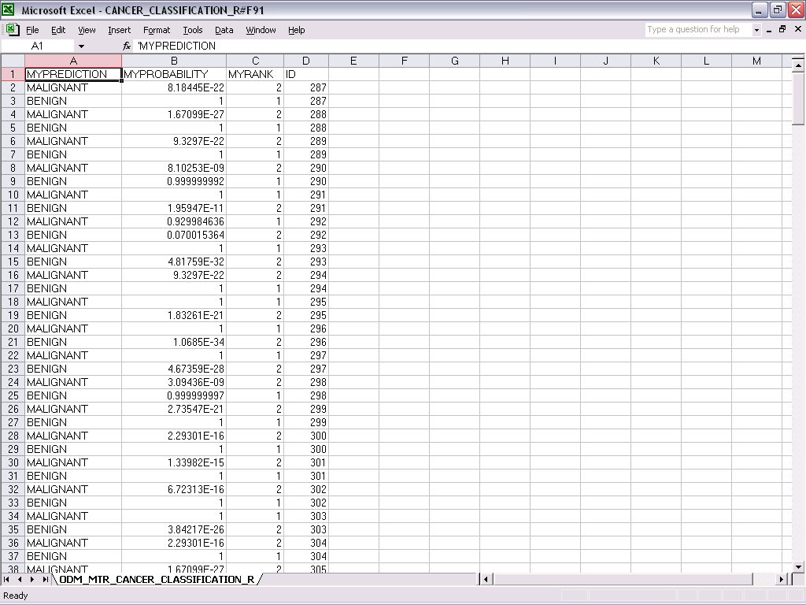
Results – also refer to Excel file for complete results

Slide 22
Results Analysis
SQL> select count(1) from cancer;
COUNT(1)
----------
171
SQL> select count(1),CLASS from cancer
2 group by class;
COUNT(1) CLASS
---------- -------------------------
108 BENIGN
63 MALIGNANT
2. Classification (incorrect prediction)
SQL> select MYPREDICTION ,b.CLASS, b.sample
2 from CANCER_CLASSIFICATION_RESULT a, cancer b
3 where
4 a.MYPROBABILITY>0.5
5 and a.id=b.SAMPLE
6 and a.MYPREDICTION<>b.CLASS;
MYPREDICTION CLASS SAMPLE
------------ ------------------------- ----------
MALIGNANT BENIGN 292
MALIGNANT BENIGN 307
MALIGNANT BENIGN 336
MALIGNANT BENIGN 387
4 rows selected.

Slide 23
Results Analysis
SQL> select MYPREDICTION ,b.CLASS, b.sample
2 from CANCER_CLASSIFICATION_RESULT a, cancer b
3 where
4 a.MYPROBABILITY>0.5
5 and a.id=b.SAMPLE
6 and a.MYPREDICTION<>b.CLASS;
MYPREDICTION CLASS SAMPLE
------------ ------------------------- ----------
MALIGNANT BENIGN 292
MALIGNANT BENIGN 307
MALIGNANT BENIGN 336
MALIGNANT BENIGN 387
4 rows selected.
SQL>

Slide 24
Conclusion
Correct Prediction rate:
Total Correct Prediction rate: (171-4)/171 = .976608187
BENIGN Correct Prediction rate: (108-4)/108 = .962962963
MALIGNANT Correct Prediction rate: (63-0)/63 = 1

Slide 25
Prior Research
Proc Natl Acad Sci U S A. 1990 December; 87 (23): 9193–9196
Multisurface method of pattern separation for medical diagnosis applied to breast cytology.
W H Wolberg and O L Mangasarian
Department of Surgery, University of Wisconsin, Madison 53792.

Slide 26
Article Abstract
Multisurface pattern separation is a mathematical method for distinguishing between elements of two pattern sets. Each element of the pattern sets is comprised of various scalar observations. In this paper, we use the diagnosis of breast cytology to demonstrate the applicability of this method to medical diagnosis and decision making. Each of 11 cytological characteristics of breast fine-needle aspirates reported to differ between benign and malignant samples was graded 1 to 10 at the time of sample collection. Nine characteristics were found to differ significantly between benign and malignant samples. Mathematically, these values for each sample were represented by a point in a nine-dimensional space of real variables. Benign points were separated from malignant ones by planes determined by linear programming. Correct separation was accomplished in 369 of 370 samples (201 benign and 169 malignant). In the one misclassified malignant case, the fine-needle aspirate cytology was so definitely benign and the cytology of the excised cancer so definitely malignant that we believe the tumor was missed on aspiration. Our mathematical method is applicable to other medical diagnostic and decision-making problems.

Slide 27
Future Work
Probe deeper to understand why there were miss-classifications of the data.
Possibly build a Java applet or VB program where a user could enter the integer value (after being transformed) for the different attributes to get an indication if the tumor is benign or malignant.

