Slide 1
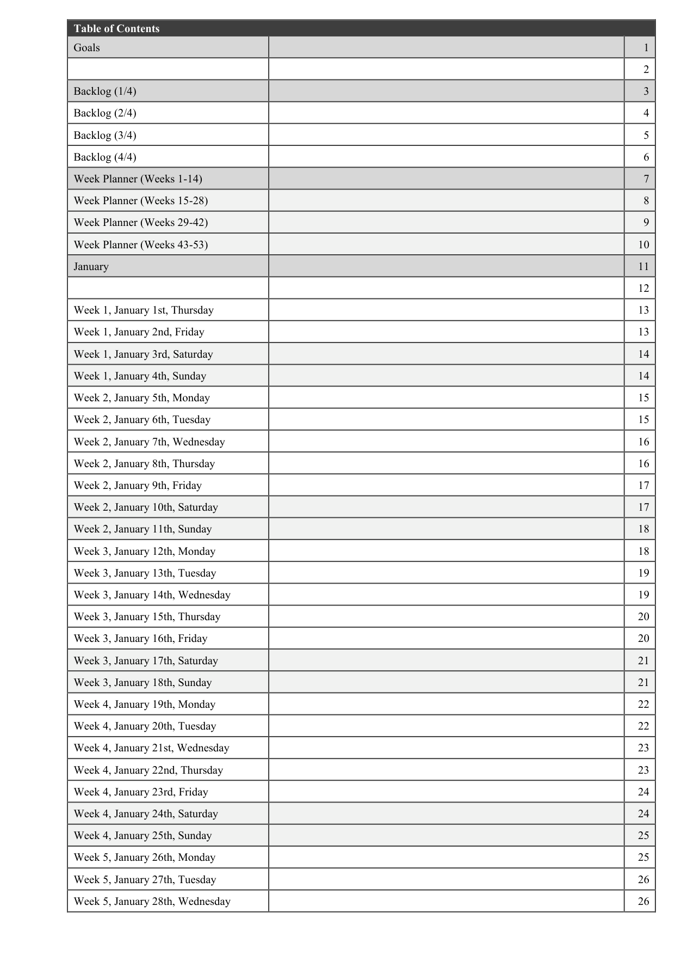
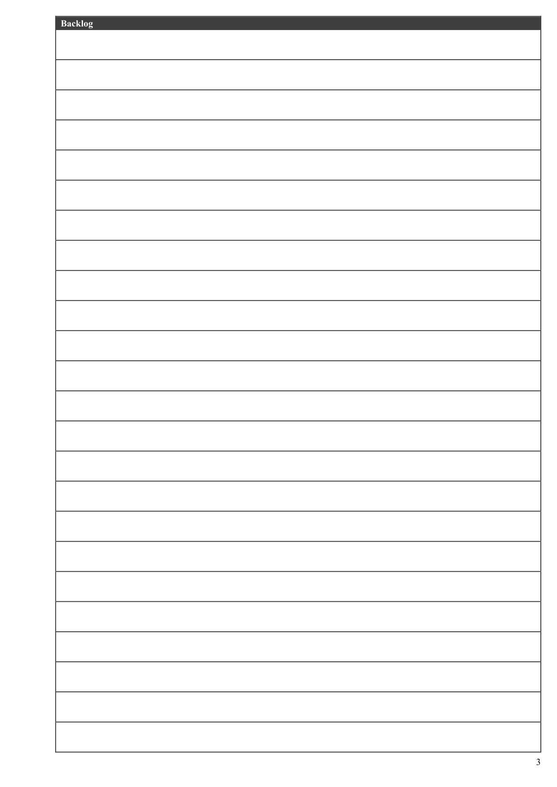
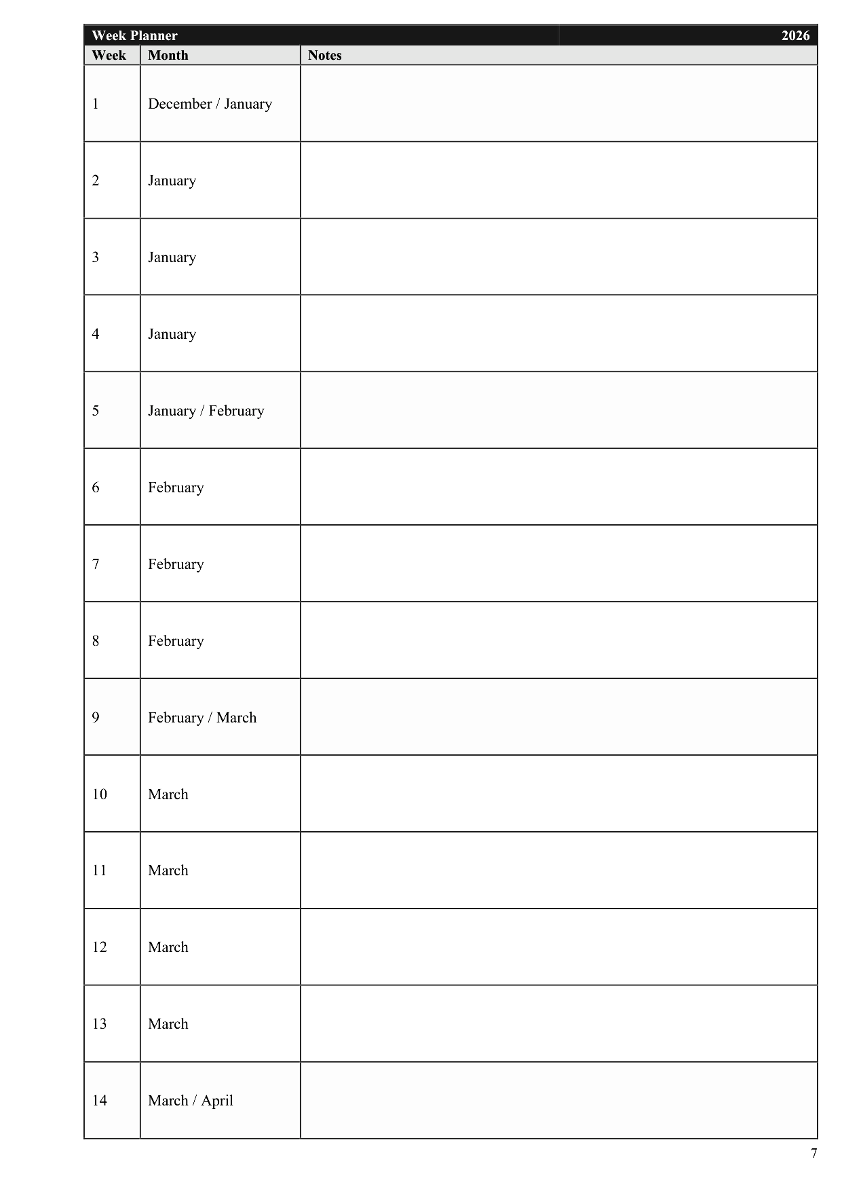
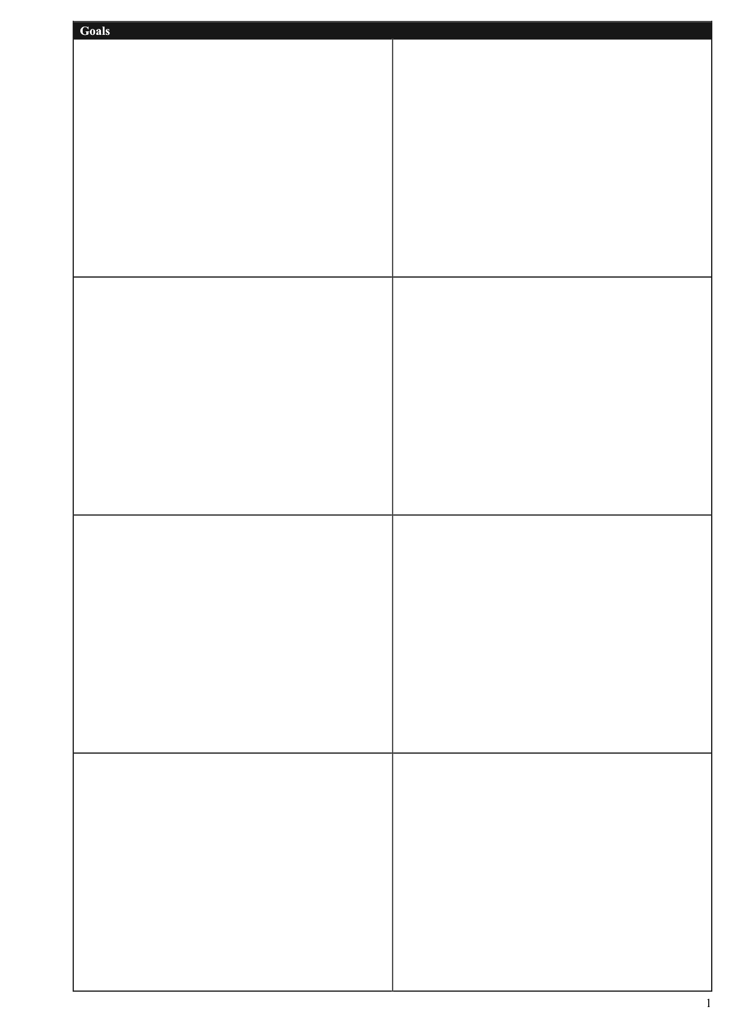
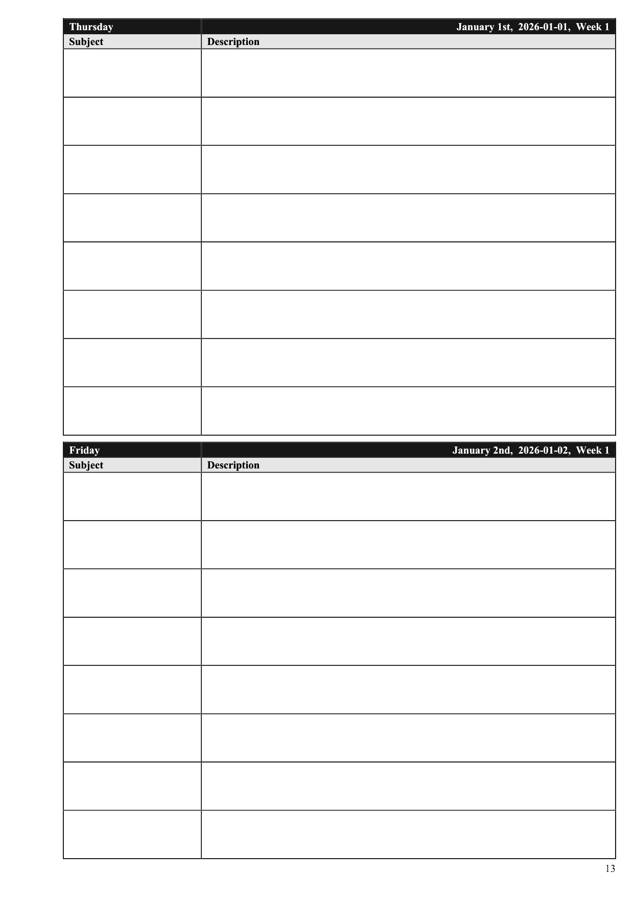
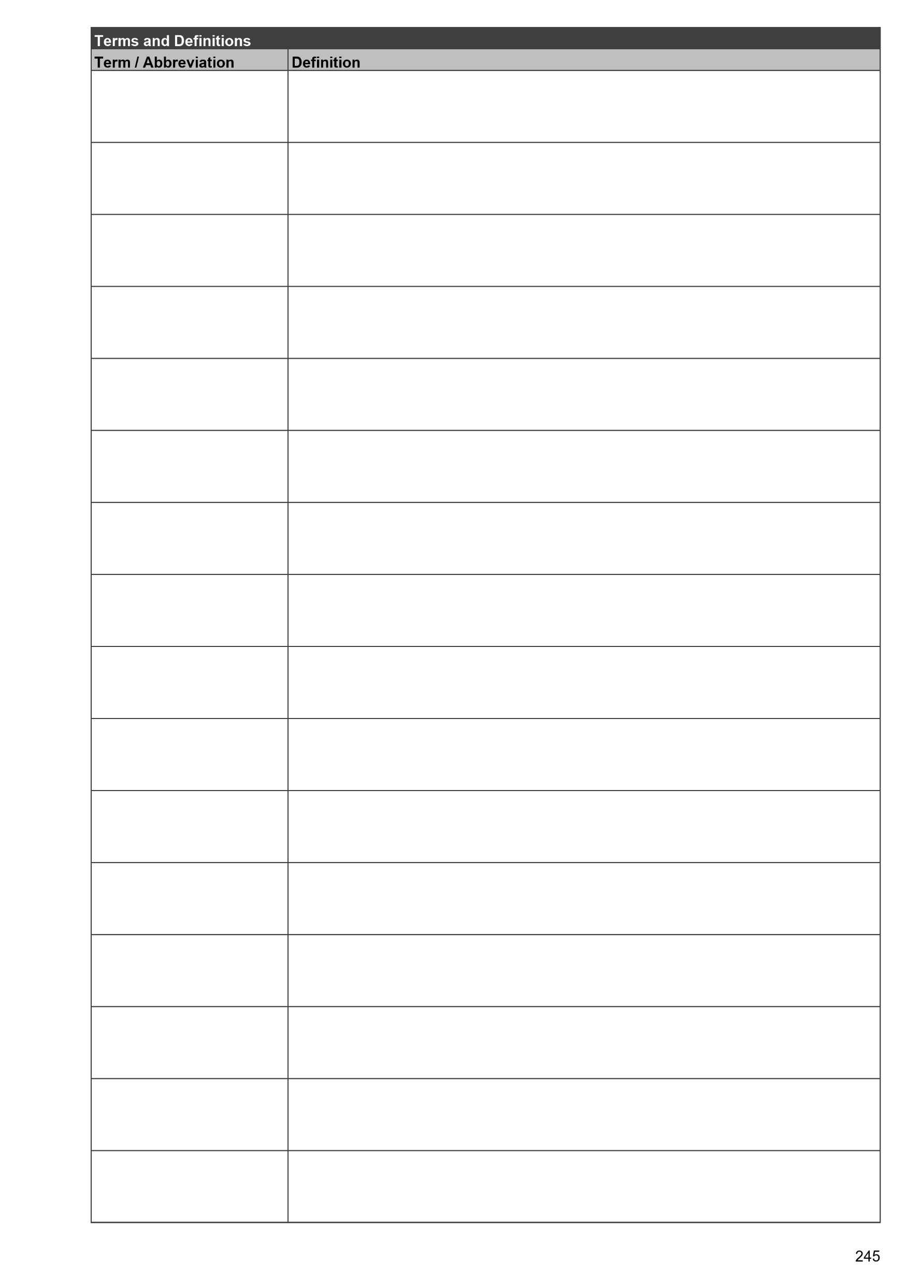
Table of Contents
Backlog
Find
Use the table of contents to reference content on any page.
The table of contents serves as both a table of contents and an index.
Remember
Write down tasks, ideas, and events that are not ready to be committed to a date yet.
Week Planner
Goals
Plan
Use the week planner to schedule tasks and events over the course of the year, at a weekly scale.
Stay on Course
Write down high-level, long-term goals.
Daily Spread
Terms and Definitions
To-Do
Task-oriented view of your day.
Define.
Write down the definition of terms and abbreviations.

