Slide 1
Dialex – Solar Installation Package
Sales offer and partner overview for Australian solar installers
More solar opportunities from
the calls you already receive
Capture quote enquiries, arrange site assessments
and help your solar team follow up with context.
An inbound solar agent with guided setup
and a workspace for enquiries, visits and callbacks.
Partner discussion draft. Australian market. September 2026.
01
Notes:
Dialex is a working product name. The first target market is Australian solar installation businesses. The planned Australian business and commercial model remain at proposal stage. Harbour Solar and all displayed calls are fictional. The product promise is to capture otherwise missed solar and battery enquiries and help the team progress them to assessments and completed installations. No conversion or revenue outcome is guaranteed.

Slide 2
The core sales offer
Recover solar enquiries your team would otherwise miss
Missed solar enquiries
Keep quote requests moving while your team is on the roof or with another customer.
One recovered install
At $1,000 contribution per extra installation, one covers the $799 monthly Growth fee.
A clear starting price
$799/month plus $799 once for setup. Two extra installs cover the $1,598 first-month cost.
Proof from a pilot
Track missed calls, quote enquiries, site visits and completed installations during a 30-day pilot.
Illustrative economics. Extra installations must be attributable to Dialex. Calendar integration required for bookings.
02
Notes:
This slide is the sales offer, distinct from the feature list on the following slide. Proposed Growth terms are AUD $799 per month plus AUD $799 once for standard setup, excluding GST, with 1,500 included minutes. At an illustrative $1,000 contribution per additional completed solar installation, one installation contributes $1,000, leaving $201 after the monthly fee. Two installations contribute $2,000, leaving $402 after the first month plus setup. This $1,000 input is an example, not a researched solar industry average. Use the prospect's actual revenue less variable costs and attribute additional completed installations to Dialex. Site visits and quote enquiries must not be counted as sold installations. Overage, connector charges and additional operating costs increase the break-even requirement. A 30-day pilot is a proposed measurement period, not a free trial or money-back guarantee.

Slide 3
Features and site visits
Example: Harbour Solar, a fictional Sydney solar installer
Qualify solar enquiries
Capture the property suburb, solar or battery interest, quote request and callback preference.
Arrange a site visit
Book an approved calendar slot. If booking is unavailable, collect preferred times for staff to confirm.
Answer and hand off
Explain the approved installation process. Pass off-grid design and requests for a human to the team.
Keep the record
Show call summaries, quote enquiries, visit status and the next action in one workspace.
Proposed service. The prototype simulates calls and bookings. The installer confirms designs and final quotes.
03
Notes:
Direct site-visit booking is a proposed extension to the previous enquiry-and-callback scope. The production flow needs an authorised calendar or scheduling integration, staff availability, service-area eligibility, visit duration, travel buffers, time zone and daylight-saving handling, successful booking confirmation, duplicate prevention, and cancellation/rescheduling handling. The agent should only confirm a visit after the scheduling system accepts it. If no suitable slot is available or an integration fails, capture preferred times and request staff confirmation. Send the record to the installer's CRM or job system and deliver authorised customer/staff confirmations. Start with the pilot installer's actual system. OpenSolar supports project-linked calendar events and Google or Outlook calendar connections. Its API includes on-site sales visits, but API access is a paid product and needs separate cost and implementation review. Simpro markets scheduling to solar businesses. ServiceM8 provides booking services with availability and service-radius rules. These are documented options, not a claim about market share. Sources accessed 9 September 2026: https://support.opensolar.com/hc/en-us/articles/15951527060751-Calendar-Scheduling-in-OpenSolar ; https://developers.opensolar.com/api/events/ ; https://developers.opensolar.com/api/ ; https://www.simprogroup.com/industries/solar-renewable-business-software ; https://support.servicem8.com/help-center/servicem8-add-ons/services-online-booking/how-to-create-online-booking-forms-services ; https://developers.google.com/workspace/calendar/api/v3/reference ; https://learn.microsoft.com/en-us/graph/api/calendar-getschedule?view=graph-rest-1.0

Slide 4
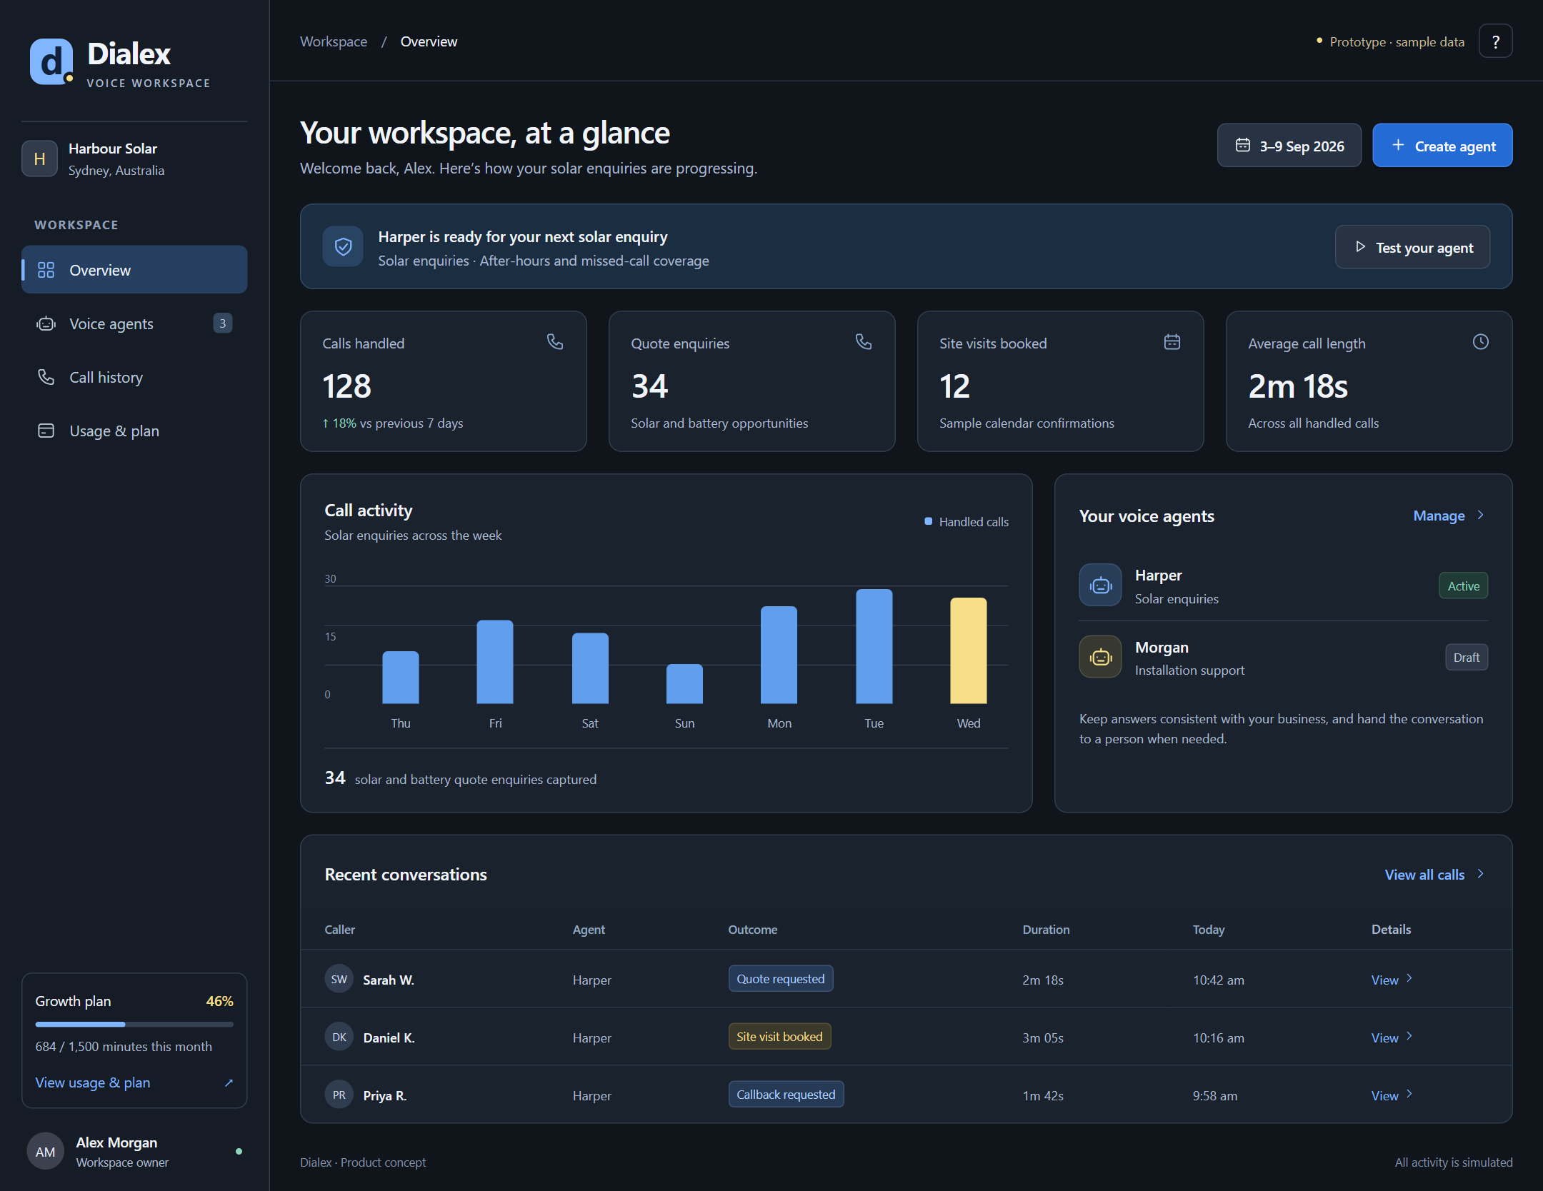
The customer workspace
A solar team sees enquiries, site visits and recent conversations
One place to check
Quote enquiries
Site visits
Agent status
Recent conversations
Interface concept with fictional solar data. Authentication and external calendars are not connected.
04
Notes:
The overview shows Harbour Solar, a fictional Sydney installer. Sample metrics include solar and battery quote enquiries and site visits. They illustrate the workspace, not measured outcomes. The browser prototype has no authentication, telephony, AI, payment or calendar connection. Its booking records are fictional. The hosted demo is https://rohingosling.github.io/dialex-mvp-1/ .

Slide 5
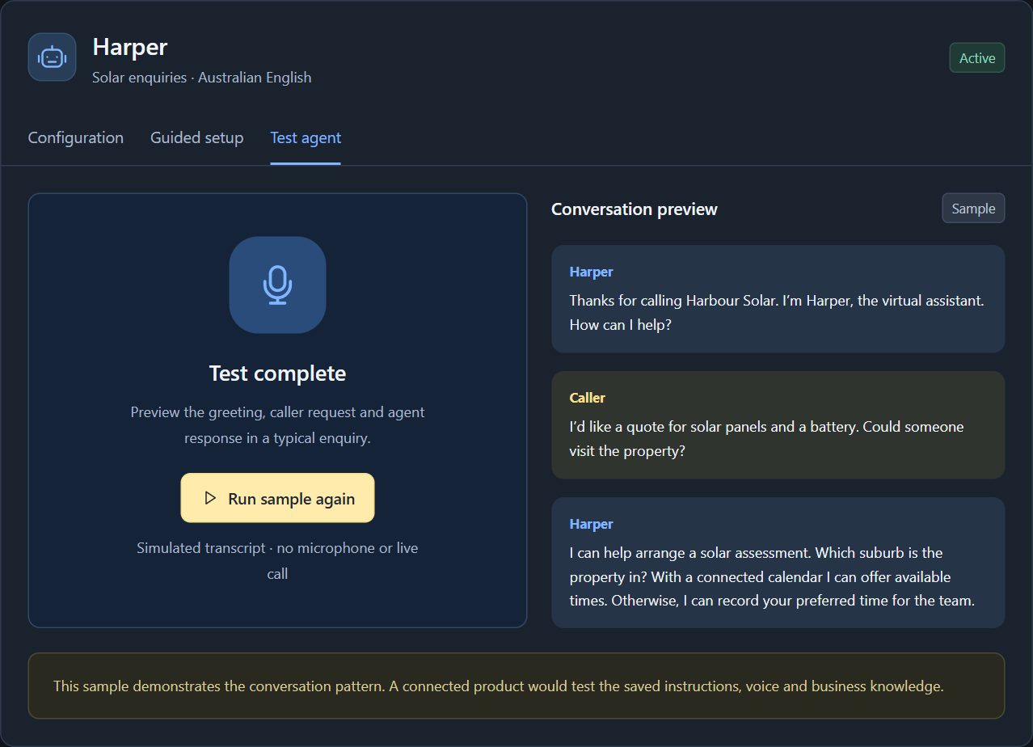
Agent setup and testing
Solar business instructions and a sample enquiry
The customer can
Choose a solar agent role.
Describe the service area.
Review booking rules.
Try a quote enquiry.
Working prototype controls. AI assistance, live voice and calendar bookings are simulated.
05
Notes:
Harper handles solar and battery enquiries. Guided setup produces a sample instruction template. The test displays a fixed solar enquiry transcript; it does not run the saved instructions through a live voice or AI service. Production instructions should distinguish general approved process information from technical design, off-grid suitability and final pricing that require a specialist. Booking rules should specify when a calendar may confirm a site assessment and when the team must follow up.

Slide 6
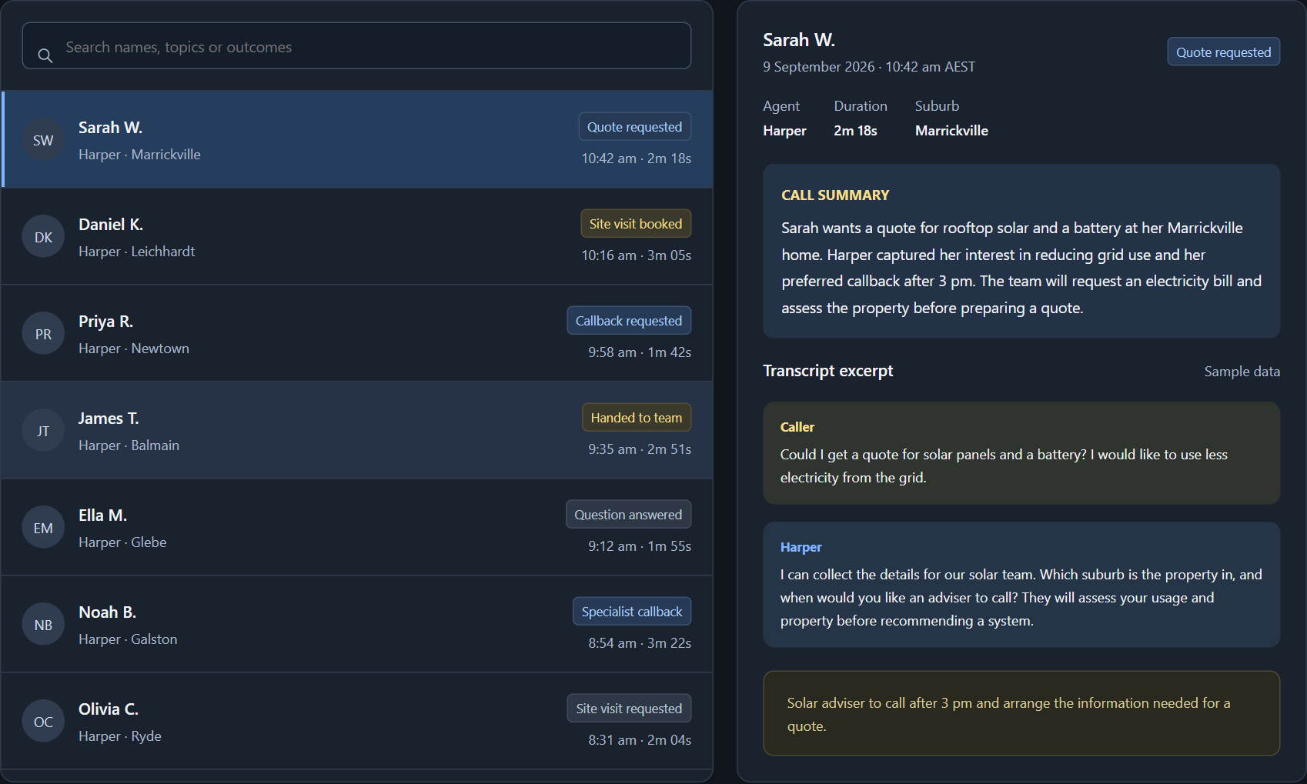
Solar enquiries and next steps
Quotes, site visits, callbacks and questions for the solar team
Search solar enquiries. Read the conversation. See the next action.
Fictional records. A requested site visit requires confirmation. A booked visit is still not a completed installation.
06
Notes:
Seven fictional call examples cover a solar and battery quote, a booked site assessment in a connected-calendar scenario, a battery callback, a request for a human, the installation process, an off-grid specialist enquiry, and a site visit awaiting confirmation. Both booked and requested visit states are simulations. The installation-process answer represents the fictional business's sample process. Actual approvals and timing vary by property and project. Off-grid questions receive general qualification and a specialist handoff, without a design, system-size recommendation or promised outcome.

Slide 7
A simple pricing model
Illustrative AUD prices, excluding GST
Monthly plan | Starter | Growth | Scale
Subscription | $399 | $799 | $1,499
Included minutes | 500 | 1,500 | 3,500
Voice agents | 1 | 3 | 5
Additional minute | $0.35 | $0.30 | $0.25
$799 one-off setup
Solar agent setup, testing and team handover.
Calendar connections scoped separately.
Growth first month: $799 subscription + $799 setup = $1,598.
Working prices to validate with customers and suppliers before launch.
07
Notes:
Illustrative AUD prices excluding GST: Starter $399/month for 500 minutes and one agent with additional minutes at $0.35. Growth $799/month for 1,500 minutes and three agents, additional minutes $0.30. Scale $1,499/month for 3,500 minutes and five agents, additional minutes $0.25. Minutes pool per account each month. Standard $799 setup covers one solar agent's greeting, enquiry questions, approved knowledge, handoff rules, test call and team handover. Calendar integration is separately scoped; do not present a custom integration as included. Growth costs $1,598 in the first month before overage, integrations and GST. Matching the setup amount to Growth's monthly price is a working pricing choice, not evidence of optimal conversion. Test the total upfront cost and setup scope with prospects. Support and outbound agent roles remain later concepts.

Slide 8
When the customer breaks even
Illustration: $1,000 per installation after variable job costs
Extra completed installs | 1 install | 2 installs | 3 installs
Contribution after job costs | $1,000 | $2,000 | $3,000
Growth subscription | $799 | $799 | $799
Benefit after Dialex fee | $201 | $1,201 | $2,201
Monthly break-even
One extra install covers the $799 monthly fee.
First month with setup
Two extra installs cover $799 + $799 = $1,598.
AUD ex GST. Contribution is before fixed overheads and tax. Extra usage and calendar-provider fees excluded.
08
Notes:
Contribution per installation means the additional installation revenue, excluding GST, less the costs that vary because that installation is delivered. Examples include panels, inverter, battery, mounting, installation labour or subcontractors, job-specific fees, variable selling commissions and other incremental delivery costs. It contributes toward fixed overheads and profit. It is not gross sales revenue or net profit after all business costs. It can differ from accounting gross profit because cost classifications differ. Illustrative example only: $8,000 revenue minus $7,000 variable job costs leaves $1,000 contribution. At that contribution: monthly break-even is ceiling(799/1000)=1 completed extra installation. First month plus setup is ceiling((799+799)/1000)=2 installations. One/two/three extra monthly installations leave $201/$1,201/$2,201 after the recurring subscription, before any extra overhead or tax. Sensitivity: at $500 contribution, two installations cover recurring and four cover first month. At $2,000 contribution, one covers either. The previous generic $200 assumption gave four recurring or eight first-month jobs and should not be treated as solar-market evidence. Count only additional completed installations attributable to Dialex. No time savings, additional-minute charges, calendar fees, cancellations, or collection delays are included. Source for contribution methodology: https://www.accaglobal.com/uk/en/student/exam-support-resources/fundamentals-exams-study-resources/f5/technical-articles/CVP-analysis.html .

Slide 9
Our economics per customer
A solar installer on Growth, using the full 1,500-minute allowance
Per account / month | AUD
Growth subscription | $799
Voice delivery: 1,500 × $0.20 | $300
Support and account operations | $100
Total delivery cost | $400
Gross profit | $399
49.9%
Illustrative gross margin
8 Growth customers
cover an assumed $3,000
in fixed monthly overhead.
Each additional 1,000 minutes adds $100 gross profit at these rates.
Planning costs exclude calendar-provider fees. Gross profit is before fixed overheads, acquisition and tax.
09
Notes:
Our own illustrative Growth economics remain unchanged: monthly revenue $799, voice delivery at 1,500 minutes times $0.20 = $300, plus $100 support/account operations gives $400 recurring cost and $399 gross profit (49.94%). These are assumptions, not supplier quotes. They exclude fixed overhead, founder pay, acquisition expense and tax. Calendar-provider/API costs and additional scheduling support have not been costed and may reduce the margin. Eight Growth customers at $399 gross profit cover an assumed $3,000 monthly fixed overhead before those exclusions. Each additional 1,000 minutes sold at $0.30 and delivered at $0.20 adds $100 gross profit before extra support. Do not confuse our margin per installer account with the installer's contribution per solar installation on the previous slide.

Slide 10
An early revenue outlook
Illustrative first 12 months with all solar installer accounts on Growth
Scenario | Cautious | Base | Faster
New customers / month | 1 | 2 | 4
Customers at month 12 | 12 | 24 | 48
Month-12 recurring | $9,588 | $19,176 | $38,352
Year-1 total revenue | $71,910 | $143,820 | $287,680
Year-1 gross profit | $37,110 | $74,220 | $148,440
Base case
$124,644 subscriptions + $19,176 setup = $143,820 in year 1.
AUD excluding GST. Full-month billing from signup; no cancellations. Gross profit is before fixed overheads.
10
Notes:
First-year arithmetic scenarios for solar installer accounts, not demand forecasts. Start with zero accounts, add 1/2/4 new Growth customers at the beginning of every month, charge a full first month and $799 setup once, and assume no cancellations, discounts, refunds, free trials or collection delays. Customer-months are 78/156/312; month-12 customers are 12/24/48. Recurring revenue in month 12 is $9,588/$19,176/$38,352. Year-one subscription revenue is $62,322/$124,644/$249,288 and setup revenue is $9,588/$19,176/$38,352, for total revenue $71,910/$143,820/$287,680. Gross profit uses $399 per customer-month and $499 per setup, assuming $300 setup delivery cost, for $37,110/$74,220/$148,440. Figures exclude fixed overheads, acquisition, founder pay, tax and currently uncosted calendar integrations. All amounts exclude GST.

Slide 11
The first sales conversation
A solar pilot tests the sales promise against real outcomes
The pitch
Capture the solar enquiries you miss while your team is busy, and turn them into the next sales conversation.
Sales and discovery
Review missed calls, quote conversion, job contribution and the site-visit calendar. Then demonstrate the workspace.
Proposed pilot: one solar installer, one inbound agent, 30 days. Use the installer's actual job contribution.
11
Notes:
Start with the solar installer's own missed-call records and sales process. Ask who handles incoming solar and battery enquiries, whether a site visit or remote assessment comes first, which calendar/CRM/job system owns visits, service areas and travel constraints, quote-to-install conversion, contribution after variable costs and time to complete an installation. Define which enquiry counts as incremental. Use one bounded inbound pilot for 30 days and follow completed installations beyond the pilot if the sales cycle is longer. The proposed pitch is outcome-led, with conditional arithmetic rather than a promised number of recovered installations. No free pilot, discount or performance guarantee has been approved.

