Slide 1

Machine learning for music: Predicting user engagement using song characteristics
API 222 - Machine Learning & Big Data Analytics Project, April 2023
Rohini Iyer and Pranav Bhargava

Slide 2

LISTEN TO the song and Guess its popularity PollEv.com/pranavb384
Notes:
Play the song
Ask audience to predict the popularity – subjective assessment but we provide an objective way of assessing a song’s popularity
Hold the results till the end of the presentation

Slide 3



Problem statement
We use ML techniques to predict a song’s popularity/engagement based on the song’s characteristics
Helps music studios and artists predict which songs are more likely to garner greater engagement
ML models can identify patterns and trends in data, making the talent selection process for music companies more data driven.

Slide 4



approach
Predict song popularity – Streams per Views based on song characteristics
Song characteristics / predictors like Danceability, Key, Energy, Loudness, Speechiness, Acousticness, Instrumentalness, Liveness, Valence, Tempo
We use multiple ML techniques to make this prediction
Notes:
1. Stream per views – helps normalize scale effect. Stream and Views in absolute terms could be very high due to scale effect. We wanted to have a fair measure of a popularity.

Slide 5
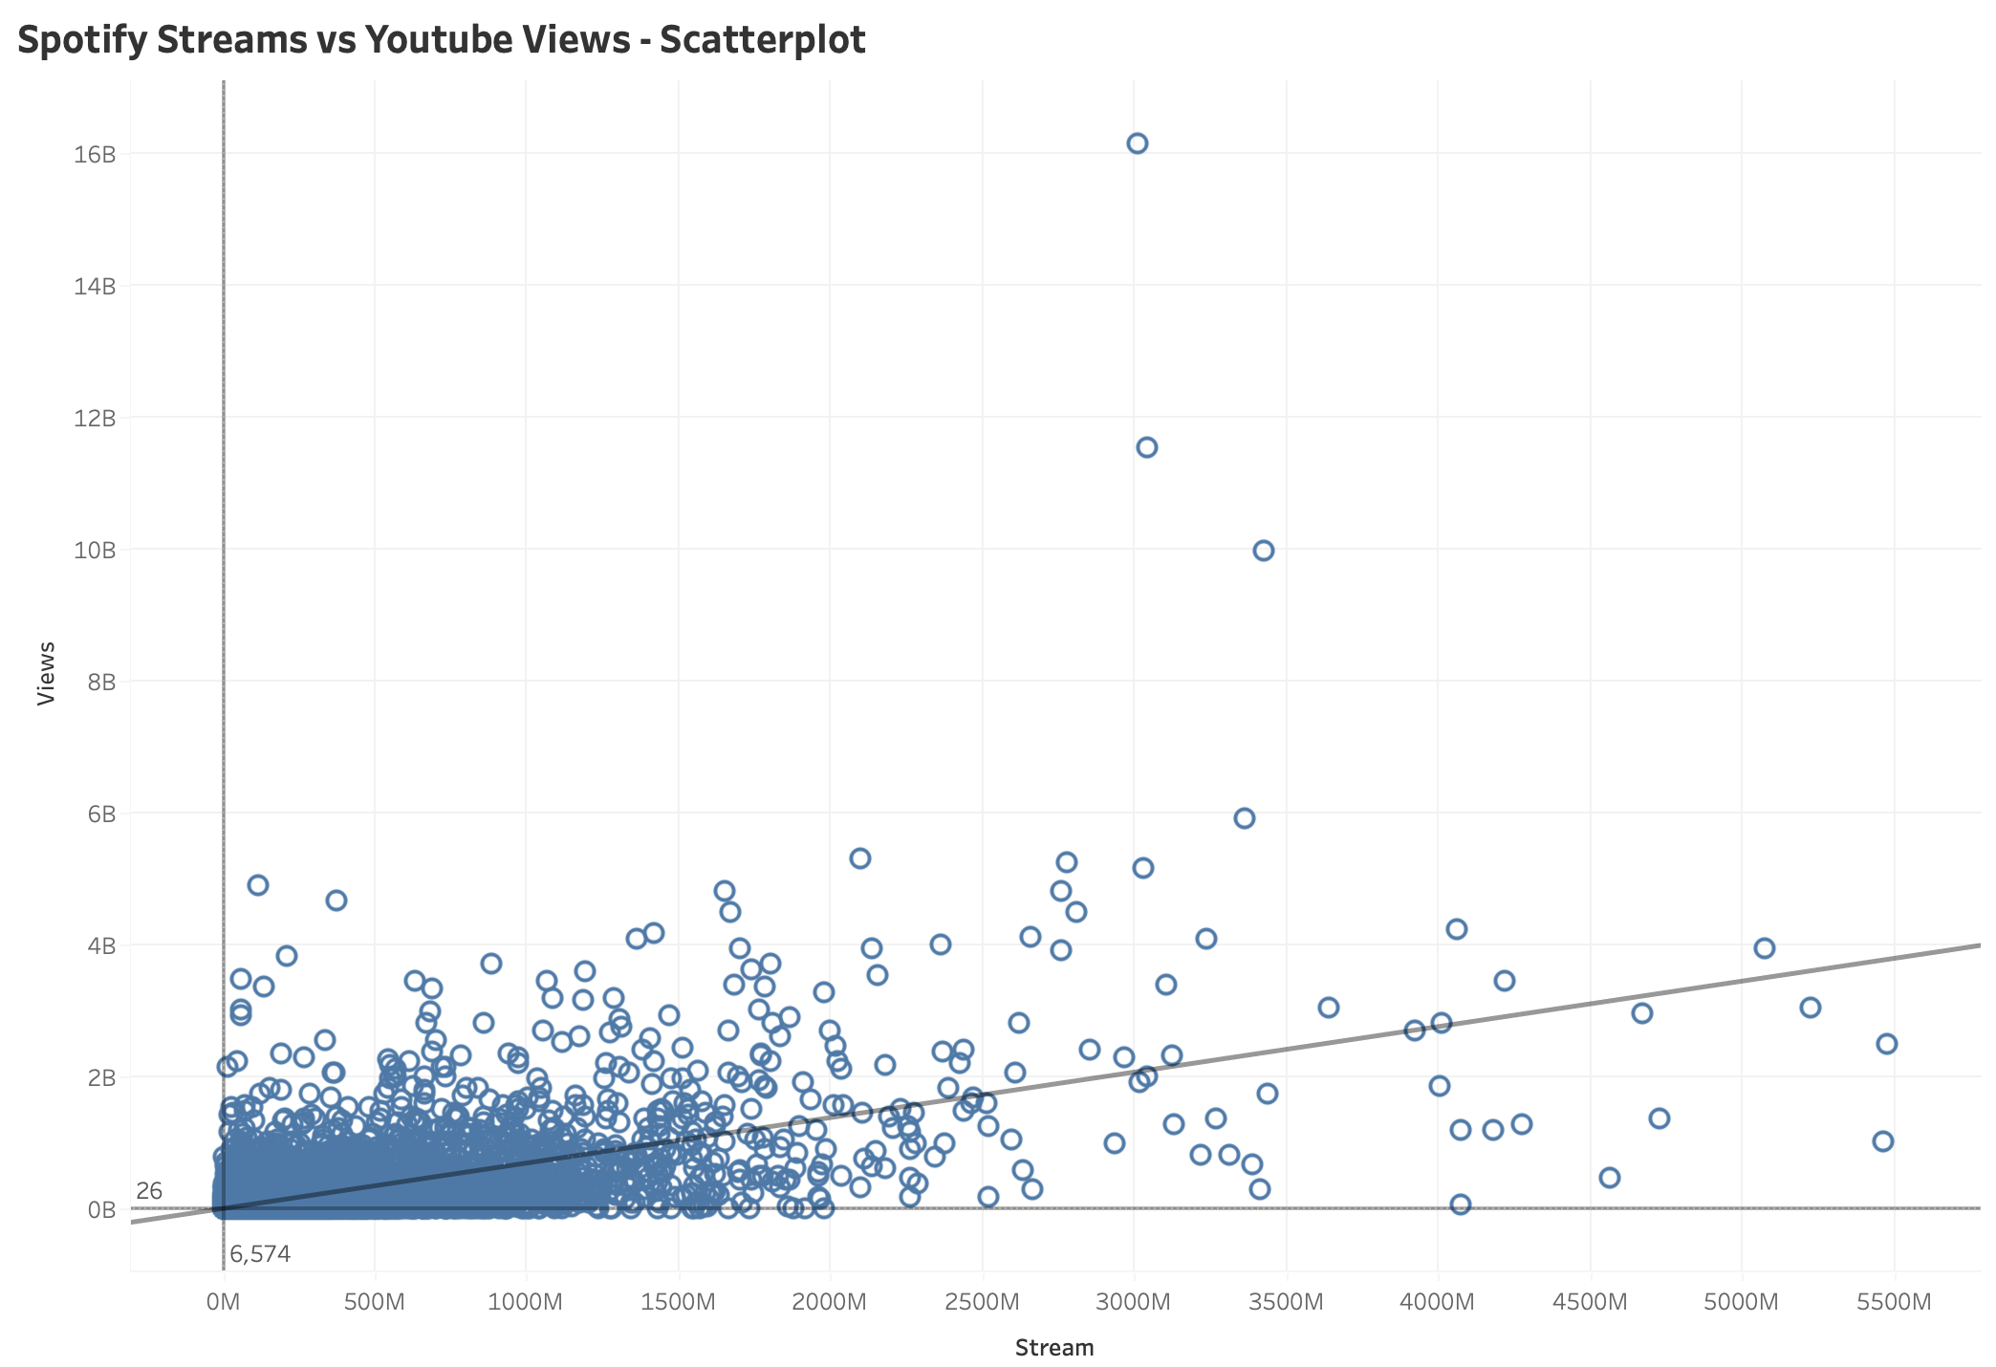
Songs with higher streams on Spotify also have higher views on Youtube
Correlation = 0.64

Slide 6
Almost 75% of songs have a higher number of Spotify Streams than Youtube Views
Summary of the outcome variable – Streams Per Views (N = ~20k)
Minimum | 1st Quartile | Median (2nd Quartile | 3rd Quartile | Maximum
0 | 1 | 3 | 12 | 38,637,558

Slide 7
Predictor | Definition
Danceability | Describes how suitable a track is for dancing based on a combination of musical elements including tempo, rhythm stability, beat strength, and overall regularity. A value of 0.0 is least danceable and 1.0 is most danceable.
Energy | Is a measure from 0.0 to 1.0 and represents a perceptual measure of intensity and activity. Typically, energetic tracks feel fast, loud, and noisy. For example, death metal has high energy, while a Bach prelude scores low on the scale. Perceptual features contributing to this attribute include dynamic range, perceived loudness, timbre, onset rate, and general entropy.
Key | The key the track is in. Integers map to pitches using standard Pitch Class notation. E.g. 0 = C, 1 = C♯/D♭, 2 = D, and so on. If no key was detected, the value is -1.
Loudness | The overall loudness of a track in decibels (dB). Loudness is the quality of a sound that is the primary psychological correlate of physical strength (amplitude). Values typically range between -60 and 0 db.
Speechiness | Detects the presence of spoken words in a track. The more exclusively speech-like the recording (e.g. talk show, audio book, poetry), the closer to 1.0 the attribute value. Values above 0.66 describe tracks that are probably made entirely of spoken words. Values between 0.33 and 0.66 describe tracks that may contain both music and speech, either in sections or layered, including such cases as rap music. Values below 0.33 most likely represent music and other non-speech-like tracks.
Acousticness | A confidence measure from 0.0 to 1.0 of whether the track is acoustic. 1.0 represents high confidence the track is acoustic.
Instrumentalness | Predicts whether a track contains no vocals. "Ooh" and "aah" sounds are treated as instrumental in this context. Rap or spoken word tracks are clearly "vocal". The closer the instrumentalness value is to 1.0, the greater likelihood the track contains no vocal content. Values above 0.5 are intended to represent instrumental tracks, but confidence is higher as the value approaches 1.0.
Liveness | Detects the presence of an audience in the recording. Higher liveness values represent an increased probability that the track was performed live. A value above 0.8 provides strong likelihood that the track is live.
Valence | A measure from 0.0 to 1.0 describing the musical positiveness conveyed by a track. Tracks with high valence sound more positive (e.g. happy, cheerful, euphoric), while tracks with low valence sound more negative (e.g. sad, depressed, angry).
Tempo | The overall estimated tempo of a track in beats per minute (BPM). In musical terminology, tempo is the speed or pace of a given piece and derives directly from the average beat duration.
Views/Likes/Comments | Number of views/likes/Comments on Youtube
Streams | Number of Streams on Spotify
Source : Kaggle

Slide 8
Models selected
Linear regression – to establish a MSE baseline if there exists a linear relationship
KNN – to take advantage of a non-parametric supervised learning model
Decision Tree – easy to interpret and graph. Not computationally intensive (only 10 predictors)
Bagging – further reduces variance of a decision tree while keeping the same bias
Random Forest – provide an improvement over Bagging
Boosting – another extension of decision trees that might give better performance

Slide 9
RESULTS
Mean Squared Error of Prediction (MSEP) :
Models explored | Streams/Views (Training) (in 10⁸) | Streams/Views (Test) (in 10⁸)
Ordinary Least Squares (OLS) | 981.86 | 0.64
K-Nearest Neighbours (KNN) | 984.76 | 2.61
Decision Tree | 982.14 | 0.38
Random Forest | 252.36 | 3.08
Bagging | 494.63 | 3.04
Boosting | 6.12 | 34.62
Predictors used: Danceability, Key, Energy, Loudness, Speechiness, Acousticness, Instrumentalness, Liveness, Valence, Tempo
Seed: 222 | Original N: 20718
Missing data: 1655 observations had missing data across one or multiple variables and hence were dropped from the data
Training data: Contains 80% of non-missing data observations = 15250 observations
Test data: Contains 20% of non-missing data observations = 3813 observations

Slide 10



Reflections and next steps
Analysis next steps
Testing prediction accuracy
Classification of songs as "hits" or "misses" | assigning a popularity score
Deep diving into the predictors - are they correlated?
Limitations
Missing song release data
Lack of user data
Concerns (with current data) that hinder adoption
Calculating the values of the predictors
User engagement could also depend on factors other than song characteristics

Slide 11
THANK YOU!

Slide 12
APPENDIX

Slide 13
Introduction
Problem Motivation – Using machine learning techniques to help artists and music companies predict the expected views/streams that new tracks might garner (i.e., their popularity), using data on song characteristics like danceability, loudness, valence, tempo, etc. from past songs.
Current methods used – In addition to complex analyses using streaming, sales, and user data; companies currently conduct market research and focus groups, rely on industry experts, and social media analytics to assess user engagement AFTER the songs have been released.
Use of ML to augment existing approaches – ML models can identify patterns and trends in data that may not be immediately apparent to human analysts, making the talent selection process for music companies more data driven. They can also predict user engagement BEFORE songs are released, enabling artists to create content with greater potential for mass appeal.

Slide 14
Results (v1)
Mean Squared Error of Prediction
Model fitted | Views (YouTube) (in 10¹⁶) | Likes (YouTube) (in 10¹²) | Streams (Spotify) (in 10¹⁶)
OLS | 6.64 | 2.85 | 6.69
KNN | 6.66 (k = 100) | 2.86 (k = 187) | 6.78 (k = 72)
Decision Tree | 6.59 | 2.88 | 6.85
Random Forest | 5.68 | 2.31 | 5.42
Bagging | 5.85 | 2.37 | 5.50
Boosting | 6.91 | 2.77 | 6.29
Predictors used: Danceability, Key, Energy, Loudness, Speechiness, Acousticness, Instrumentalness, Liveness, Valence, Tempo
Seed: 222 | Original N: 20718
Missing data: 1655 observations had missing data across one or multiple variables and hence were dropped from the data
Training data: Contains 80% of non-missing data observations = 15250 observations
Test data: Contains 20% of non-missing data observations = 3813 observations

Slide 15
Results (v2)
Mean Squared Error of Prediction (MSEP) :
Model fitted | Views/Streams (Training) | Views/Streams (Test) | Streams/Views (Training) | Streams/Views (Test) | Likes/Views (Training) | Likes/Views (Test)
OLS | 12172.73 | 3860.424 | 98,186,250,736 | 64,008,591 | 0.0001229585 | 0.0001093745
KNN | 12261.9 | 3944.848 | 98,475,885,939 | 261,292,981 | 0.0001296594 | 0.0001138033
Decision Tree | 12177.8 | 3860.378 | 98,213,651,158 | 37,818,826 | 0.0001265753 | 0.0001122965
Random Forest | 3050.763 | 3950.387 | 25,235,877,532 | 307,857,387 | 0.00002539191 | 0.0001027211
Bagging | 3858.163 | 6241.07 | 49,462,853,002 | 303,533,254 | 0.00002380341 | 0.0001063668
Boosting | 122.1899 | 4842.992 | 611,915,839 | 3,461,813,651 | 0.00004074487 | 0.0001249777
Predictors used: Danceability, Key, Energy, Loudness, Speechiness, Acousticness, Instrumentalness, Liveness, Valence, Tempo
Seed: 222 | Original N: 20718
Missing data: 1655 observations had missing data across one or multiple variables and hence were dropped from the data
Training data: Contains 80% of non-missing data observations = 15250 observations
Test data: Contains 20% of non-missing data observations = 3813 observations
Notes:
Boosting best for training data, followed by RF, Bagging, OLS, KNN
OLS best for test data, followed by KNN, RF, Boosting, Bagging

Slide 16
Results (v3)
Mean Squared Error of Prediction (MSEP) :
Model fitted | Views/Streams (Training) | Views/Streams (Test) | Streams/Views (Training) | Streams/Views (Test)
OLS | 12172.73 | 3860.424 | 98,186,250,736 | 64,008,591
KNN | 12261.9 | 3944.848 | 98,475,885,939 | 261,292,981
Decision Tree | 12177.8 | 3860.378 | 98,213,651,158 | 37,818,826
Random Forest | 3050.763 | 3950.387 | 25,235,877,532 | 307,857,387
Bagging | 3858.163 | 6241.07 | 49,462,853,002 | 303,533,254
Boosting | 122.1899 | 4842.992 | 611,915,839 | 3,461,813,651
Predictors used: Danceability, Key, Energy, Loudness, Speechiness, Acousticness, Instrumentalness, Liveness, Valence, Tempo
Seed: 222 | Original N: 20718
Missing data: 1655 observations had missing data across one or multiple variables and hence were dropped from the data
Training data: Contains 80% of non-missing data observations = 15250 observations
Test data: Contains 20% of non-missing data observations = 3813 observations

Slide 17
Path forward
Scope (open questions/things to do)
Classification of upcoming songs as potential "hits" or "misses"
Grouping songs into "genres" or "categories" to improve user experience
Deep diving into the predictor - are the different predictors correlated?
Limitations
Inability to predict hits due to missing song release data
Inability to do recommendation analysis due to lack of user data
Concerns (with current data) that hinder adoption
Calculating the values of the predictors
User engagement could also depend on factors other than song characteristics

