Slide 1
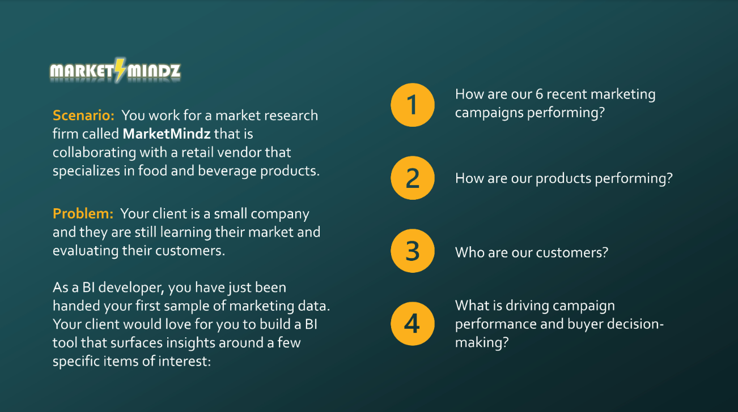

MARKET MINDZ
Developed By Rohini Patturaja

Slide 2
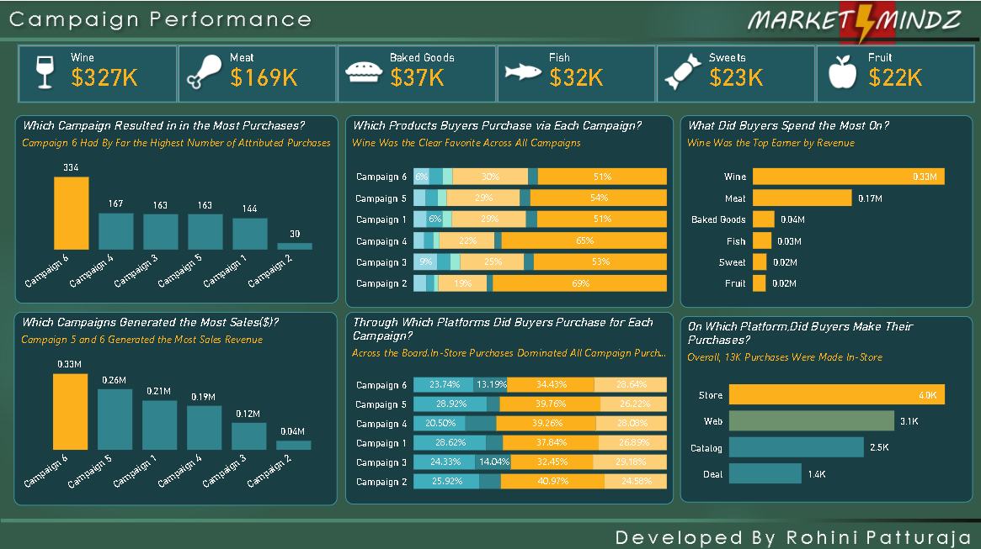
Campaign Performance
MARKET MINDZ
Developed By Rohini Patturaja

Slide 3
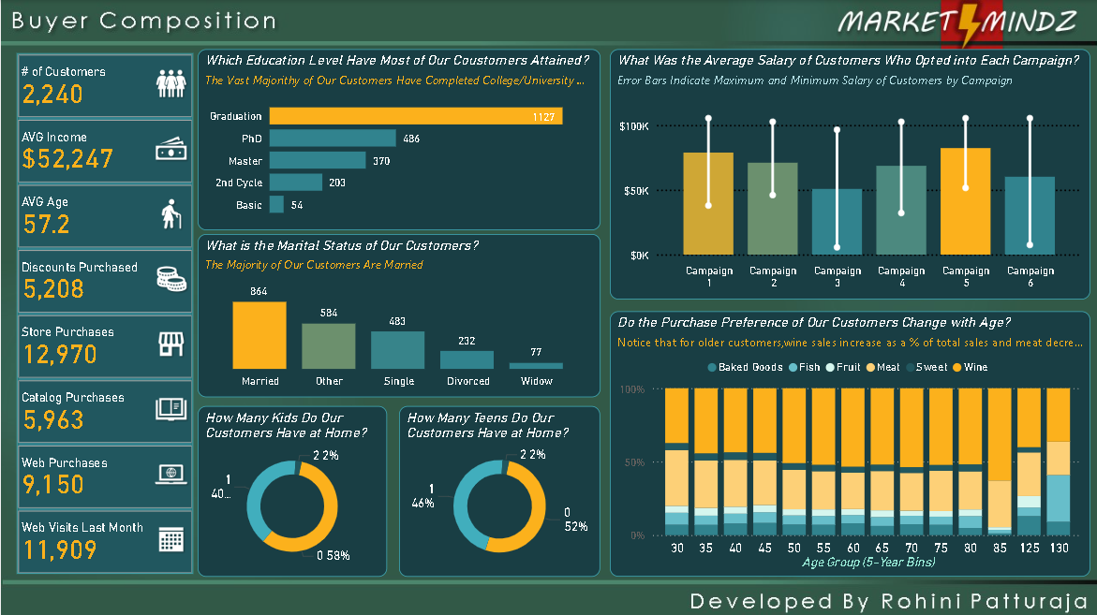
Buyer Composition
MARKET MINDZ
Developed By Rohini Patturaja

Slide 4
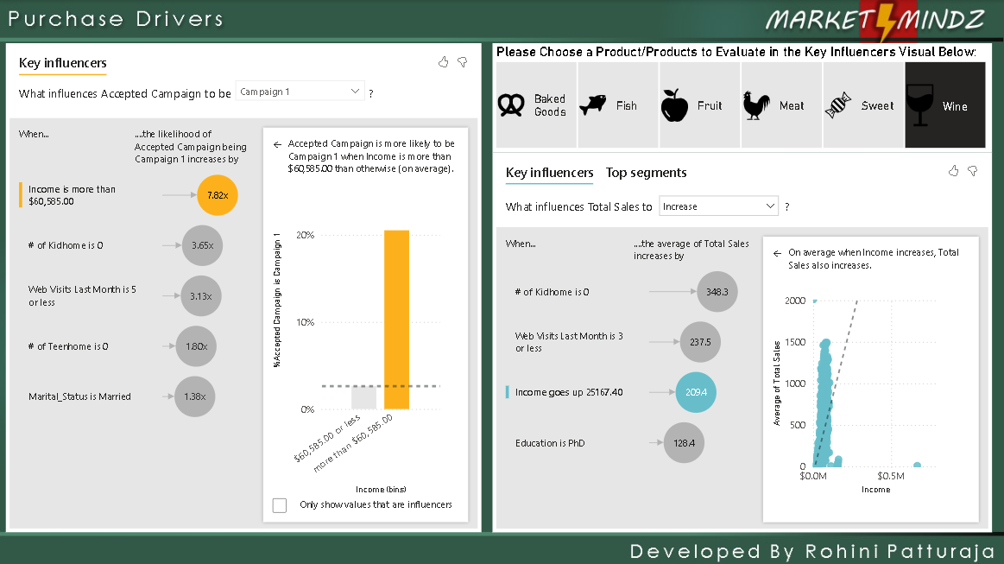
Purchase Drivers
MARKET MINDZ
Developed By Rohini Patturaja

