Slide 1
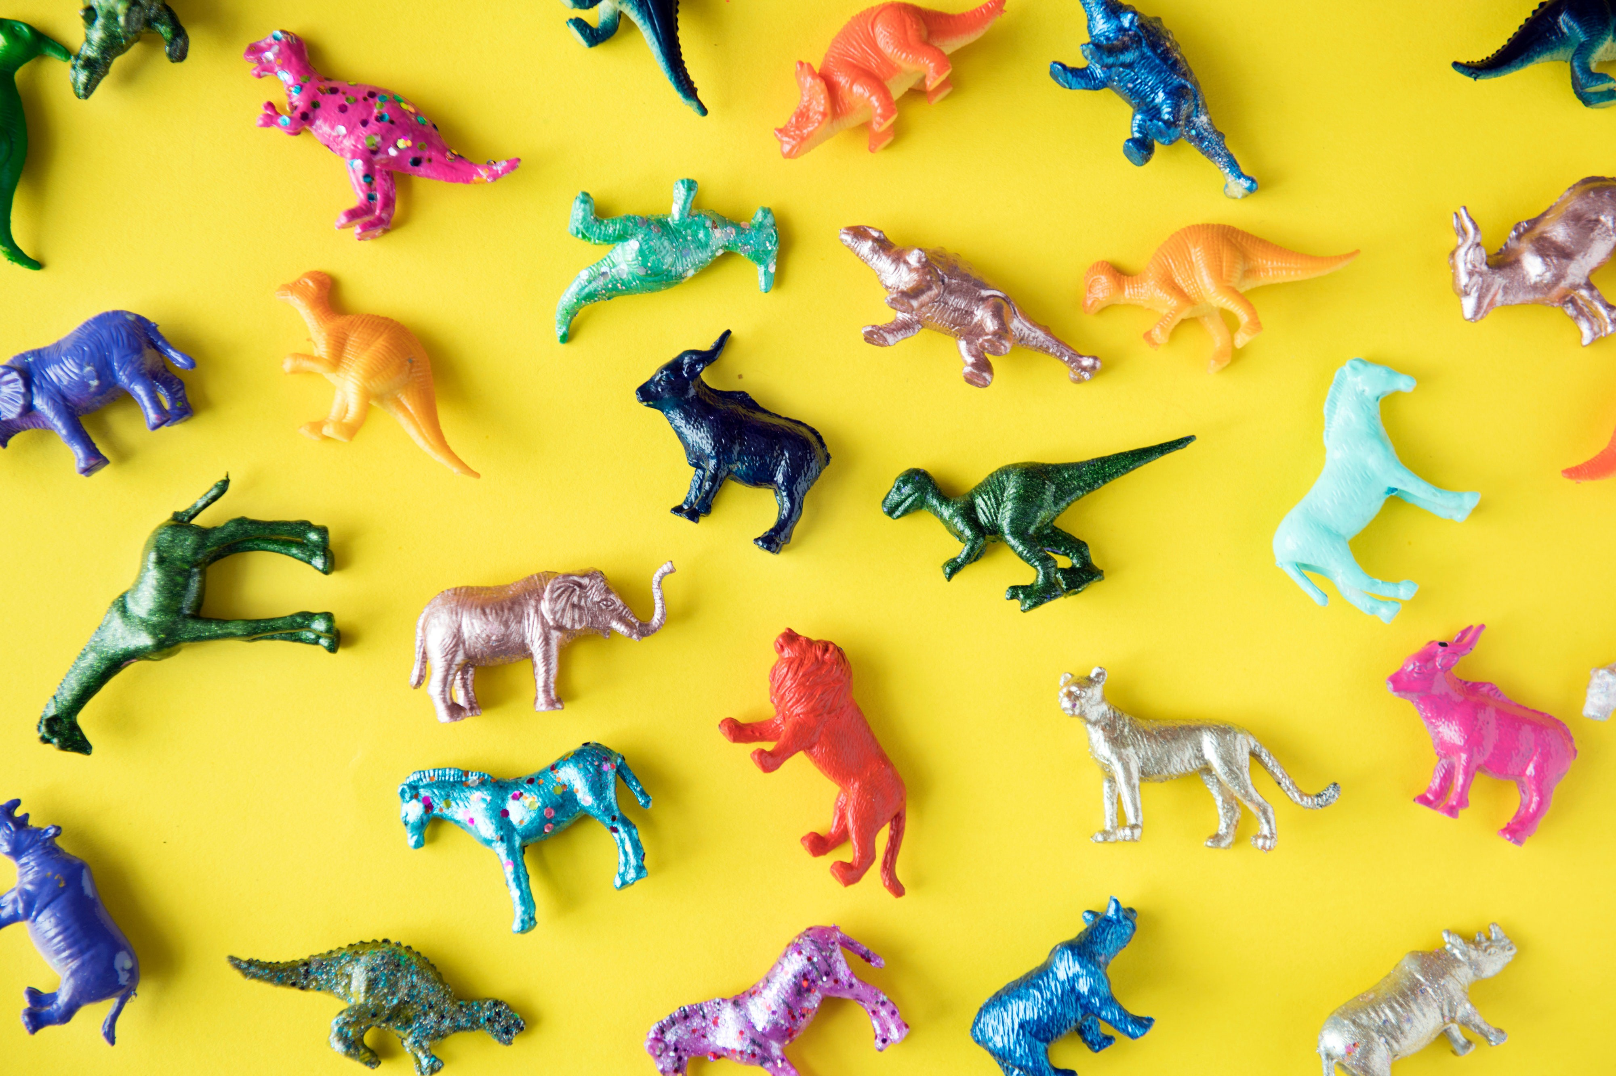
Color Detection using OpenCV
Submitted By:-
Mrs. Rohini Bhilare

Slide 2
Introduction
Color detection is the process of detecting the name of any color by using pandas and openCV.
you can automatically get the name of the color by clicking on them.
So for this, we will have a data file that contains the color name and its values.
Then we will calculate the distance from each color and find the shortest one.

Slide 3
Collecting Data
Colors are made up of 3 primary colors; red, green, and blue.
In computers, we define each color value within a range of 0 to 255.
So in how many ways we can define a color?
The answer is 256*256*256 = 16,581,375.
There are approximately 16.5 million different ways to represent a color.
In our dataset, we need to map each color’s values with their corresponding names. But don’t worry, we don’t need to map all the values.
We will be using a dataset that contains RGB values with their corresponding names.

Slide 4
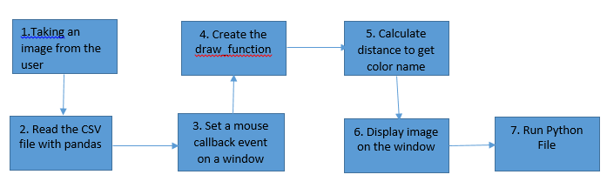
Proposed System Workflow

Slide 5
Requirements
Libraries
OpenCV
Pandas
Numpy
Argparse

Slide 6
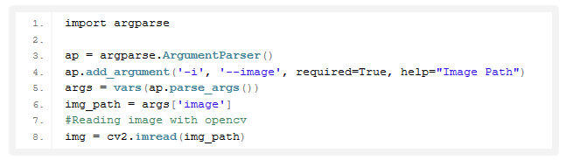
Steps for Building a Project in Python – Color Detection
1. Taking an image from the user:
We are using argparse library to create an argument parser. We can directly give an image path from the command prompt.

Slide 7

Steps for Building a Project in Python – Color Detection
2. We read the CSV file with pandas:
The pandas library is very useful when we need to perform various operations on data files like CSV.
pd.read_csv() reads the CSV file and loads it into the pandas DataFrame. We have assigned each column with a name for easy accessing.

Slide 8

Steps for Building a Project in Python – Color Detection
3. Set a mouse callback event on a window:
First, we created a window in which the input image will display. Then, we set a callback function which will be called when a mouse event happens.
we named our window as ‘image’ and set a callback function which will call the draw_function() whenever a mouse event occurs.

Slide 9
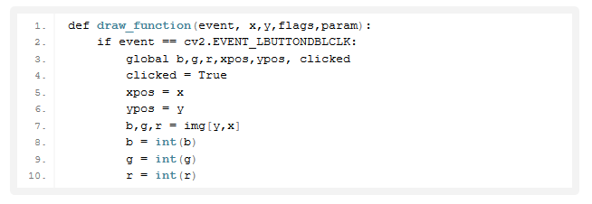
Steps for Building a Project in Python – Color Detection
4. Create the draw_function:
It will calculate the rgb values of the pixel which we double click.
The function parameters have the event name, (x,y) coordinates of the mouse position, etc.
In the function, we check if the event is double-clicked then we calculate and set the r,g,b values along with x,y positions of the mouse.

Slide 10
Steps for Building a Project in Python – Color Detection
5. Calculate distance to get color name:
We have the r,g and b values. Now, we need another function which will return us the color name from RGB values.
To get the color name, we calculate a distance(d) which tells us how close we are to color and choose the one having minimum distance.
Our distance is calculated by this formula:
d = abs(Red – ithRedColor) + (Green – ithGreenColor) + (Blue – ithBlueColor)

Slide 11
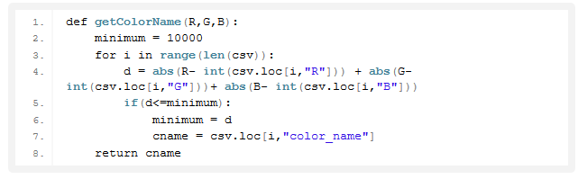
Steps for Building a Project in Python – Color Detection

Slide 12
Steps for Building a Project in Python – Color Detection
5. Display image on the window:
Whenever a double click event occurs, it will update the color name and RGB values on the window.
Using the cv2.imshow() function, we draw the image on the window.
When the user double clicks the window, we draw a rectangle and get the color name to draw text on the window using cv2.rectangle and cv2.putText() functions.

Slide 13
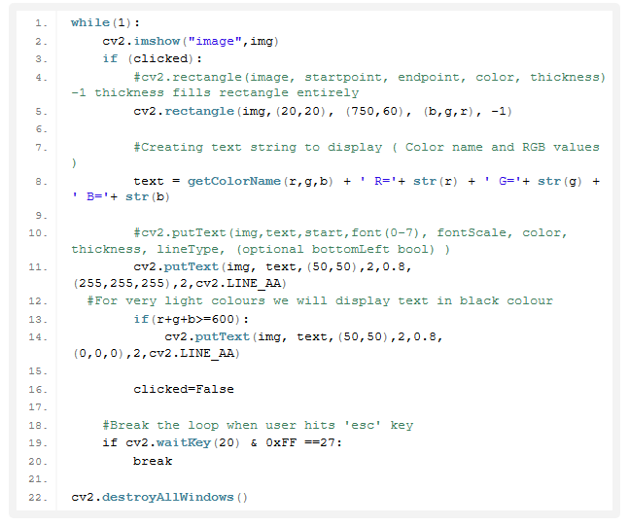
Steps for Building a Project in Python – Color Detection

Slide 14
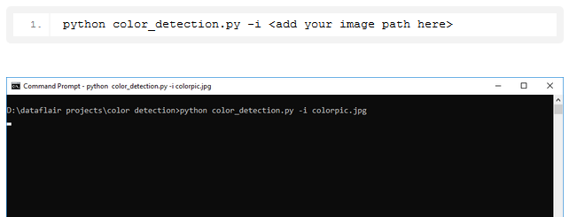
Steps for Building a Project in Python – Color Detection
5. Run Python File:
The beginner Python project is now complete, you can run the Python file from the command prompt.
Make sure to give an image path using ‘-i’ argument.
If the image is in another directory, then you need to give full path of the image:

Slide 15
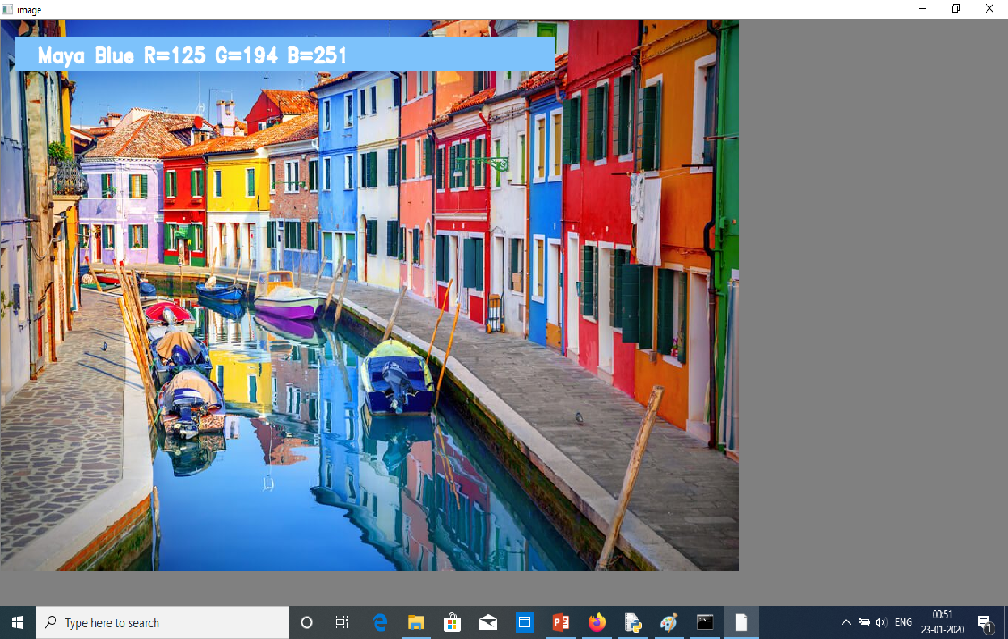
Output

Slide 16
Thank You!

