Slide 1
Quantum Mechanics Basics and Principles
Rohini V
GiQ Indian Ambassador | IBM Qiskit Certified Associate Developer

Slide 2
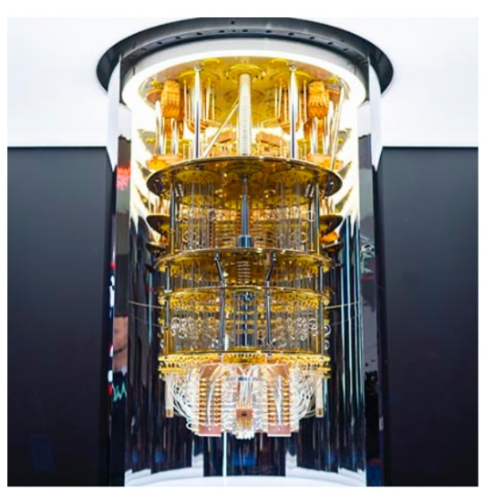
Quantum Stack
Quantum Applications
Quantum Algorithms and Protocols
Quantum Circuits
Gates and Measurement
Qubits

Slide 3
The different components of quantum computers are organized in the Quantum Stack
Qubits are the fundamental units of quantum computers
Quantum Gates manipulate qubits, and many gates form a quantum circuit
Quantum Circuits implement quantum algorithms for different applications
The quantum computing stack is still being developed
In this course, we will climb up the quantum stack!

Slide 4
The World of Quantum Mechanics
Discreteness
Superposition
Interference
Entanglement
Measurement

Slide 5
“If you think about quantum theory without getting dizzy, you don’t get it.”
-Niels Bohr, Danish physicist

Slide 6
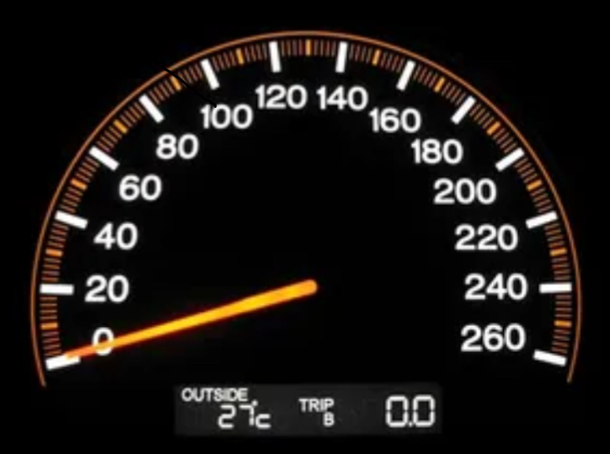
Quantum Mechanics is Discrete
A classical physics car accelerates continuously – when it goes from 0 to 70mph, it hits all the speeds in between.
In quantum, this car would have to jump from one speed to another. There would be certain speeds that are not allowed.

Slide 7
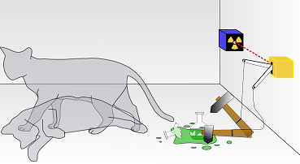
Superposition
Being in a combination of states at the same time

Slide 8

A Superposition Analogy

Slide 9
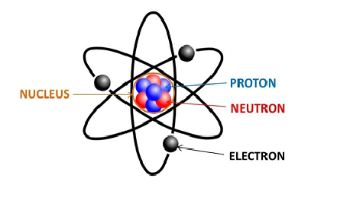
Superposition in Action
In an atom, we cannot predict the exact location of the electron

Slide 10

Interference
In the quantum world, the states of an object can add up or cancel out

Slide 11
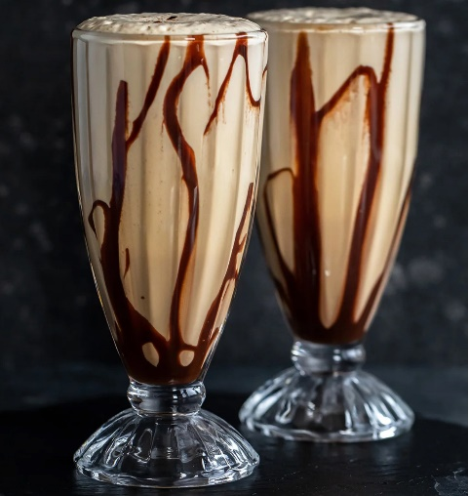
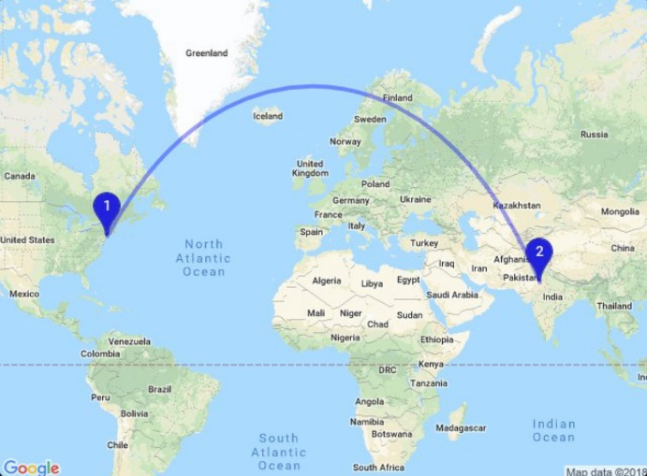
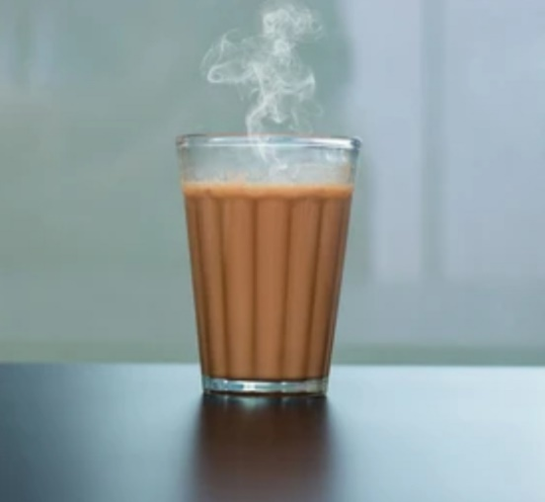
Entanglement
When two qubits are entangled, they share a defined relationship
That is, when you know one object’s state you know the other as well
Entanglement occurs between two or more qubits

Slide 12
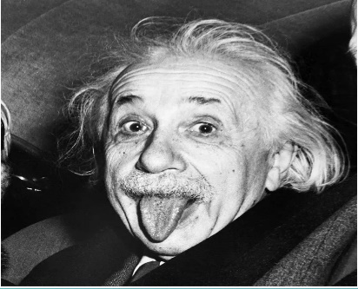
Spooky Action at a Distance!
One of the foundational insights of Einstein’s Theory of Relativity is that the speed of light is a fundamental speed limit in the universe.
No information can be transmitted faster than this speed.
But what does entanglement say? Two objects could be correlated so that even if they were separated by millions of miles, if you changed one of them, the other one was affected too!
To Einstein, This instantaneous change was a violation of Relativity.
Thus he concluded that quantum mechanics must be incomplete.

Slide 13
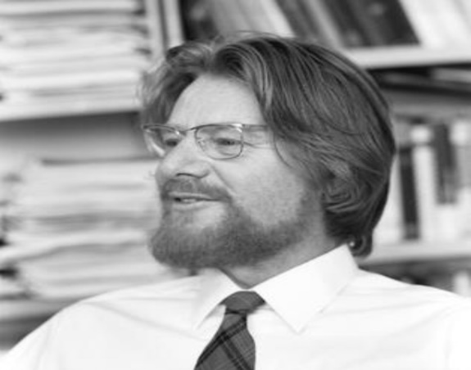
John Bell to the Rescue!
Einstein’s argument was theoretical!
John Bell moved from theory to experiment.
In 1960’s he showed that we could do an experiment to determine if QM was right or did it have any hidden information that QM missed.
So what did the experiments say?
The experiment is called the Bell Test.
We’ve been doing the experiment proposed by Bell with increasing accuracy for over 40 years!
Every experiment shows that Quantum Mechanics was right, and Einstein was wrong.

Slide 14
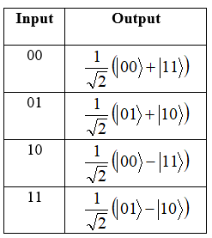
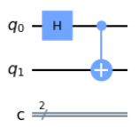
A must to create an entangled state
Truth table of the bell states

Slide 15
Visualizations
Circuit Diagram
Histogram Representation
State Vector Representation
Qsphere Representation
Unitary Representation
Bloch Sphere Representation
Plot state city
Plot state hinton
Plot state paulivec

Slide 16
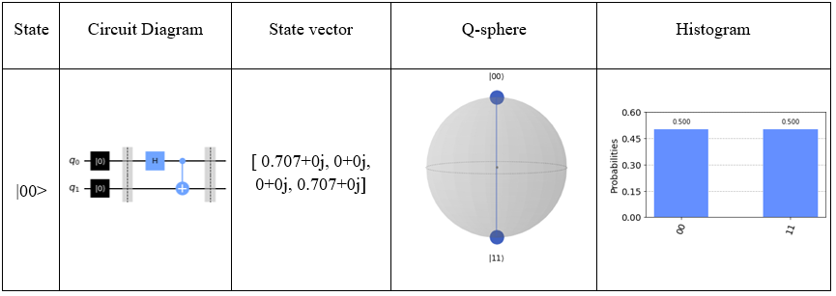
Bell State 1

Slide 17
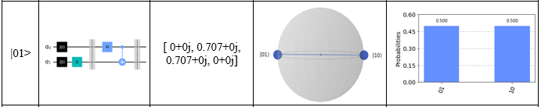
Bell State 2

Slide 18
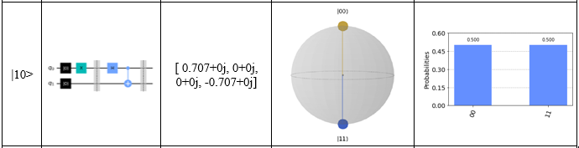
Bell State 3

Slide 19
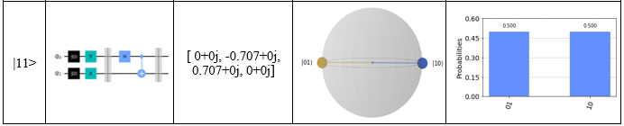
Bell State 4

Slide 20
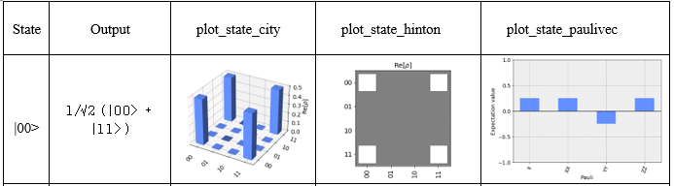
Bell State 1

Slide 21
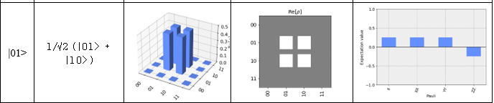
Bell State 2

Slide 22
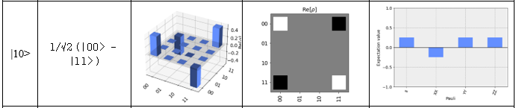
Bell State 3

Slide 23
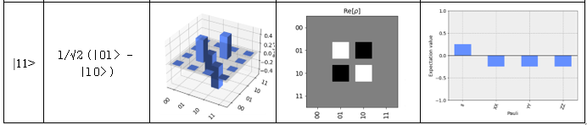
Bell State 4

Slide 24
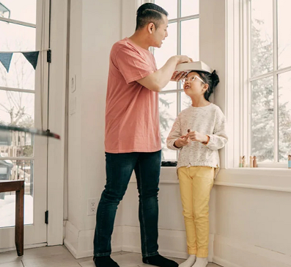
Measurement
In classical measurement, you can measure an outcome, and expect the same answer everytime
But, Measurement in the Quantum World is very different.
In classical physics, objects behave predictably
In quantum physics, objects behave randomly

Slide 25
Uniqueness of Quantum Measurement
The outcome of a quantum measurement is often random.
By measuring a quantum state, we can change it.

